Slide 1

Letter Frequency in Multiple Languages and the Vigenère Cipher
By: Joshua Rowan

Slide 2
Basic Vigenère Decryption
Vigenère encryption relies on a keyword to translate into the ciphertext.
The most efficient way to break it is through frequency analysis.
Frequency analysis helps in finding the length of the keyword used as well as probable keyword candidates.

Slide 3
Letter Frequency
Letter frequency changes between languages.
Letter frequency relies on longer messages. The longer the message, the more accurate it is.
In messages that are not intentionally manipulated to have fewer common letters, using the most common letter in the language is most effective.
Many languages, but not all, have ‘e’ as the most common letter.
UK English Language Letter Frequency:
e t a o i n s r h l d c u m f p g w y b v k x j q z
Spanish Language Letter Frequency:
e a o s r n i d l c t u m p b g y í v q ó h f z j é á ñ x ú ü w k
Italian Language Letter Frequency:
e a i o n l r t s c d u p m v g h f b q z ò à ù ì é è ó y k w x j ô
Russian Language Letter Frequency:
o e a и н т с в л р к д м п у ë я г б з ч й х ж ш ю ц щ e ф (ъ ы ь)
Polish Language Letter Frequency:
i a e o z n s c r w y ł d k m t p u j l g ę b ą h ż ś ó ć ń f ź v q x

Slide 4
Sentences without ‘e’
I could try, but I’m not particularly good at this sort of thing! I usually start strongly and it’s all going swimmingly for a bit… until… whoops! Crash, bang, wallop! All in a rush, without any warning, all my faithful consonants and my four trusty, licit non-consonants just quit and won’t play; and so (If you don’t mind my trying to sound a bit bookish and arty-farty?) - I find that I’m linguistically stuck up a shitty tributary in a boat without an outboard motor, drifting with no wind to fill my sails and (continuing my nautical analogy) aground, or possibly sinking! I’m going down rapidly, caught in sucking quicksand, and at risk from sharks, alligators and all sorts of aquatic horrors. So I think I’ll pass (on this occasion) – but good luck finding a willing idiot on Quora who will try to do what you want by constructing a chunk of nugatory linguistic folly that shuns that particular, amazingly-common symbol with a morphology that puts you in mind of a comb!
-Owen Henry, Quora.com
In this example, the letter ‘e’ is not used even once.
The letter ‘i’ (76 times/9%) is used most often followed by ‘t’ (75 times/9%). Usually ‘t’ is most common after ‘e’ but neither ‘e’ nor ‘t’ are guaranteed.
Rare letters are still rare and can be used to eliminate possibilities.
Very few occurrences of ‘z’ ‘q’ ‘x’

Slide 5
Difficulties With Other Languages
While ‘e’ is the most common letter in English, it isn’t the case for all languages.
The most common letter isn’t always much more common than other letters
Other languages have different length alphabets.
Alphabet order is paramount in both encoding and decoding in Vigenerès, if the order I uncertain, cracking is equally encertain.
In terms of analysis, many languages have characters that don’t translate well into ascii. Greek, Russian and Japanese are examples of this.

Slide 6
Solutions When Language is Known
For Vigenère cipher to work, any language’s characters must translate into numbers. This means that once the cipher text is changed into numbers, it acts almost exactly like any other language.
The only differences are the most common letters, the length of the alphabet and the order of the alphabet.
In a deciphering program, characters would need to be analyzed and translated into the appropriate integer.

Slide 7
Solutions When Language is Unknown
When the language of the plaintext is unknown, there are often simple clues as to which language it is. Greek, Russian and English all have very distinct characters from each other. English and Dutch, however, have nearly the exact same alphabets.
Most languages do have clues about which characters belong to them. With a proper character analyzer, the candidates for probable language can be reduced to a few.
Methods that reduce the possibilities without letter frequency are required.

Slide 8
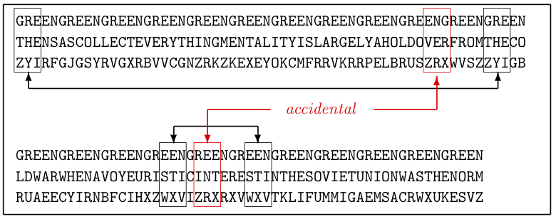
Kasiski Method
Named after Friedrich Kasiski, the Kasiski method relies on repeating combinations of letters to find the key word length.
Looking for repeating combinations of characters it is possible to find spots where the keyword, the plaintext and thus the cyphertext sync up.
This method is entirely independent of “most common letters” and can be applied to any language whose characters can be translated into integers.

Slide 9
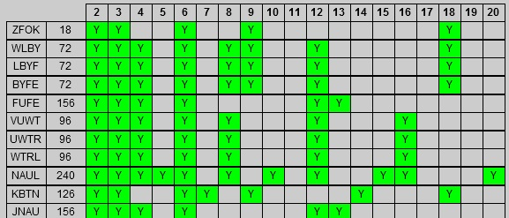
Kasiski Method (cont)
What the Kasiski method/test gives us is the probable length of the keyword.
Found by distance between repeating characters.
The keyword is a multiple of this distance.
For example if the keyword is ‘key’ and the distance is 6 characters.
This table shows that the keyword is likely 6 characters long.
(table from Crypto-Corner www.interactive-maths.com)

Slide 10
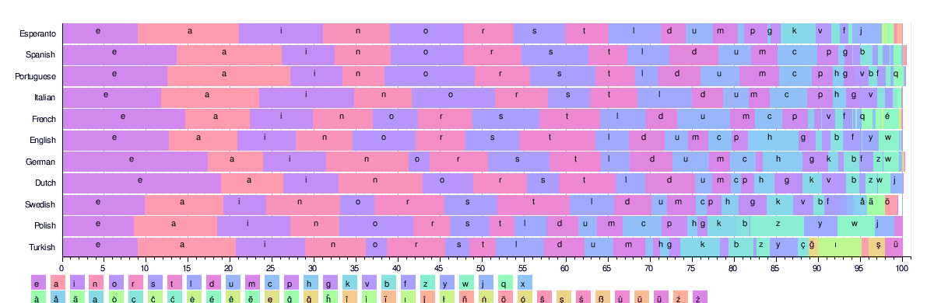
Return to Frequency Analysis

Slide 11
Differences in Frequencies
English alone has different frequencies depending on source material.
Other languages have similar issues.
In Arabic, one source used the Quran as a source, another was over 3000 pages from several books.
Letter frequency for the two most common letters went from a 1.6% distance to .5% distance, as well as some other shuffling throughout.
The Concise Oxford Dictionary (9th edition, 1995) has the top spots in this order:
E A R I O T
Old English (source from the Bible) has:
E O T H A S
By modern usage is:
E T A R I O

Slide 12
Languages with Unusual Number of Characters
Chinese, being a logographic language, has thousands of characters.
Converting to a number wouldn’t be difficult.
Size of the alphabet is undetermined(100k+ according to some).
Agreed upon size would be required, defeating the purpose of a cipher.

Slide 13
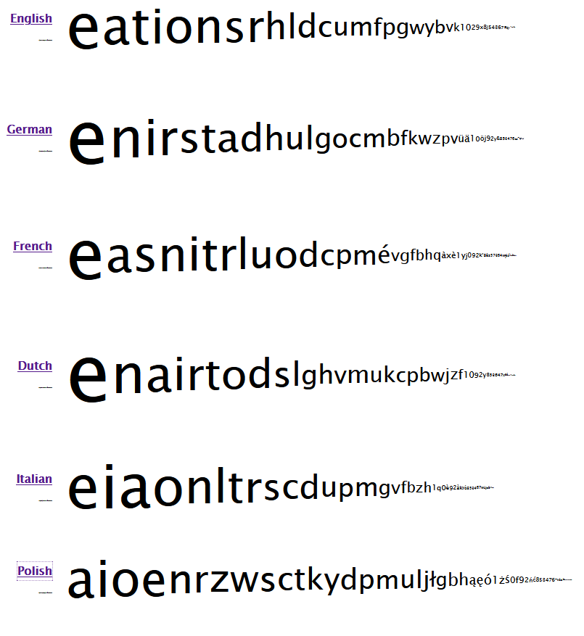
Summary
Letter frequency is important, but not the starting point
Letter frequencies can change based on sources
The language must be identified before frequency analysis works
More than just the most common letters may be required

