Slide 1

SecantusDB
THE SQLITE OF DOCUMENT DATABASES
An embeddable — or standalone — MongoDB-compatible server
Why it exists · how it works · where it's going
Speaker notes ▸
Notes:
Frame it with the tagline: SecantusDB is 'the SQLite of document databases' — a real MongoDB-compatible database you embed in a process, not a server you operate. This is a 30-minute overview of why it exists, how it stays faithful, and the current Rust acceleration work. Invite questions throughout.

Slide 2
Agenda
WHAT WE'LL COVER
▪ The gap it fills, and the idea
▪ Design philosophy & scope
▪ Architecture — socket to storage
▪ The hard parts — types, indexes, change streams
▪ How we prove it works
▪ Progression to date — and Rust
▪ Roadmap & takeaways
Speaker notes ▸
Notes:
Six parts over thirty minutes: first the product and its design, then the engineering progression, ending with the Rust acceleration work and what's next. Keep it conversational.

Slide 3
PART 1
The gap it fills
Document-database behaviour, without a deployment
Speaker notes ▸
Notes:
Open with the analogy everyone gets: SQLite. You rarely run a SQL server just to get SQL — you embed SQLite. There was no equivalent for MongoDB. That's the gap.

Slide 4
Running MongoDB is a deployment
THE GAP
▪ MongoDB means a server (or cluster) to operate
▪ Install, version-match, start, monitor, tear down
▪ Heavy for tests, demos, edge, prototypes, embedding
▪ Re-implemented “fakes” quietly diverge from the real thing
Speaker notes ▸
Notes:
To get MongoDB behaviour you normally stand up and operate mongod — fine for production, heavy everywhere else: automated tests, CI, local development, demos, prototypes, edge/embedded scenarios. The usual shortcut is a hand-rolled in-memory fake, but those drift: they accept things real MongoDB rejects and vice-versa, so anything built on them is subtly wrong.

Slide 5
The idea: the SQLite of document DBs
THE PITCH
▪ A real MongoDB-compatible server
▪ Embed it in-process — or run it standalone
▪ Speaks the wire protocol — every client connects
▪ Single-node, lightweight, ephemeral when you want
Speaker notes ▸
Notes:
Just as SQLite is a real SQL database you embed, SecantusDB is a real MongoDB-compatible server. Embed it in your process for tests and apps, or start it as a standalone server on a port — same engine either way. It speaks the MongoDB wire protocol, so every client connects unmodified: not just the drivers, but Compass, mongosh, and mongodump/mongorestore. 'Surrogate', not 'fake' — it implements the protocol rather than faking responses, which is why nothing can tell it apart.

Slide 6
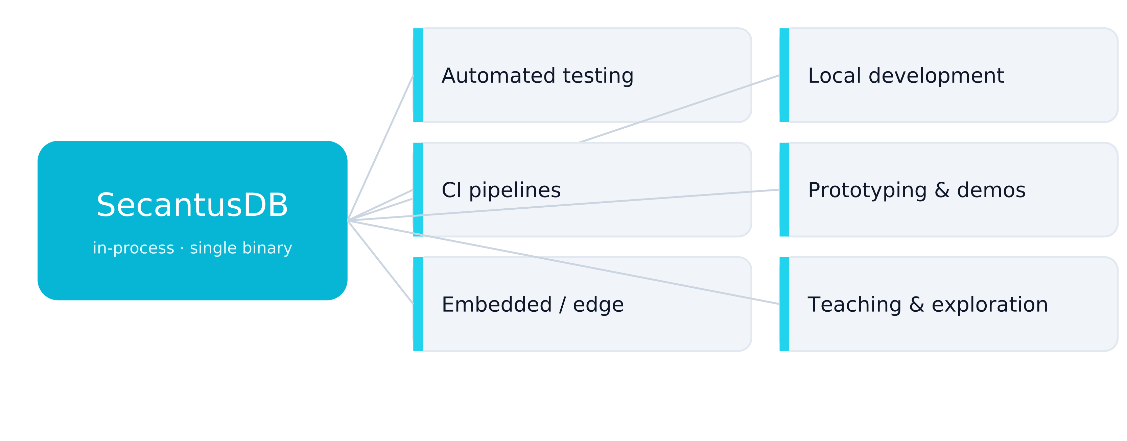
Where it fits
ONE ENGINE, MANY USES
Speaker notes ▸
Notes:
Testing is where it started and still shines, but the in-process model serves far more: local development without a daemon, fast CI, prototyping and demos, embedded / edge deployments where a full server is overkill, and teaching. One small dependency, many places it's useful.

Slide 7
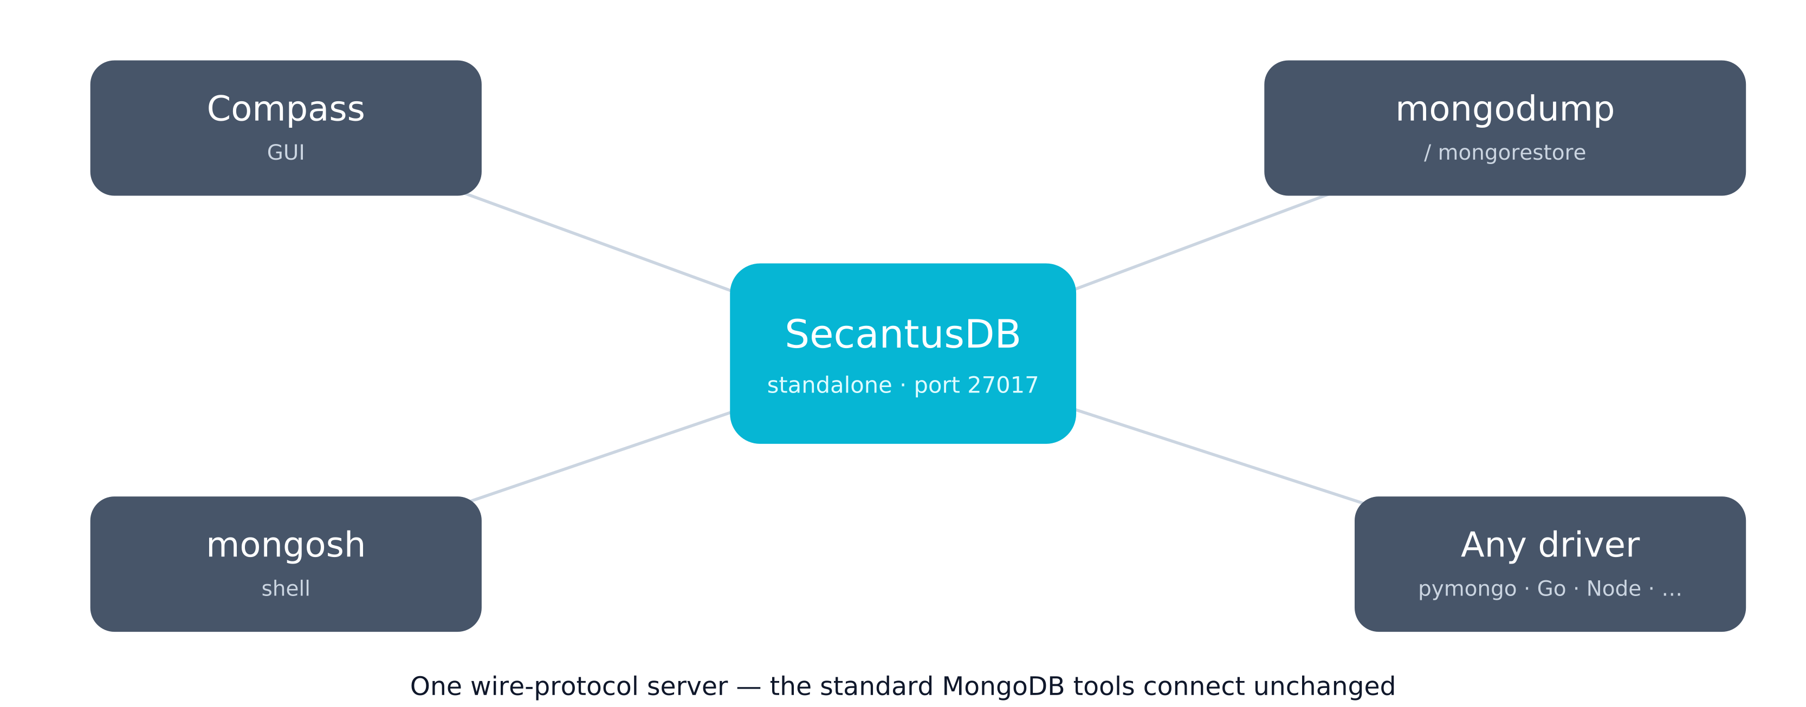
Standalone — and the toolchain just works
NOT ONLY EMBEDDED
Speaker notes ▸
Notes:
Unlike SQLite, it isn't embed-only: start it as a standalone server on a port and the whole MongoDB toolchain connects unchanged — inspect data in Compass, script against it with mongosh, and back up / load fixtures with mongodump and mongorestore. Same wire protocol, so there's nothing special to configure — point any MongoDB tool at the address and it works.

Slide 8
A quick word on the name
fongo → fongodb → SecantusDB
fongo
fongodb
SecantusDB
early prototype
→
follow-on
→
today
clashes with the “Fongo” brand
still brand-adjacent / confusing
avoids Fongo and MongoDB confusion
Speaker notes ▸
Notes:
A light aside. The early prototype was 'fongo', then 'fongodb' — both clash with the existing Fongo brand and blur into MongoDB. 'SecantusDB' dodges both. Lingering 'fongo'/'fongodb' references in the code are stale and mean SecantusDB.

Slide 9
PART 2
Design philosophy
The rules that keep it honest
Speaker notes ▸
Notes:
Three constraints are the whole discipline; everything follows from them.

Slide 10
Three constraints
NON-NEGOTIABLES
▪ A real driver can't tell us apart from mongod
▪ Wire fidelity over feature completeness
▪ Trivial to embed — one or two lines
Speaker notes ▸
Notes:
One: 'correct' means a driver client can't distinguish us from mongod — when unsure, run the same code against both and assert equal responses. Two: we'd rather return a faithful 'not supported' than a half-feature that silently diverges. Three: ergonomics — embedding it is trivial, no processes to manage.

Slide 11
Scope — single-node by design
Faithful where it counts
✓ In scope
✗ Out of scope
CRUD & cursors
Real replica sets
Aggregation pipeline
Sharding
findAndModify
Multi-node consistency
Change streams
Elections / cross-node oplog
The connection handshake
Speaker notes ▸
Notes:
In scope: the subset of the wire protocol drivers actually emit — handshake, CRUD, cursors, aggregation, findAndModify, change streams. Out of scope: anything that only makes sense across nodes. One nuance: hello advertises a single-node 'replica-set primary' so the driver's change-stream machinery is satisfied — but the topology is fictional.

Slide 12
PART 3
Architecture
From socket bytes to durable storage
Speaker notes ▸
Notes:
Walk the layers; the key idea is strict separation — each knows only the one below.

Slide 13
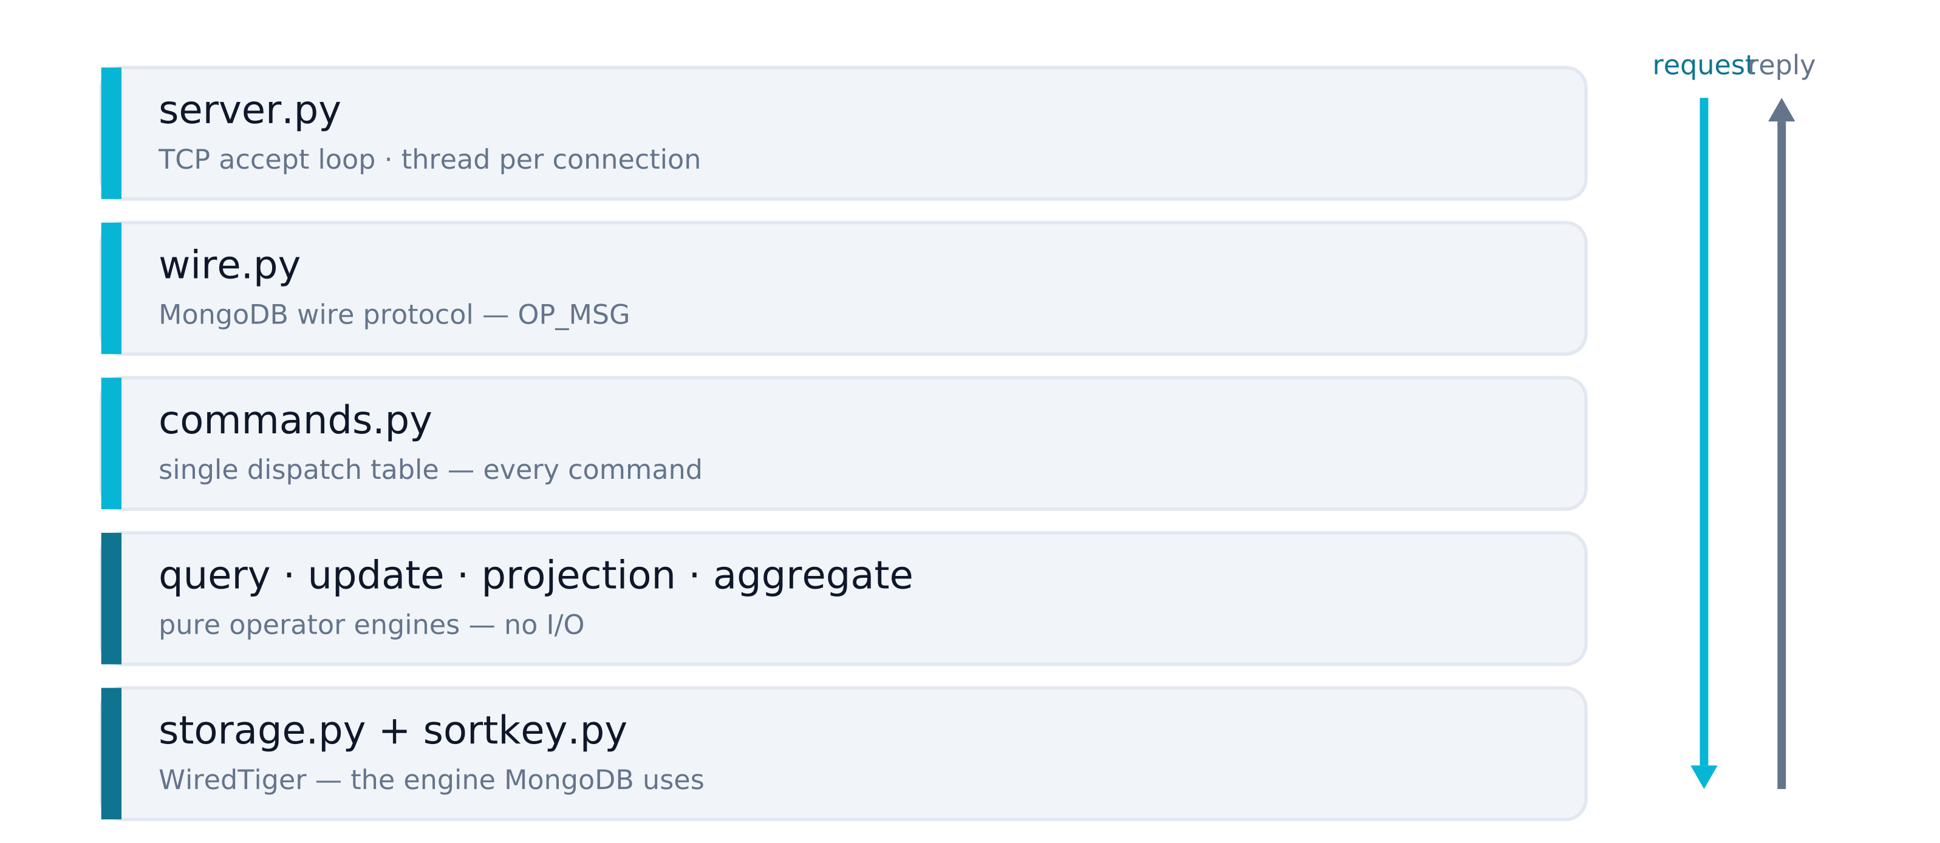
The layers, outermost-in
EACH LAYER KNOWS ONLY THE ONE BELOW
Speaker notes ▸
Notes:
server.py owns the accept loop and per-connection threads. wire.py speaks bytes and never knows about commands. commands.py is a single dispatch table and never knows about storage. The operator engines are pure — documents in, documents out, no I/O — which is exactly what made the Rust port tractable. storage.py sits on WiredTiger. A request flows down; the BSON reply flows back up.

Slide 14
The critical decision: opaque BSON
TYPE FIDELITY IS THE WHOLE GAME
▪ Documents stored as raw BSON bytes
▪ All logic runs in Python after decode
▪ Every BSON type preserved exactly
▪ Lossy storage would break the thesis
Speaker notes ▸
Notes:
Documents are stored as opaque BSON blobs — never JSON, never native columns. The storage layer never inspects content. ObjectId, Decimal128, int32-vs-int64, Date-with-tz, Binary, Regex must round-trip exactly, because 'a driver can't tell us apart' depends on it. sortkey.py turns BSON values into byte-sortable keys matching MongoDB's cross-type order.

Slide 15
Storage: WiredTiger, the real thing
SAME ENGINE AS MONGODB
▪ The exact engine MongoDB itself uses
▪ Vendored; ships as pre-built wheels
▪ Four tables, byte-sortable keys
▪ “:memory:” for instant, throwaway DBs
Speaker notes ▸
Notes:
WiredTiger is MongoDB's own storage engine, vendored and built into self-contained wheels — users just pip install, no cmake or swig. Four tables: collections, documents, indexes, index-entries. Documents are keyed by a byte-sortable _id so iteration matches mongod's natural order. ':memory:' maps to an in-memory temp dir removed on close.

Slide 16
Indexing — broader than you'd expect
A REAL QUERY PLANNER
▪ Compound, multikey, partial, TTL
▪ Geospatial: 2d and 2dsphere
▪ Planner picks IXSCAN vs COLLSCAN
▪ hint, $natural, indexed sort — all honoured
Speaker notes ▸
Notes:
Indexing is surprisingly complete: single-field and compound with a trailing range, multikey for arrays, partial and TTL indexes, and geospatial — 2d geohash and 2dsphere via S2 cell coverings. A planner chooses index-scan vs collection-scan and explain reports the winning plan. Missing by choice: collation and text/hashed/wildcard indexes.

Slide 17
Change streams — the ambitious bit
OPLOG · RESUME TOKENS · PRE-IMAGES
▪ Oplog-backed, mongod-shaped entries
▪ Resume tokens — pick up where you left off
▪ fullDocument & before-change pre-images
▪ awaitData blocking; invalidation events
Speaker notes ▸
Notes:
The most ambitious feature: a real oplog whose entries mirror mongod's shape, scoped to a collection, database, or cluster. Resume tokens let a client resume exactly. updateLookup full documents, before-change pre-images, awaitData blocking (getMore parks until a writer notifies), and invalidate events on drop/rename. This is what the fictional single-node 'primary' buys us.

Slide 18
PART 4
How we prove it works
Conformance over confidence
Speaker notes ▸
Notes:
The credibility of the project rests here: we don't trust our own tests, we run the drivers'.

Slide 19
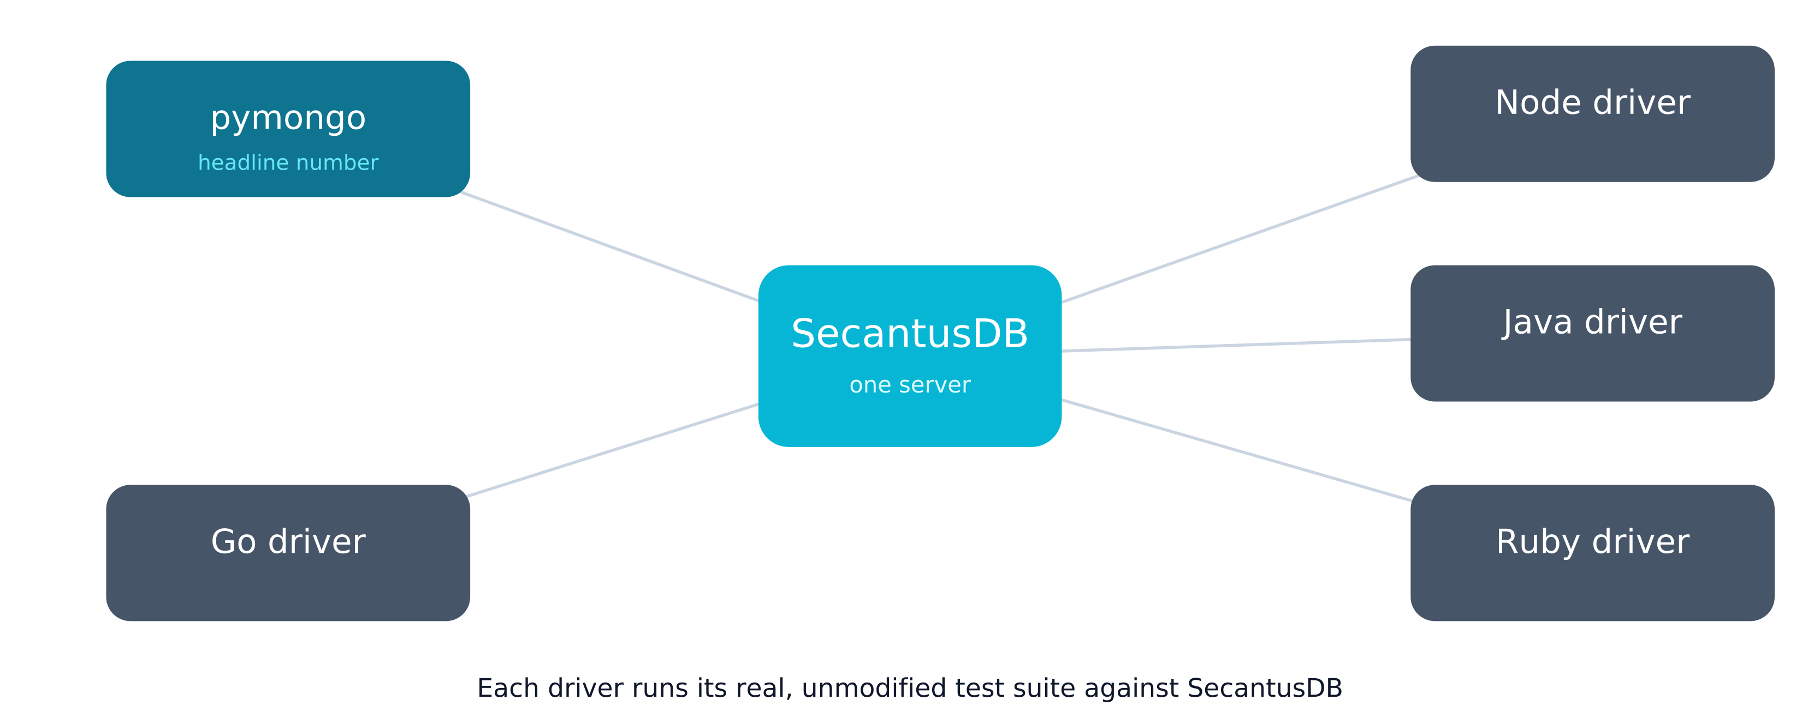
Driver-conformance gauges
RUN THE TESTS A REAL DRIVER RUNS
Speaker notes ▸
Notes:
We run real, unmodified upstream driver test suites against SecantusDB. Five gauges: pymongo embedded (the headline 'MongoDB compatibility' number) plus the Go, Node, Java and Ruby drivers as real clients over the wire. The other-language drivers catch wire-protocol bugs pymongo is too permissive to notice — like requiring a real int64 cursor id. The default suite runs against on-disk WiredTiger in parallel; CI is load-bearing.

Slide 20
PART 5
Progression to date
And the next chapter: Rust
Speaker notes ▸
Notes:
Pivot from 'what it is' to 'how it got here and where it's going'.

Slide 21
Where we've been
A rough progression
Prototype
prove the wire protocol with a driver
Core server
wire + dispatch + CRUD
Real storage
WiredTiger vendored; opaque BSON
Breadth
aggregation, rich indexing, geo
Change streams
oplog, resume tokens, pre-images
Multi-driver
5 conformance gauges, binary wheels, CI
Acceleration
the Rust core — in progress
Speaker notes ▸
Notes:
From the prototype that proved the protocol, to a real server, to vendoring WiredTiger for true storage fidelity, then breadth (aggregation, indexing, geo), then change streams, then the multi-driver gauges and packaging. The chapter in flight is the Rust acceleration core.

Slide 22
Why a Rust core now?
A DELIBERATE DUAL-ENGINE DECISION
▪ Python bottlenecks: CPU and the GIL
▪ Rust runs the hot work off the GIL
▪ Keep BOTH engines — Python stays default
▪ Accelerator, not replacement
Speaker notes ▸
Notes:
Two bottlenecks: the operator engines run hot in Python, and the GIL serialises work across connections. A Rust core does the heavy lifting off the GIL, unlocking cores. The firm rule: BOTH engines are permanent — the pure-Python engine stays the default and never goes away; Rust is an opt-in accelerator that must reproduce Python exactly.

Slide 23
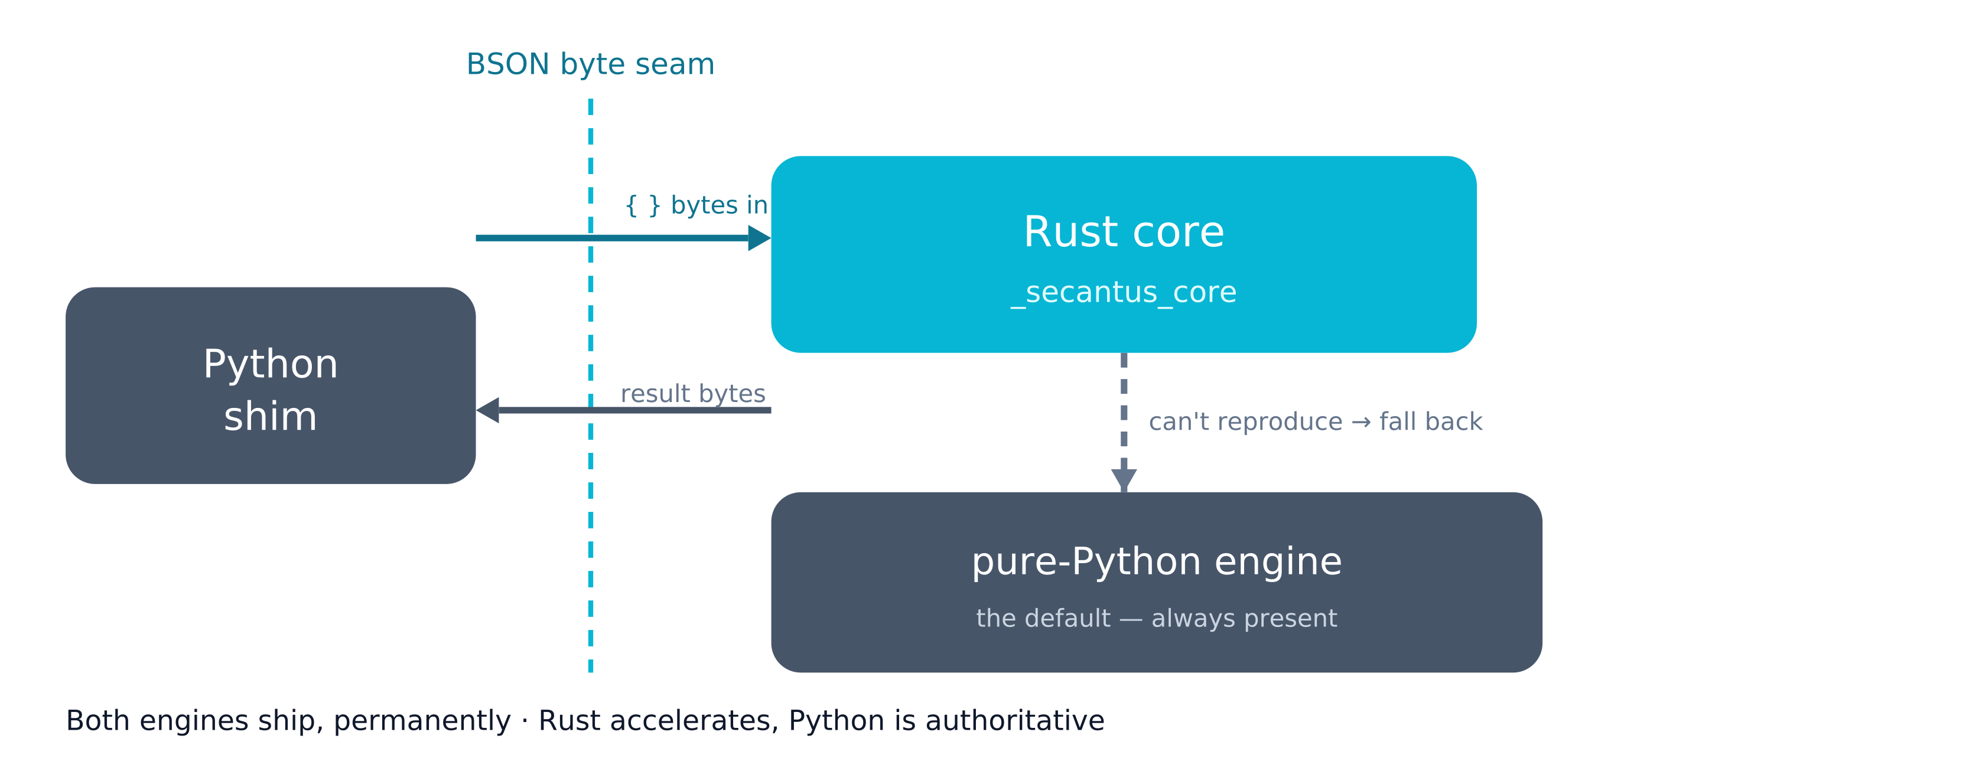
How the Rust core is built
BYTE SEAM · FALLBACK · PARITY
Speaker notes ▸
Notes:
An optional PyO3/maturin extension. Values cross as BSON bytes — a 'fat byte seam' — keeping the opaque-BSON design intact and avoiding per-field marshalling. Crucially, when Rust hits anything it can't reproduce exactly it signals fallback and the authoritative Python path runs, so it's always correct. Every engine is pinned by a curated-plus-fuzz parity suite asserting Rust equals Python byte-for-byte.

Slide 24
What's ported so far
LEAF ENGINES + THE FULL PIPELINE
▪ Six leaf engines + collation
▪ The entire storage-independent pipeline
▪ 515 parity cases green
▪ Storage-backed stages still in Python
Speaker notes ▸
Notes:
Done: de-risking spikes; all six pure leaf engines (sortkey, query, update, expressions, projection, diff) plus collation; and the whole storage-independent aggregation pipeline — match, project, group, sort, unwind, bucket, facet, densify and the rest. 515 parity cases green across curated corpora and multi-seed fuzzing. Still in Python because they need storage: $lookup, $geoNear, $out, $merge, and storage itself.

Slide 25
Performance: the GIL is the story
Release it, then batch the seam
▪ Single-thread: ~2× CRUD, ~8× pipeline
▪ Per-call across threads thrashes the GIL
▪ Batch one call over a whole list →
▪ ~10–12× more throughput on 4 threads
Speaker notes ▸
Notes:
Single-threaded the Rust path is ~2× faster on CRUD ops and ~8× on a full pipeline — even paying the byte seam. But per-call across threads the GIL ping-pongs on tiny ops and throughput regresses. The fix is batching: one call filters or updates a whole list under a single GIL release, turning the regression into ~10–12× more throughput on four threads. Lesson: the win is releasing the GIL and coarsening the seam, not micro-optimising operators. Numbers from a 4-core dev box; the real proof is a concurrent-connection server benchmark.

Slide 26
PART 6
Roadmap & takeaways
Speaker notes ▸
Notes:
Land the plane: what's left, and the one-screen summary.

Slide 27
What's next
THE REMAINING PHASES
▪ Batch the seam into storage's loops
▪ Port storage onto a WiredTiger FFI
▪ Then wire & dispatch → never touch Python
▪ Compatibility number must not regress
Speaker notes ▸
Notes:
Next: wire the batched seam into storage's scan / update / projection loops; port the storage layer onto a WiredTiger FFI (the largest single step, sub-phased by table family); then move wire and dispatch into Rust so a request never re-enters Python; finish with packaging and a full conformance and performance sign-off. The invariant throughout: the compatibility number must not regress.

Slide 28
Takeaways
THE STORY IN FIVE LINES
▪ The SQLite of document databases
▪ Embedded or standalone — the toolchain just works
▪ Fidelity by design; honesty by gauges
▪ Rust adds speed — Python stays, always
▪ The win was the GIL + batching, not micro-opts
Speaker notes ▸
Notes:
To close: SecantusDB is a MongoDB-compatible server — the SQLite of document databases — that you embed in-process OR run standalone, useful far beyond testing. Because it's a faithful wire-protocol server, Compass, mongosh and mongodump/mongorestore all just work. Fidelity comes from opaque BSON plus real WiredTiger plus the driver as conformance target; honesty from five gauges and load-bearing CI. The Rust core adds speed without giving up Python — both ship, parity-pinned. And the performance lesson generalises: release the GIL and batch the boundary.

Slide 29
Thank you
Questions & discussion
SecantusDB · the SQLite of document databases · package: secantus
Speaker notes ▸
Notes:
Open the floor. Likely questions: how close is the compatibility number; why WiredTiger over a pure-Python store; why keep two engines; when does Rust become the default; production use beyond tests. Answers are in the preceding slides' notes.

Slide 30
APPENDIX
Speaker notes
One page per slide · click “Speaker notes ▸” on any slide to jump here

Slide 31
Notes — Title
slide 1 of 29
Frame it with the tagline: SecantusDB is 'the SQLite of document databases' — a real MongoDB-compatible database you embed in a process, not a server you operate. This is a 30-minute overview of why it exists, how it stays faithful, and the current Rust acceleration work. Invite questions throughout.
◂ Back to slide

Slide 32
Notes — Agenda
slide 2 of 29
Six parts over thirty minutes: first the product and its design, then the engineering progression, ending with the Rust acceleration work and what's next. Keep it conversational.
◂ Back to slide

Slide 33
Notes — The gap it fills
slide 3 of 29
Open with the analogy everyone gets: SQLite. You rarely run a SQL server just to get SQL — you embed SQLite. There was no equivalent for MongoDB. That's the gap.
◂ Back to slide

Slide 34
Notes — Running MongoDB is a deployment
slide 4 of 29
To get MongoDB behaviour you normally stand up and operate mongod — fine for production, heavy everywhere else: automated tests, CI, local development, demos, prototypes, edge/embedded scenarios. The usual shortcut is a hand-rolled in-memory fake, but those drift: they accept things real MongoDB rejects and vice-versa, so anything built on them is subtly wrong.
◂ Back to slide

Slide 35
Notes — The idea: the SQLite of document DBs
slide 5 of 29
Just as SQLite is a real SQL database you embed, SecantusDB is a real MongoDB-compatible server. Embed it in your process for tests and apps, or start it as a standalone server on a port — same engine either way. It speaks the MongoDB wire protocol, so every client connects unmodified: not just the drivers, but Compass, mongosh, and mongodump/mongorestore. 'Surrogate', not 'fake' — it implements the protocol rather than faking responses, which is why nothing can tell it apart.
◂ Back to slide

Slide 36
Notes — Where it fits
slide 6 of 29
Testing is where it started and still shines, but the in-process model serves far more: local development without a daemon, fast CI, prototyping and demos, embedded / edge deployments where a full server is overkill, and teaching. One small dependency, many places it's useful.
◂ Back to slide

Slide 37
Notes — Standalone — and the toolchain just works
slide 7 of 29
Unlike SQLite, it isn't embed-only: start it as a standalone server on a port and the whole MongoDB toolchain connects unchanged — inspect data in Compass, script against it with mongosh, and back up / load fixtures with mongodump and mongorestore. Same wire protocol, so there's nothing special to configure — point any MongoDB tool at the address and it works.
◂ Back to slide

Slide 38
Notes — The name
slide 8 of 29
A light aside. The early prototype was 'fongo', then 'fongodb' — both clash with the existing Fongo brand and blur into MongoDB. 'SecantusDB' dodges both. Lingering 'fongo'/'fongodb' references in the code are stale and mean SecantusDB.
◂ Back to slide

Slide 39
Notes — Design philosophy
slide 9 of 29
Three constraints are the whole discipline; everything follows from them.
◂ Back to slide

Slide 40
Notes — Three constraints
slide 10 of 29
One: 'correct' means a driver client can't distinguish us from mongod — when unsure, run the same code against both and assert equal responses. Two: we'd rather return a faithful 'not supported' than a half-feature that silently diverges. Three: ergonomics — embedding it is trivial, no processes to manage.
◂ Back to slide

Slide 41
Notes — Scope
slide 11 of 29
In scope: the subset of the wire protocol drivers actually emit — handshake, CRUD, cursors, aggregation, findAndModify, change streams. Out of scope: anything that only makes sense across nodes. One nuance: hello advertises a single-node 'replica-set primary' so the driver's change-stream machinery is satisfied — but the topology is fictional.
◂ Back to slide

Slide 42
Notes — Architecture
slide 12 of 29
Walk the layers; the key idea is strict separation — each knows only the one below.
◂ Back to slide

Slide 43
Notes — The layers, outermost-in
slide 13 of 29
server.py owns the accept loop and per-connection threads. wire.py speaks bytes and never knows about commands. commands.py is a single dispatch table and never knows about storage. The operator engines are pure — documents in, documents out, no I/O — which is exactly what made the Rust port tractable. storage.py sits on WiredTiger. A request flows down; the BSON reply flows back up.
◂ Back to slide

Slide 44
Notes — The critical decision: opaque BSON
slide 14 of 29
Documents are stored as opaque BSON blobs — never JSON, never native columns. The storage layer never inspects content. ObjectId, Decimal128, int32-vs-int64, Date-with-tz, Binary, Regex must round-trip exactly, because 'a driver can't tell us apart' depends on it. sortkey.py turns BSON values into byte-sortable keys matching MongoDB's cross-type order.
◂ Back to slide

Slide 45
Notes — Storage: WiredTiger, the real thing
slide 15 of 29
WiredTiger is MongoDB's own storage engine, vendored and built into self-contained wheels — users just pip install, no cmake or swig. Four tables: collections, documents, indexes, index-entries. Documents are keyed by a byte-sortable _id so iteration matches mongod's natural order. ':memory:' maps to an in-memory temp dir removed on close.
◂ Back to slide

Slide 46
Notes — Indexing — broader than you'd expect
slide 16 of 29
Indexing is surprisingly complete: single-field and compound with a trailing range, multikey for arrays, partial and TTL indexes, and geospatial — 2d geohash and 2dsphere via S2 cell coverings. A planner chooses index-scan vs collection-scan and explain reports the winning plan. Missing by choice: collation and text/hashed/wildcard indexes.
◂ Back to slide

Slide 47
Notes — Change streams — the ambitious bit
slide 17 of 29
The most ambitious feature: a real oplog whose entries mirror mongod's shape, scoped to a collection, database, or cluster. Resume tokens let a client resume exactly. updateLookup full documents, before-change pre-images, awaitData blocking (getMore parks until a writer notifies), and invalidate events on drop/rename. This is what the fictional single-node 'primary' buys us.
◂ Back to slide

Slide 48
Notes — How we prove it works
slide 18 of 29
The credibility of the project rests here: we don't trust our own tests, we run the drivers'.
◂ Back to slide

Slide 49
Notes — Driver-conformance gauges
slide 19 of 29
We run real, unmodified upstream driver test suites against SecantusDB. Five gauges: pymongo embedded (the headline 'MongoDB compatibility' number) plus the Go, Node, Java and Ruby drivers as real clients over the wire. The other-language drivers catch wire-protocol bugs pymongo is too permissive to notice — like requiring a real int64 cursor id. The default suite runs against on-disk WiredTiger in parallel; CI is load-bearing.
◂ Back to slide

Slide 50
Notes — Progression to date
slide 20 of 29
Pivot from 'what it is' to 'how it got here and where it's going'.
◂ Back to slide

Slide 51
Notes — Timeline
slide 21 of 29
From the prototype that proved the protocol, to a real server, to vendoring WiredTiger for true storage fidelity, then breadth (aggregation, indexing, geo), then change streams, then the multi-driver gauges and packaging. The chapter in flight is the Rust acceleration core.
◂ Back to slide

Slide 52
Notes — Why a Rust core now?
slide 22 of 29
Two bottlenecks: the operator engines run hot in Python, and the GIL serialises work across connections. A Rust core does the heavy lifting off the GIL, unlocking cores. The firm rule: BOTH engines are permanent — the pure-Python engine stays the default and never goes away; Rust is an opt-in accelerator that must reproduce Python exactly.
◂ Back to slide

Slide 53
Notes — How the Rust core is built
slide 23 of 29
An optional PyO3/maturin extension. Values cross as BSON bytes — a 'fat byte seam' — keeping the opaque-BSON design intact and avoiding per-field marshalling. Crucially, when Rust hits anything it can't reproduce exactly it signals fallback and the authoritative Python path runs, so it's always correct. Every engine is pinned by a curated-plus-fuzz parity suite asserting Rust equals Python byte-for-byte.
◂ Back to slide

Slide 54
Notes — What's ported so far
slide 24 of 29
Done: de-risking spikes; all six pure leaf engines (sortkey, query, update, expressions, projection, diff) plus collation; and the whole storage-independent aggregation pipeline — match, project, group, sort, unwind, bucket, facet, densify and the rest. 515 parity cases green across curated corpora and multi-seed fuzzing. Still in Python because they need storage: $lookup, $geoNear, $out, $merge, and storage itself.
◂ Back to slide

Slide 55
Notes — Performance
slide 25 of 29
Single-threaded the Rust path is ~2× faster on CRUD ops and ~8× on a full pipeline — even paying the byte seam. But per-call across threads the GIL ping-pongs on tiny ops and throughput regresses. The fix is batching: one call filters or updates a whole list under a single GIL release, turning the regression into ~10–12× more throughput on four threads. Lesson: the win is releasing the GIL and coarsening the seam, not micro-optimising operators. Numbers from a 4-core dev box; the real proof is a concurrent-connection server benchmark.
◂ Back to slide

Slide 56
Notes — Roadmap & takeaways
slide 26 of 29
Land the plane: what's left, and the one-screen summary.
◂ Back to slide

Slide 57
Notes — What's next
slide 27 of 29
Next: wire the batched seam into storage's scan / update / projection loops; port the storage layer onto a WiredTiger FFI (the largest single step, sub-phased by table family); then move wire and dispatch into Rust so a request never re-enters Python; finish with packaging and a full conformance and performance sign-off. The invariant throughout: the compatibility number must not regress.
◂ Back to slide

Slide 58
Notes — Takeaways
slide 28 of 29
To close: SecantusDB is a MongoDB-compatible server — the SQLite of document databases — that you embed in-process OR run standalone, useful far beyond testing. Because it's a faithful wire-protocol server, Compass, mongosh and mongodump/mongorestore all just work. Fidelity comes from opaque BSON plus real WiredTiger plus the driver as conformance target; honesty from five gauges and load-bearing CI. The Rust core adds speed without giving up Python — both ship, parity-pinned. And the performance lesson generalises: release the GIL and batch the boundary.
◂ Back to slide

Slide 59
Notes — Thank you
slide 29 of 29
Open the floor. Likely questions: how close is the compatibility number; why WiredTiger over a pure-Python store; why keep two engines; when does Rust become the default; production use beyond tests. Answers are in the preceding slides' notes.
◂ Back to slide

