Slide 2
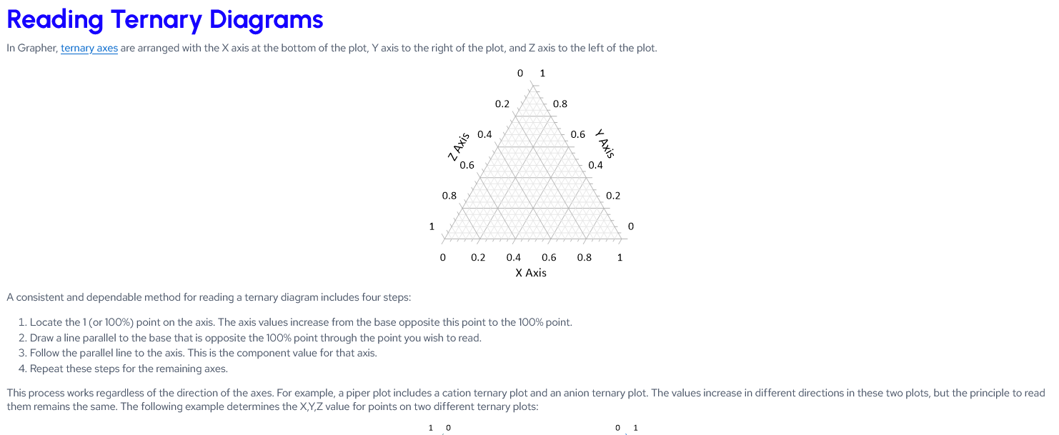
https://grapherhelp.goldensoftware.com/Graphs/Reading_Ternary_Diagrams.htm

Slide 3
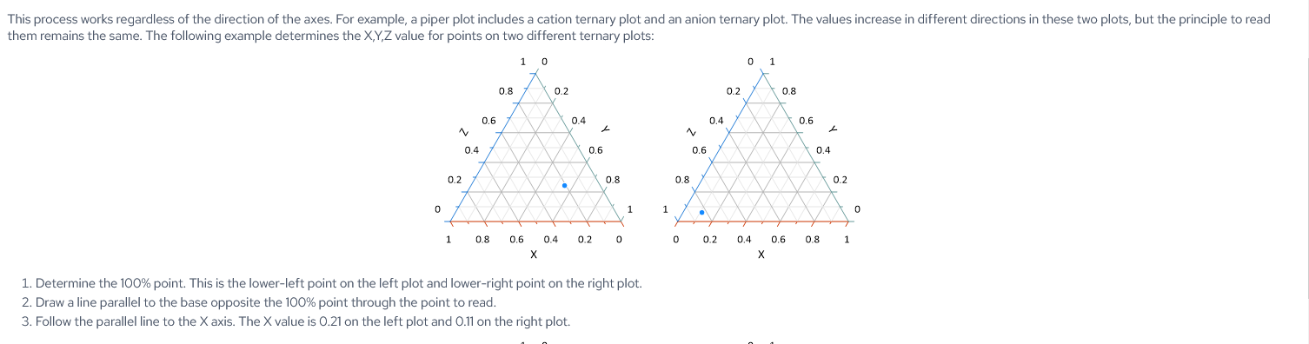

Slide 4
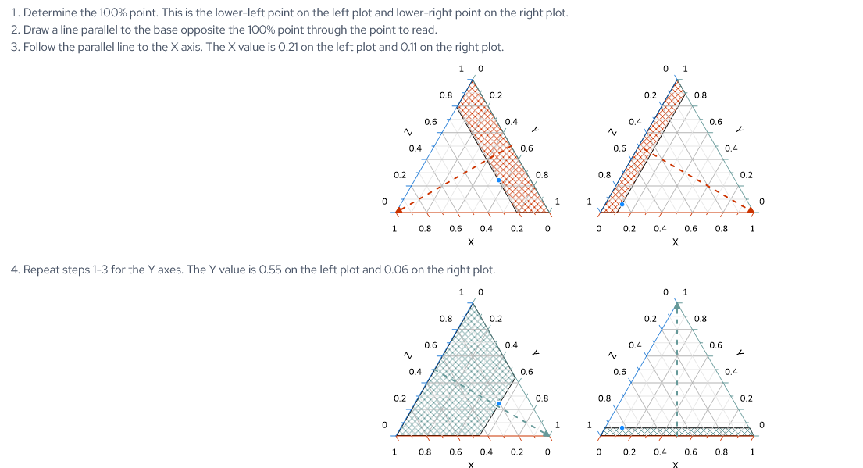

Slide 5
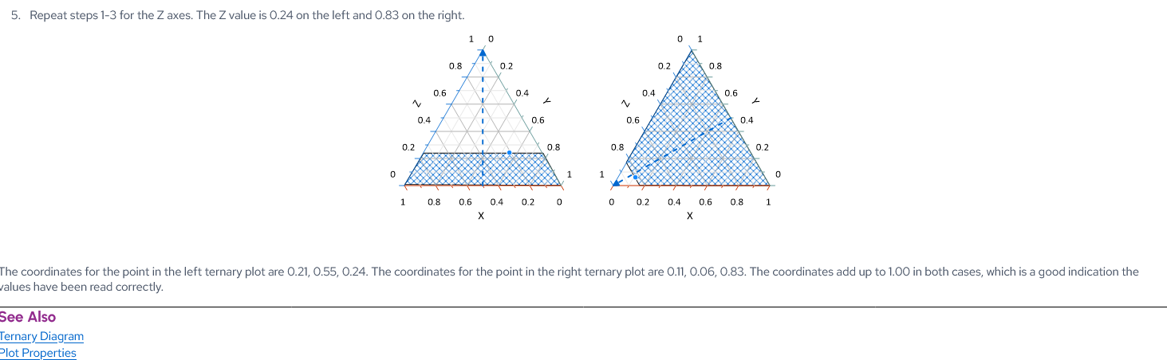

Slide 6
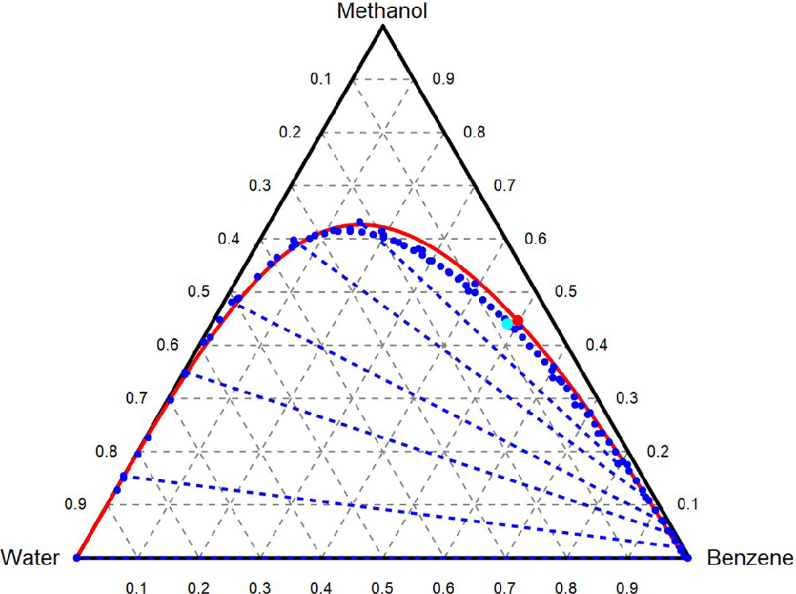
Real tie lines are not horizontal, but for our system we are approximating that they are (imagine the dashed blue lines are not “diagonal” here.

Slide 7
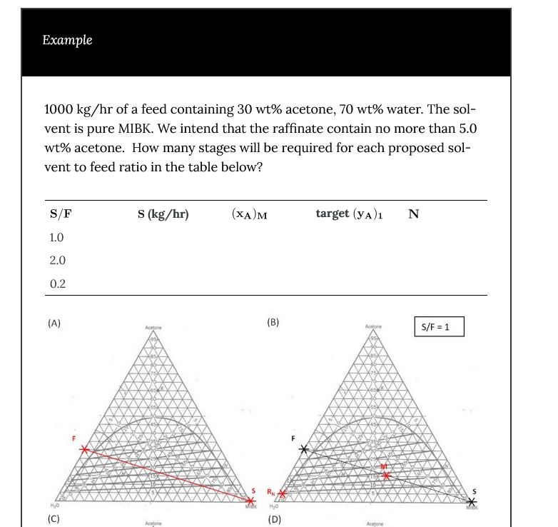
Location of ternary (3 species) mixture composition INSIDE the LLE column before the separation occurs, in other words mixing of the streams is via inverse lever rule math on the feed and the solvent. If mass flow of feed and solvent is equal (S/F=1) then M is midpoint of line connecting S and F.
IF S/F=2, the M is 2/3 of the way from F to S or 1/3 of the way from S to S (closer to S than F)
https://iastate.pressbooks.pub/chemicalengineeringseparations/chapter/liquid-liquid-extraction-2/

Slide 8
Feed: F
Solvent : S
Mixture :M
(point found from inverse lever of mass flow rates of F,S, on the line connecting them
R: Raffinate on this “stage”
Approximately from horizontal line through M
E: Extract on this “stage”
Rn: target raffinate at final stage
Column/Stage #1
R
E

Slide 9
Feed to next LLE “stage” (column unit) should be E from previous column re-mixed with some water (but not a lot)
E1+ some water or E1+ some water/acetic gives F2 (feed to 2nd column
F2-S line has M2 point lower than 1st tie line,
Can further enrich the extract E2 compared to E1
R1
F2
E1
R2
E2
M2

Slide 10
Feed to next LLE “stage” (column unit) should be E from previous column re-mixed with some water (but not a lot)
When E2 (or E3 or E4…) is “pure enough” ,
Then take it and send this mixture to a distillation column. Distill off the solvent leaving behind mostly Acetic Acid with trace water / solvent.
R1
F2
E1
R2
E2
M2

