Slide 1
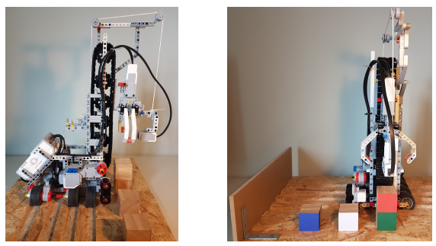
Brick
Reference plate
Colour sensor
Rails

Slide 2
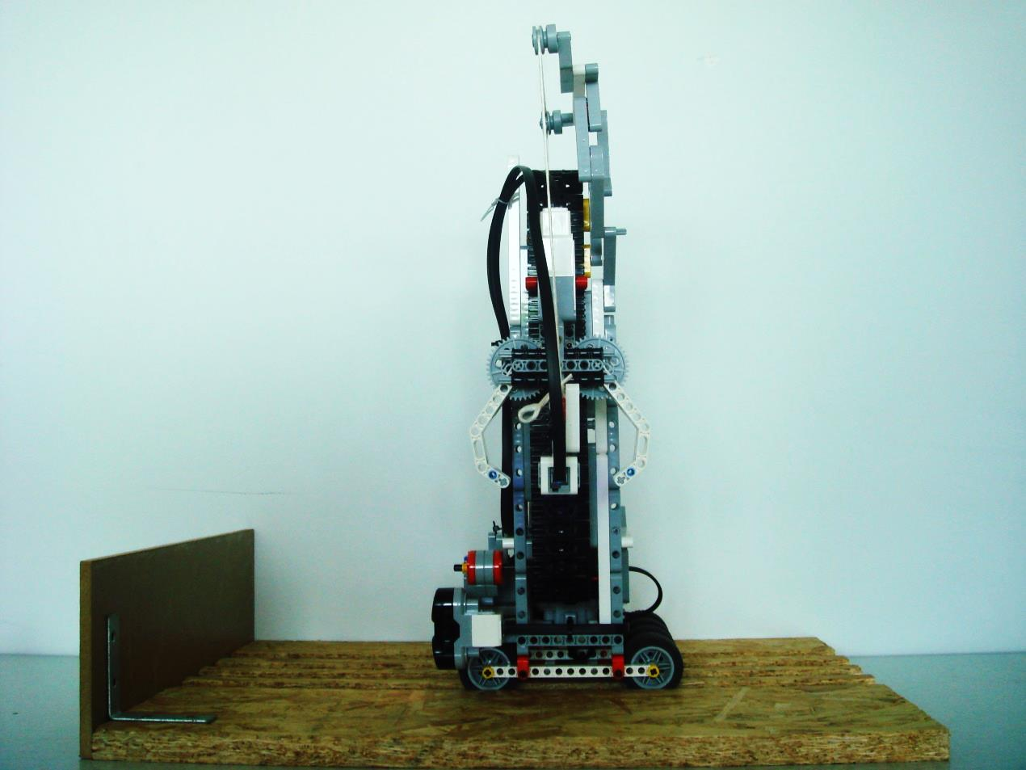
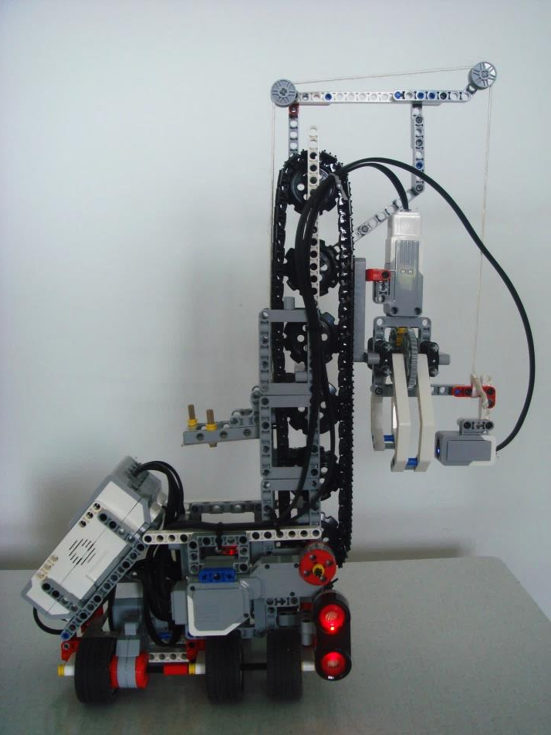
Supporting rope
Supporting rope
Reference plate
Brick
Colour sensor
Ultrasonic sensor
Rails
Ultrasonic sensor

Slide 3
