Slide 1


Sarvajanik College of Engineering & Technology
Branch | : | Computer Engineering (Shift-I)
Subject | : | Cyber Security (2150002)
Faculty | : | Prof. Jaydeep Barad
Topic | : | Aircrack-ng
Submitted by | : | Jainam Shah 160420107051 Roma Shah 160420107052

Slide 2
Contents
Introduction
How to Crack Wifi Password, Step By Step
Airmon-ng
Airodump-ng
Aireplay-ng
Aircrack-ng
References

Slide 3

Introduction
Aircrack-ng is a complete suite of tools to assess WiFi network security.
Aircrack-ng is a network software suite consisting of a detector, packet sniffer, WEP and WPA/WPA2-PSK cracker and analysis tool for 802.11 wireless LANs.
It works with any wireless network interface controller whose driver supports raw monitoring mode and can sniff 802.11a, 802.11b and 802.11g traffic.
Aircrack-ng is developed by Thomas d'Otreppe de Bouvette.

Slide 4
Introduction
It focuses on different areas of WiFi security:
Monitoring: Packet capture and export of data to text files for further processing by third party tools.
Attacking: Replay attacks, de-authentication, fake access points and others via packet injection.
Testing: Checking WiFi cards and driver capabilities (capture and injection).
Cracking: WEP and WPA PSK (WPA 1 and 2).

Slide 5
How to Obtain Wifi Password, Step By Step
Start the wireless interface in monitor mode on the specific AP channel
Start airodump-ng on AP channel with filter for bssid to collect authentication handshake
Use aireplay-ng to deauthenticate the wireless client
Run aircrack-ng to crack the pre-shared key using the authentication handshake

Slide 6
Airmon-ng
Step-1: Start the wireless interface in monitor mode on the specific AP channel
Airmon-ng script can be used to enable monitor mode on wireless interfaces. It may also be used to go back from monitor mode to managed mode.
Entering the airmon-ng command without parameters will show the interfaces status.
Usage:
airmon-ng <start|stop|check> <interface> [channel or frequency]

Slide 7
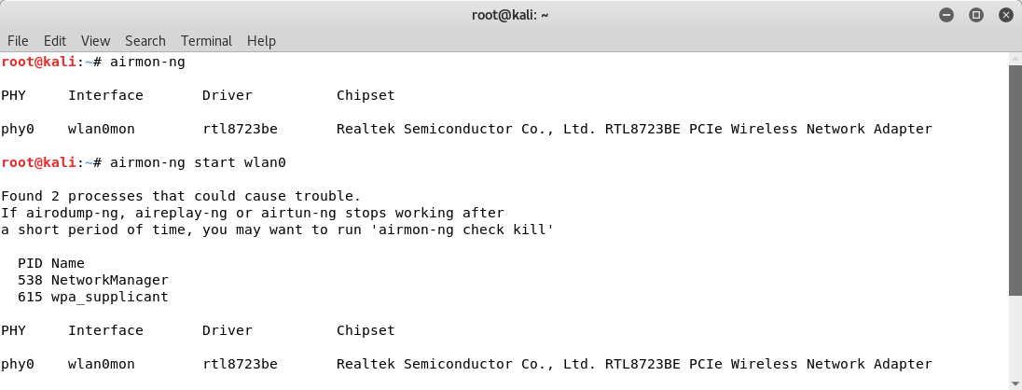
Airmon-ng

Slide 8
Airodump-ng
Step-2:Start airodump-ng on AP channel with filter for bssid to collect authentication handshake
Airodump-ng is used for packet capturing of raw 802.11 frames and is particularly suitable for collecting WEP IVs (Initialization Vector) for the intent of using them with aircrack-ng.
Additionally, airodump-ng writes out several files containing the details of all access points and clients seen.
Usage:
airodump-ng <options> <interface>[,<interface>,...]

Slide 9
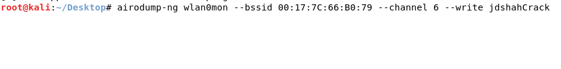
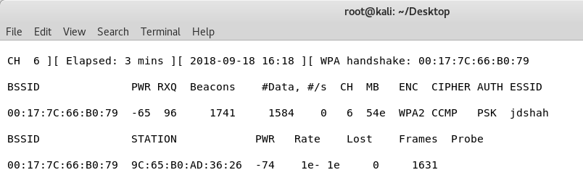
Airodump-ng

Slide 10
Aireplay-ng
Step-3: Use aireplay-ng to deauthenticate the wireless client
Aireplay-ng is used to inject frames.
The primary function is to generate traffic for the later use in aircrack-ng for cracking the WEP and WPA-PSK keys.
There are different attacks which can cause deauthentications for the purpose of capturing WPA handshake data, fake authentications, Interactive packet replay, hand-crafted ARP request injection and ARP-request reinjection.

Slide 11
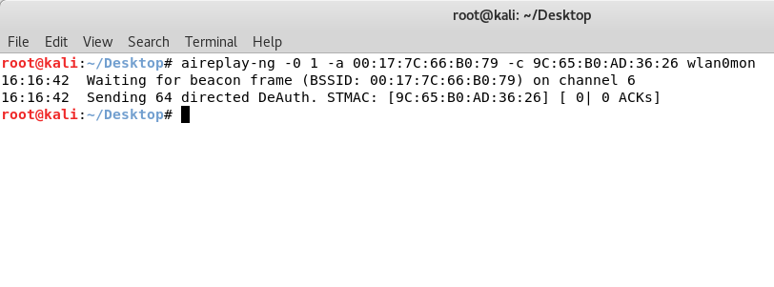
Aireplay-ng

Slide 12
Aircrack-ng
Step-4:Run aircrack-ng to crack the pre-shared key using the authentication handshake
Aircrack-ng is an 802.11 WEP and WPA/WPA2-PSK key cracking program.
Aircrack-ng can recover the WEP key once enough encrypted packets have been captured with airodump-ng.
It uses a password list to obtain the wifi password.
Usage:
aircrack-ng [options] <capture file(s)>

Slide 13
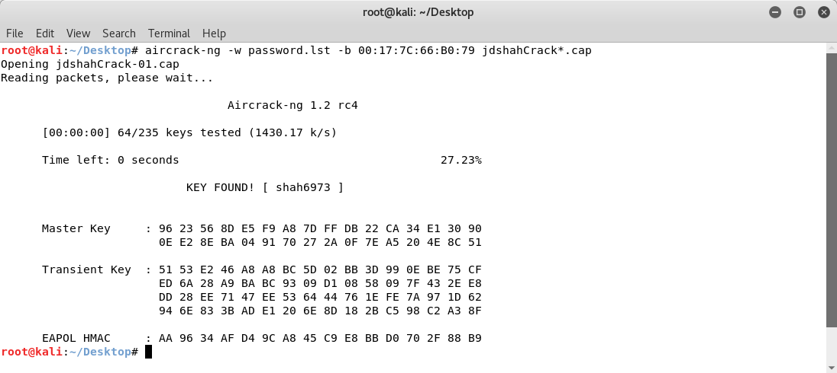
Aircrack-ng

Slide 14
References
http://aircrack-ng.org/
https://www.computerweekly.com/tip/Step-by-step-aircrack-tutorial-for-Wi-Fi-penetration-testing

Slide 15
Thank You

