Slide 1


Sarvajanik College of
Engineering and Technology
Branch : Computer Engineering (Shift 1)
Subject : Microprocessor and Interfacing (2150707)
Faculty : Prof. Vandana Joshi
: Prof. Mitisha Patel
Topic : Advance Microprocessor 80286
Submitted by :
Name | Enrollment No.
Yash Patel | 160420107043
Parth Roy | 160420107046
Saurabh Maheshwari | 160420107048
Jainam Shah | 160420107051
Parth Shekhaliya | 160420107053

Slide 2
Content
What is Microprocessor ?
Comparison of 80286 among some other microprocessors of Intel family.
80286 Salient features
80286 Internal Architecture
80286 Microprocessor Functions
80286 Pin diagram

Slide 3
What is Microprocessor?
The microprocessor is an multipurpose, programmable device that accepts digital data as input, processes it according to instructions stored in it’s memory and provide results as output.
It is an example of digital logic and it uses binary and hexadecimal numerical systems.

Slide 4
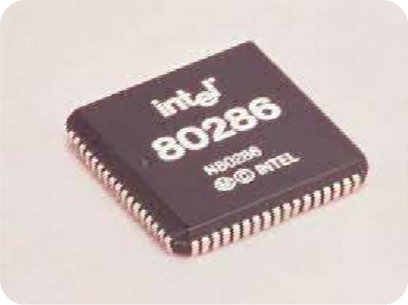
Intel 80286 Microprocessor
Introduced in 1982
Faster clock speed than previous versions
(12.5 MHz clock speed vs 10mhz)
16-bit microprocessor as like 8086
125K transistors, HMOS III technology
Advanced memory management
Multitasking ability
Better pipelining method
4 independent functional unit in internal architecture

Slide 5
Comparison of 80286 among some other microprocessors of Intel family
Microprocessor | Data bus width | Address bus width | Memory size
8086 | 16 | 20 | 1M
80186 | 16 | 20 | 1M
80286 | 16 | 24 | 16M
80386 DX | 32 | 32 | 4G
80486 | 32 | 32 | 4G
Pentium 4 & core 2 | 64 | 40 | 1T

Slide 6
80286 Salient features
Two mode of operation
More Addressable Memory
Virtual Memory in Protected Mode

Slide 7
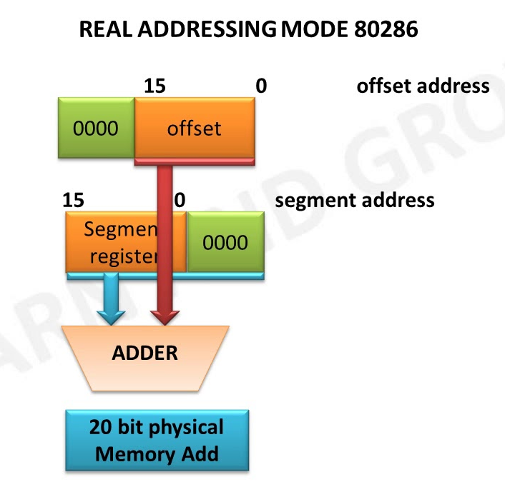
Operating Modes
Intel 80286 has 2 operating modes.
Real Address Mode
Protected Virtual Address Mode
Real Address Mode :
80286 just act as a faster version of 8086 up to 6 times

Slide 8
Virtual Address in Protected Mode
80286 can treat external storage as it were physical memory
Execute programs that are too large to be contained in physical memory
Program can be upto 2³⁰ bytes(1GB).

Slide 9
80286 Internal Architecture

Slide 10
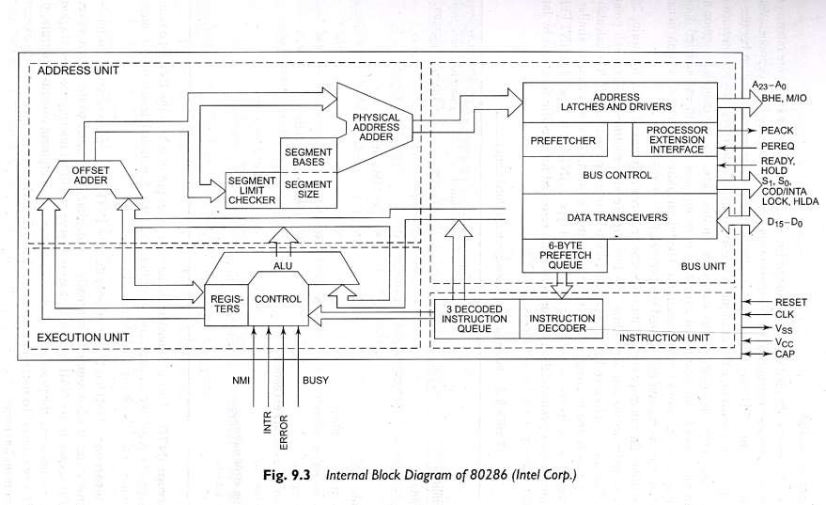

Slide 11
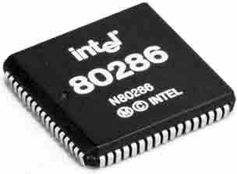
Functional Parts
Address unit
Bus unit
Instruction unit
Execution unit

Slide 12
Address Unit
Calculate the physical addresses of the instruction and data that the CPU want to access
Address lines derived by this unit may be used to address different peripherals.
Physical address computed by the address unit is handed over to the BUS unit.

Slide 13
Bus Interface Unit
Performs all memory and I/O read and write operations.
Take care of communication between CPU and a coprocessor.
Transmit the physical address over address bus A₀ – A_{23.}
Pre-fetcher module in the bus unit performs this task of prefetching.
Bus controller controls the pre-fetcher module.
Fetched instructions are arranged in a 6 – byte pre-fetch queue.

Slide 14
Instruction Unit
Receive arranged instructions from 6 byte pre-fetch queue.
Instruction decoder decodes up to 3 pre-fetched instruction and are latched them onto a decoded instruction queue.
Output of the decoding circuit drives a control circuit in the Execution unit.

Slide 15
Execution Unit
EU executes the instructions received from the decoded instruction queue sequentially.
Contains Register Bank.
contains one additional special register called Machine status word (MSW) register --- lower 4 bits are only used.
ALU is the heart of execution unit.
After execution ALU sends the result either over data bus or back to the register bank.

Slide 16
Register Organization of 80286
The 80286 CPU contains almost the same set of registers
as in 8086.
Eight 16-bit general purpose registers.
Four 16 bit segment registers.
Status and control register.
Instruction pointer.

Slide 17
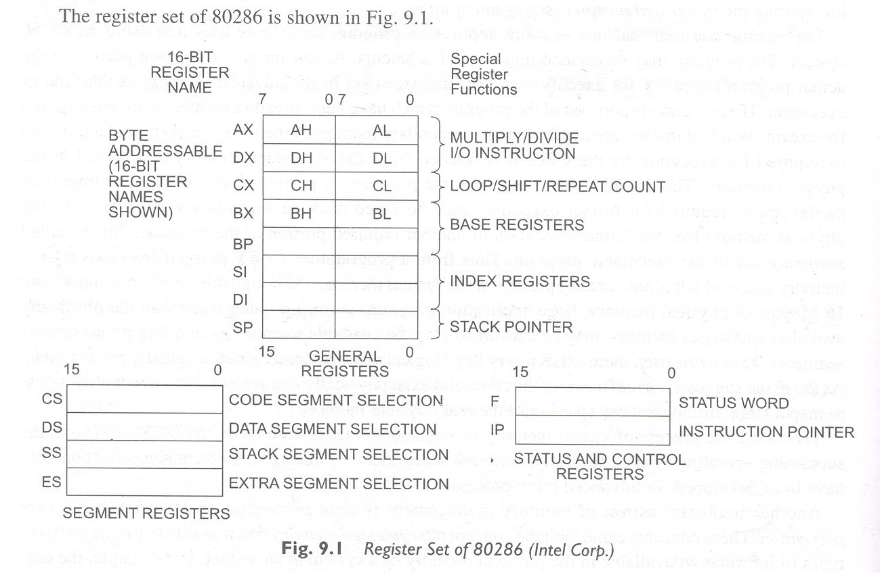

Slide 18
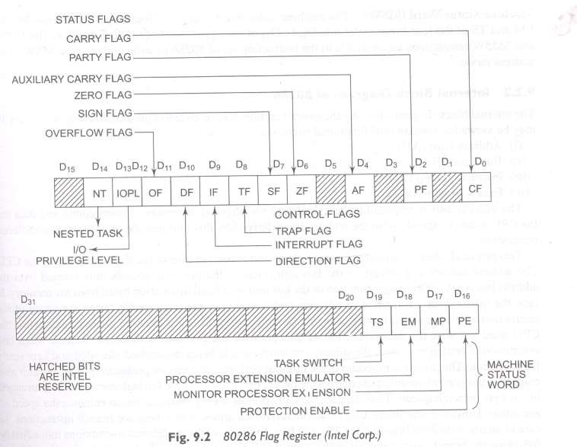

Slide 19
The flag register bits D_{0,}D_{2 ,} D_{4 ,}D_{6 ,} D₇ & D₁₁ are modified according to the result of the execution of logical and arithmetic instruction. These are called Status Fag Bit.
D₈ - Trap Flag (TF)
D₉ - Interrupt Flag (IF)
D₈ & D₉ – are used to control machine operation and thus they are called Control flags.
IOPL – I/O privilege field (bit D12 and D13)
NT – Nested task flag (bit D14)

Slide 20
PE - Protection enable
Protection enable flag places the 80286 in protected mode, if set. This can only be cleared by resetting the CPU.
MP – Monitor processor extension
Flag allows WAIT instruction to generate a processor extension.
EM – Emulate processor extension flag
If set , causes a processor extension absent exception and permits the emulation of processor extension by CPU.
TS – Task switch
If set this flag indicates the next instruction using extension will generate exception 7, permitting the CPU to test whether the current processor extension is for current task.

Slide 21
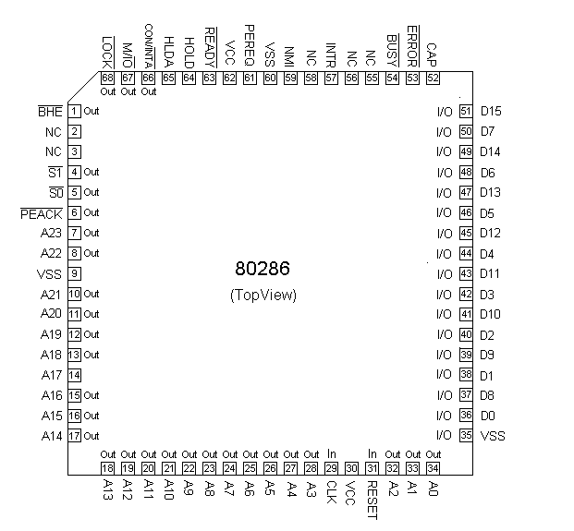
80286 pin diagram

Slide 22
Additional Instructions of 80286
No. Instruction Purpose
1. | CLTS | Clear the task – switched bit
2. | LDGT | Load global descriptor table register
3. | SGDT | Store global descriptor table register
4. | LIDT | Load interrupt descriptor table register
5. | SIDT | Store interrupt descriptor table register
6. | LLDT | Load local descriptor table register
7. | SLDT | Store local descriptor table register
8. | LMSW | Load machine status register
9. | SMSW | Store machine status register

Slide 23
No.
Instruction
Purpose
10.
11.
LAR LSL
Load access rights Load segment limit
12.
SAR
Store access right
13.
ARPL
Adjust requested privilege level
14.
VERR
Verify a read access
15.
VERW
Verify a write access

Slide 24
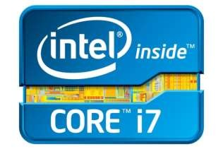
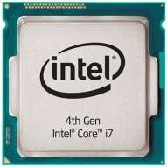
Conclusion
80286 took vital role for today’s high end desktop pc’s.Now we have many high end processors for desktop,notebook,laptop ,mobile phone etc

Slide 25
References
http://www.geeksforgeeks.com
http://www.Wikipedia.in

Slide 26
Thank You

