Slide 1


Sarvajanik College of
Engineering and Technology
Branch : Computer Engineering (Shift 1)
Subject : Analysis and Design of Algorithms (2150703)
Faculty : Prof. (Dr.) Mayuri Mehta
: Prof. Urvashi Mistry
Topic : Real time application of Heap-sort
Submitted by :
Name | Enrollment No.
Yash Patel | 160420107043
Parth Roy | 160420107046
Saurabh Maheshwari | 160420107048
Jainam Shah | 160420107051
Parth Shekhaliya | 160420107053

Slide 2
Contents
Heap Sort
Heap in Memory Management
Priority Queue
Graph Algorithms
Embedded Systems
Kth largest or smallest element

Slide 3
Heap Sort
Heap is a specialized tree-based data structure that satisfies the heap
property.
Heap properties:
It has to be a complete binary tree.
It has to have any of the following properties:
Max Heap
Store data in ascending order
Has property of
A[Parent(i)] ≥ A[i]
Min Heap
Store data in descending order
Has property of
A[Parent(i)] ≤ A[i]

Slide 4
Heapsort algorithm
Build a max heap from the input data.
Replace the root of the heap with the last item of the heap followed by reducing the size of heap.
Heapify the root of tree.
Repeat above steps until size of heap is greater than 1.

Slide 5




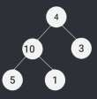

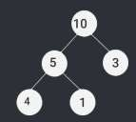
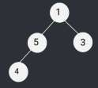


Heapsort algorithm
Creating heap
Building max-heap
Replace root with last element
Sorted array

Slide 6
Heapsort Algorithm
void heapSort(int arr[], int n)
{
for(int i = n/2 - 1; i >= 0; i--)
Creating heap
heapify(arr, n, i);
Swaps the first and last
node
for(int i = n - 1; i >= 0; i--)
{
swap(arr[0], arr[i]);
Creates max heap on
reduced array
heapify(arr,i,0);
}
}

Slide 7
Merits and Demerits
Merits
Demerits
Time Complexity of heap sort is Ɵ(nlogn).
It is in-place sorting algorithm so it doesn’t require extra space for sorting elements.
Space complexity of heap sort is Ɵ(1).
It works better than selection and bubble sort.
For random input heap sort works slower than quick sort.
It is not a stable sorting algorithm.
Best Case | Average Case | Worst case
O(nlogn) | O(nlogn) | O(nlogn)

Slide 8
Heap In Memory Management
Data structure "heap" might be used in various places.
Heap used for dynamic memory allocation wherever it is needed.
How to use heap in memory :
The heap is a region of computer's memory that is not managed automatically for , and is not as tightly managed by the CPU.
To allocate memory on the heap, we use malloc() or calloc(), which are built-in C functions.

Slide 9
Why we use heap in memory???
Variables can be accessed globally
No limit on memory size
No guaranteed efficient use of space, memory may become fragmented over time as blocks of memory are allocated, then free’d
User must manage memory
Variables can be resized using realloc()

Slide 10
Priority queue
A priority queue is an abstract data type which is like a regular queue or stack data structure, but where additionally each element has a "priority" associated with it. In a priority queue, an element with high priority is served before an element with low priority.
Priority queues can be efficiently implemented using Binary Heap because it supports insert(), delete() and extractmax(), decreaseKey() operations in O(logn) time.

Slide 11
Priority Queue
A typical Priority Queue requires following operations to be efficient.
Get Top Priority Element (Get minimum or maximum)
Insert an element
Remove top priority element
Decrease Key
A Binary Heap supports operations with following time complexities:
O(1)
O(Logn)
O(Logn)
O(Logn)

Slide 12
Priority Queue
The major advantage of using the binary heap for priority queue is that you can add new values to it efficiently after initially constructing it.
If all the values in the queue are known in advance, you can just sort the values, as you've mentioned. But what happens when you the want to add a new value to the priority queue?
This might take time Θ(n) in the worst case because you'd have to shift down all the array elements to make space for the new element that you just added.
On the other hand, insertion into a binary heap takes time O(log n), which is exponentially faster.

Slide 13
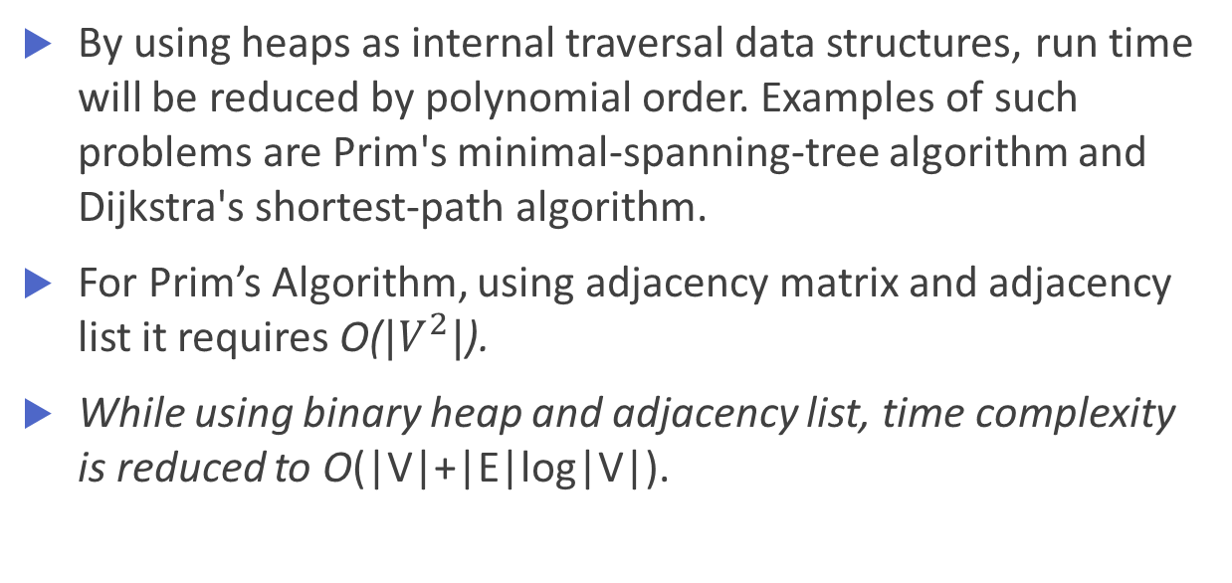
Graph Algorithms
By using heaps as internal traversal data structures, run time will be reduced by polynomial order. Examples of such problems are Prim's minimal-spanning-tree algorithm and Dijkstra's shortest-path algorithm.
For Prim’s Algorithm, using adjacency matrix and adjacency list it requires O(${|V}^{2}|$).
While using binary heap and adjacency list, time complexity is reduced to O(|V|+|E|log|V|).

Slide 14
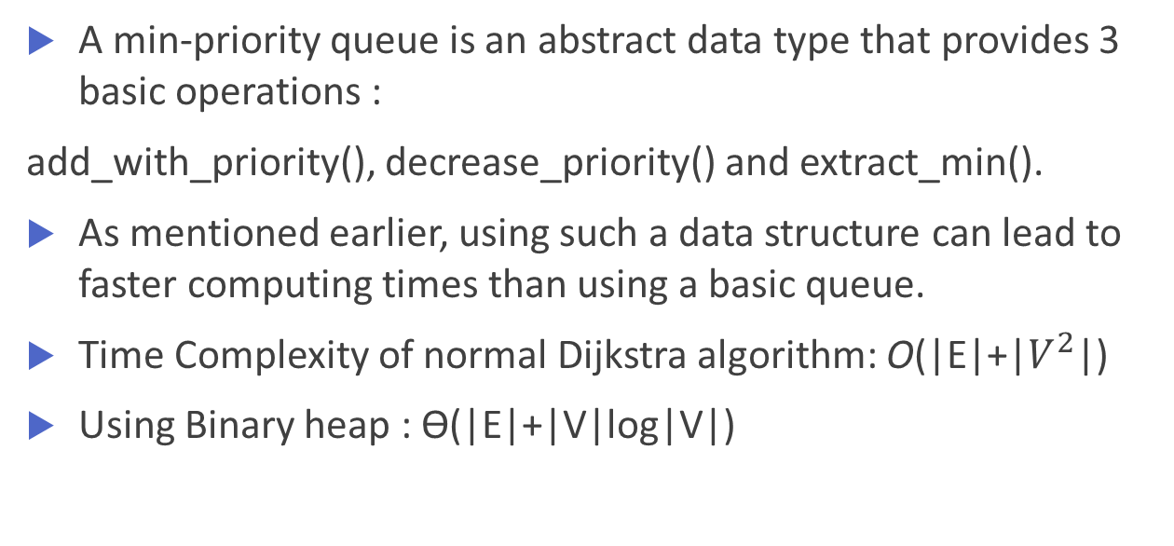
Dijkstra Algorithm
A min-priority queue is an abstract data type that provides 3 basic operations :
add_with_priority(), decrease_priority() and extract_min().
As mentioned earlier, using such a data structure can lead to faster computing times than using a basic queue.
Time Complexity of normal Dijkstra algorithm: O(|E|+|$V^{2}$|)
Using Binary heap : Ɵ(|E|+|V|log|V|)

Slide 15
Embedded Systems
Embedded systems are devices that perform a few simple functions.
Embedded devices typically have limited power, memory and computational resources.
Many embedded systems applications involve storing and querying large datasets.
Sorting algorithms are commonly used in query processing.

Slide 16
Embedded Systems
The optimal sorting algorithm for embedded systems has these characteristics:
It must sort in place.
The algorithm must not be recursive.
Its best, average and worst case running times should be of similar magnitude.
Its running time should increase linearly or logarithmically with the number of elements to be sorted.

Slide 17
Embedded Systems
Merge sort and quick sort are better than heap sort but they require extra space.
In Embedded systems there is less space available, so quick sort and merge sort doesn’t fit.
So heap sort is better for Embedded systems
Ex. Systems concerned with security and embedded system such as Linux Kernel uses Heap Sort because of the O(nlog(n)) which reduces the processing time of the system.

Slide 18

$K^{th}$ largest or smallest Element
Selection algorithm is an algorithm for finding the kth smallest or largest number in a list or array.
For finding kth smallest or largest number, in a list or array we require it to sort first.
For this heap sort can be used because of its less time complexity than using other sorting techniques.
For this we can use Max heap or Min heap to find kth smallest or largest number

Slide 19

$K^{th}$ largest or smallest Element
A heap allows access to the min or max element in constant time, and other selections i.e. kth-element can be done in sub-linear time on data that is in a heap.
Time Complexity: O(n + klogn)
1) Build a Max Heap tree in O(n) 2) Use Extract Max k times to get k maximum elements from the Max Heap O(klogn)

Slide 20
References
https://en.wikipedia.org/wiki/Heap_(data_structure)
https://embeddedgurus.com/stack-overflow/2009/03/sorting-in-embedded-systems/
https://www.geeksforgeeks.org
https://people.ok.ubc.ca/rlawrenc/research/Students/TC_11_Presentation.pptx

Slide 21
Thank You !!!

