Slide 1
Insignificant Role of Photochemical Oxidation in Indoor Environments
Joshua L Cox and Joshua D Shutter

Slide 2
Why Study Indoor Air Chemistry?

Slide 3
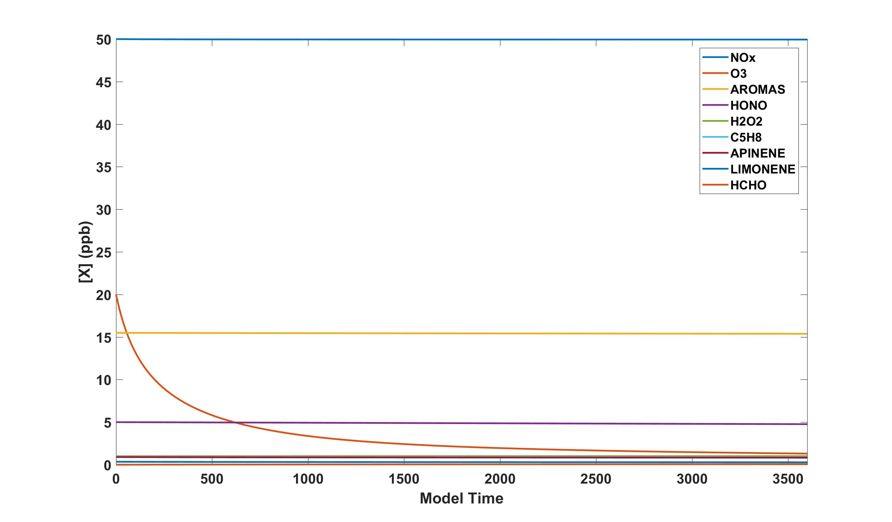
Base Case

Slide 4
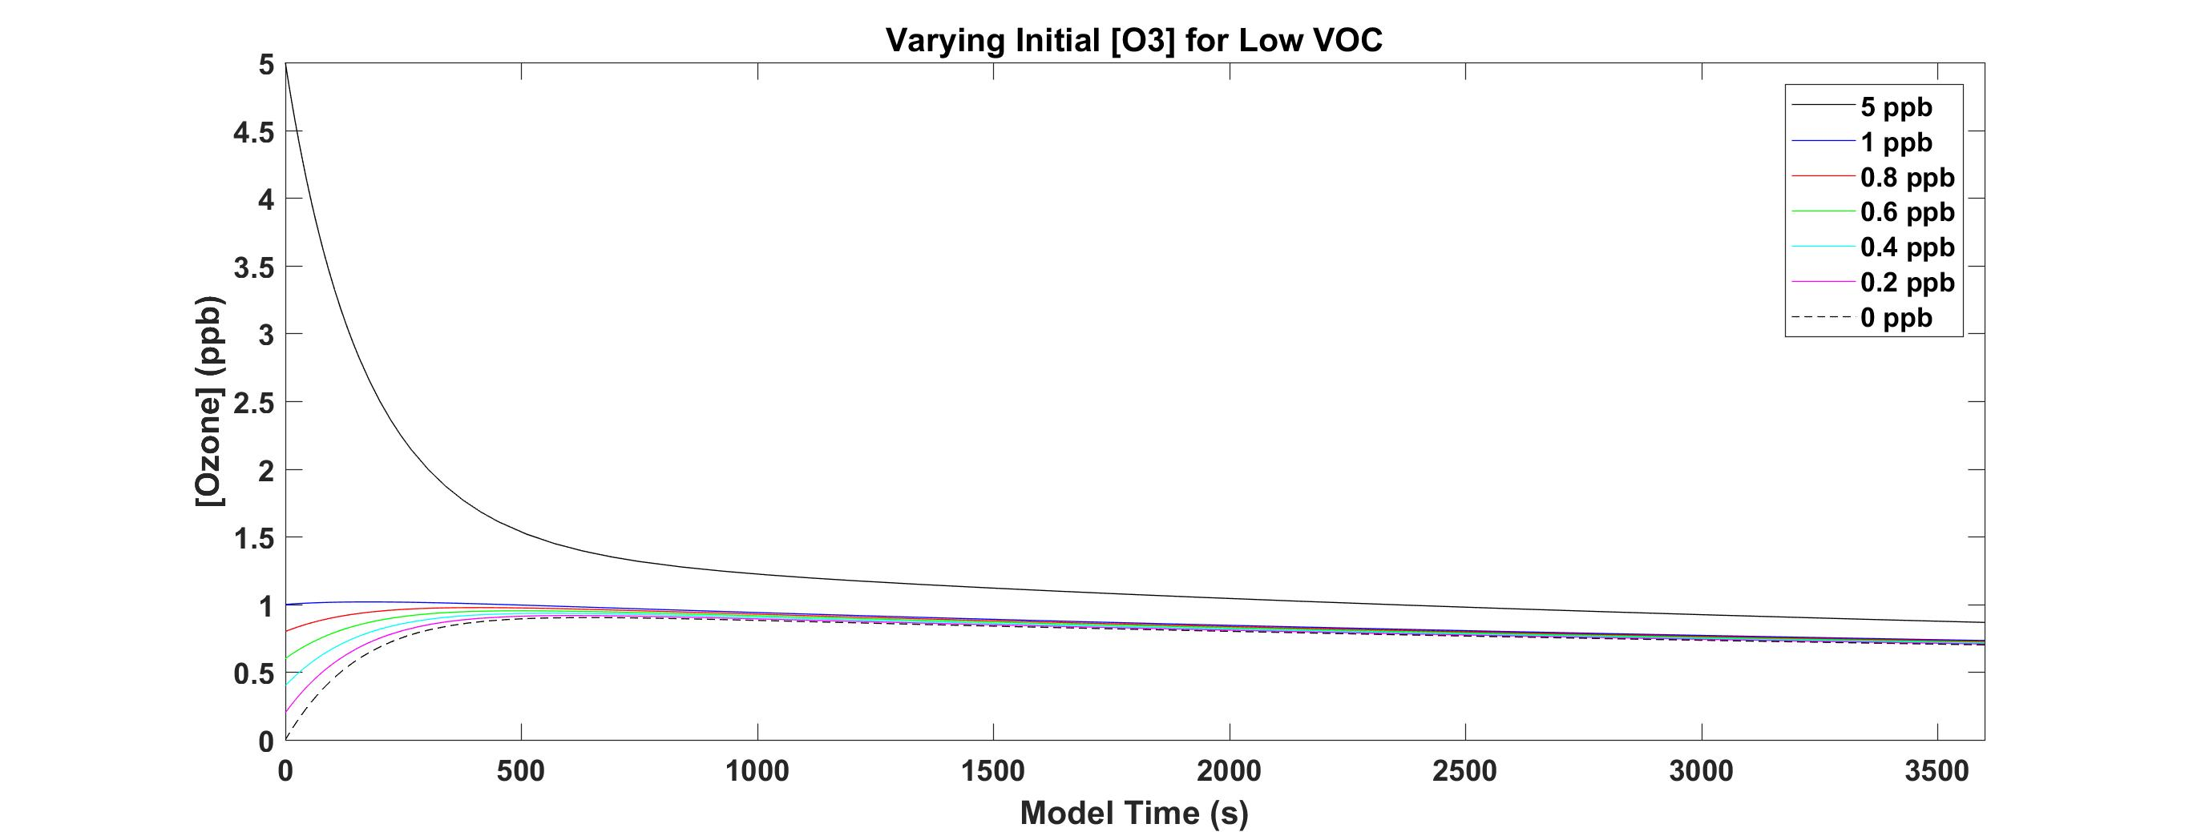
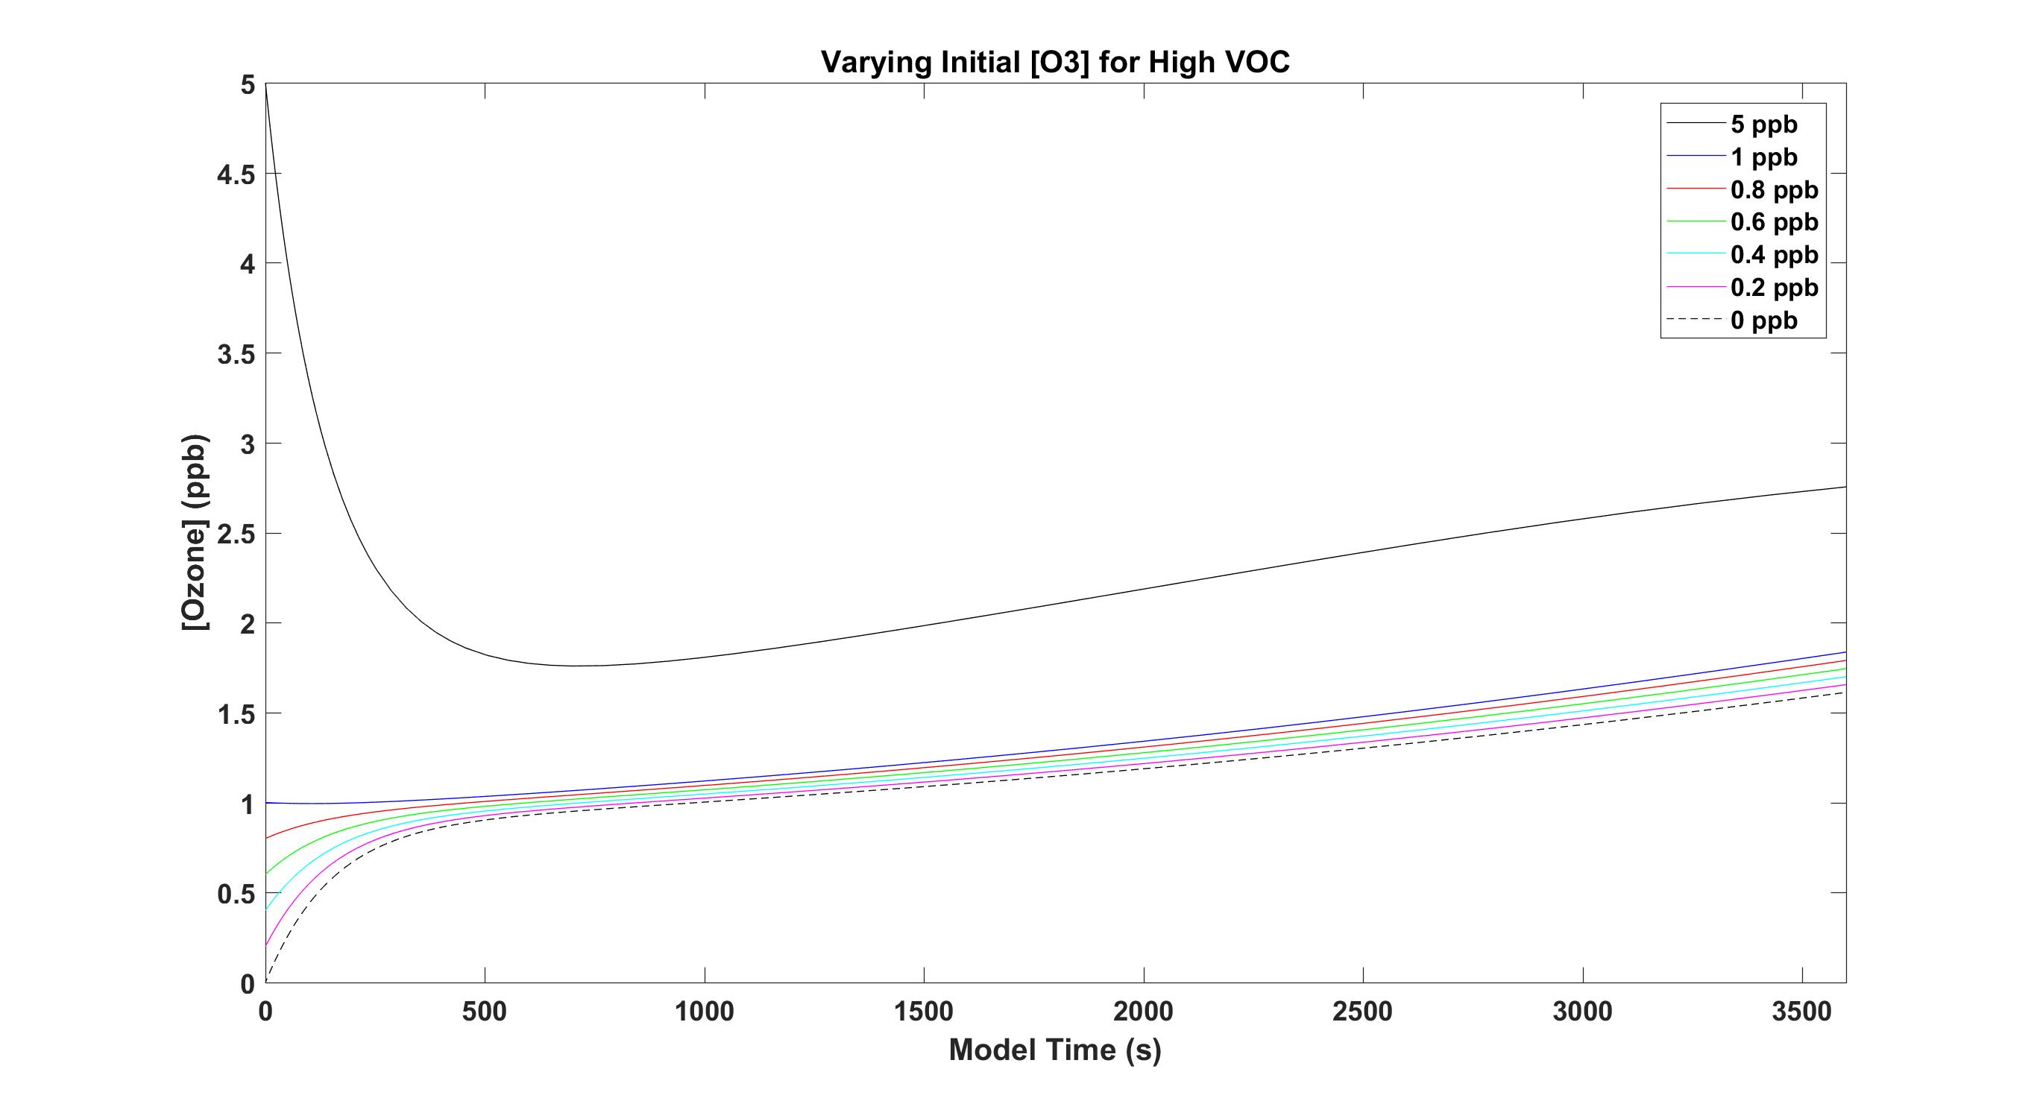
Varying Initial [O₃]

Slide 5
Indoor Light Sources Examples

Slide 6
Varying Indoor Light Source

Slide 7
Varying Surface Deposition

Slide 8
Varying [NO_{x}]

Slide 9
Indoor Flux Measurement Idea
Since deposition and re-emission of chemical species onto indoor surfaces are a major process affecting indoor air, the rate of these processes is little quantified

