Slide 1
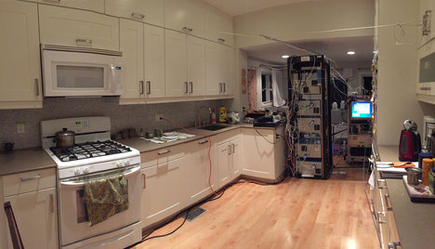
Extent of O₃ Photochemical Production in Indoor Environments
Josh + Josh
2 x Josh
Josh²?
7 December 2017, 3:53 AM… ☺

Slide 2
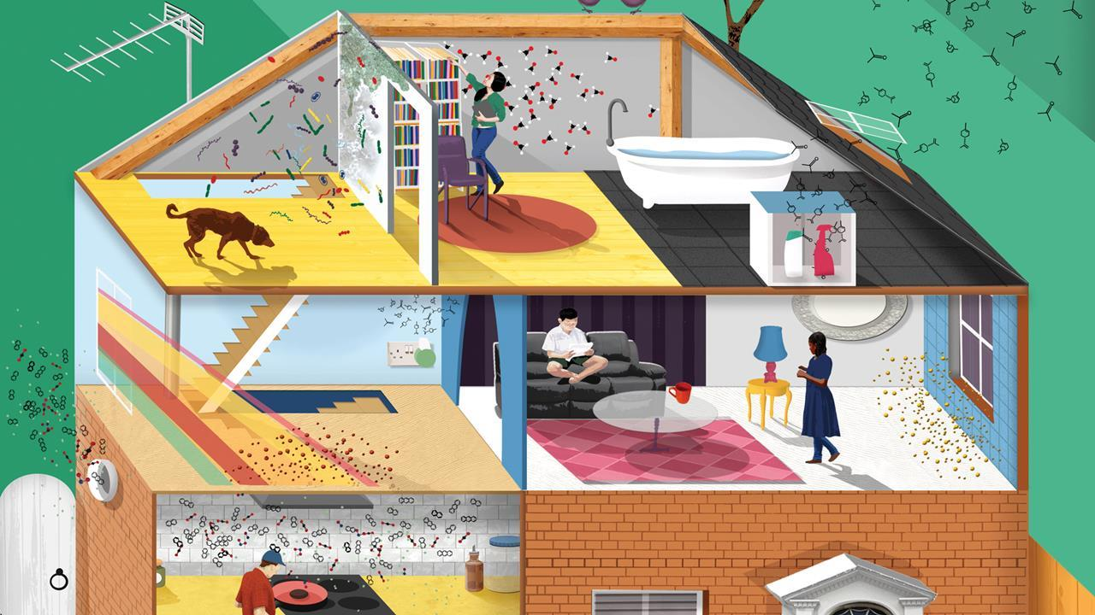
Why Study Indoor Air Chemistry?
We spend ~80-90% of our time indoors
Relative to outdoor chemistry, indoor chemistry is understudied
What are the impacts of indoor chemistry on human health?
What are the sources of primary and secondary pollutants indoors? Surfaces?

Slide 3
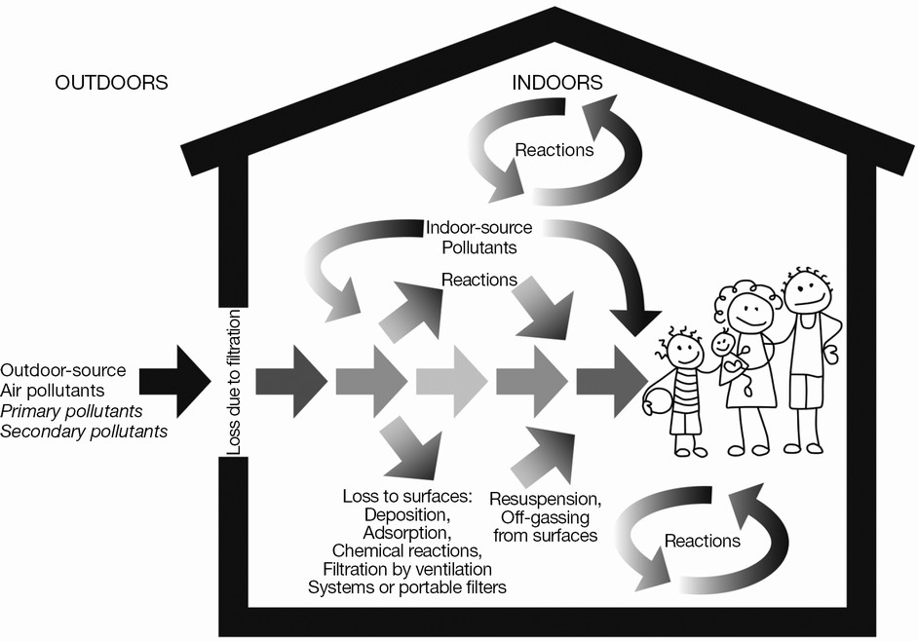
Pollutants Indoors: Processing and Origins
VOC
VOC
O₃
VOC
O₃
SOA
O₃
SOA
SOA
VOCs, O₃, and SOA have sources originating from both outdoor and indoor environments and undergo complex chemical processing

Slide 4
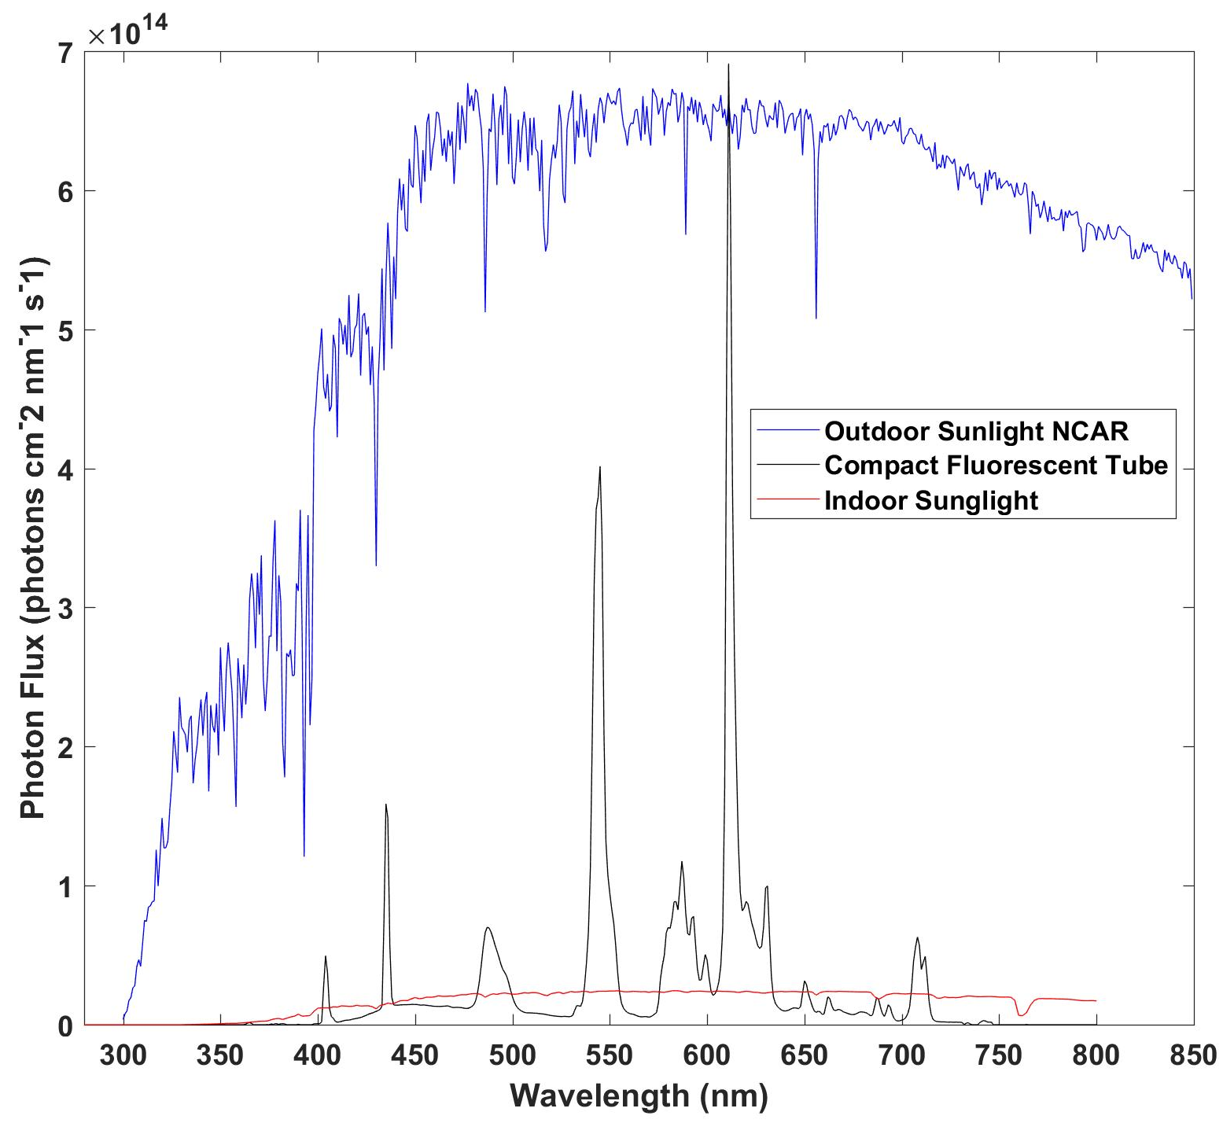
Photochemistry Indoors vs. Outdoors
Outside, VOC processing is largely driven via photochemical processes
However, indoors, the light sources can vary—how does this impact photochemical production of secondary pollutants like O₃ and SOA?
Note that CFTs and Sunlight transmitted indoors from outdoors are markedly weaker than outside sunlight
Kwan et al., 2017

Slide 5
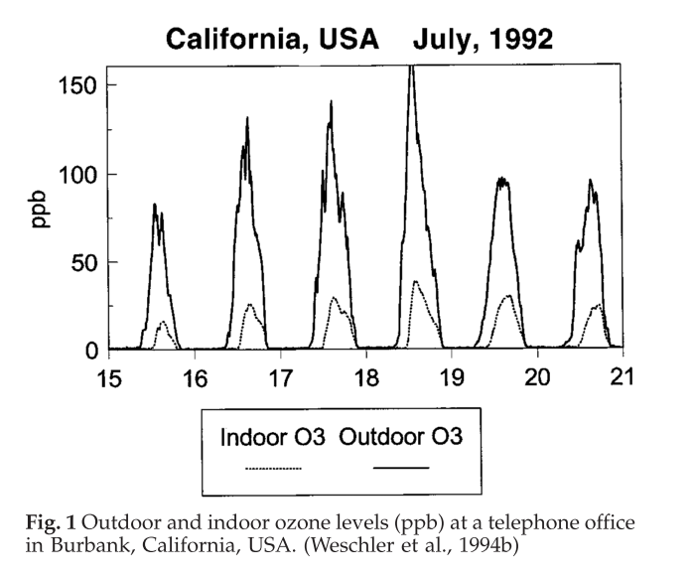
Ozone Indoors vs. Outdoors
O₃ is produced via photochemical cycles involving NO_{x}, VOCs, and light → Formed indoors largely in photocopiers, laser printers, etc.
O₃ is thought to mainly originate indoors from outdoors

Slide 6
Main Research Question
To what extent does indoor photochemistry produce and affect O₃ relative to the amount transported from outside?

Slide 7
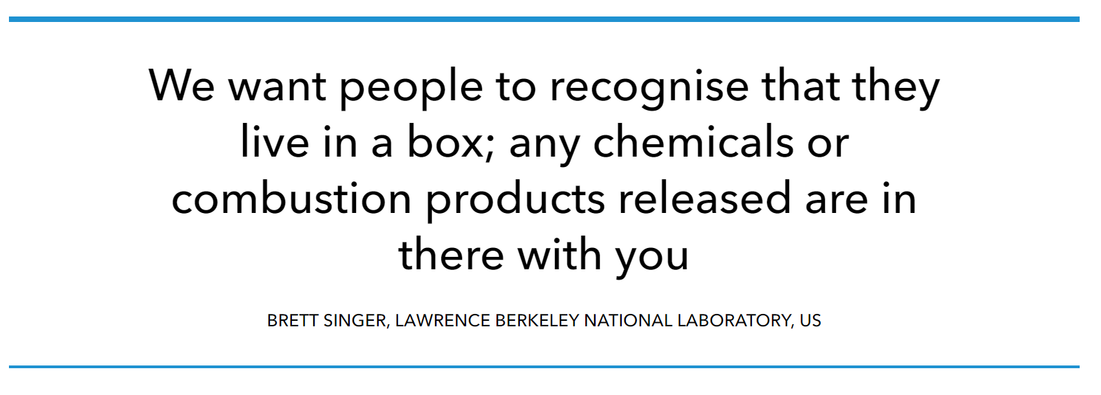
Factors to be Investigated for O₃ Production Indoors
VOC Mixing Ratios
Light Source
[O₃]₀
Surface Deposition
NO_{x} Mixing Ratios
The F0AM Model provides an excellent tool to model O₃ production in this environment—indoors, we are essentially living in a box!
November 24, 2017 from RSC.

Slide 8
Base Model Inputs: VOCs and Inorganics
Isoprene – from human breath
Aromatics (toluene, benzene, xylenes) – from paints, solvents, etc.
Limonene/α-pinene – found in air fresheners
HONO – thought to originate from NO₂, H₂O, light, and a surface
NO_{x}– transport from outside; photolysis of HONO
H₂O₂ → Ozonolysis of alkenes; HO₂ self-reaction
O₃ initialized to 20 ppb unless stated otherwise
Note: Low and high VOC mixing ratios correspond to Limonene at 0.35 ppb and 70 ppb, respectively. All other VOCs are at ~1 ppb or less. Model was run for 1 hour to account for typical air exchange rates

Slide 9
Model Inputs Contd.: Surface Deposition and Light Source
Light source = Indoor Sunlight from Kowal et al., 2017
Surface Deposition Rate = 5/hr from Weschler et al., 2000

Slide 10
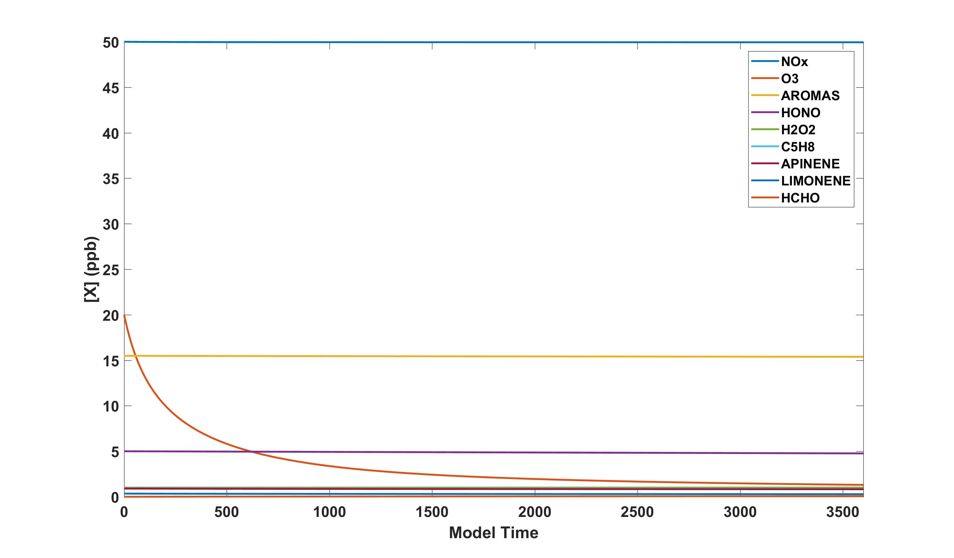
Base Case Model Run Example (Low VOC)
At first glance, mixing ratios of species are constant except for O₃ → Warrants Investigation!

Slide 11
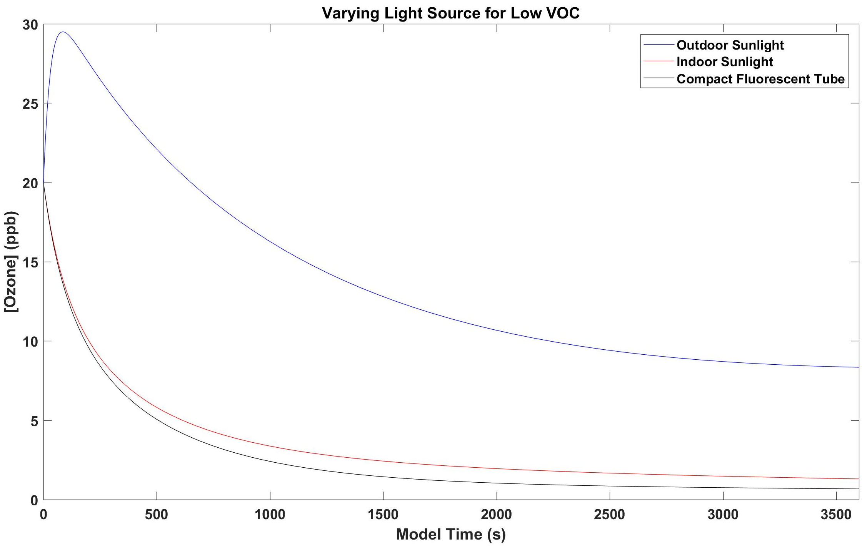
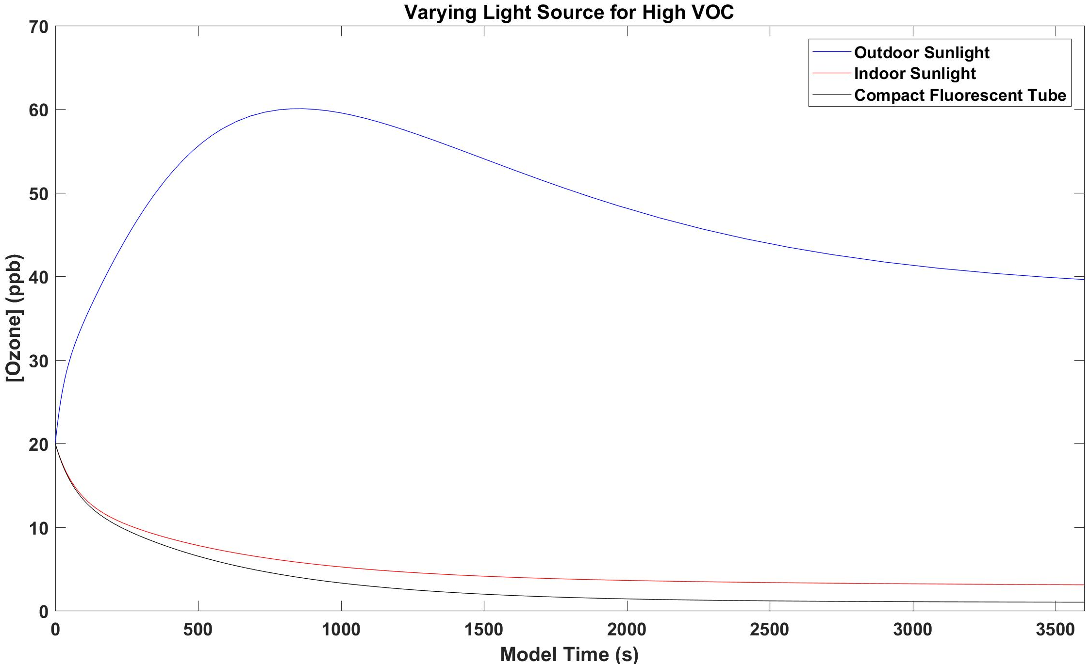
Varying Indoor Light Source
The maximum observed outdoors is likely due to elevated photon flux → Propagating the VOC/NO_{x}/O₃ cycle
Indoors, decreases in [O₃] are likely a result of lower photon flux → Does NO₂ efficiently photolyze here?

Slide 12
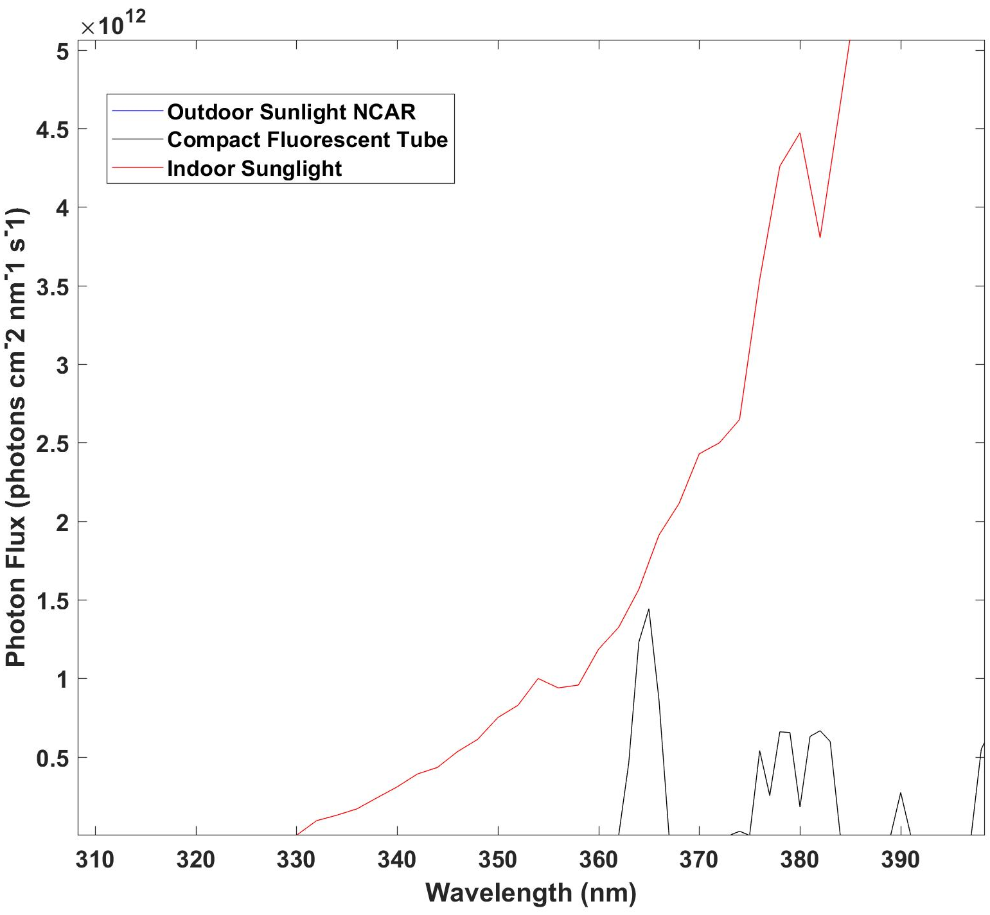
Photon Fluxes and NO₂: Photolysis Efficiency Indoors
Indoor photon fluxes at wavelengths < 390 nm are small indoors relative to outdoors → less NO₂ photolysis, leading to reduced O₃ production

Slide 13
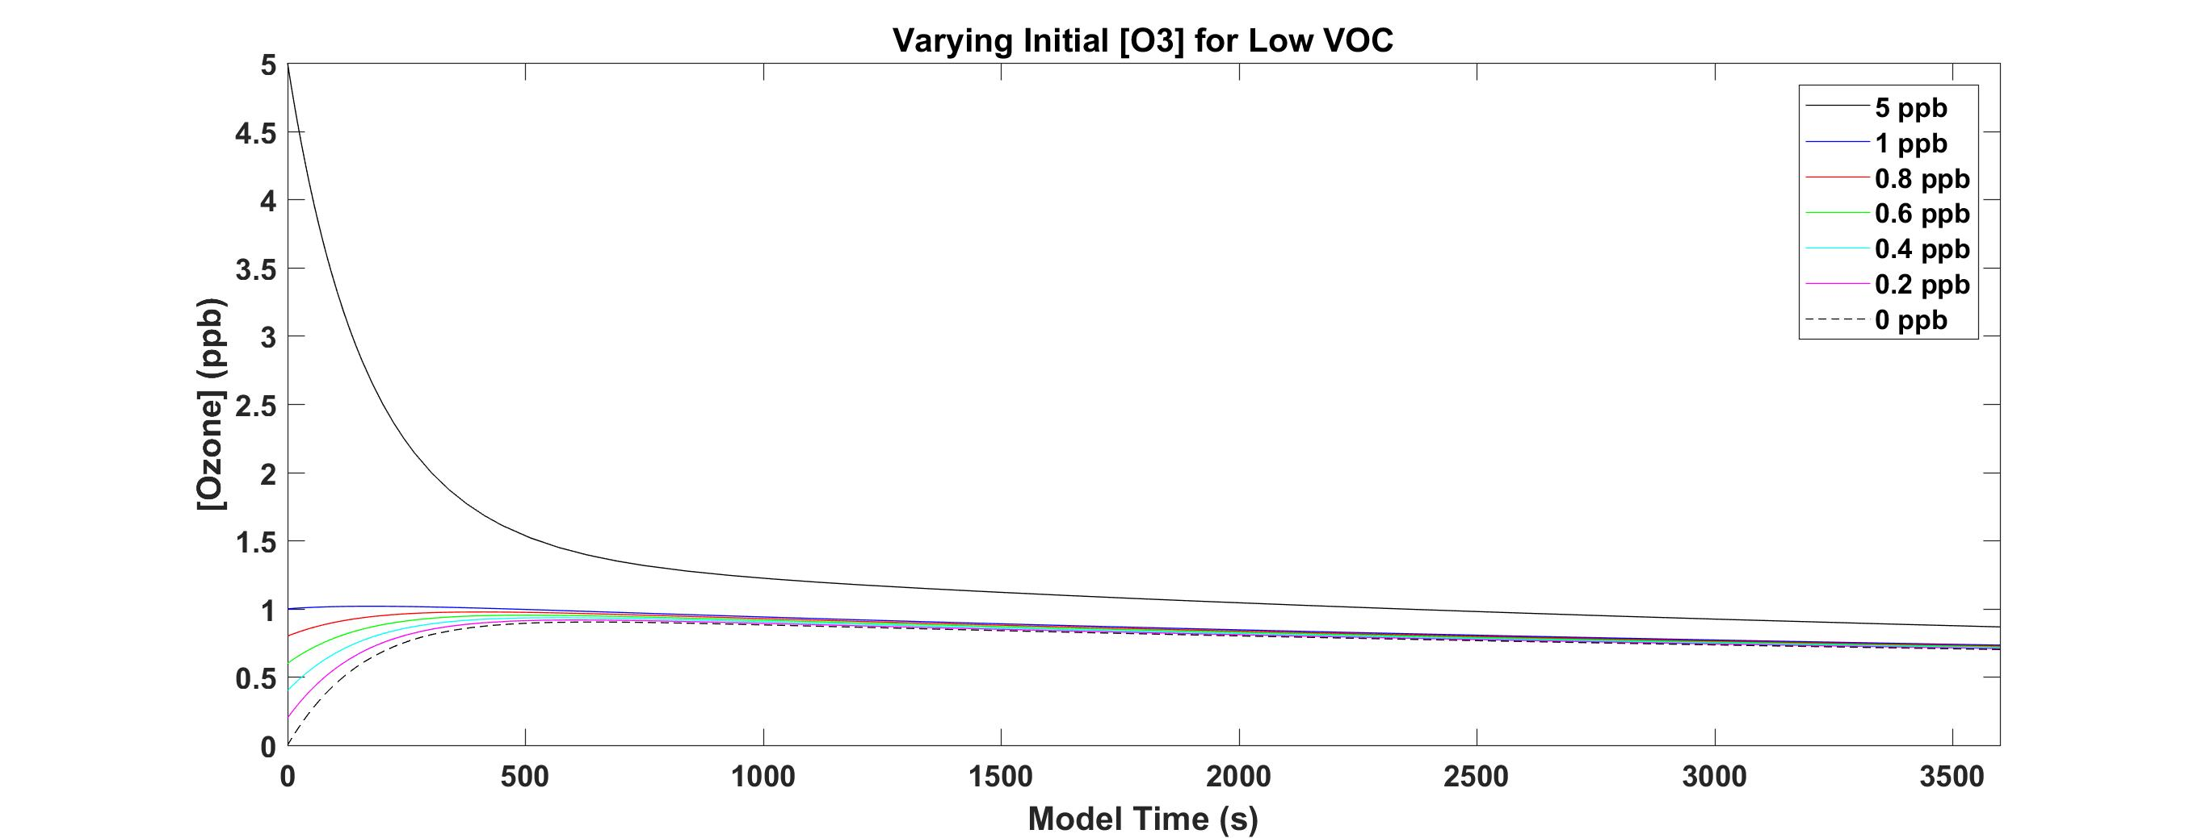
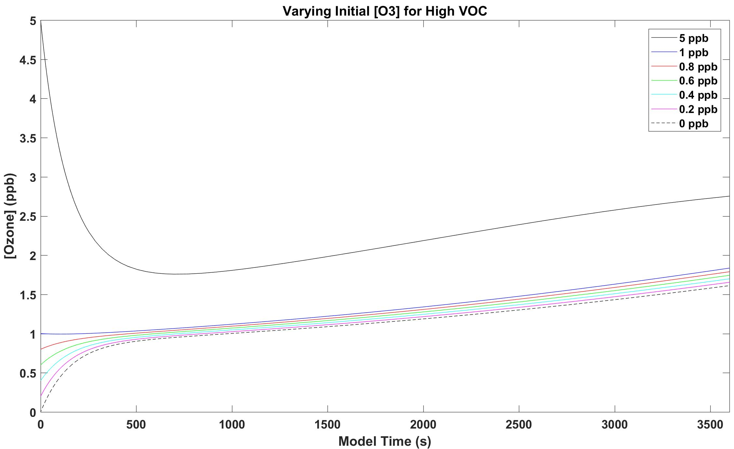
Varying Initial [O₃] at Indoor Sunlight
2 O₃ regimes observed: one where O₃ is initially produced and one where O₃ decays → Null Cycle Equilibria (NO₂/O₃)
For Low VOC, O₃ profiles decrease over time due to lack of RO₂ being produced; vice-versa for High VOC
-Note: We looked at plot rates and saw the RO₂ species were produced when O₃ started to increase for high VOC

Slide 14
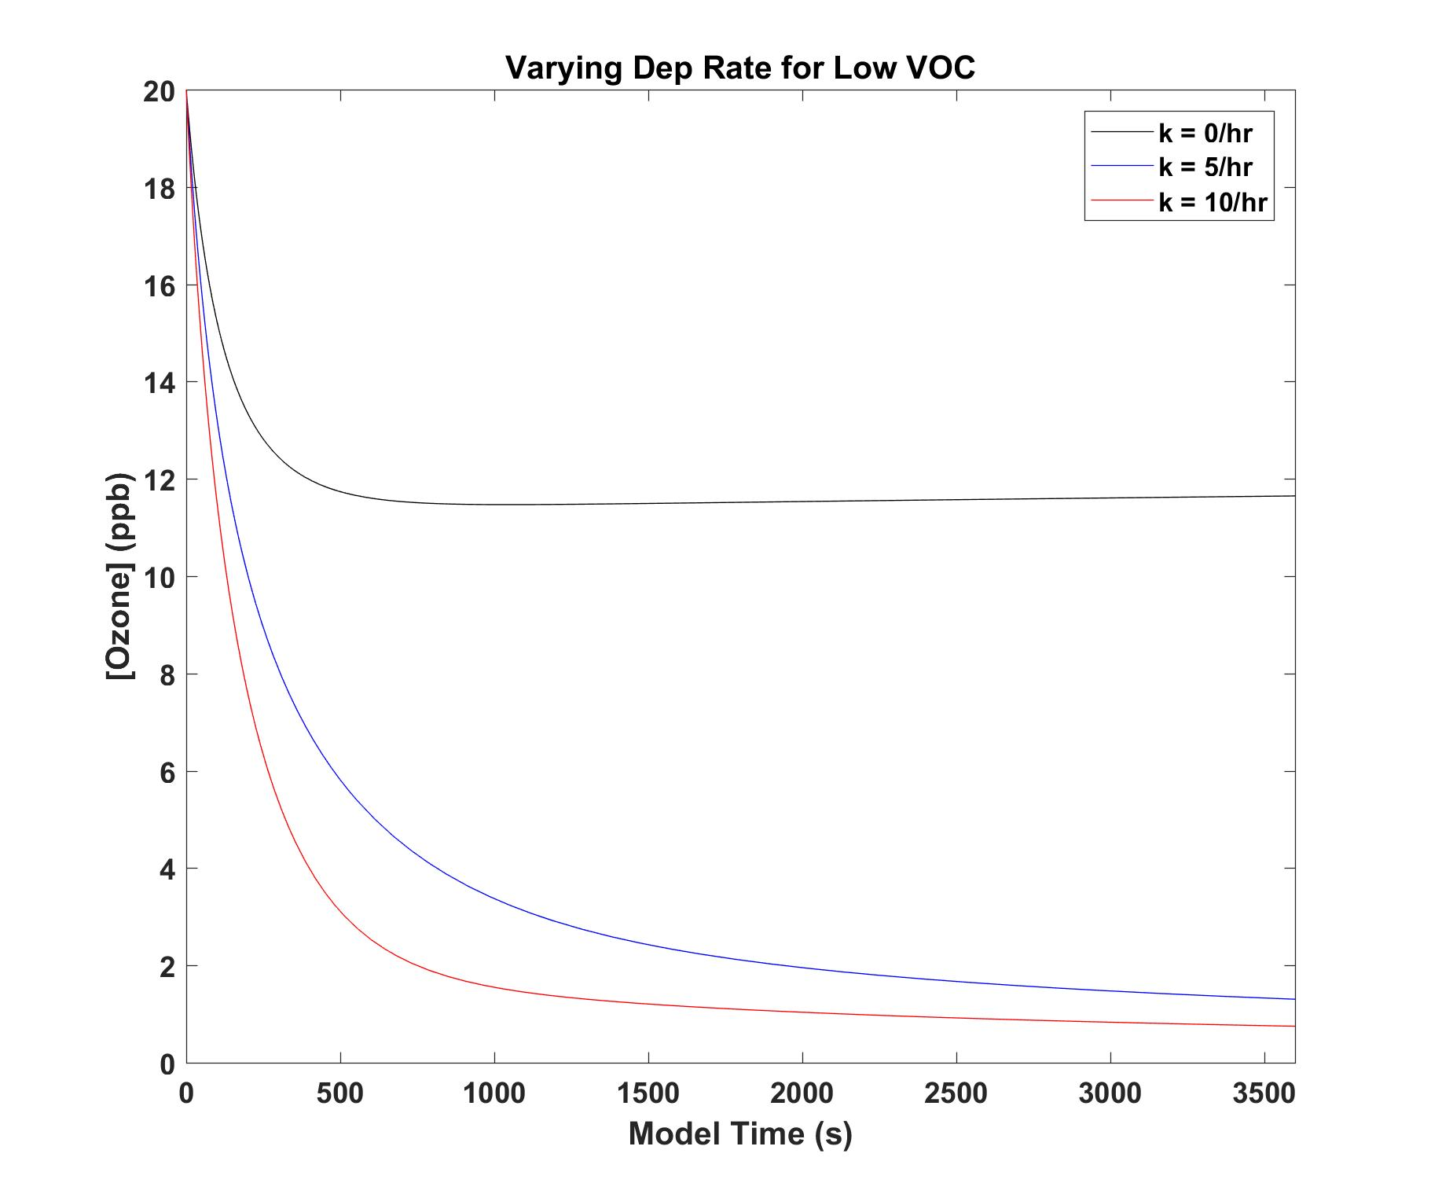
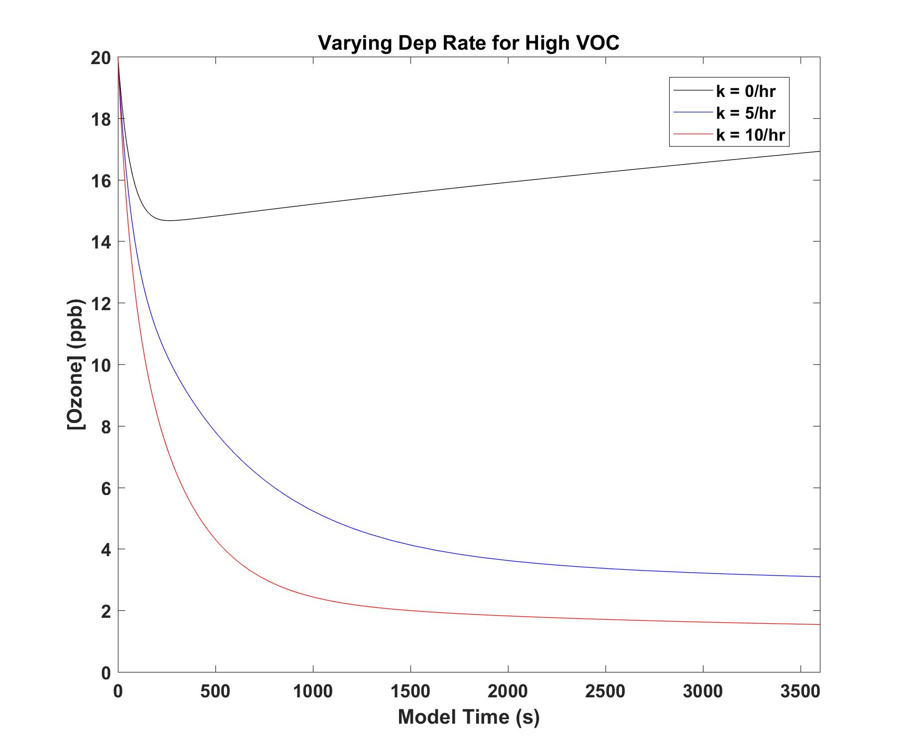
Varying Surface Deposition
Increasing surface deposition rate results in significant loss of O₃ (almost 100% loss over an hour) → strong sink!
High VOC case without surface deposition shows a small decrease due to NO + O₃; increase again due to RO₂

Slide 15
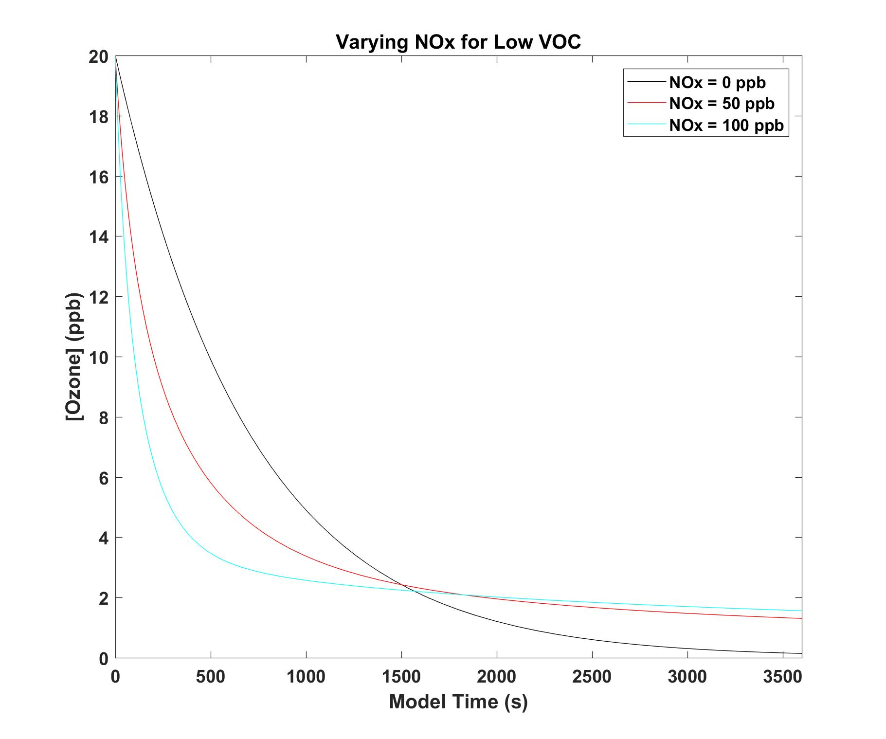
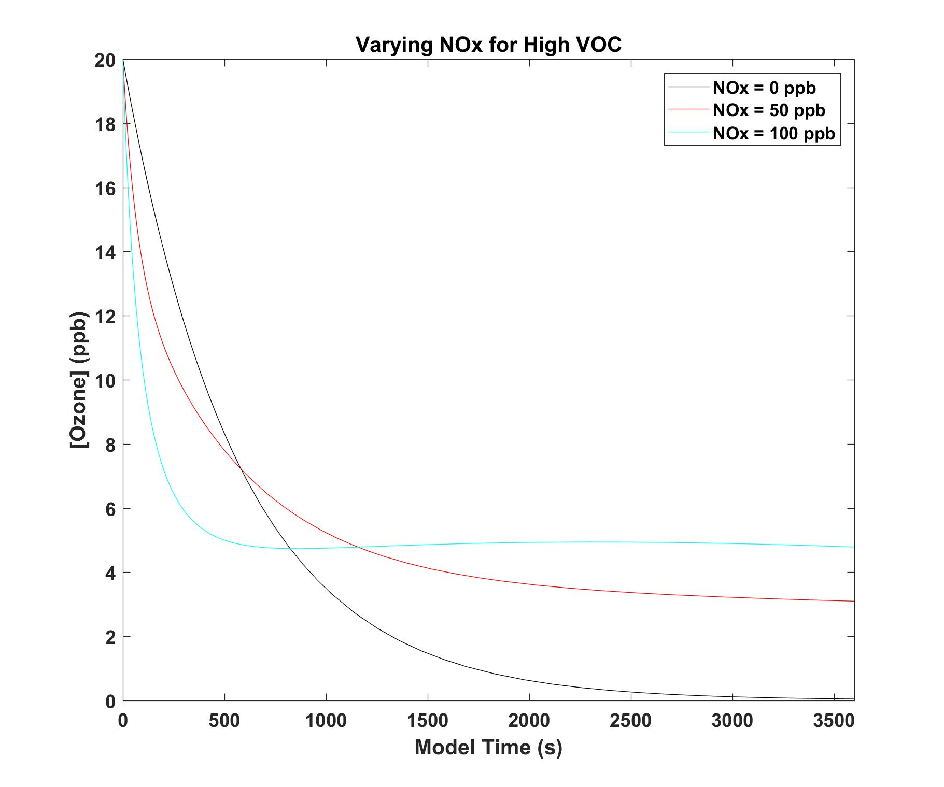
Varying [NO_{x}]
At NO_{x} = 0 ppb for both VOC regimes, loss of O₃ is completely dominated by surface deposition
For Low VOC (VOC limited): <1500 s, O₃ decreases fast due to NO + O₃; >1500s, slower removal due to NO_{x} cycling
For High VOC (NO_{x} limited): O₃ is more sensitive to NO_{x} → 50 + 100 ppb NO_{x} cases show larger differences compared to low VOC; however, there is always a decrease in O₃ independent of NO_{x} mixing ratios

Slide 16
Base Case Model Run Example (Low VOC) : Revisited
1) Low photon fluxes <390 nm → less NO₂ photolysis → less VOC/NO_{x}/O₃ cycling
2) High (~20 ppb) O₃ mixing ratio leads to a sharp decrease due to null cycle equilibria and lack of RO₂
3) Modest deposition rate (5/hr) is strong enough to cause O₃ to sharply decrease and doesn’t go to 0 due to null cycle equilibria
4) NO_{X} mixing ratios result in a non zero ozone mixing ratio

Slide 17
Conclusions/Future Directions
1) Photochemistry appears to be relatively weak indoors with respect to O₃ production
2) Surface Deposition Rates appear to be significant in O₃ removal and should be taken into account in all indoor air chemistry models (What about other species?? This is not currently known!!) → Surfaces extremely important!
3) Indoor Field Campaign: Measure VOCs + HCHO/CHOCHO → F0AM → Constrain/Compare
4) Measurement of Deposition and Resuspension Rates of Indoor VOCs/Inorganics

