Slide 1
Intelligent Adaptive RRT* Path Planning Algorithm for Mobile Robots
Abubakar Siddiq | 120403422
Gayatri Davuluri | 120304866
Santhosh Reddy | 120405570
GROUP - 22

Slide 2
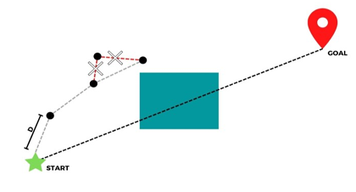
RRT*N explained..
RRT*N : optimizes the processing time to find the optimal path
Helps to concentrate more around the path instead areas that are far away from path.
The main change was changing the nodes from random generation to normally distributed generation around the line from the start to the goal.
These points are distributed within a certain standard deviation from Normal line.

Slide 3
Fuzzy Adaptive –RRT*N
FA-RRT*N : Fuzzy logic and probabilistic distribution to enhance path planning efficiency and quality.
Fuzzy logic : Establishes a Mathematical connection between human yes or no (0 or 1)
Fuzzification: Real-world input is translated into linguistic terms
Defuzzification: The fuzzy outputs are combined and converted into a crisp value for action.
Rules: Fuzzy logic uses a set of IF-THEN rules
To control the randomly generated nodes

Slide 4
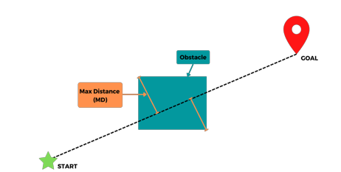
Fuzzy Adaptive - RRT*N
Problem with RRT*N is setting up a correct SD in different environments.
Maximum distance from line to edges of the largest obstacle is calculated from both sides and largest of both it is fed as input to intelligent fuzzy inference system(FIS )

Slide 5
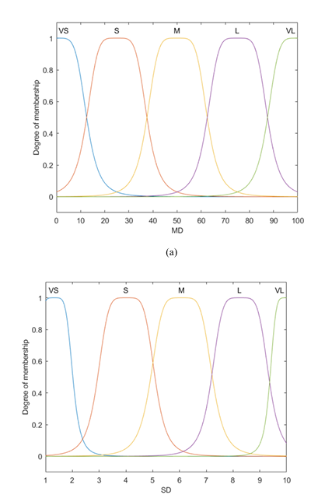
Membership Function and Rules
Both the input (MD) and output(SD) had five membership functions labelled very small (VS), small (S), medium (M), large (L) and very large (VL).
Rule 1: IF the MD distance is very small, then the SD is very small.
Rule 2: IF the MD is small, then the SD is small.
Rule 3: IF the MD is medium, then the SD is medium.
Rule 4: IF the MD is large, then the SD is large.
Rule 5: IF the MD is very large , then the SD is very large.

Slide 6
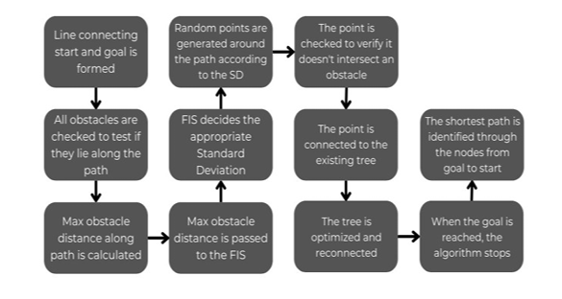
FA-RRT*N Flow chart

Slide 7
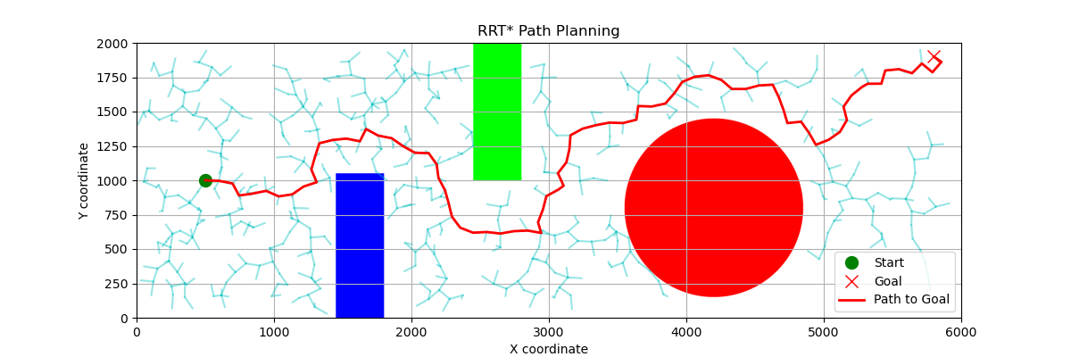
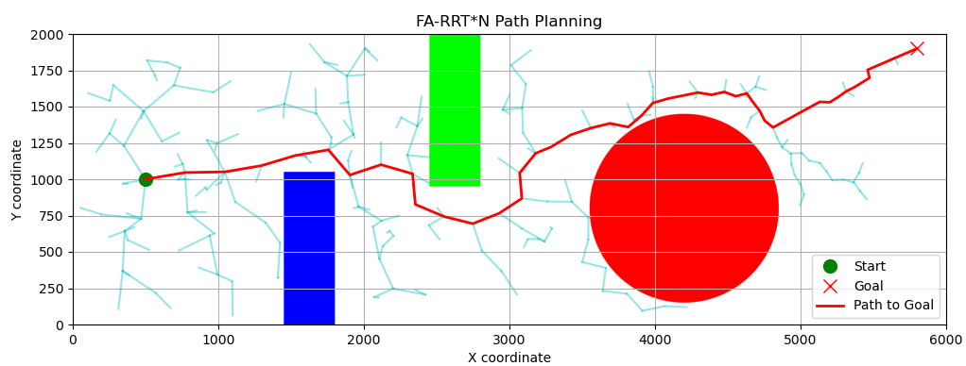
Results:

Slide 8
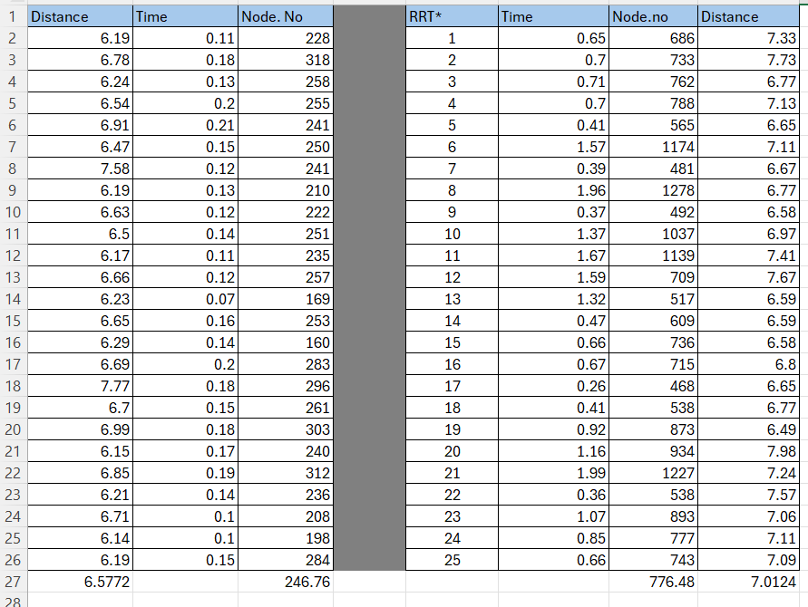
Data collected over 25 runs of same start and goal on the two algorithms

Slide 9
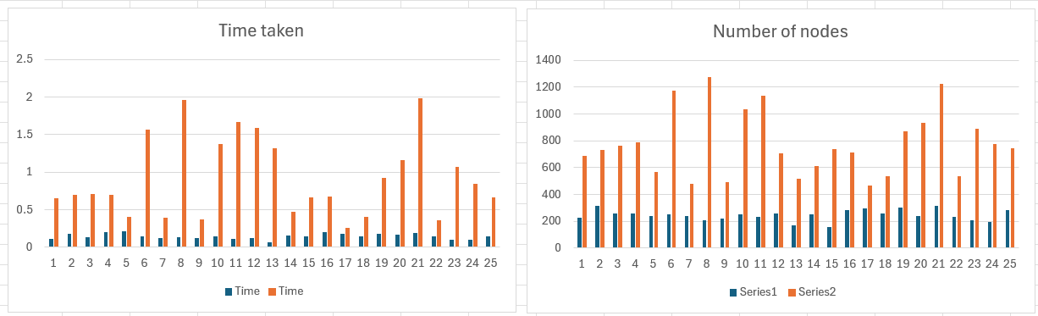
Time taken and Number of Nodes distribution over the runs in a histogram
FA-RRT*N
RRT*

Slide 10
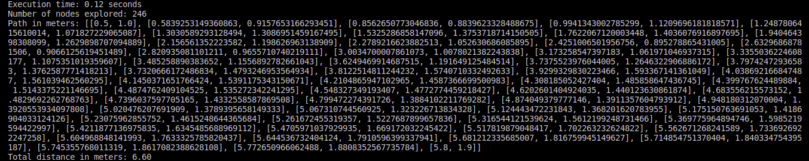
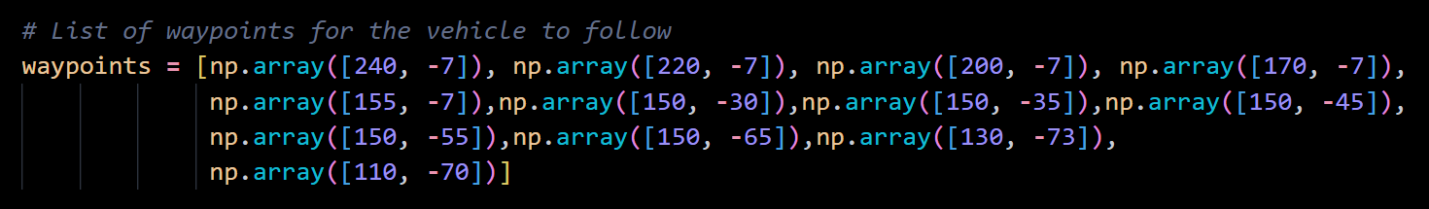
FA-RRT*N
CARLA
The algorithm will output a set of WAYPOINTS which can be fed into the script that is written to control the vehicle in the CARLA simulator to move from one waypoint to another.
FA-RRT*N Output
CARLA script Input

Slide 11

Implementation https://youtu.be/uBteTbpqdzo

Slide 12
Future Work
Extract the CARLA town map dimensions from “Point Cloud” into 2D binary map to be fed directly into the path planning algorithm
Creating a Customized map in CARLA and feed the same 2d binary map into the path planning algorithm.
Refine the control system of the vehicle.

