Slide 1
Clubs
Diamonds
Hearts
Spades
Sample Space

Slide 2
Spades’
Spades

Slide 3
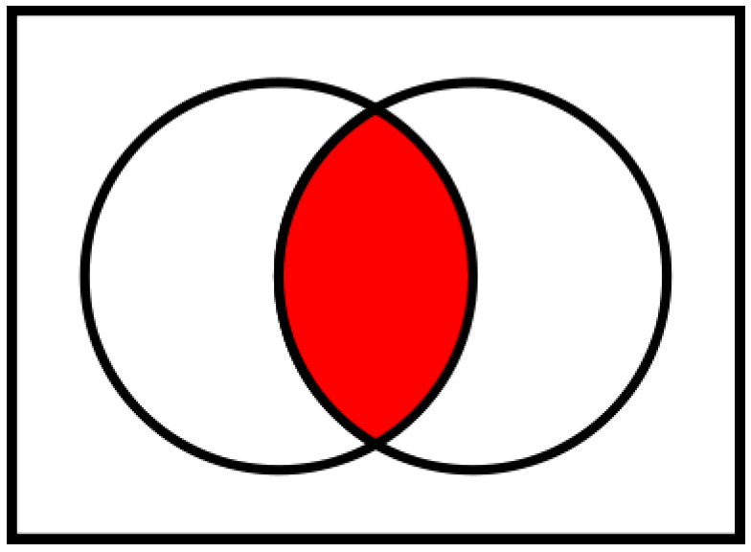
U
A
B
x
Intersect
A∩B = x
A∪B = n(A) + n(B) - x

Slide 4
U
A
B
Disjoint
A∩B = ∅
A∪B = n(A) + n(B)

Slide 5
U
A
B
Subset
B⊆A
A∩B = B
A∪B = A

Slide 6
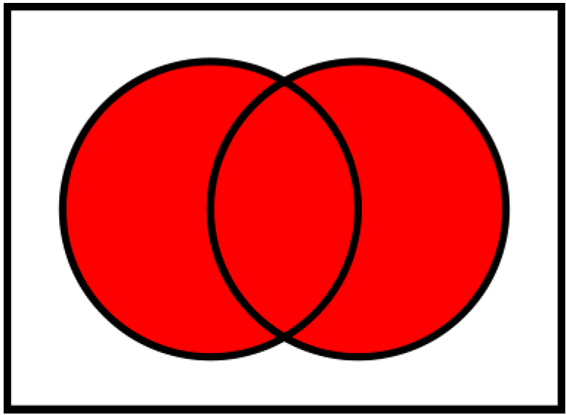
U
A
B
Union
A∪B

Slide 7
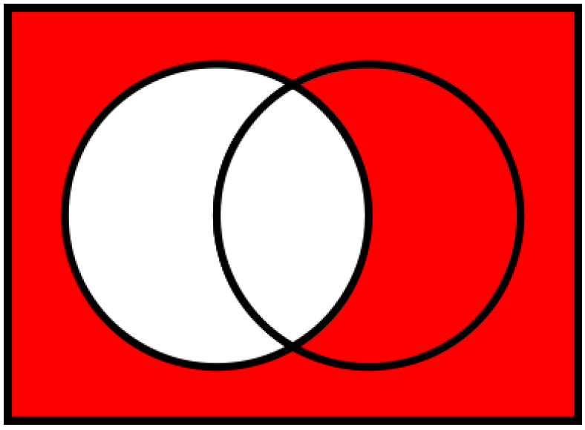
U
A^{c}
A
Complement
A^{c} = U\A

Slide 8
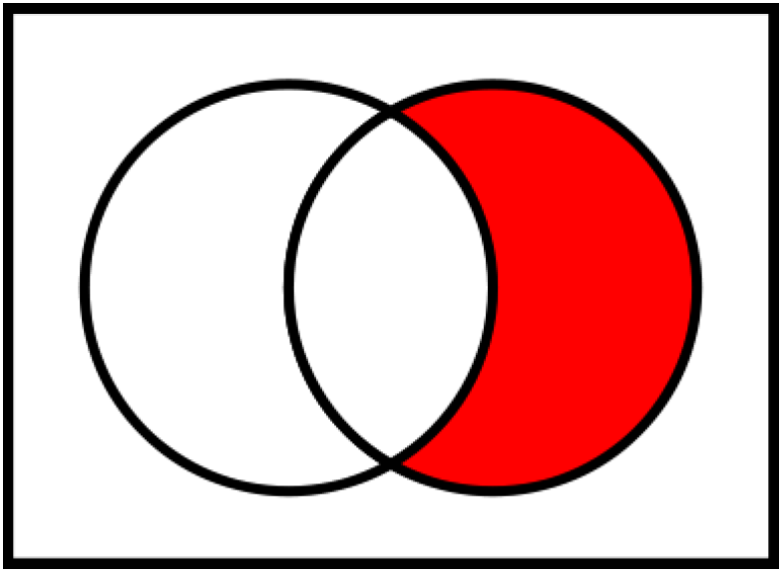
U
A
B
A^{c}∩B = B\A

Slide 9
U
A^{c}
A
Complement
A^{c} = U\A

Slide 10
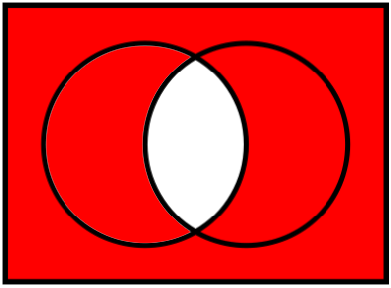
U
A
B
De Morgan’s Law (1): A∩B = A∪B
A’∪B’

Slide 11

U
A
B
De Morgan’s Law (2): A∪B = A∩B
A’∩B’

