Slide 1

Tensorflow Part 1: Intro and Installation problem solving CMB team

Slide 2
Outline for Part 1
Historical aspects and basic components of Tensorflow
Deep learning libraries comparison
Tensorflow installation

Slide 3

History of Machine Learning and Deep Learning libraries
Google
Facebook
NVIDIA
UC Berkeley
Ex-Google
NVIDIA
Facebook
Twitter
University of Montreal
(Yoshua Bengio)
NVIDIA

Slide 4
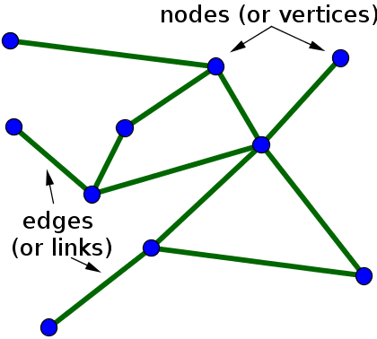
Computational graph
Nodes: Operations
Edges: Data (Tensors, that flow = Tensorflow!)

Slide 5
Computational graph
Sum
Logistic regression
Nodes: Operations
Edges: Data (Tensors, that flow = Tensorflow!)

Slide 6
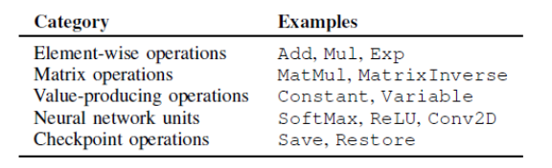
Computational graph
Sum
Logistic regression
Nodes: Operations
Edges: Data (Tensors, that flow = Tensorflow!)

Slide 7
Components of a Tensorflow computational or dataflow graph
1. Operations
2. Data
3. Variables
4. Sessions

Slide 8
Components of a Tensorflow computational or dataflow graph: Variables

Slide 9
Components of a Tensorflow computational or dataflow graph: Sessions

Slide 10
Which Deep Learning library should you learn and use?

Slide 11
Which Deep Learning library should you learn and use?

Slide 12
Installing Tensorflow

Slide 13
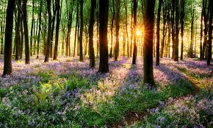
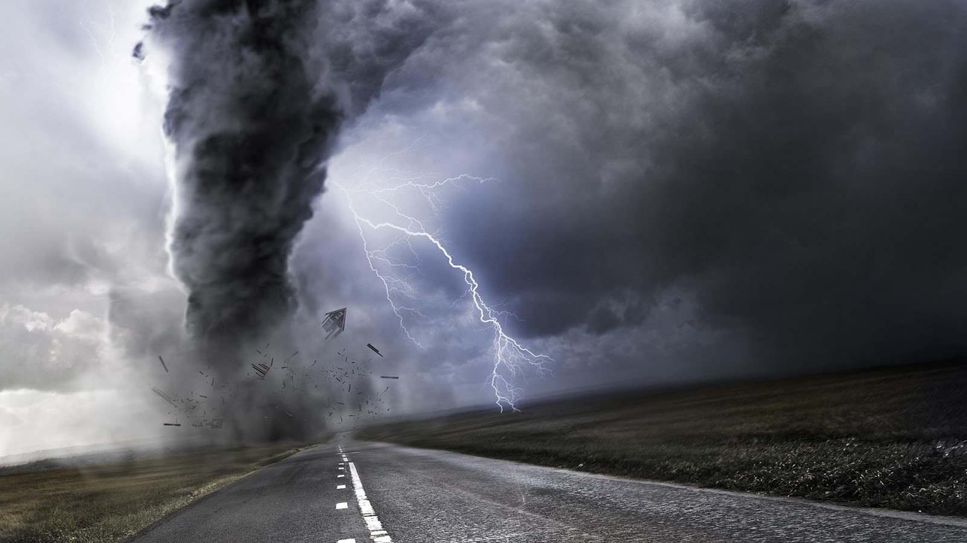
Installing Tensorflow
VS.

Slide 14
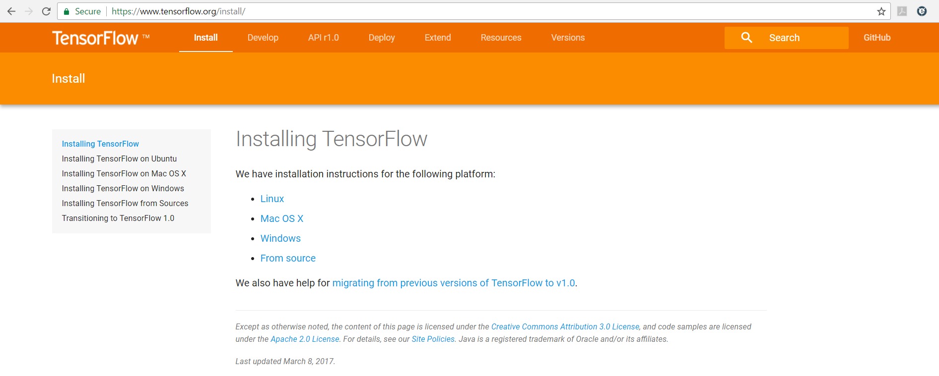

Slide 15
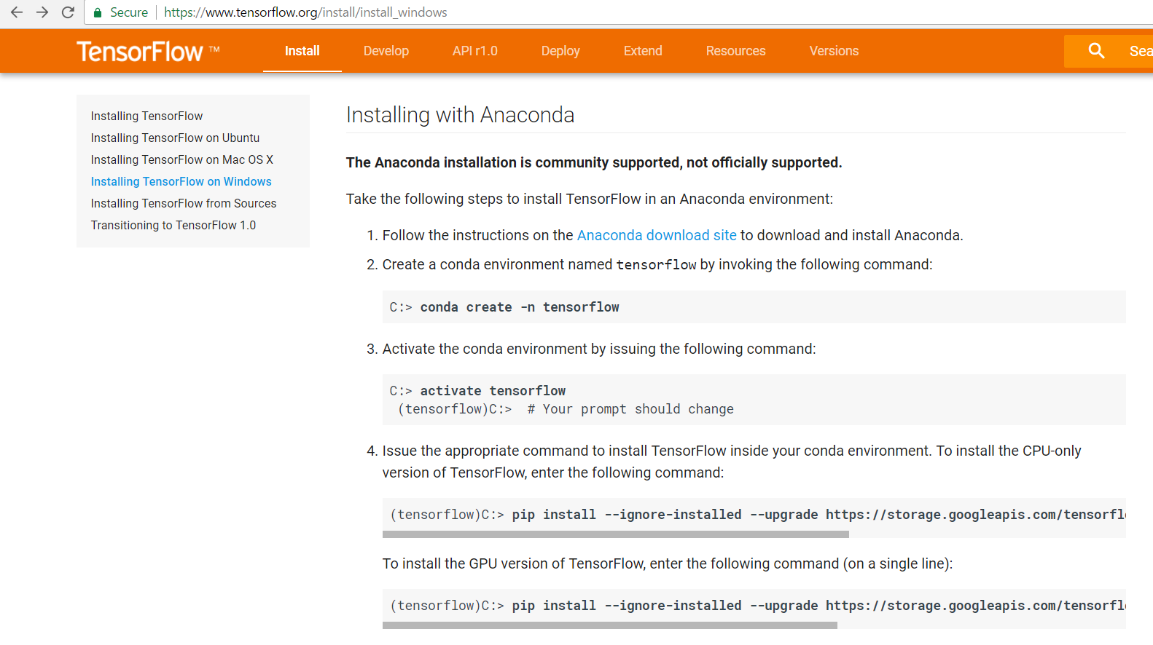

Slide 16

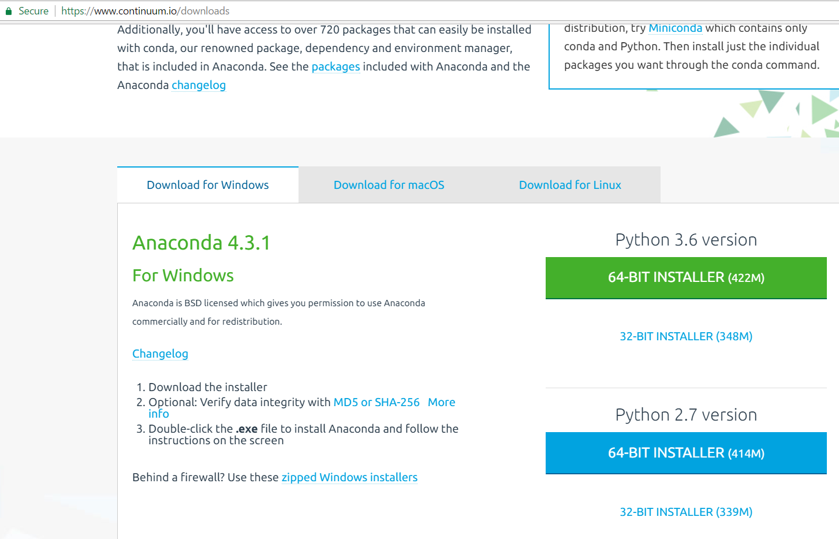

Slide 17
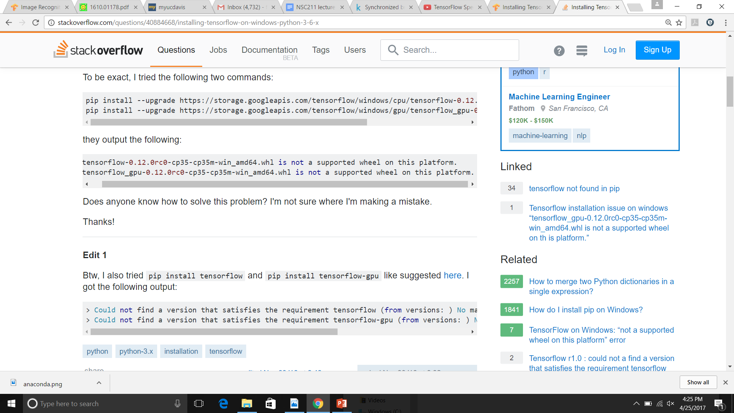
Error message:
http://chris35wills.github.io/conda_python_version/

Slide 18
Error message:
What can you do?
http://chris35wills.github.io/conda_python_version/

Slide 19
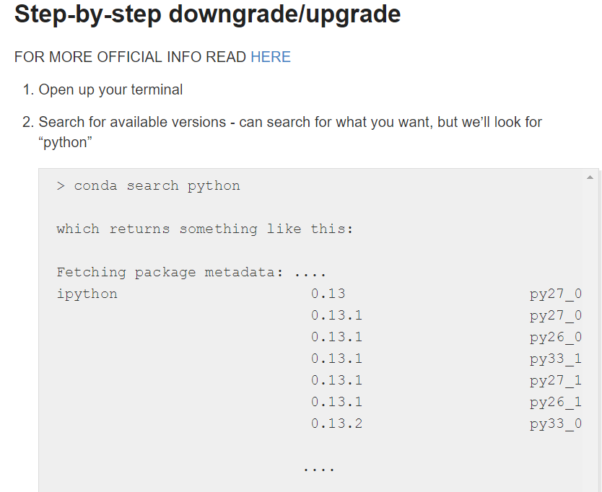
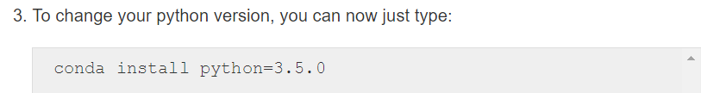
Error message:
What can you do?
http://chris35wills.github.io/conda_python_version/

Slide 20
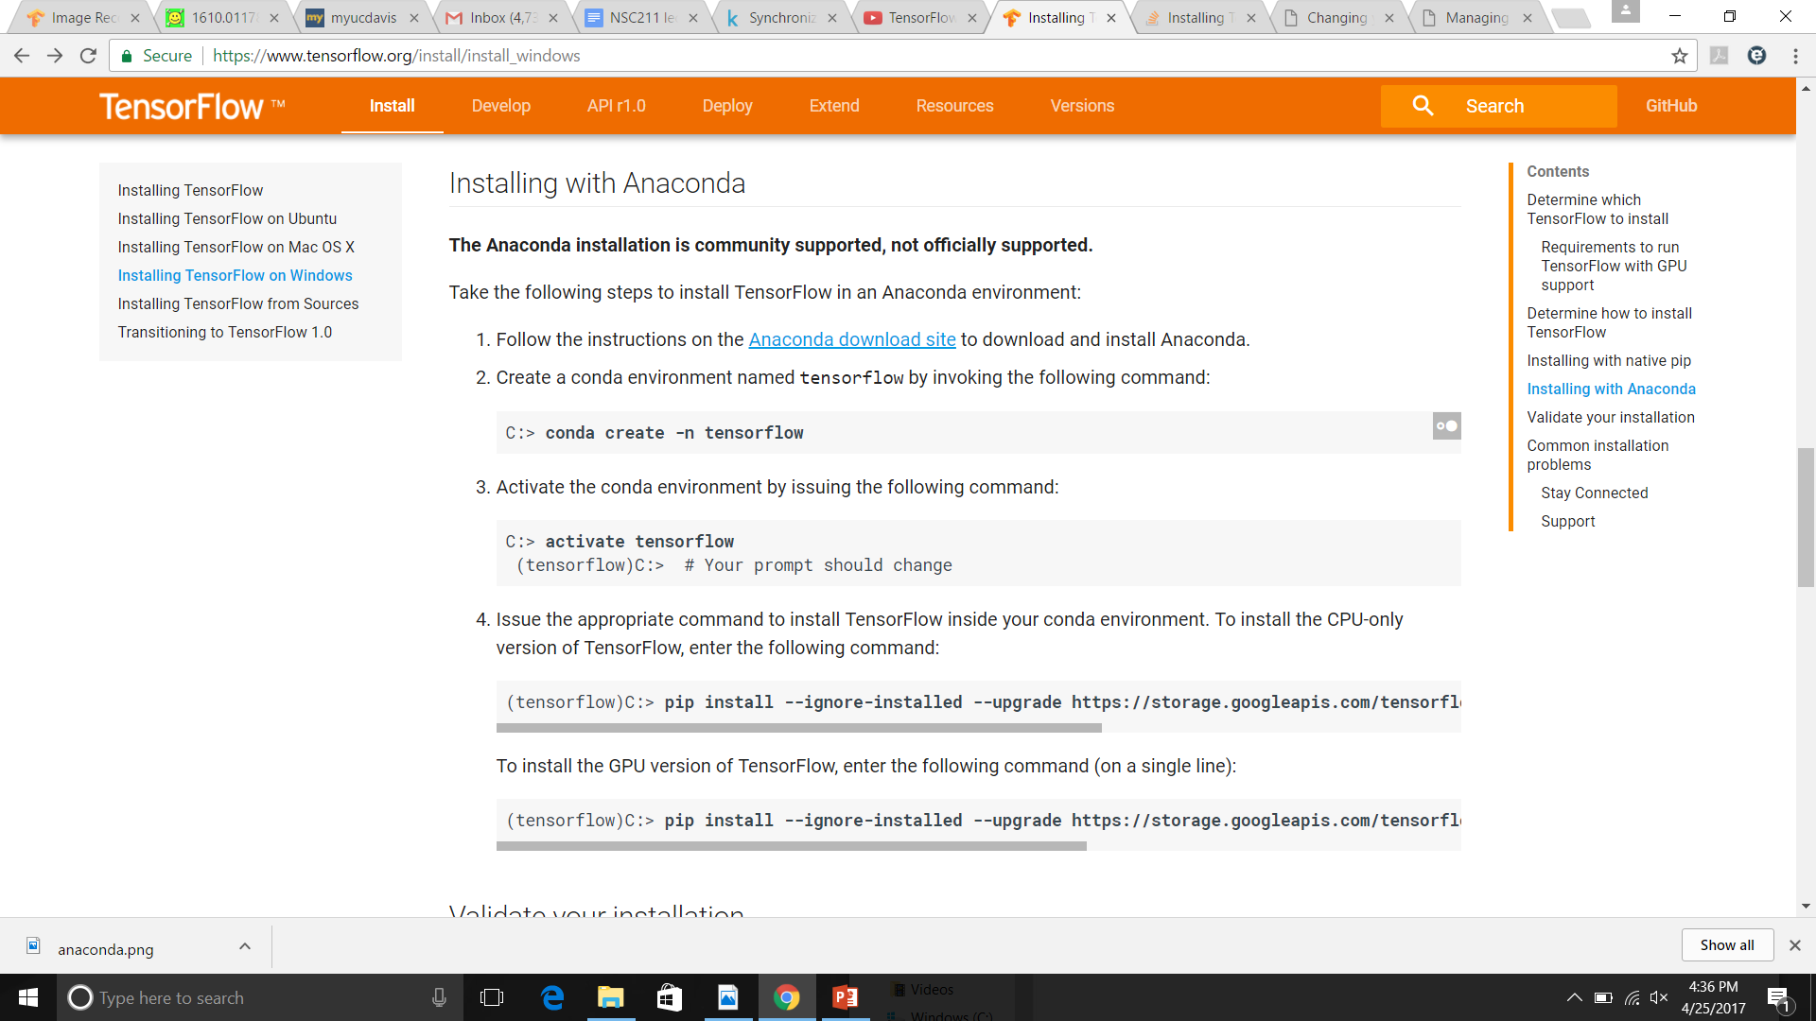

Slide 21
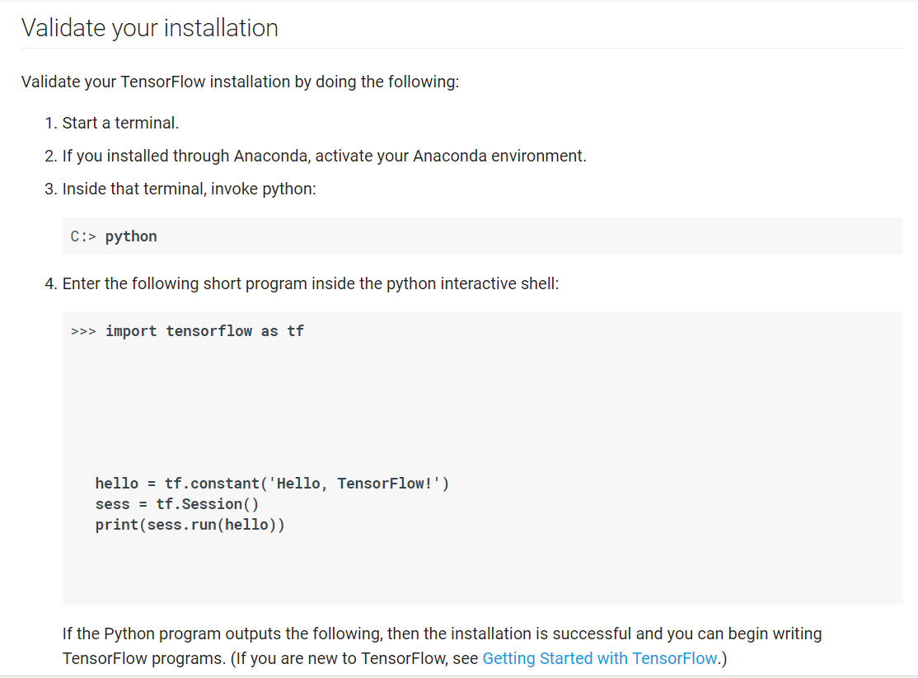

Slide 22


