Slide 1
Open Stanford Policing Project:
An Analysis of Police Officer Stop Data
Team Members: J.D. Strode, Vaidehee Shah, Peter Sparks & Melissa Mongrella

Slide 2
Questions We Aim To Answer
Motivation
To understand the nuances of traffic stops in the city and identify racial bias in traffic stops
Traffic stops are the most common interaction people have with law enforcement
What data will we be analyzing?
The Stanford Open Policing Project
Dataset of over 60 million state patrol stops between 2011 and 2015 in 20 U.S. states
Chicago Specific Data
Total N = 846,455
1) What are the general demographics of people who get pulled over?
2) What area of Chicago do the most stops occur?
3) What are the most common time points for a stop to occur?
4) How does the race and gender of the police officer affect the race and gender of the person getting stopped?

Slide 3
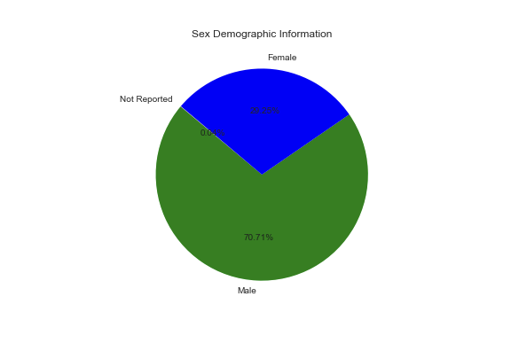
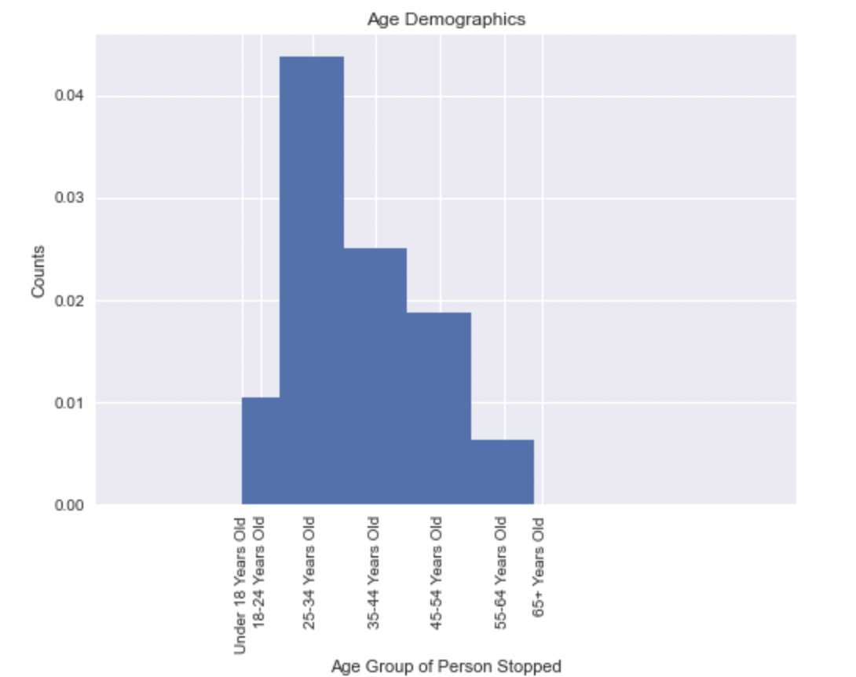
Sample Sex and Age
Notes:
Sex is the most consistently reported demographic (few missing values)

Slide 4
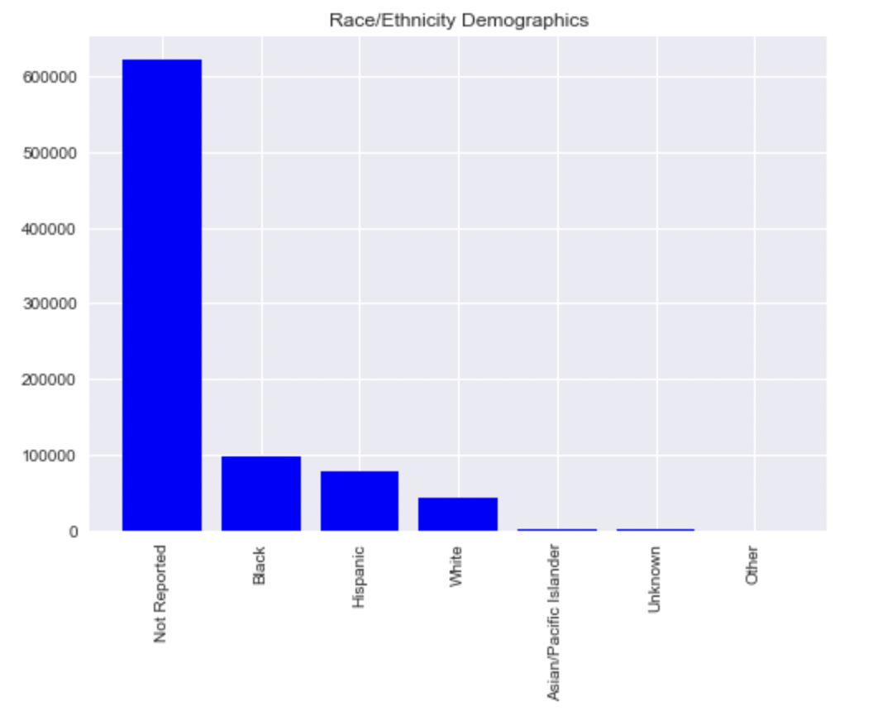
Sample Race/Ethnicity
Additional Source: Census.gov: https://www.census.gov/quickfacts/chicagocityillinois
Notes:
Overwhelming missing values for Race/ethnicity means we need to ensure the integrity of the data being collected. In a perfect world - perhaps audits for officer reports can occur to ensure they’re collecting all information.
Regardless of the missing information, the demographics presented does not reflect the demographics of Chicago. According to Census.gov population estimates, the population of Chicago is approximately, 33% Non-hispanic white, 29% Black, and 29% Hispanic/Latinx.

Slide 5
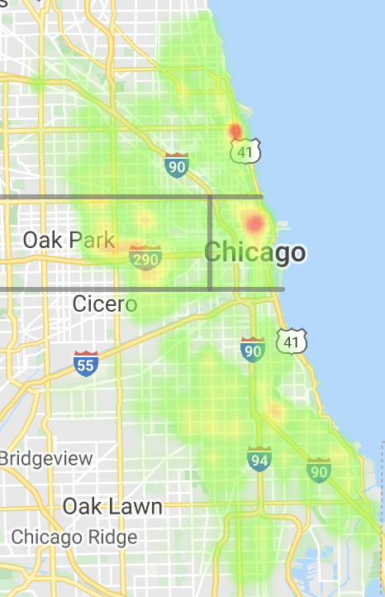
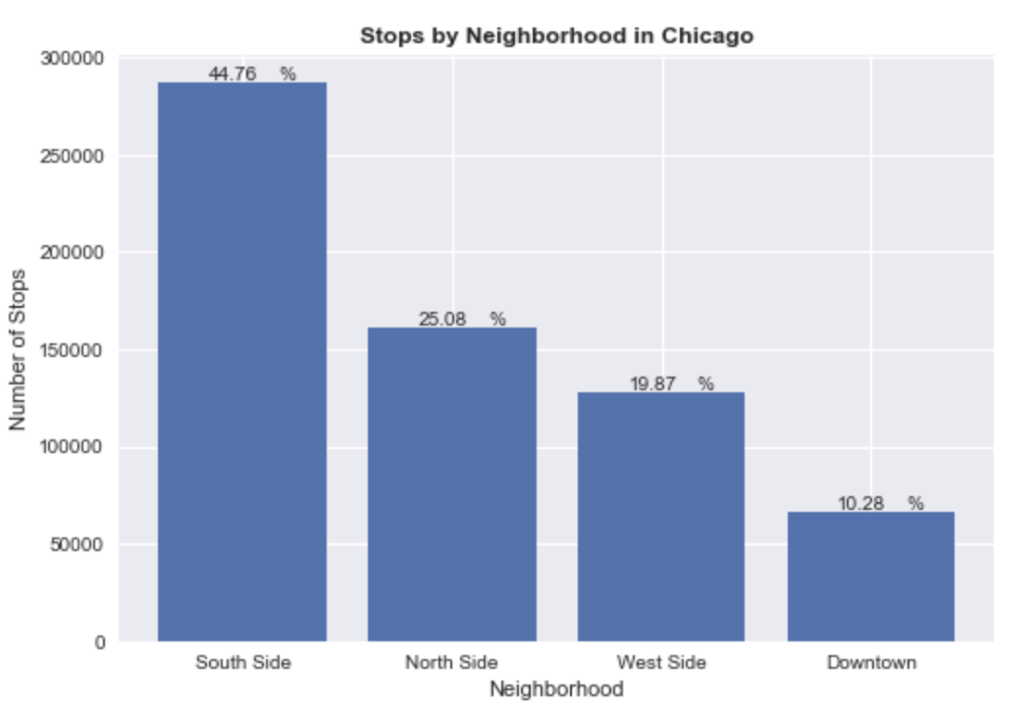
Where do Stops Occur?

Slide 6
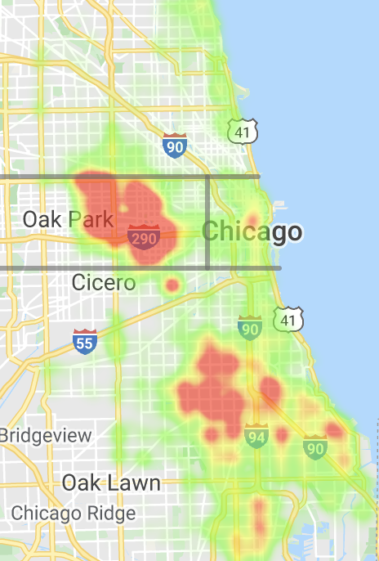
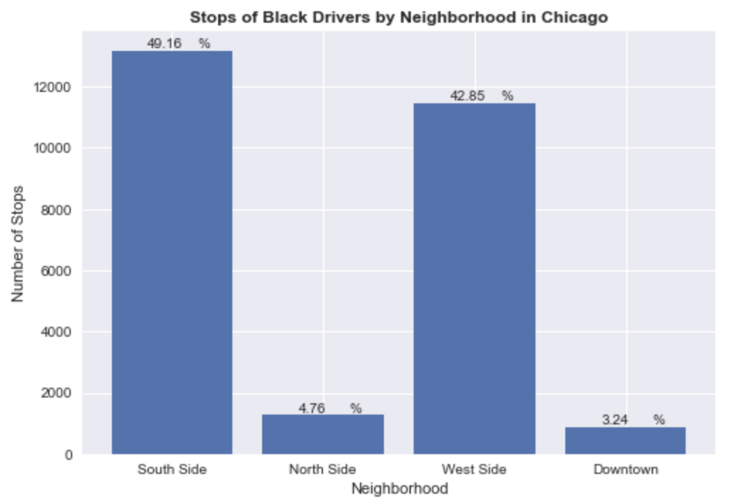
Stops of Black Drivers

Slide 7
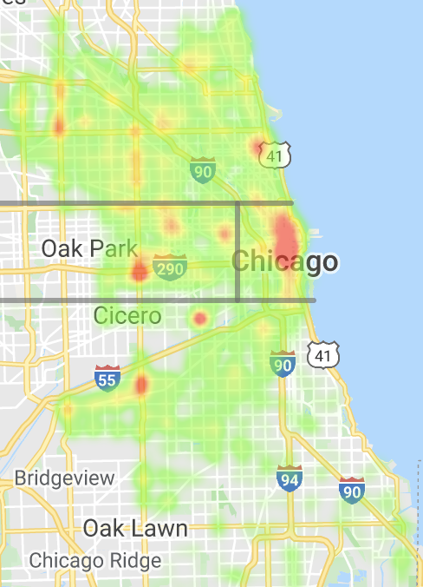
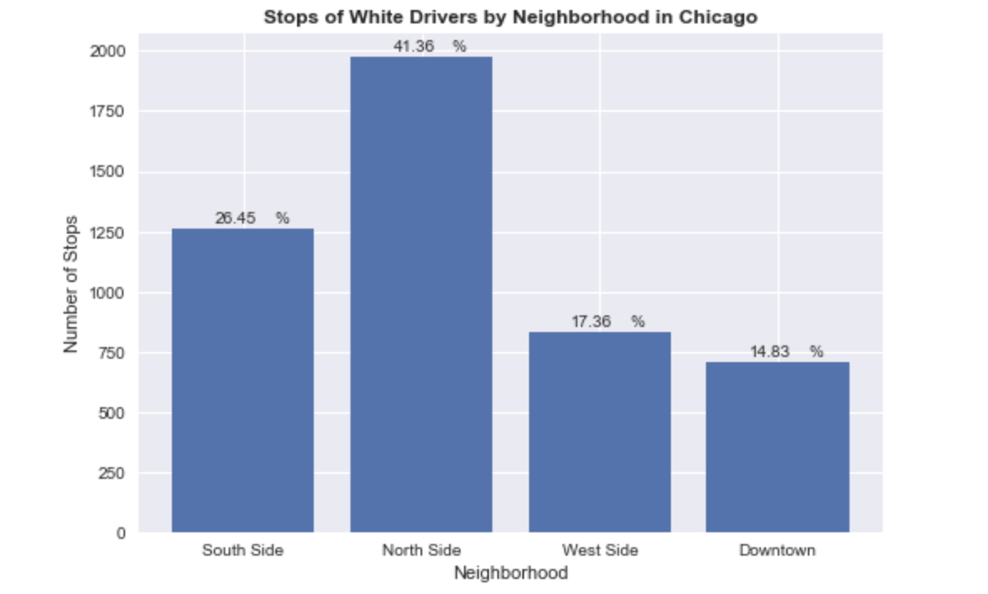
Stops of White Drivers

Slide 8
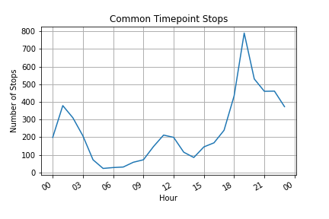
Common Timepoint Spots
Q: What are the most common time points for police stops?
A: Stop rate significantly increases throughout the night and drops into the early morning hours. 7 PM (19:00) has the greatest number of stops.

Slide 9
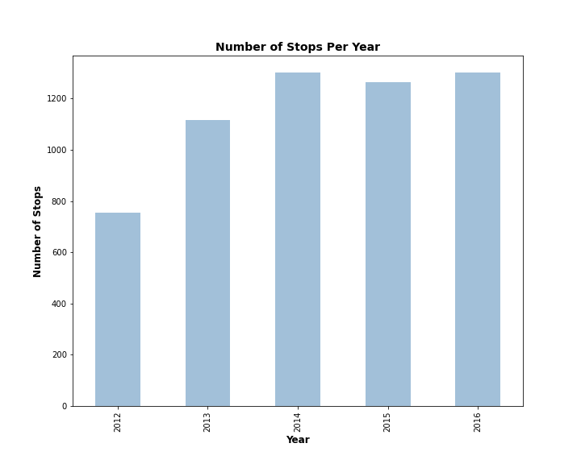
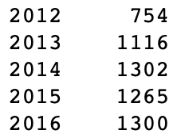
Yearly Analysis

Slide 10
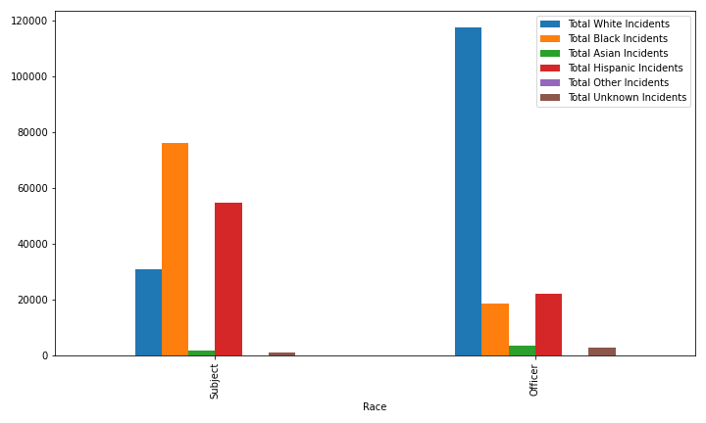
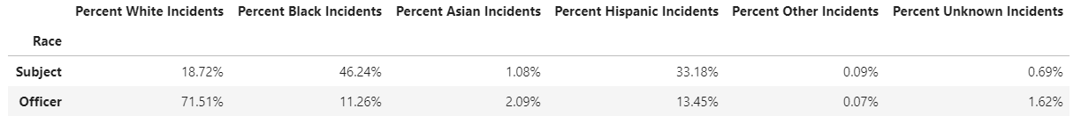
What role does race play in traffic incidents?
Incident Count by Race
Q: By count, is any race significantly overrepresented by officer or subject?
A: White officers represent over half the entire police force, while black & hispanic subjects are involved in over ⅔ of the incidents reported
*Note: 164,434 of 846,121 total data points were analyzed for incident trends relating to race.

Slide 11
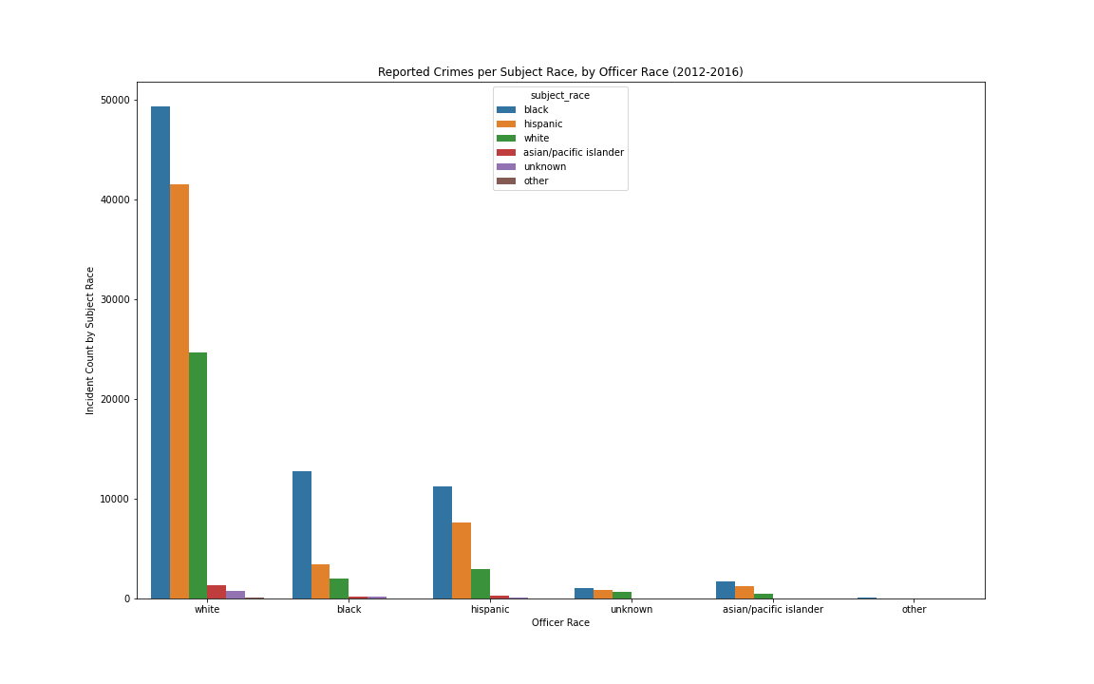
Reported Crimes per Subject Race, by Officer Race
*Note white officers represent a disproportionate share of total incidents as they represent a significantly larger portion of the police force reviewed in this analysis
Question: What role does Officer race play who is being stopped, if any?
Answer:
-White officers overwhelmingly stop more hispanic & black offenders (about half as many white as black offenders).
-Black officers overwhelmingly stop more black offenders.
-Hispanic officers stop significantly more black & hispanic offenders

Slide 12
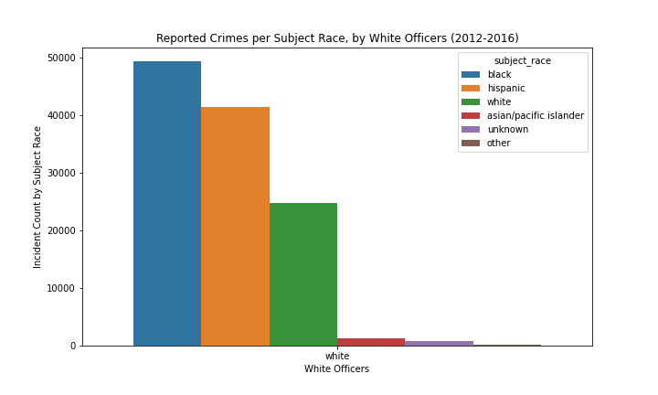
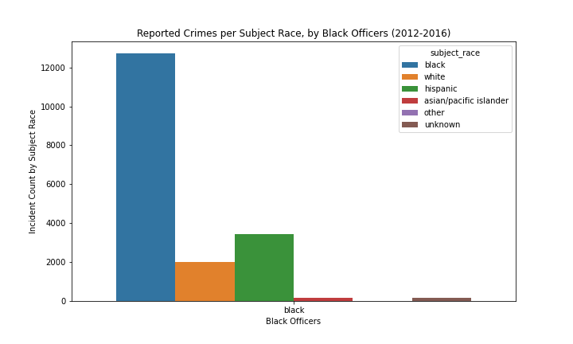
Deeper Dive: Analysis of White & Black Officer Related Incidents
Q: Is there a significant difference in the race of the offenders that each officers group (black & white) are involved in?
*Note the total # of incidents reported by each officer subset are substantially different.
Determination: The proportion of hispanic & white reported stops are substantially less for black officers than those of white officers..

Slide 13
Limitations:
This is an incomplete dataset, as it had many missing variables.
Reflective of the issues the Stanford Open Policing Report encountered
Filed public record requests with all 50 states, were able to collect data from 31 states, and 20 of those states provided enough detail to analyze racial disparities

