Slide 1
1
Calculus 1 · Week 1
Introduction and inequalities

Slide 2
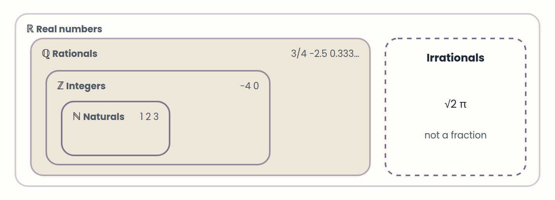
Lesson 1 · The real numbers and the number line
ℕ ⊂ ℤ ⊂ ℚ ⊂ ℝ, and the irrationals complete ℝ.
Think of it like this. Think of the number line as a long street where every address exists, even 2.5 and √2. "Less than" just means "further west".
Notes:
• ℕ ⊂ ℤ ⊂ ℚ ⊂ ℝ, and the irrationals complete ℝ.
• Every real number is one point on the line; left means smaller.
• |a − b| is the distance between a and b.
Calculus works with real numbers. They grow in layers: the natural numbers (1, 2, 3, …) count things; the integers add zero and the negatives; the rationals are every fraction p/q with q ≠ 0, such as 3/4 or −2.5; and the irrationals, such as √2 or π, fill the gaps that fractions leave. Rationals and irrationals together make the real numbers, ℝ.
Every real number is exactly one point on the number line, and every point is a real number. The line has an order: a < b means a is to the left of b. For any two numbers exactly one is true: a < b, a = b, or a > b. That simple fact is what makes inequalities possible.
The absolute value |a| is the distance from a to 0, so it is never negative: |−7| = 7 and |7| = 7. More generally, |a − b| is the distance between a and b. Keep this picture; it turns absolute value problems into questions about distance.

Slide 3
Lesson 2 · Equations, degree, and roots
Move everything to one side: P(x) = 0.
The degree is the highest power after simplifying.
Degree n means at most n real roots; check roots by substitution.
Think of it like this. An equation is a balance scale. Whatever you do to one pan, you do to the other, and the scale stays level.
Notes:
• Move everything to one side: P(x) = 0.
• The degree is the highest power after simplifying.
• Degree n means at most n real roots; check roots by substitution.
An equation states that two expressions are equal. When both sides are polynomials, you can move everything to one side and get P(x) = 0. The degree of the equation is the highest power of x left after simplifying: 4x³ − x + 2 = 0 has degree 3.
A root (or zero) is a value of x that makes the equation true. To check a candidate, substitute it: x = 2 is a root of x³ − 2x² + x − 2 = 0 because 8 − 8 + 2 − 2 = 0. An equation of degree n has at most n real roots, so a quadratic never has three.
Simplify before you judge the degree. x² + 3x = x² − 5 looks quadratic, but the x² terms cancel and it is really 3x + 5 = 0, a linear equation.

Slide 4
Lesson 3 · Linear and quadratic equations
Linear: one root, x = −b/a.
Quadratic: factor, isolate x², or use the formula.
Δ = b² − 4ac decides 2, 1, or 0 real roots; in word problems discard roots that make no sense.
Think of it like this. The discriminant is a weather forecast for roots: you learn whether to expect two, one, or none before you go out and compute.
Notes:
• Linear: one root, x = −b/a.
• Quadratic: factor, isolate x², or use the formula.
• Δ = b² − 4ac decides 2, 1, or 0 real roots; in word problems discard roots that make no sense.
A linear equation ax + b = 0 (a ≠ 0) has exactly one root, x = −b/a. Most word problems become linear once you name the unknown. If a bike rental costs 6 plus 1.5 per hour and you paid 15, then 6 + 1.5h = 15, so h = 6 hours.
A quadratic ax² + bx + c = 0 can be solved three ways. If it factors, use the zero product rule: (x − 2)(x + 7) = 0 means x = 2 or x = −7. If there is no x term, isolate x²: x² = 49 gives x = ±7. Otherwise use the formula x = (−b ± √(b² − 4ac)) / 2a.
The discriminant Δ = b² − 4ac tells you how many real roots to expect before you compute them: two if Δ > 0, one (repeated) if Δ = 0, none if Δ < 0. A garden that is 3 m longer than wide with area 40 m² gives w(w + 3) = 40, so w² + 3w − 40 = 0 = (w + 8)(w − 5); only w = 5 makes sense.

Slide 5
Lesson 4 · Higher-degree and special equations
Rational root candidates: ± (divisors of the constant) / (divisors of the leading coefficient).
Remainder 0 in synthetic division means you found a root.
After squaring or clearing denominators, check every answer.
Think of it like this. Synthetic division is like peeling an onion: each root you find removes one layer, until the core is a quadratic.
Notes:
• Rational root candidates: ± (divisors of the constant) / (divisors of the leading coefficient).
• Remainder 0 in synthetic division means you found a root.
• After squaring or clearing denominators, check every answer.
For a polynomial with integer coefficients, any rational root p/q has p dividing the constant term and q dividing the leading coefficient. That gives a short list of candidates. For x³ − 2x² − 5x + 6 = 0 the candidates are ±1, ±2, ±3, ±6, and x = 1 works.
Once you know a root r, divide by (x − r) with synthetic division (Ruffini's rule). The quotient has one degree less, and you repeat until you reach a quadratic you can solve. Here the quotient is x² − x − 6 = (x − 3)(x + 2), so the roots are 1, 3, and −2.
Equations with a radical, an absolute value, or x in a denominator need one extra step: check every answer in the original equation. Squaring √(x + 7) = x − 5 gives x² − 11x + 18 = 0, so x = 9 or x = 2, but only x = 9 works; x = 2 is extraneous. And a value that makes a denominator zero is never a solution.

Slide 6
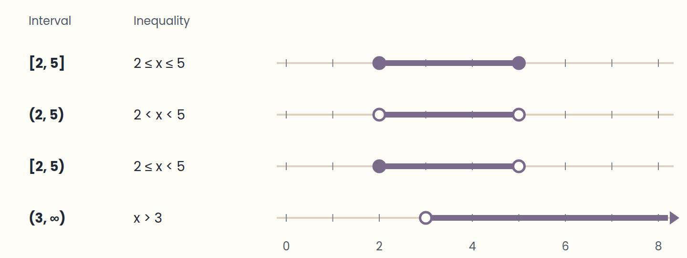
Lesson 5 · Inequalities and interval notation
[ ] includes the endpoint, ( ) excludes it; ∞ always takes ( ).
Think of it like this. A bracket is a closed door you can stand in; a parenthesis is a door you can walk up to but never step through.
Notes:
• [ ] includes the endpoint, ( ) excludes it; ∞ always takes ( ).
• Filled dot = included, hollow dot = excluded.
• "or" is a union ∪; "and" is an intersection ∩.
An inequality compares two expressions with <, ≤, >, or ≥. Its solution is usually not one number but a whole set of them, which we draw on the number line and write with intervals.
A square bracket includes the endpoint and a parenthesis excludes it: [2, 5] is 2 ≤ x ≤ 5, (2, 5) is 2 < x < 5, and [2, 5) is 2 ≤ x < 5. On the line, a filled dot means included and a hollow dot means excluded. Infinity is not a number you can reach, so it always gets a parenthesis: x ≥ 3 is [3, ∞).
Solutions in separate pieces are joined with the union symbol ∪: (−∞, −1) ∪ (4, ∞) means "x < −1 or x > 4". When two conditions must both hold, keep only their overlap, the intersection ∩. All real numbers is ℝ = (−∞, ∞), and no solution at all is the empty set ∅.

Slide 7
Lesson 6 · Properties and linear inequalities
Add, subtract, or multiply by a positive: the sign stays.
Multiply or divide by a negative: flip the sign.
Check one value from your answer in the original inequality.
Think of it like this. Multiplying by a negative number is like looking in a mirror: left and right swap, so "smaller" becomes "larger".
Notes:
• Add, subtract, or multiply by a positive: the sign stays.
• Multiply or divide by a negative: flip the sign.
• Check one value from your answer in the original inequality.
You solve a linear inequality almost like an equation. Adding or subtracting the same number on both sides keeps the inequality. Multiplying or dividing by a positive number keeps it too. The one new rule: multiplying or dividing by a negative number reverses the sign. From −2 < 3, multiplying by −1 gives 2 > −3.
Example: 4 − 3x ≤ 10. Subtract 4: −3x ≤ 6. Divide by −3 and flip: x ≥ −2, that is [−2, ∞). Check with x = 0: 4 ≤ 10 is true, and 0 is in the answer. A double inequality such as 1 ≤ 2x − 3 < 7 is solved on all three parts at once: 4 ≤ 2x < 10, so 2 ≤ x < 5.
Comparisons in daily life are inequalities. A gym charges 30 to join plus 2 per visit; another charges 5 per visit. The first is cheaper when 30 + 2v < 5v, that is 30 < 3v, so v > 10 visits.

Slide 8
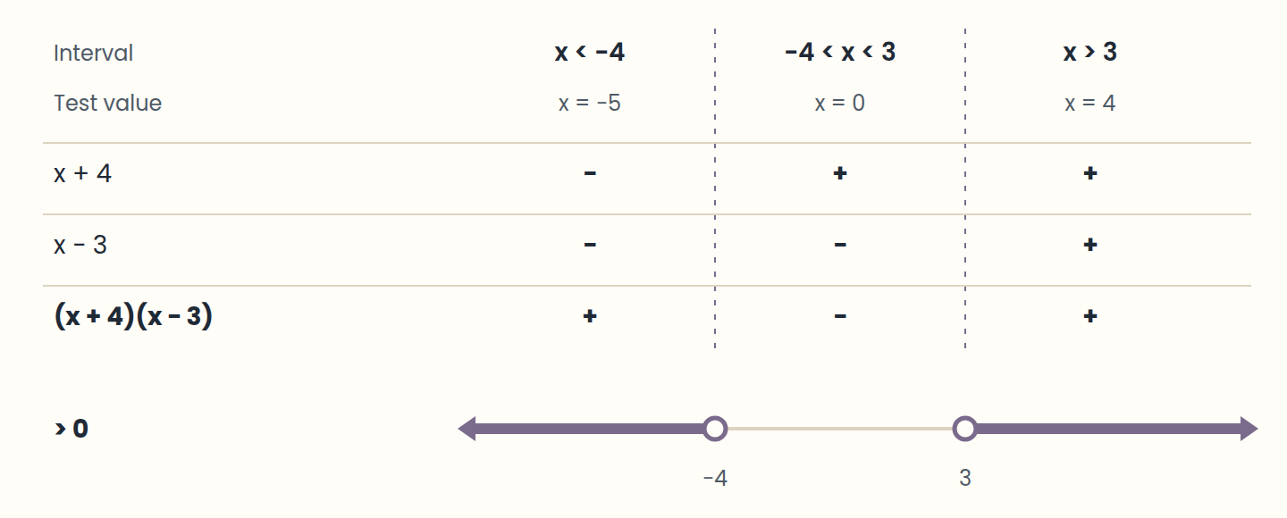
Lesson 7 · Polynomial and rational inequalities
Zero on one side, factor, find critical points, test one value per interval.
Think of it like this. Critical points are the traffic lights of the number line. Between two lights the colour cannot change, so you only need to look once per block.
Notes:
• Zero on one side, factor, find critical points, test one value per interval.
• ≤ or ≥ include the zeros of the numerator; < or > exclude them.
• Zeros of a denominator are always excluded.
For anything beyond linear, use a sign chart. Step 1: move everything to one side so the other side is 0. Step 2: factor. Step 3: find the critical points, where a factor is zero. Step 4: they split the line into intervals; on each one the expression keeps one sign, so one test value per interval is enough. Step 5: keep the intervals with the sign you need.
Example: x² + x − 12 > 0 factors as (x + 4)(x − 3) > 0. Critical points −4 and 3. Test −5: (−1)(−8) > 0 ✓. Test 0: (4)(−3) < 0 ✗. Test 4: (8)(1) > 0 ✓. The answer is (−∞, −4) ∪ (3, ∞), with open ends because the inequality is strict.
With fractions, never multiply both sides by an expression whose sign you do not know. Instead subtract to get 0 on one side and combine into one fraction. The zeros of the denominator are also critical points, and they are always excluded. For (x − 1)/(x + 2) ≤ 0 the answer is (−2, 1]: −2 is excluded even though the inequality has ≤.

Slide 9
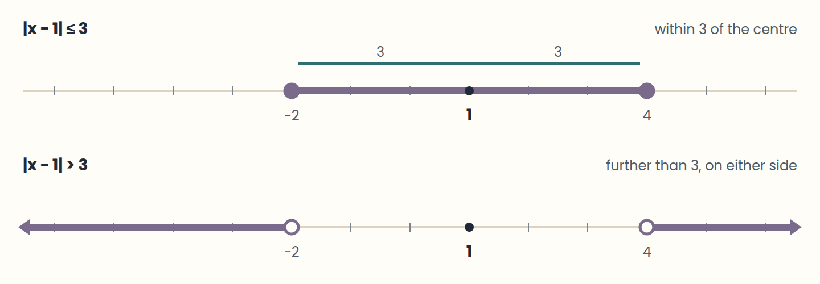
Lesson 8 · Absolute value and systems of inequalities
|x − a| < r → a − r < x < a + r (one interval).
Think of it like this. |x − a| < r is a dog on a leash of length r tied at a: it can be anywhere within r of the post, on either side.
Notes:
• |x − a| < r → a − r < x < a + r (one interval).
• |x − a| > r → x < a − r or x > a + r (a union).
• A system keeps the intersection of the solutions.
Read |x − a| as "the distance from x to a". Then |x − a| < r means x is closer than r to a: a − r < x < a + r, one interval. And |x − a| > r means x is further than r from a: x < a − r or x > a + r, two pieces. For |x − 1| ≤ 4: −3 ≤ x ≤ 5. For |x + 2| > 3, that is |x − (−2)| > 3: x < −5 or x > 1.
Tolerances are absolute value inequalities. A recipe needs 180 °C give or take 5 degrees: |T − 180| ≤ 5, so 175 ≤ T ≤ 185. When there is a number in front of x, divide at the end: |2x − 3| < 5 gives −5 < 2x − 3 < 5, so −1 < x < 4.
A system of inequalities asks for the values that satisfy all of them at once. Solve each one, draw them on the same line, and keep the overlap. For x + 1 > −2 and 3x ≤ 6, you get x > −3 and x ≤ 2, so (−3, 2]. If the pieces do not overlap, the system has no solution, ∅. With two variables, each inequality is a half-plane, and the solution is the region they share.

Slide 10
Step by step
Steps of a sign chart
1
2
3
4
5
Move everything to one side: x² + 2x − 3 > 0
Factor: (x + 3)(x − 1) > 0
Mark the critical points −3 and 1
Test −4, 0, and 2 in the factors
Keep the positive intervals: (−∞, −3) ∪ (1, ∞)
Notes:
Without 0 on one side the signs of the factors mean nothing, so that step always comes first.

Slide 11
Check yourself
1. Which set contains √7?
A) The integers ℤ B) The rationals ℚ C) The reals ℝ
2. What is the degree of x(x − 1) = x² + 4?
A) 2 B) 1 C) 0
3. How many real roots has 4x² − 4x + 1 = 0?
A) Two B) One (repeated) C) None
Answers are in the speaker notes.
Notes:
1. C — √7 is irrational: it is a real number but not a fraction.
2. B — x² − x = x² + 4 simplifies to −x − 4 = 0: degree 1.
3. B — Δ = 16 − 16 = 0. In fact 4x² − 4x + 1 = (2x − 1)², so x = 1/2.

Slide 12
Practise next
Labs
On the site
Equations warm-up
Linear inequalities and intervals
Sign charts
Absolute value, systems, and a model
Inequality Lab

