Slide 1
1
Databases 1 · Week 1
Database management systems

Slide 2
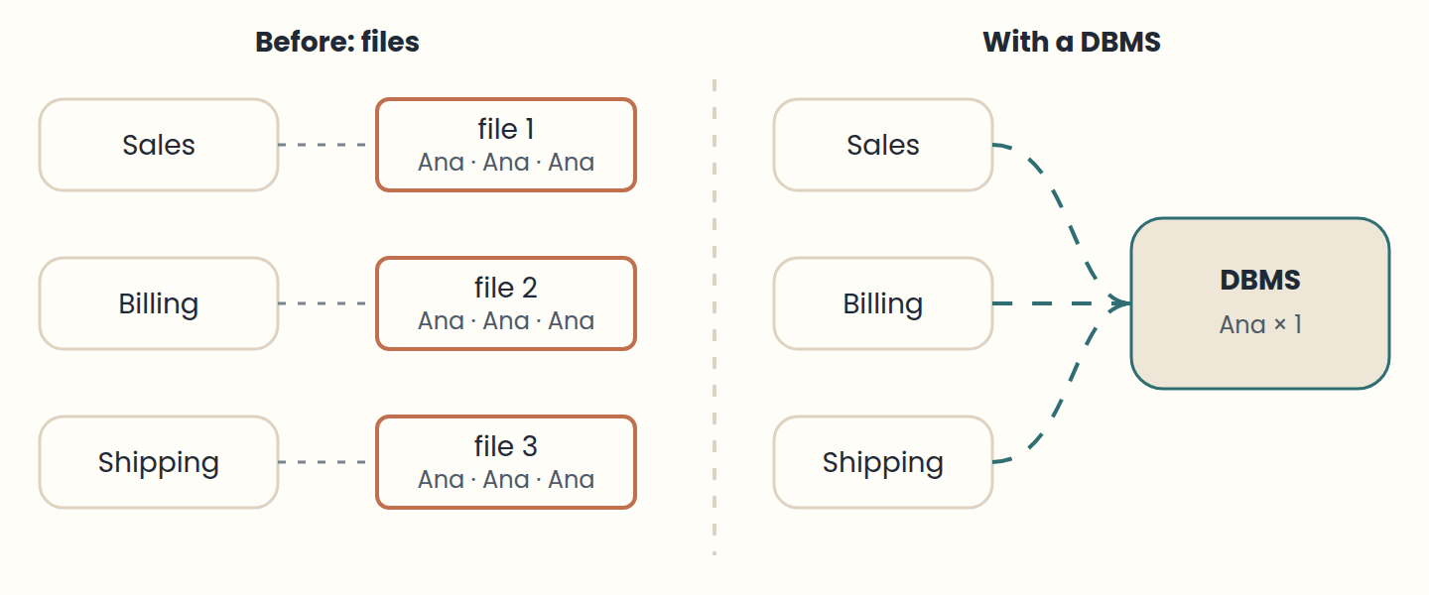
Lesson 1 · From files to databases
File-based systems duplicated data, so copies became inconsistent.
Think of it like this. Picture every office in a company keeping its own paper address book. When a customer moves, someone has to update every book, and some will be missed. A database is one shared, well-organised address book that everyone consults.
Notes:
• File-based systems duplicated data, so copies became inconsistent.
• Programs depended on file layouts: a layout change meant rewriting code.
• A DBMS stores data once, describes it, protects it, and shares it.
Before databases, each program kept its data in its own simple files: one record after another, in a format only that program understood. A sales program had a customer file; the billing program had another customer file. Nothing was shared, so the same customer appeared in several places, and sometimes several times inside the same file.
As companies came to depend on their data, the problems became serious. Redundant copies drifted apart, so the same customer could have two different addresses. Sharing data between applications meant copying it. A damaged file often could not be rebuilt. Anyone who could open a file could read all of it. And because each program knew the exact layout of its files, any change in the layout forced programmers to rewrite code.
The answer was the database management system (DBMS): one piece of software that stores the data once, describes its structure, and lets many programs and people use it safely. In 1970, Edgar F. Codd proposed the relational model, which organises data in tables linked by keys. Over the following decade it went from a research idea to the foundation of most business systems.

Slide 3
Lesson 2 · Data, information, and what a database is
Data + context = information; people turn information into knowledge.
A database models a mini-world, is coherent, and has a purpose.
The catalogue stores metadata: the structure and rules of the data.
Think of it like this. A single puzzle piece is data. Seeing that it is part of the sky is information. Knowing where to start the puzzle next time is knowledge. The box with the picture on the lid is the metadata.
Notes:
• Data + context = information; people turn information into knowledge.
• A database models a mini-world, is coherent, and has a purpose.
• The catalogue stores metadata: the structure and rules of the data.
Data are raw facts that can be recorded, such as "35000" or "F". On their own they are ambiguous: "F" could mean female in one context and false in another. Information is data given context and meaning: "the USB drive costs 35,000 pesos". Knowledge is the understanding people build on top of information, such as "the USB drive sells best at the start of term".
A database is an organised collection of related data with a purpose. It represents part of the real world, sometimes called the mini-world or universe of discourse, such as a campus store. Its data are logically coherent: random facts, even if true, are not a database. And it is designed, built, and filled for specific users and uses.
A database also describes itself. Besides the data, it stores a catalogue with the structure of every table, the type of every column, and the rules the data must follow. This data about data is called metadata. Programs, and the DBMS itself, read the catalogue to know how the data are organised.

Slide 4
Lesson 3 · What a DBMS does
A DBMS defines, constructs, manipulates, and shares databases.
Database system = DBMS + data + application programs.
Key advantages: less redundancy, access control, fast queries, recovery, integrity.
Think of it like this. A DBMS is like a librarian. You do not walk into the storage room yourself: you ask, and the librarian finds the book quickly, checks you may borrow it, records the loan, and makes sure two people do not take the last copy.
Notes:
• A DBMS defines, constructs, manipulates, and shares databases.
• Database system = DBMS + data + application programs.
• Key advantages: less redundancy, access control, fast queries, recovery, integrity.
A database management system is general-purpose software for creating and maintaining databases. It does four jobs. It defines the database: tables, data types, and rules. It constructs it: stores the data on disk under its own control. It manipulates it: answers queries, inserts, updates, and reports. And it shares it: many users and programs work with the same data at the same time.
Well-known DBMSs include PostgreSQL, MySQL, SQL Server, Oracle Database, and SQLite for relational data, and MongoDB or Redis for other data models. The DBMS together with the data and the application programs that use it is called a database system.
Compared with files, a DBMS brings real advantages: it controls redundancy, enforces access rules, uses indexes and a query optimiser to answer quickly, backs up and recovers data after failures, represents complex relationships, and enforces integrity rules, also called business rules, such as "a price cannot be negative".

Slide 5
Lesson 4 · Who works with a database
DBA: access, performance, security. Designer: structure, rules, views.
Analysts specify; application programmers build and maintain.
End users can be casual, parametric, sophisticated, or stand-alone.
Think of it like this. Think of a theatre: the designer draws the stage, the administrator runs the building and holds the keys, programmers build the props, and the audience, the end users, are why the show exists.
Notes:
• DBA: access, performance, security. Designer: structure, rules, views.
• Analysts specify; application programmers build and maintain.
• End users can be casual, parametric, sophisticated, or stand-alone.
Several roles share a database. The database administrator (DBA) authorises access, monitors performance and security, controls changes to the structure, and plans hardware and software. The database designer decides which data to store and how to structure it, talks with future users, defines integrity rules, and designs views for each group.
Systems analysts find out what end users need and specify the transactions that serve them. Application programmers turn those specifications into programs, then test, document, and maintain them.
End users are the reason the database exists. Casual users query it now and then, each time asking something different. Parametric users, such as a cashier, repeat the same standard operations all day. Sophisticated users, such as data analysts, write their own queries and tools. Stand-alone users keep a personal database for their own work.

Slide 6
Lesson 5 · The relational model: tables, rows, and columns
Relation = table, attribute = column, tuple = row.
Schema = structure; data (instance) = content at a moment.
Other models exist: hierarchical, network, object-oriented, NoSQL.
Think of it like this. A table is like a well-designed form printed many times: the questions on the form are the columns (the schema), and each filled-in copy is a row (the data).
Notes:
• Relation = table, attribute = column, tuple = row.
• Schema = structure; data (instance) = content at a moment.
• Other models exist: hierarchical, network, object-oriented, NoSQL.
In the relational model, data live in tables. Each table, formally a relation, represents one kind of thing, such as Product. Each column, or attribute, holds one property, such as price. Each row, also called a record or tuple, describes one specific thing: product 20, a USB drive that costs 35,000.
The schema is the structure: table names, columns, and their data types. The data, sometimes called the instance, is the content at a given moment. Adding a stock column changes the schema; changing a price changes only the data. Common data types are integers, decimals, text such as VARCHAR(60), booleans, dates, and timestamps.
The relational model is not the only one. Hierarchical databases organise records as trees, like an organisation chart. Network databases connect records with links. Object-oriented databases store objects with their methods. Many modern NoSQL systems use documents or key-value pairs. The relational model remains the starting point because tables and keys are simple and powerful.

Slide 7
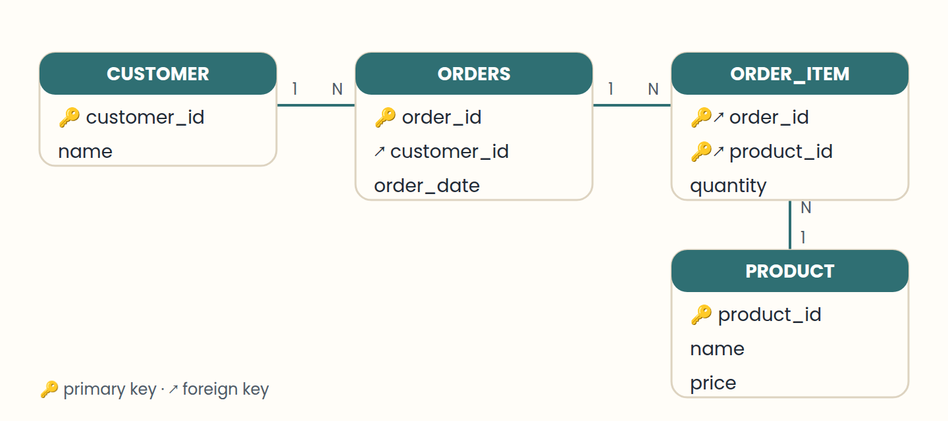
Lesson 6 · Keys and relationships
PK: unique and not null; it identifies each row.
Think of it like this. A primary key is like a national ID number: one per person, never shared. A foreign key is that same number written on a form somewhere else, so you can always find the person it refers to.
Notes:
• PK: unique and not null; it identifies each row.
• FK: stores another table's PK; it creates the relationship.
• N:M relationships need a junction table with two FKs.
A primary key (PK) identifies each row of a table. It must be unique and never empty. In Customer, customer_id 1, 2, and 3 each appear once. Two customers with id 2 would break the key.
A foreign key (FK) is a column that stores the primary key of another table, creating a relationship. Order has a customer_id column pointing to Customer. One customer can place many orders, so this is a one-to-many (1:N) relationship. The DBMS can refuse an order for customer 99 if no such customer exists: that is referential integrity.
Some relationships are many-to-many (N:M): an order can include several products, and a product can appear in several orders. Relational databases model this with an intermediate table, often called a junction table, such as Order_Item with order_id, product_id, and quantity. Its primary key combines both foreign keys.

Slide 8
Lesson 7 · Integrity, transactions, and safety
Constraints: PRIMARY KEY, FOREIGN KEY, NOT NULL, CHECK.
Transaction = all or nothing: COMMIT or ROLLBACK.
Concurrency control, logs, backups, and least privilege keep data safe.
Think of it like this. A transaction is like a bank transfer: money leaves one account and arrives in the other, or nothing happens. You never want the money to leave and not arrive.
Notes:
• Constraints: PRIMARY KEY, FOREIGN KEY, NOT NULL, CHECK.
• Transaction = all or nothing: COMMIT or ROLLBACK.
• Concurrency control, logs, backups, and least privilege keep data safe.
Integrity constraints are rules the DBMS enforces so invalid data never gets in. PRIMARY KEY forbids repeated identifiers. FOREIGN KEY keeps relationships valid. NOT NULL requires a value. CHECK tests a condition, such as price >= 0. Because the database enforces them, every application gets the same protection.
A transaction groups several operations into one unit: all or nothing. Selling a USB drive means creating the order, adding the item, and reducing stock. If every step succeeds, the transaction is committed (COMMIT). If any step fails, all changes are undone (ROLLBACK), so the database never stays half-updated.
The DBMS also coordinates concurrent users: if two cashiers try to sell the last USB drive at the same time, only one sale may succeed. It keeps a log of changes to recover after failures, supports regular backups and a recovery plan, and controls security with roles and permissions, following the principle of least privilege: each user gets only the access they need.

Slide 9
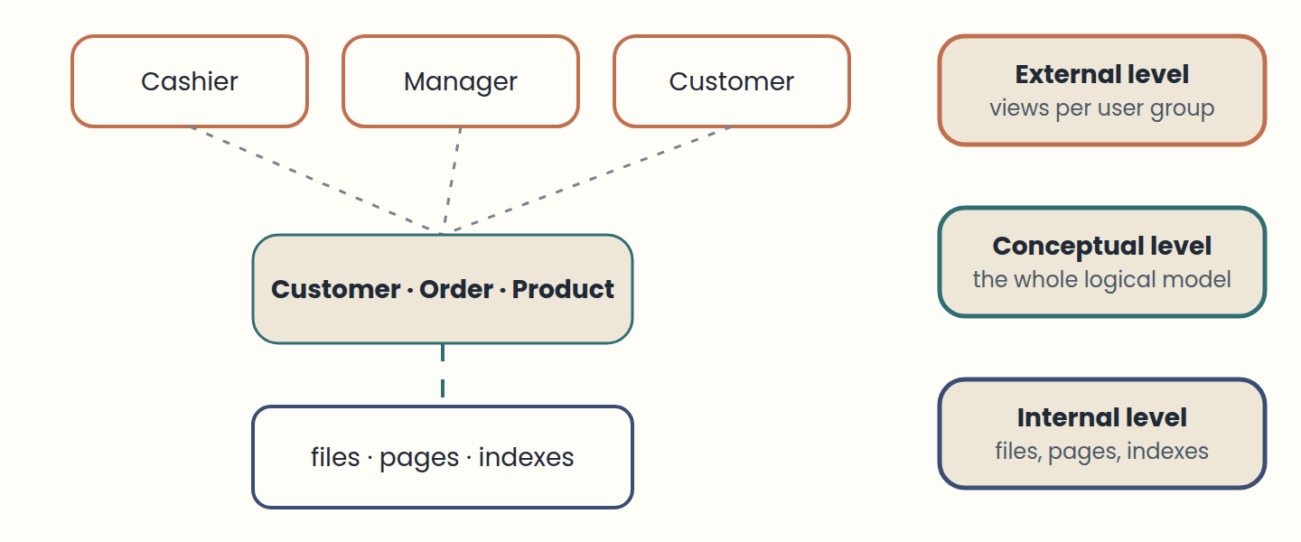
Lesson 8 · Three levels, views, and indexes
External = user views; conceptual = logical model; internal = physical storage.
Think of it like this. A restaurant: diners see the menu (external), the chef works from recipes (conceptual), and the pantry is organised in shelves and fridges (internal). Reorganising the pantry should not change the menu.
Notes:
• External = user views; conceptual = logical model; internal = physical storage.
• Data independence lets one level change without breaking the others.
• Indexes speed up searches but cost space and update time.
The three-schema architecture separates how data is seen, organised, and stored. The external level holds the views of each user group: a cashier sees orders and prices. The conceptual level describes the whole database logically: Customer, Order, Product, and their relationships. The internal level describes physical storage: files, pages, and indexes.
This separation gives data independence. Physical independence means the storage can change, for example by adding an index, without changing the applications. Logical independence means the conceptual schema can grow, for example with a new table, without breaking existing views. A view is a named query: CREATE VIEW expensive_products AS SELECT … lets users query a tailored subset as if it were a table, and can also hide sensitive columns.
Most databases follow a client-server architecture: the application, the client, sends SQL; the server, the DBMS, validates it, plans it, and runs it. An index works like the index of a book: it finds rows without reading the whole table. The query optimiser chooses an execution plan, for example whether to use an index. Indexes speed up reads but take space and must be updated on every change.

Slide 10
Lesson 9 · First SQL queries
SELECT columns FROM table WHERE condition.
ORDER BY sorts; JOIN … ON combines tables through keys.
UPDATE and DELETE always need a WHERE clause.
Think of it like this. SELECT is like asking a librarian: "show me the titles and authors (SELECT) from the history shelf (FROM) published after 2000 (WHERE)".
Notes:
• SELECT columns FROM table WHERE condition.
• ORDER BY sorts; JOIN … ON combines tables through keys.
• UPDATE and DELETE always need a WHERE clause.
SQL is the language for working with relational data. A query starts with three words: SELECT says which columns to show, FROM says which table to read, and WHERE says which rows qualify. SELECT name, price FROM product WHERE price > 20000; returns only the products that cost more than 20,000.
AND combines conditions, and ORDER BY sorts the result: ORDER BY price DESC goes from highest to lowest. JOIN brings related tables together using their keys: joining Customer and Order on customer_id lists each customer with their orders, so a customer with two orders appears twice.
SQL also changes data. INSERT adds a row, UPDATE changes rows, and DELETE removes rows. Always write a WHERE clause on UPDATE and DELETE: without it, the change applies to every row in the table. Try every query in this week's SQL Lab, which runs a real database in your browser.

Slide 11
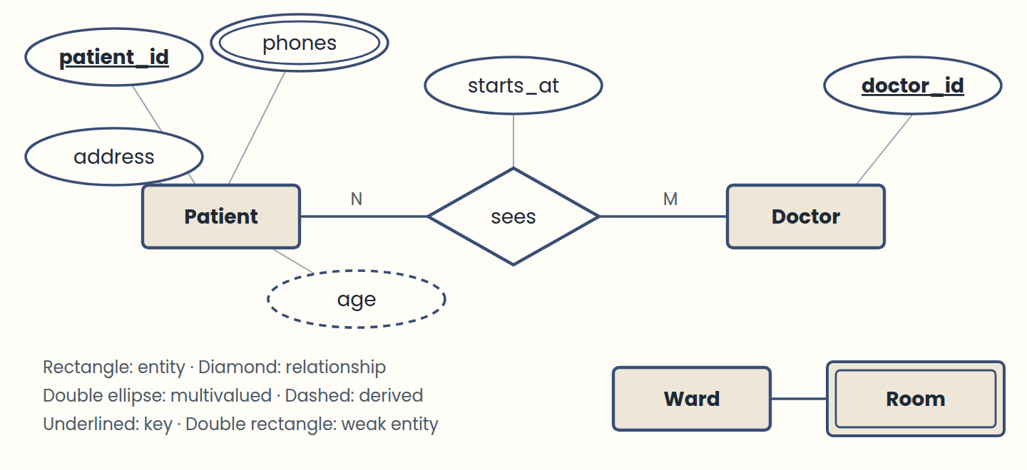
Lesson 10 · Design in three stages: the ER model
Conceptual (ER) → logical (tables) → physical (SQL).
Think of it like this. The three stages are like building a house: the sketch you discuss with the family (conceptual), the architect's floor plan with measurements (logical), and the construction itself with real materials (physical).
Notes:
• Conceptual (ER) → logical (tables) → physical (SQL).
• Entities are nouns (rectangles); relationships are verbs (diamonds).
• Attributes: simple, composite, multivalued (double), derived (dashed), key (underlined).
• A weak entity depends on its owner: key = owner key + discriminator.
A database is designed in three stages, each one less abstract than the last. The conceptual model describes the real world with an entity–relationship (ER) diagram. The logical model turns it into tables with keys. The physical model is the SQL that creates those tables in a specific DBMS.
The ER model, proposed by Peter Chen in 1976, has three building blocks. Entities are things with their own existence that we want to remember, always nouns: Patient, Doctor, Appointment. They are drawn as rectangles. Relationships connect entities, are usually verbs, and are drawn as diamonds; a relationship can have its own attributes when the fact only makes sense for the pair, such as the date a doctor started at a clinic.
Attributes describe an entity and are drawn as ellipses. A simple attribute cannot be split (first name). A composite one can (address → street, city, country). A multivalued attribute can hold several values for one entity (a patient's phone numbers) and is drawn with a double ellipse. A derived attribute is calculated from others (age from birth date) and is drawn dashed. The key attribute identifies each entity and is underlined.
Some entities cannot be identified on their own. A room is "room 12 of hospital B": without the hospital, the number means nothing. That is a weak entity, drawn as a double rectangle. Its key is the key of its owner plus its own partial key, called the discriminator.

Slide 12
Lesson 11 · From the ER diagram to tables
Entity → table; composite → several columns; multivalued → new table; derived → not stored.
1:N → FK on the N side; N:M → junction table; 1:1 → FK on either side.
Keys can be natural, surrogate, or composite.
Think of it like this. The mapping rules are a recipe: the ER diagram is the list of ingredients, and the rules tell you exactly which pot each one goes into.
Notes:
• Entity → table; composite → several columns; multivalued → new table; derived → not stored.
• 1:N → FK on the N side; N:M → junction table; 1:1 → FK on either side.
• Keys can be natural, surrogate, or composite.
The logical model follows a short set of rules. 1) Each strong entity becomes a table, its attributes become columns, and its key becomes the primary key. 2) A composite attribute becomes one column per part. 3) A multivalued attribute gets its own table with a foreign key back to the owner. 4) A derived attribute is not stored: it is calculated in queries.
Relationships depend on their cardinality. 5) 1:1: put the key of one side as a foreign key in the other, preferably in the side that always participates. 6) 1:N: the key of the "1" side travels as a foreign key to the "N" side. 7) N:M: create a junction table with both keys as foreign keys. 8) A weak entity becomes a table whose primary key is the owner's key plus its discriminator.
Primary keys come in three flavours. A natural key already exists in the real world (a national ID number). A surrogate key is generated by the system, usually an auto-increment number; it never changes and carries no meaning. A composite key combines two or more columns, as in the junction and weak-entity tables. Two more words you will meet: a table's degree is its number of columns, and its cardinality is its number of rows.

Slide 13
Lesson 12 · SQL to build and change data: DDL and DML
DDL: CREATE, ALTER, DROP, TRUNCATE. DML: INSERT, SELECT, UPDATE, DELETE.
Use DECIMAL for money, VARCHAR for text, DATE for dates.
ON DELETE: CASCADE, RESTRICT, or SET NULL, chosen per relationship.
Think of it like this. DDL builds the shelves; DML puts things on them, moves them, and takes them off. TRUNCATE empties the shelves; DROP takes them out of the room.
Notes:
• DDL: CREATE, ALTER, DROP, TRUNCATE. DML: INSERT, SELECT, UPDATE, DELETE.
• Use DECIMAL for money, VARCHAR for text, DATE for dates.
• ON DELETE: CASCADE, RESTRICT, or SET NULL, chosen per relationship.
SQL has two families of commands. DDL (data definition language) builds the structure: CREATE DATABASE and CREATE TABLE create, ALTER TABLE changes columns, DROP TABLE removes a table and its data, and TRUNCATE empties a table but keeps its structure. DML (data manipulation language) works with rows: INSERT, SELECT, UPDATE, and DELETE.
Each column has a data type, which is its domain. The common ones are integers (INT, BIGINT), exact decimals for money (DECIMAL(p, s)), approximate decimals (FLOAT, DOUBLE), text (CHAR(n) for a fixed length, VARCHAR(n) for a variable one), dates and times (DATE, TIME, TIMESTAMP), and BOOLEAN. Names differ a little between systems: auto-increment is AUTO_INCREMENT in MySQL and SERIAL in PostgreSQL, and SQLite, used in the SQL Lab, makes any INTEGER PRIMARY KEY auto-increment.
A foreign key can say what happens when the parent row is deleted or its key changes. CASCADE deletes or updates the child rows too. RESTRICT refuses the change while children exist. SET NULL keeps the children but empties their foreign key. Choose per relationship: deleting a doctor should not silently delete their visit history, so RESTRICT fits there.

Slide 14
Step by step
Put the sale in order
1
2
3
4
5
BEGIN the transaction
Insert the new order
Insert the order item
Reduce the product stock
COMMIT if every step worked
Notes:
Everything between BEGIN and COMMIT is one unit; any failure means ROLLBACK.

Slide 15
Check yourself
1. What is the main risk of storing the same customer in several files?
A) The copies become inconsistent B) The files load faster C) Programs need less code
2. Which statement is information, not just data?
A) "Customer 2 lives in Lima" B) "Lima" C) "2"
3. A data analyst writes her own SQL queries and small tools to study sales. What kind of end user is she?
A) Sophisticated B) Parametric C) Casual
Answers are in the speaker notes.
Notes:
1. A — When one copy changes and the others do not, the data contradict each other.
2. A — It places the values in context. Alone, "Lima" or "2" have no clear meaning.
3. A — Sophisticated users know the database well enough to build their own queries and tools.

Slide 16
Practise next
Labs
On the site
First queries in the SQL Lab
Join customers and orders
See integrity and transactions at work
Design a library in the Design Studio
Design Studio
SQL Lab

