Slide 1
1
Software Development 1 · Week 1
Introduction to Software Engineering Management

Slide 2
Lesson 1 · What software engineering is
Software engineering is a discipline about delivering and maintaining software, not only writing it.
Most project problems come from communication and planning gaps.
Models let teams discuss and check a system before building it.
Think of it like this. Building a house needs blueprints before bricks. Software needs plans and models before code, because changing a wall on paper costs far less than tearing it down.
Notes:
• Software engineering is a discipline about delivering and maintaining software, not only writing it.
• Most project problems come from communication and planning gaps.
• Models let teams discuss and check a system before building it.
Programming is the act of writing instructions a computer can run. Software engineering adds the discipline needed to deliver a system that works, can be changed, and is understood by the people who depend on it. The difference matters because most software failures are not coding typos. They come from unclear requirements, poor planning, missing documentation, and communication gaps between the customer and the builders.
A useful way to see the gap is a chain of translations. The customer has a real need. They describe it imperfectly. Sales promises something. Analysts write requirements. Designers propose a structure. Programmers write code. Each handoff can lose meaning. Software engineering tries to make each handoff explicit and checkable, with written specifications, reviews, and tests.
Software is also special as a product. It is intangible, it changes often, and it is rarely finished. Engineers therefore work with models: simplified descriptions of a system, such as a diagram of the data flow or a list of use cases. A good model is abstract enough to be simple, precise enough to be trusted, and cheap enough to change before code is written.

Slide 3
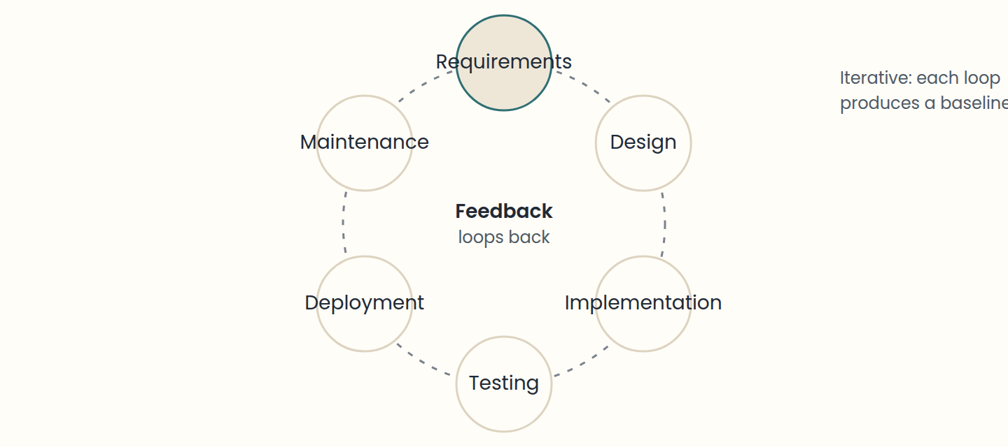
Lesson 2 · The development lifecycle and process models
A process model is a simplified description of how real teams work.
Think of it like this. Think of a cooking class. Waterfall is following a recipe from start to finish without tasting. Iterative work is tasting the sauce after each step and adjusting the next one.
Notes:
• A process model is a simplified description of how real teams work.
• Iterative work produces baselines; the difference between baselines is an increment.
• Choose a process by how much change you expect and how costly late mistakes are.
A software development process defines what is done, by whom, when, and how. Every process performs four broad activities: specifying the software, developing it, validating it, and evolving it after release. The lifecycle is the sequence of phases a product moves through: requirements analysis, design, implementation, testing, deployment, and maintenance.
A waterfall process runs these phases once, in order. It is easy to plan but slow to react to change, and problems discovered in testing are expensive to fix. An iterative and incremental process divides the project into iterations. Each iteration plans, analyses, designs, builds, and tests a small part, and produces a baseline: a working, partially complete version of the system. The difference between two baselines is an increment.
Unified-style processes organise iterations into phases: inception (goals and scope), elaboration (architecture and main risks), construction (building the system), and transition (delivery). Adaptive methods such as Scrum apply the same idea with short cycles and frequent feedback from users. In each case, the key question is how early the team learns something that would be expensive to learn late.

Slide 4
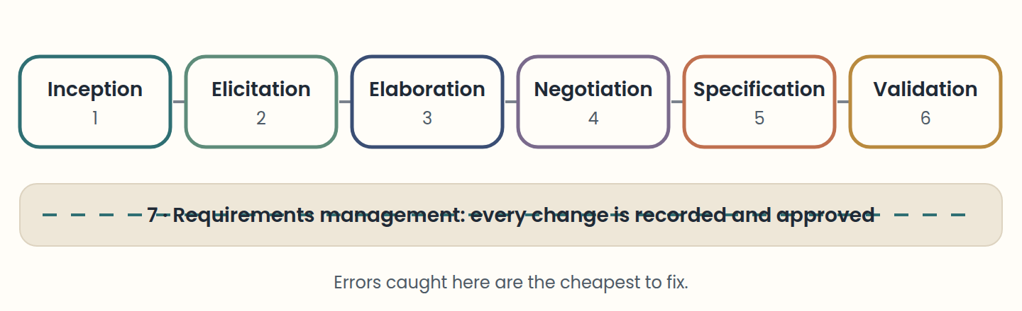
Lesson 3 · Requirements engineering: from wishes to specifications
A requirement must be checkable: someone should be able to say "met" or "not met".
Think of it like this. A tailor measures twice and cuts once. Requirements are the measurements: if they are wrong, no amount of careful sewing (coding) will make the suit fit.
Notes:
• A requirement must be checkable: someone should be able to say "met" or "not met".
• Seven activities: inception, elicitation, elaboration, negotiation, specification, validation, management.
• Functional = what the system does. Non-functional = how well it does it.
A requirement is a capability or condition a system must have to be accepted by its users, its customer, or a standard. Requirements engineering turns a business wish into precise, checkable statements that analysts, designers, programmers, and testers all share. Mistakes here are the most expensive kind, because every later phase is built on top of them.
The work flows through seven activities that often overlap. Inception identifies the need and a high-level solution. Elicitation gathers needs from stakeholders. Elaboration refines them into scenarios, business rules, and main and alternative flows. Negotiation reconciles conflicting views and weighs risk, cost, and time. Specification writes everything down in a standard template, often with diagrams and prototypes. Validation reviews the specification with users and fixes problems before building. Management tracks every change to the requirements for the whole project.
Elicitation is hard for three reasons. Scope problems: the system boundaries are unclear, so the analyst writes assumptions and constraints that say what is in and what is out. Understanding problems: users may not know what they need, or describe it at too high a level. Volatility: requirements change from one meeting to the next, so teams record agreements in written minutes and work with one representative user.
Requirements come in layers. Business requirements state the organisation's goals. Stakeholder requirements describe the needs of a group of users. Solution requirements say what the system must do, and split into functional requirements (behaviour: "the system emails a receipt after payment") and non-functional requirements (qualities: "a page loads in under 2 seconds with 500 users online"). Transition requirements are temporary capabilities to move from the old situation to the new one, such as migrating old data.

Slide 5
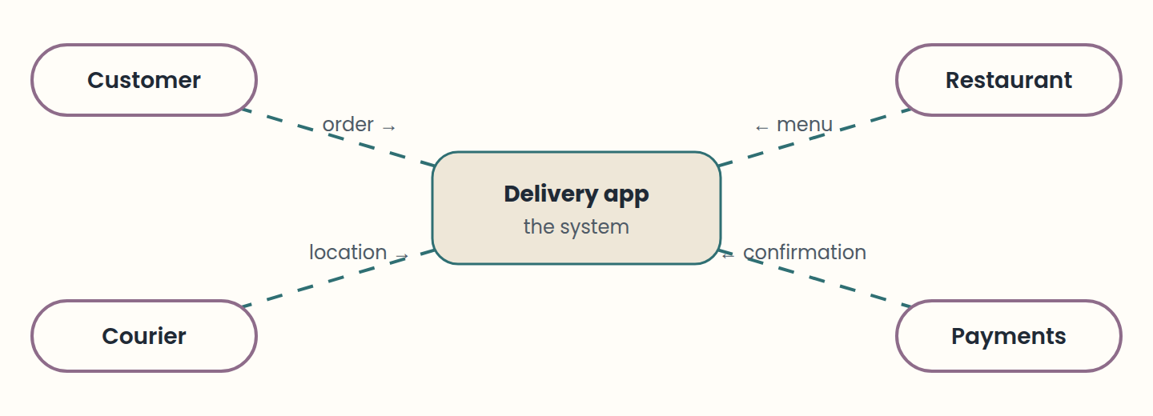
Lesson 4 · Modelling software: from context diagrams to UML
A model is useful when it is simpler than the system but still correct about what matters.
Think of it like this. A city map is a model. It ignores the colour of each house (abstract) but gets the streets right (precise), so you can plan a route before walking (predictive and cheap).
Notes:
• A model is useful when it is simpler than the system but still correct about what matters.
• Context diagram = boundaries; ER model = data; state machine = lifecycle of one thing.
• UML has structure diagrams and behaviour diagrams; choose by the question you need answered.
A model is a simplified representation of a system that helps you reason about it. Good models have five qualities: they are abstract (they leave out what does not matter), understandable, precise (faithful to the system), predictive (they support correct conclusions), and cheaper than building and studying the real thing. Models become the shared language between users, analysts, and developers.
Analysis models describe the problem in the real world: what the business does. Design models describe the software solution: how the system will do it. Forward engineering goes from a model to working code; reverse engineering rebuilds a model from an existing product or code base, which is common when documentation is missing.
Early in a project, a context diagram draws the system as a single box surrounded by the external actors and the data that flows in and out; it fixes the boundaries. A data flow diagram then breaks the process into steps with inputs and outputs. For data, an entity-relationship model shows entities, their attributes, and relationships with cardinality: one-to-one, one-to-many, or many-to-many. In a table, a primary key identifies each row, and a foreign key stores another table's primary key to link them. A state machine shows the states a component can be in, such as Draft, Paid, and Shipped, and the events that move it between them. A data dictionary defines every data item, so everyone uses the same meaning.
UML, the Unified Modeling Language, standardises diagrams for object-oriented development. Structure diagrams show the parts of a system: class, component, object, package, and deployment diagrams. Behaviour and interaction diagrams show how it acts: use case, activity, state, and sequence diagrams. You rarely need all of them. Pick the diagram that answers the question your team is asking right now.

Slide 6
Lesson 5 · Software configuration management
Configuration items include everything that makes up the product, not only code.
SCM answers: which version, which change, approved by whom, and in which baseline.
Think of it like this. A library keeps a catalogue of every edition and who borrowed it. SCM does the same for a product: every item, version, and change has a record you can check.
Notes:
• Configuration items include everything that makes up the product, not only code.
• SCM answers: which version, which change, approved by whom, and in which baseline.
Software configuration management (SCM) controls how the parts of a system change over time. Its items are not only source code: requirements documents, designs, test scripts, build files, and manuals are all configuration items. The goal is to know exactly which version of each item belongs to which version of the product.
SCM rests on four ideas. Identification names each item and version. Version control records every change. Change control decides which changes are approved and when. Status accounting reports what is currently in each baseline. An audit then checks that the baseline matches what was intended.
Without SCM, teams struggle with questions like "which build is in production?" or "why did this test pass yesterday?". Keeping a stable baseline lets people keep working in parallel without overwriting each other.

Slide 7
Lesson 6 · Version control systems
A VCS stores history, supports recovery, and shows who changed what and when.
Git is distributed; GitHub is a hosting service for Git repositories.
One commit should hold one logical change with a clear message.
Think of it like this. Version control is like a video game with save points. You can go back to any save, see what changed between two saves, and let friends play from their own copy.
Notes:
• A VCS stores history, supports recovery, and shows who changed what and when.
• Git is distributed; GitHub is a hosting service for Git repositories.
• One commit should hold one logical change with a clear message.
A version control system (VCS) records changes to files over time. It gives you a history of what changed, when, and by whom; the ability to recover earlier versions; and a way for several people to work on the same project without losing each other's work.
Centralised systems keep one master repository on a server. Distributed systems, such as Git, give every developer a full local copy of the repository and its history. You can commit, branch, and browse history offline, and share changes when you are connected. Git is a distributed VCS. GitHub, GitLab, and similar services host Git repositories and add collaboration features; they are not Git itself.
A commit is a snapshot of the project with a message. Good commits represent one logical change, and their messages say what changed in the imperative mood, for example "add sum functionality" or "fix off-by-one in pagination". Small, frequent commits make history easier to read and to revert.

Slide 8
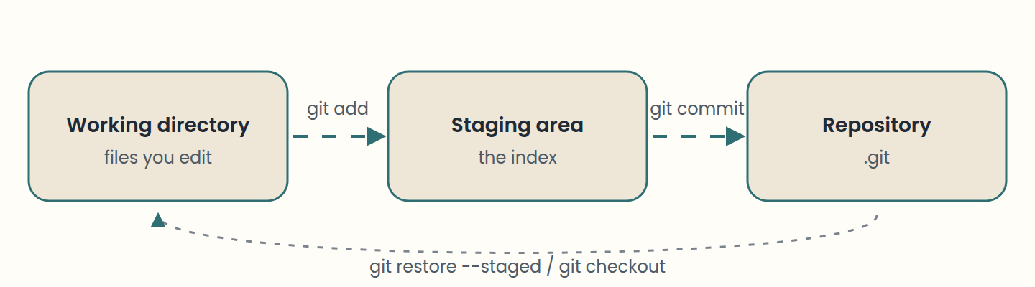
Lesson 7 · Git fundamentals: areas, commits, and branches
Edit in the working directory, stage with git add, and record with git commit.
Think of it like this. Git is a photo studio. The working directory is the set, staging is choosing which photos go in the album, and commit is printing the album page. A branch is a second album you can build without touching the first.
Notes:
• Edit in the working directory, stage with git add, and record with git commit.
• git status and git log show where you are; use them before and after each step.
• A branch is a pointer. Merging combines history; conflicts require a human decision.
Git has three areas. The working directory holds the files you edit. The staging area (also called the index) holds the changes you have chosen for the next commit. The repository, stored in the hidden .git folder, holds the committed history. Most commands move changes between these areas: git add moves work into staging, and git commit moves staged work into the repository.
The everyday loop is: edit, check, stage, commit. Run git status often; it shows which files are modified, which are staged, and which are untracked. Use git log --oneline --graph to read history. Use git diff to see unstaged changes and git diff --staged to see what the next commit will contain.
A branch is a movable pointer to a commit. Creating a branch does not copy files. It lets you develop a feature without changing main. When the feature is ready, you merge it back. If both branches changed the same lines, Git stops and marks a conflict: the file contains markers <<<<<<<, =======, and >>>>>>> showing both versions. You edit the file to the intended result, stage it, and commit.

Slide 9
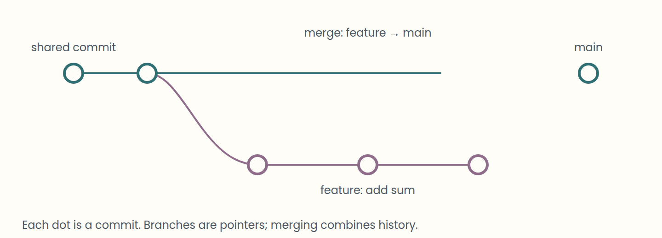
Lesson 8 · GitHub, remotes, and collaboration workflows
origin is the conventional name for the remote you cloned or connected.
Think of it like this. A pull request is like a draft essay sent to a classmate before handing it in. The reviewer does not write it for you, but catches mistakes while they are cheap to fix.
Notes:
• origin is the conventional name for the remote you cloned or connected.
• fetch downloads; pull downloads and integrates; push uploads.
• Pull requests make review a planned step before code reaches main.
A remote is a named link to another repository, conventionally called origin. git remote add origin <url> registers it. git push -u origin main uploads your main branch and sets the upstream. git fetch downloads new commits without changing your files; git pull fetches and then integrates them into your current branch.
A common team workflow is feature branches with pull requests (called merge requests on GitLab). You create a branch, push it, and open a request. Reviewers read the diff, comment, and approve. Only after approval is the branch merged into main. The review step is where teams catch defects and share knowledge.
Good collaboration also means keeping main stable, updating your local copy before you start work, and writing commits that a reviewer can understand one at a time.

Slide 10
Step by step
Put the lifecycle in order
1
2
3
4
5
6
Requirements analysis
Design
Implementation
Testing
Deployment
Maintenance
Notes:
Each phase depends on the output of the previous one. Maintenance feeds new requirements, so the cycle repeats.

Slide 11
Check yourself
1. Which item is a configuration item in software configuration management?
A) A requirements document B) The office coffee machine C) A personal calendar
2. Which statement about Git is correct?
A) Git is a distributed version control system; every clone holds the full history. B) Git cannot record a commit without an internet connection to GitHub. C) Git and GitHub are two names for the same tool.
3. In an iterative and incremental process, what does the difference between two successive baselines represent?
A) An increment B) A risk register C) The final delivery only
Answers are in the speaker notes.
Notes:
1. A — Any artefact that is part of the product or its documentation can be a configuration item. Requirements are a core example.
2. A — Each clone has the full repository and history, so you can commit offline.
3. A — By definition, the difference between two baselines is an increment.

Slide 12
Practise next
Labs
On the site
Initialise a repository and make your first commit
Read history and work on a branch
Resolve a merge conflict
Connect to a remote and simulate a review
Git Playground

