Slide 1
2
Software Development 1 · Week 2
Requirements engineering

Slide 2
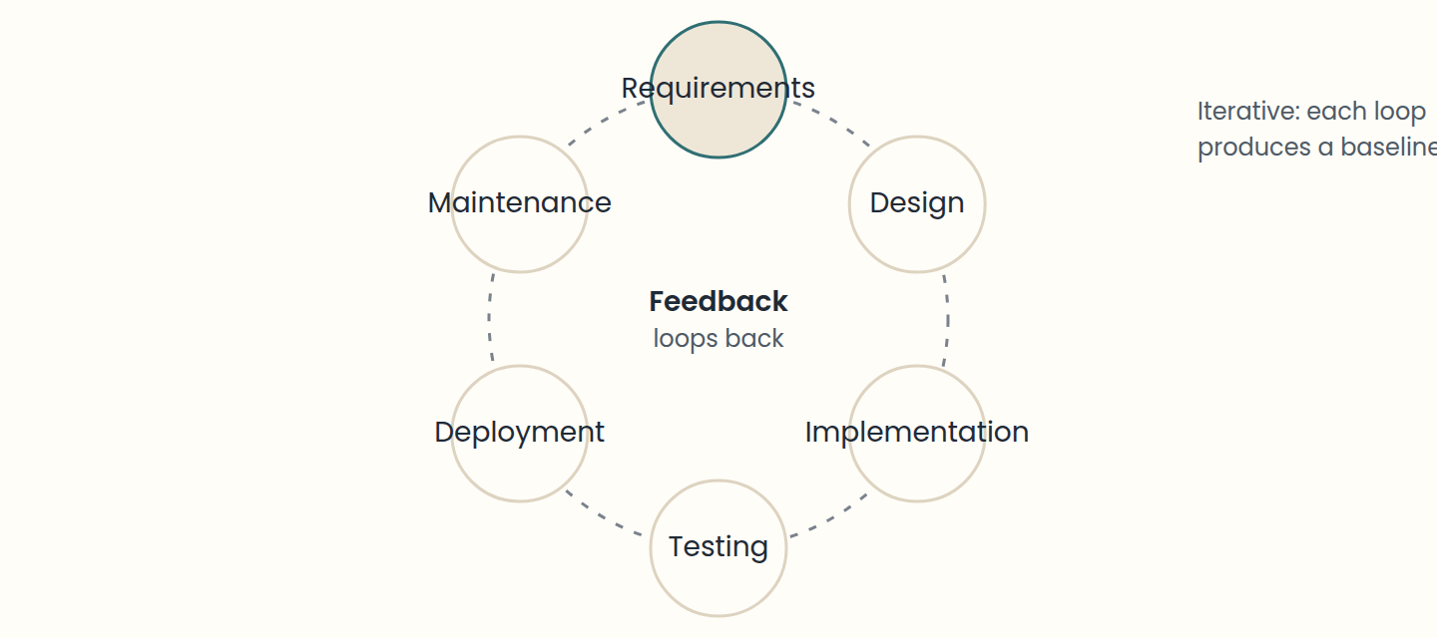
Lesson 1 · What a requirement is, and why it comes first
A requirement says what the system must do or how well, not how it is built.
Think of it like this. A doctor does not prescribe medicine for "I feel bad". She asks questions until she finds the cause, because headache from stress and headache from an infection need different treatments. Requirements engineering is the diagnosis; code is the treatment.
Notes:
• A requirement says what the system must do or how well, not how it is built.
• Clients bring problems; you find the causes and derive requirements from them.
• Requirements = wishes adjusted to physical, legal, financial, social, and security constraints.
• The later a requirements error is found, the more it costs to fix.
A requirement is a condition or capability that a system must have so that a user can reach a goal, or so that it satisfies a contract, a law, or a standard. It describes what the system must do or how well it must do it, never how the code will do it. Compare a bad and a good version. Bad: "the library app stores loans in a MySQL table and calls a REST endpoint to renew them" (that names a database and a backend: it is how). Good: "a reader can renew a loan up to 2 times, unless another reader is waiting for the book" (a capability the user gets: it is what). The bad version also hides the real rule.
Clients rarely hand you requirements. They hand you a problem statement: "readers wait months for popular books, yet reserved copies sit uncollected on our hold shelf". Detecting a problem is not the same as understanding it. Ask why it happens. Maybe readers are told by a letter that arrives late (cause A), maybe they reserved weeks ago and forgot (cause B), maybe there is no easy way to cancel a reservation they no longer want, so the copy waits for nobody (cause C). Each cause leads to a different solution: instant notifications, reminders, or one-tap cancellation. Requirements come from the causes you choose to attack.
Requirements are not just wishes. They are wishes adjusted to the real world: physical limits (the hold shelf has room for 200 books), legal rules (what a person reads must be kept private), money (the budget allows one mobile app, not two), social habits (older readers prefer a phone call), and threats (someone may try to reserve every copy of a new bestseller with fake accounts). A good analyst writes the wish and the constraints together.
Why so much care? Because errors made in requirements are the most expensive ones. An error found while writing the requirement costs a conversation; the same error found after release can cost a hundred times more, because design, code, tests, and manuals were all built on it. Poor requirements analysis is one of the most common causes of project failure: the team builds the wrong system, fills it with features nobody uses, and finishes late and over budget. Many of those projects had good programmers; they built the wrong thing very well. Each person in the chain (client, salesperson, analyst, designer, programmer, tester) understands the need a little differently, and requirements are the shared written agreement that stops the meaning from drifting.

Slide 3
Lesson 2 · Types of requirements: functional, non-functional, user, and system
Functional = what the system does. Non-functional = how well it does it, or under which constraints.
Non-functional families: product (efficiency, usability, reliability, portability, security), organisational, external.
FURPS+: Functionality, Usability, Reliability, Performance, Supportability, plus constraints.
Every non-functional requirement needs a number you can test.
User requirements speak to clients; system requirements give developers the detail.
Think of it like this. Ordering a car: "it has five seats, a trunk, and air conditioning" are functional requirements (what it does). "It does 15 km per litre, reaches 100 km/h in 10 seconds, and passes the safety test" are non-functional (how well, and under which rules). Two cars with the same features can feel completely different because of the second list.
Notes:
• Functional = what the system does. Non-functional = how well it does it, or under which constraints.
• Non-functional families: product (efficiency, usability, reliability, portability, security), organisational, external.
• FURPS+: Functionality, Usability, Reliability, Performance, Supportability, plus constraints.
• Every non-functional requirement needs a number you can test.
• User requirements speak to clients; system requirements give developers the detail.
Functional requirements describe behaviour: what the system does in response to an input or a situation. "The app sends a reminder 2 days before a loan is due." "A courier can mark an order as delivered." "The system issues an invoice when a membership is paid." If you can imagine a user pressing a button and seeing something happen, you are probably looking at a functional requirement.
Non-functional requirements (also called quality requirements) describe how well the system does those things, or the limits it must respect. "Login completes in under 3 seconds." "The app works on phones from the last five years." "Payment data is encrypted." They usually apply to many functions at once, and they are often the reason a product feels good or terrible. A system can do everything it should and still fail because it is too slow, crashes, or leaks data.
Non-functional requirements come in three families. Product requirements limit the product itself: efficiency (performance: response time, throughput; space: memory, storage), usability (time to learn, number of errors), reliability (availability, mean time between failures), portability, and security. Organisational requirements come from the client's or developer's organisation: delivery dates, the programming language or platform to use, internal standards. External requirements come from outside: interoperability with other systems, laws (privacy, safety, accessibility), and ethics. A popular checklist is FURPS+: Functionality (including security), Usability, Reliability, Performance, Supportability, plus constraints such as design, implementation, interface, and physical limits. In everyday projects the categories you will meet most are performance (response time), security (who can see and do what), availability (percentage of uptime), usability (time and errors to finish a task), scalability (how many users or orders at the same time), and portability (which devices and operating system versions).
A non-functional requirement is only useful if it can be measured. Turn adjectives into numbers: speed becomes response time or transactions per second; ease of use becomes training time or errors per task; reliability becomes availability (99.5% uptime per month) or mean time between failures; scalability becomes the number of users served at once (5,000 readers searching the catalogue at the same time); robustness becomes time to recover after a crash; portability becomes the list of platforms supported. "The app must be fast" cannot be tested; "the menu of a restaurant loads in under 2 seconds on a 4G connection for 95% of requests" can.
Requirements are also written at different levels of detail for different readers. User requirements are written in plain language (sometimes with simple diagrams) for clients and end users: "a reader can reserve a book online". System requirements expand each one into precise, detailed statements for developers and testers: "when a reserved copy is returned, the system assigns it to the first reader in the queue and notifies them; the copy waits on the hold shelf for 3 days; the same copy is never assigned to two readers". Above both sit business requirements, the organisation's goals ("cut the average wait for popular books by 30% this year"). Some teams also list user interface requirements separately (screens, accessibility, languages).

Slide 4
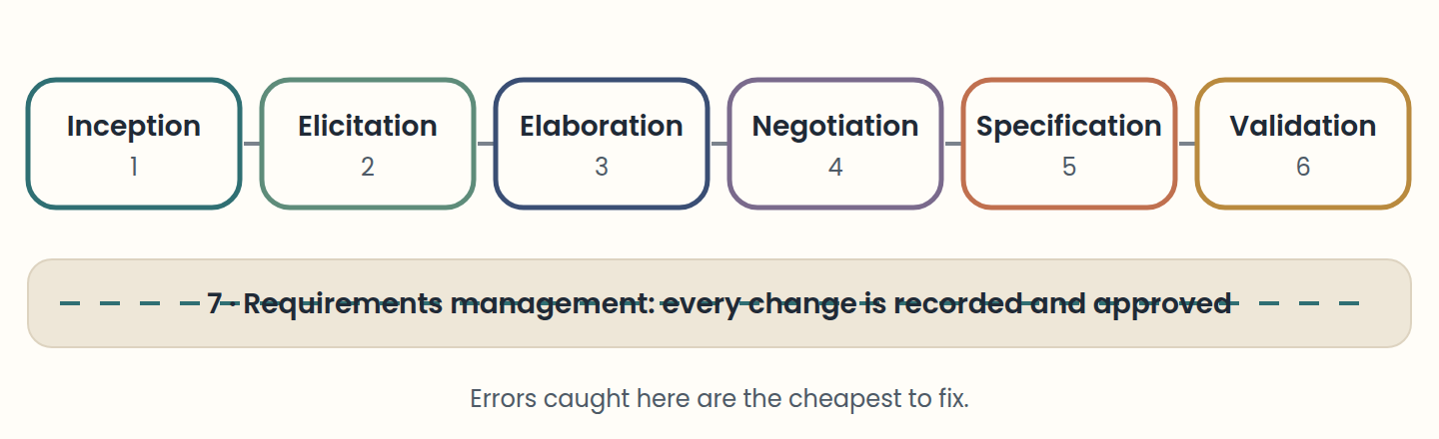
Lesson 3 · The requirements engineering process and its people
Core activities: feasibility, elicitation, analysis, specification, validation, management.
Think of it like this. Planning a wedding: first you check what the budget allows (feasibility), then you ask both families what they want (elicitation), resolve "outdoor" versus "grandma cannot walk on grass" (analysis and negotiation), write the plan (specification), show it to the couple (validation), and keep a log when the guest list changes for the fifth time (management).
Notes:
• Core activities: feasibility, elicitation, analysis, specification, validation, management.
• The activities overlap and repeat; management runs the whole time.
• A stakeholder is anyone affected by the system or able to influence it, even without using it.
• The analyst asks what, where, whose, why, how, when, and what could stop us.
Requirements engineering is the set of activities used to discover, write down, check, and maintain what a system must do. It acts as a bridge between the real-world needs of clients and users and what software technology can offer. Different books slice it differently, but the same core activities always appear: a feasibility study, elicitation (gathering), analysis (refining and negotiating), specification (writing down), validation (checking with the client), and management (handling change). The diagram shows the classic sequence; in practice the activities loop and overlap.
The feasibility study answers one question early: can the users' needs be met with the technology, time, and budget available? A short report says go, change scope, or stop. Elicitation then collects needs from people, documents, and existing systems. Analysis refines what was gathered, removes contradictions, checks that it is realistic, and decides priorities with the client. Specification writes the agreed requirements in a clear, shared form: a requirements document, a backlog of user stories, or both. Validation shows the result to the client and asks: is this really what you need? Management records every change, its reason, and its approver, for the life of the product.
A stakeholder is anyone affected by the system or who influences its requirements, directly or indirectly. For a public library system: readers, desk staff, librarians, the city council that pays, the IT staff who will maintain it, the e-book distributor whose licences limit lending, other libraries in the regional loan network, and the data-protection authority whose privacy rules apply. Stakeholders want different things (the council wants each book to circulate faster, readers want longer loans), and some never touch the app but can still block it, like a regulator. Missing a stakeholder means missing requirements.
The requirements engineer (or analyst) is an agent of change. Starting from a vague sense of a problem or opportunity, the analyst asks: what is the problem (the boundaries)? Where does it happen (the context)? Whose problem is it (the stakeholders)? Why must it be solved (their goals)? How could software help (scenarios)? When must it be solved (constraints)? What could stop us (risks)? Good analysts communicate, observe, organise, and learn the domain until they can talk like an insider. The client, in turn, must explain the business, be clear about the problem, review documents, report changes, and accept that new wishes change cost and time.

Slide 5
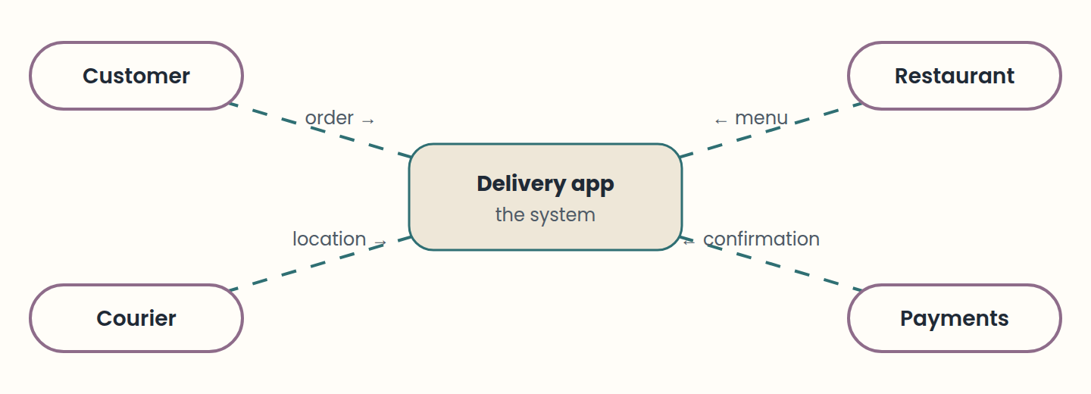
Lesson 4 · Elicitation and analysis: gathering and refining needs
Techniques: interviews, questionnaires, observation, workshops, document analysis, prototypes, scenarios.
Think of it like this. A journalist covering a story interviews witnesses (interviews), reads police reports (document analysis), visits the scene (observation), and then cross-checks the versions to remove contradictions before publishing (analysis). Publishing the first witness's version unchecked is how wrong stories, and wrong software, get made.
Notes:
• Techniques: interviews, questionnaires, observation, workshops, document analysis, prototypes, scenarios.
• Three difficulties: scope, understanding, and volatility.
• Analysis refines, splits, merges, finds conflicts, and checks feasibility.
• Business policies are the client's decisions: make them explicit and keep them configurable.
Elicitation means drawing requirements out of people and sources. Each technique has strengths. Interviews (open or with a script) give depth and let you follow surprises. Questionnaires reach many users cheaply but give shallow answers. Observation (watching people do the real work) reveals steps nobody thinks to mention. Workshops and brainstorming put several stakeholders in one room to agree faster. Document analysis mines forms, manuals, and regulations. Prototypes (sketches or clickable mock-ups) let users react to something concrete, which is often easier than describing a need. Scenarios walk through one concrete situation from start to end.
Elicitation is hard for three classic reasons. Scope: the boundary of the system is unclear, so draw a context diagram like the one above (the system in the middle, the outside actors around it, and the data they exchange) and write what is in and what is out. Understanding: users may not know what they need, use their own jargon, or describe goals at a very high level ("make deliveries better"). Volatility: needs change between meetings, so record what was agreed. Combine written communication (permanent, easy to share and review, but easy to misread) with conversation (immediate feedback, shared understanding with less effort).
Analysis turns the raw pile into a set you can build. You refine vague items into precise ones, split big ones, merge duplicates, find conflicts, and check that each one is feasible and realistic. Take the requirement "a customer can track the courier". Analysis asks: how often does the position update? What does the customer see if the courier's phone loses signal? Is tracking shown before the restaurant hands over the food? One line can grow into several, such as "position refreshes every 15 seconds" and "after 2 minutes without signal, the map shows the last known position and a notice".
Analysis also uncovers business policies: decisions that belong to the client, not to the programmer. How many wrong PIN attempts before an account is locked? How many minutes late can a gym member arrive before losing the spot? How many days does a reserved book wait on the hold shelf before it passes to the next reader? Make each policy explicit, for two reasons: the client and other stakeholders get to decide it, and the code can keep it in one configurable place, because policies change. Finally, negotiation settles conflicts (the council wants 14-day loans so books circulate, readers want 28) and priorities: what must be in the first release, and what can wait. Analysis should not be endless, but it should never be skipped.

Slide 6
Lesson 5 · Specification and validation: writing requirements people can check
An SRS has an introduction, an overall description, specific requirements, and appendices.
One idea per numbered requirement, consistent words, a glossary, a source, and a priority.
Quality: correct, unambiguous, complete, consistent, verifiable, feasible, traceable, modifiable.
Validate with reviews, prototypes, and early test cases, always with the client.
Think of it like this. A recipe is a specification. "Add some salt and bake until done" is ambiguous and unverifiable; "add 5 g of salt and bake at 180 °C for 25 minutes, until a toothpick comes out clean" can be followed by anyone and checked at the end. Validation is the friend who tastes it before the party.
Notes:
• An SRS has an introduction, an overall description, specific requirements, and appendices.
• One idea per numbered requirement, consistent words, a glossary, a source, and a priority.
• Quality: correct, unambiguous, complete, consistent, verifiable, feasible, traceable, modifiable.
• Validate with reviews, prototypes, and early test cases, always with the client.
Specification writes the agreed requirements down so that clients, managers, designers, programmers, testers, and maintainers can all use them. In traditional projects this is a requirements document, often called a software requirements specification (SRS). A well-known template (IEEE 830) has an introduction (purpose, scope, definitions), an overall description (product perspective, main functions, user characteristics, constraints, assumptions and dependencies), the specific functional and non-functional requirements, and appendices. Other common sections are a glossary, system models, and expected evolution. The document describes what the system is and does, not how it will be built.
Write each requirement as a separate, numbered statement, like the card above. Use simple, consistent language; one idea per requirement; the same word for the same thing ("loan", never sometimes "borrowing" and sometimes "checkout"); "must" for obligations and "may" only for true options. Add diagrams where they help and a glossary for domain words. Record the type, the priority, the source (who asked for it), and the reason.
A good requirement has recognisable quality attributes. It is correct (it states a real need) and unambiguous (only one reading: "soon" fails, "within 10 minutes" passes). It is complete (nothing the client needs is missing, including error cases) and consistent (it does not contradict another requirement). It is verifiable (a test can say met or not met), feasible or realistic (buildable with the available technology and budget), traceable (its origin and its links are recorded), and modifiable (it can change without rewriting half the document). Priority and stability are usually noted too.
Validation demonstrates that the requirements describe what the client really wants. It matters because fixing a requirements error after delivery can cost far more than fixing a coding error. The checks are: validity (does it support the real needs?), consistency (any conflicts?), completeness (is every needed function there?), realism (can it be built with this budget and technology?), and verifiability (can we test it?). Techniques include reviews (formal or informal, always with both the client and the developers), prototypes that users try, and writing test cases early: if you cannot write a test for a requirement, it is not clear enough yet.

Slide 7
Lesson 6 · Managing change and tracing requirements
Enduring requirements are stable; volatile ones change (changing, emergent, consequential, compatibility).
Every change: record, analyse impact, approve or reject, apply, new version.
Traceability: source (where it came from), requirements (what depends on it), design (what implements and tests it).
Think of it like this. Moving a load-bearing wall in a house: before you knock it down, you check the plans to see which pipes, cables, and rooms depend on it, you get the owner's signature, and you update the plans afterwards. Traceability is the plan that shows what depends on what; change management is the signature and the update.
Notes:
• Enduring requirements are stable; volatile ones change (changing, emergent, consequential, compatibility).
• Every change: record, analyse impact, approve or reject, apply, new version.
• Traceability: source (where it came from), requirements (what depends on it), design (what implements and tests it).
Requirements always evolve: users understand their needs better once they see the product, the business changes, laws change. Some requirements are enduring (stable, coming from the core of the business: a library will always have readers, books, and loans) and others are volatile (likely to change). Volatile ones come in several kinds: changing requirements follow the environment (a new city rule on late fees), emergent requirements appear as everyone understands the system better, consequential requirements appear because the system itself changes how people work (once readers borrow at self-service kiosks, staff need a screen to fix kiosk errors), and compatibility requirements depend on other systems or processes (the catalogue format of the regional library network).
Requirements management keeps change under control. Each change request is recorded, its impact is analysed (which requirements, designs, code, and tests does it touch, and what will it cost?), it is approved or rejected by the right person, and then it is made, giving the requirements document a new version. Without this, the documents and the running system drift apart until nobody knows which one is true. Organise the document so changes are local: modular sections, few cross-references, and an identifier for every requirement.
Traceability is what makes impact analysis possible. It records the relationships around each requirement. Source traceability links a requirement to the stakeholder or document it came from, so you know whom to ask. Requirements traceability links requirements that depend on each other, so changing one warns you about the others. Design traceability links a requirement forward to the design elements, code, and tests that implement it. The simplest tool is a traceability matrix like the one above; requirement-management tools build these links automatically.

Slide 8
Lesson 7 · User stories: requirements as conversations
Template: As a <role>, I want <goal>, so that <benefit> (who, what, why).
Three Cs: Card, Conversation, Confirmation.
INVEST: Independent, Negotiable, Valuable, Estimable, Small, Testable.
Theme > epic > story > task. Tasks say how; stories say what and why.
The backlog is ordered by value; MoSCoW sorts a release into Must, Should, Could, Won't.
Think of it like this. A user story is like a sticky note on the fridge that says "Mum, buy milk for Sunday pancakes". It does not list brands or fat percentages; it reminds you to talk ("whole or skim?") and it says why, so if the shop has no milk you might buy pancake mix instead.
Notes:
• Template: As a <role>, I want <goal>, so that <benefit> (who, what, why).
• Three Cs: Card, Conversation, Confirmation.
• INVEST: Independent, Negotiable, Valuable, Estimable, Small, Testable.
• Theme > epic > story > task. Tasks say how; stories say what and why.
• The backlog is ordered by value; MoSCoW sorts a release into Must, Should, Could, Won't.
A user story describes one piece of functionality from the point of view of the person who wants it, in their own words, in one or two sentences. The usual template is: As a <role>, I want <goal>, so that <benefit>. For example: "As a reader, I want to renew my loans from my phone, so that I do not have to travel to the library just to keep a book longer." It answers the three Ws: who (the role), what (the goal), and why (the benefit). The why is the most forgotten and the most useful part, because it lets the team find a better solution than the one first imagined.
User stories came from Extreme Programming (XP) in the late 1990s and were popularised by Mike Cohn. They combine the strengths of written and spoken communication, summed up as the three Cs. Card: the story is short enough to fit on an index card, a reminder rather than a full specification. Conversation: the details are discussed with the team and the product owner, again and again, not written once and thrown over a wall. Confirmation: acceptance criteria, agreed before work starts, say when the story is done. Anyone may write stories, but in Scrum the product owner usually keeps them in the product backlog.
The role should be a real kind of person, ideally a persona: a short, realistic profile (name, situation, goals, frustrations) that the team can empathise with. "As a user" is weak; "as a night-shift nurse who can only visit the library on Sundays" makes needs visible. The goal states the person's intention, not a screen element. A good story also passes INVEST: Independent (can be built in any order), Negotiable (details are open for discussion), Valuable (delivers value to a user or the business), Estimable (the team can size it), Small (fits in one iteration, usually a 1–2 week sprint), and Testable (has clear acceptance criteria).
Stories live in a hierarchy, shown in the block above. A theme is a broad area of the product made of related epics. An epic is a story too big for one iteration (it can take weeks or months), with more uncertainty, which will be split as its turn approaches. A story fits in an iteration, typically 1 to 5 days of work. Tasks are the technical steps to build a story; they describe how, in developer language, and do not follow the template. Besides the description, a story card often carries an ID, an estimate (story points), a priority or business value, acceptance criteria, dependencies, and the Definition of Done the team agreed on.
Agile teams usually do not give stories separate priority labels. The client or product owner keeps the backlog ordered: the top items are the most valuable and are refined first, and developers take items from the top for the next iteration. While an iteration runs, its selected items are not reprioritised, so developers have a stable goal; the rest of the backlog stays flexible. When a team must decide what goes into a release, a common technique is MoSCoW: Must have (the release fails without it), Should have (important but there is a workaround), Could have (nice if time allows), and Won't have this time (explicitly out, for now).

Slide 9
Lesson 8 · Acceptance criteria, Given–When–Then, and splitting stories
Acceptance criteria say when a story is done; agree on them before work starts.
Given (context), When (event), Then (expected result); And adds more.
Cover the happy path and the important unhappy paths with real example values.
More than about five criteria? Split the story: by steps, rules, paths, roles, data, operations.
Think of it like this. A driving test has clear acceptance criteria: given a parking space between two cars, when you park, then you finish in under three moves without touching either car. The examiner does not judge "drives well" by feeling; the criteria decide, and everyone knows them before the test starts.
Notes:
• Acceptance criteria say when a story is done; agree on them before work starts.
• Given (context), When (event), Then (expected result); And adds more.
• Cover the happy path and the important unhappy paths with real example values.
• More than about five criteria? Split the story: by steps, rules, paths, roles, data, operations.
Acceptance criteria are the Confirmation of a story: the conditions that must hold for the product owner to accept it as done. They turn a short story into something testable and help the team estimate and decide during development. The simplest form is a checklist. For "As a customer, I want to tip my courier in the app, so that I do not need cash": the tip can be 0, 10, 15, or 20% or a custom amount; the tip is charged with the order; the courier sees the tip after delivery; a tip cannot be negative. If you find more than about five criteria, the story is probably too big and should be split.
A more precise form describes scenarios with Given–When–Then, the style of Behaviour-Driven Development (BDD), often written in a language called Gherkin, as in the block above. Each scenario has a title, a context (Given: the situation before), an event (When: what the user does), and an expected result (Then: what the system does). And adds more conditions or results. Write one scenario for the happy path and one for each important unhappy path: the class is full, the card is declined, the plan has expired. Good criteria are specific and measurable, use real example values (19:00, 3 bikes), and describe behaviour, not screen layout.
Acceptance criteria become acceptance tests: given specific inputs, the system passes or fails. The customer runs or reviews them throughout the project, not only at the end. You can never test every possible situation, but choosing scenarios systematically (normal values, limits, errors) raises coverage. Acceptance criteria are different from the Definition of Done: the criteria are specific to one story, while the Definition of Done applies to every story (code reviewed, tests passing, documentation updated).
Big stories hide uncertainty, so teams split them in refinement meetings until each slice is small, valuable on its own, and testable. Common ways to slice: by workflow steps (choose dishes, set the address, pay, get confirmation); by business rules (minimum order amount, delivery zones); by happy versus unhappy path (pay with a saved card, then card declined, then payment service not responding); by platform or input (phone, desktop, kiosk); by data type or parameter (search by name, by price, by distance); by operation (create, read, update, delete a class); by role (member, trainer, owner); by test scenarios; by "simple now, optimise later" (search by address now, by GPS later); and by acceptance criteria. Often the first slices are enough to release, and the rest can wait.

Slide 10
Step by step
Put the process in order
1
2
3
4
5
6
Feasibility: check that budget and technology allow it
Elicitation: interview groomers and watch a busy Saturday
Analysis: resolve conflicts and agree priorities with the owner
Specification: write the numbered requirements and stories
Validation: review them with the owner using a prototype
Management: record and approve each later change
Notes:
This is the first pass. In real projects the activities repeat every iteration, and management continues for the life of the product.

Slide 11
Check yourself
1. A client writes: "Store each order in PostgreSQL with a UUID key." What is it?
A) A design decision, not a requirement B) A functional requirement C) A business requirement
2. Which statement is a system requirement rather than a user requirement?
A) A returned copy that someone reserved waits 3 days on the hold shelf, then passes to the next reader in the queue. B) Readers can reserve books online. C) The library wants shorter waits for popular books.
3. A gym app goes live. A week later, the city's consumer-protection office says members must be able to cancel online as easily as they signed up. Which step was weak?
A) Stakeholder identification and elicitation: a regulator was missed B) Coding: the developers typed too slowly C) Nothing: laws are not requirements
Answers are in the speaker notes.
Notes:
1. A — It says how to build something (database and key type), not what the user needs. Unless the client imposes PostgreSQL as an organisational constraint, it belongs to design.
2. A — The first gives developers precise detail. The second is a user requirement in plain language, and the third is a business goal.
3. A — External bodies are stakeholders and laws produce external non-functional requirements. Missing them early forces an expensive change after release.

Slide 12
Practise next
Labs
On the site
From complaint to requirements: a public library
Requirements review: fix a weak specification
A backlog for a gym app: stories, INVEST, and Given–When–Then

