Slide 1
Introduction to SM
(Special Measure in Matlab)
Outline
PART I: Command line based package
Basic idea and features
Motivation and advantages
Comparison of Matlab and Labview implementations.
Basic concepts
PART II: GUI
More information: ygroup\MATLAB\sm\README.TXT,
help of smrun.m and other commands.

Slide 2
Basic idea and features
Based on "abstraction" of instruments: Each physical variable can be controlled and read out in the same way. Instrument specific information is (mostly) confined to drivers.
Support of buffered readout, e. g. can read a whole scanline at once. => fast - sample rate hardware limited. => easier to accommodate hardware controlled measurements.
Command line based low level interface
Optional GUI builds on top.

Slide 3
Advantages of command based approach
Can configure complicated measurements (e.g. ramps, modules) with user defined Matlab functions or scripts.
Can run a series of measurements autonomously.
Rapid code development for specific tasks (don't need to program an edit for every parameter).
Full power of Matlab command line available: e.g. send arbitrary GPIB commands to instruments without further programming.
No GUI related bugs.
Provides basis for GUI => can combine best of both worlds.

Slide 4
Incomplete listing of the most important commands
Main routines:
smrun.m - 512 lines
smset.m - 145 lines
smget.m
Rarely used
low level:
smopen.m
smclose.m
smprintf.m
smquery.m
smscanf.m
smflush.m
Display tools
smprintchannels.m
smprintinst.m
smprintrange.m
smprintscan.m
Setup tools
smaddchannel.m
smscanpar.m
smdiagpar.m
smdispchan.m
sminitdisp.m
smloadinst.m
smsaveinst.m
smsavechans.m
smloadchans.m
logsetfile.m
Helper functions
sminc.m
smrestore.m
smgetscanconst.m
smsetscanconstant.m
Internal
smchaninst.m
smchanlookup.m
sminstlookup.m

Slide 5
Most important elements
Main measurement command:
smrun(scan, ’data_324’)
Name of data file. Actual filename will be
‘sm_data_324.mat’. This file will contain the data, a copy of scan, and further configuration data.
scan:
Struct containinfg information about scan (#loops, channels, scan range etc.)
Defining a measurement:
scan =
data: [1x1 struct]
loops: [1x2 struct]
configfn: [1x1 struct]
disp: [1x2 struct]
saveloop: 2
trafofn: {}
Optional user data
Information about each loop
Optional configuration function (e.g. program inst’s)
What data to display and how
When to save data
Optional global transformation (e.g. for rotated scans)

Slide 6
scan.loops(1)=
npoints: 50
rng: [-0.3705 -0.3655]
setchan: {'GateR'}
getchan: []
trafofn: []
ramptime: -0.0400
procfn: []
trigfn: [1x1 struct]
scan.loops(2) =
npoints: 40
rng: [-0.3975 -0.3925]
setchan: {'GateL' 'GateQPC'}
getchan: {'Scope1' 'Scope2'}
trafofn: {[] [1x1 function_handle]}
ramptime: []
procfn: [1x2 struct]
trigfn: []
scan.loops(3) = …
Fastest loop
# of samples
Range of dummy variable
Channel(s) to be set
Time per point. < 0 => use instrument
generated ramp.
User function to trigger ramp
(better synchronization)
Second loop
Channel(s) to read
Transformation for set channels.
Data preprocessing functions

Slide 7
>> smprintscan(scan)
Global transformations:
-----------------------
Loop 1
-------
x = -0.371 to -0.365, 50 points
Channels set : GateR
Ramptimes : -4.00e-002 s/point
Transform's :
Channels read:
Loop 2
-------
x = -0.398 to -0.393, 40 points
Channels set : GateL GateQPC
Ramptimes : NaN s/point NaN s/point
Transform's : identity @(x,y)-0.334-1.02*(x(2)+0.405)-0.1*(y(6)+0.250)
Channels read: Scope1 Scope2

Slide 8
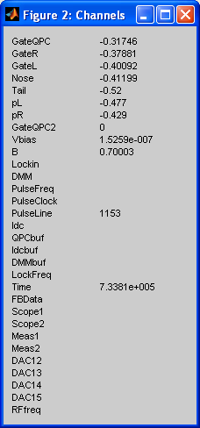
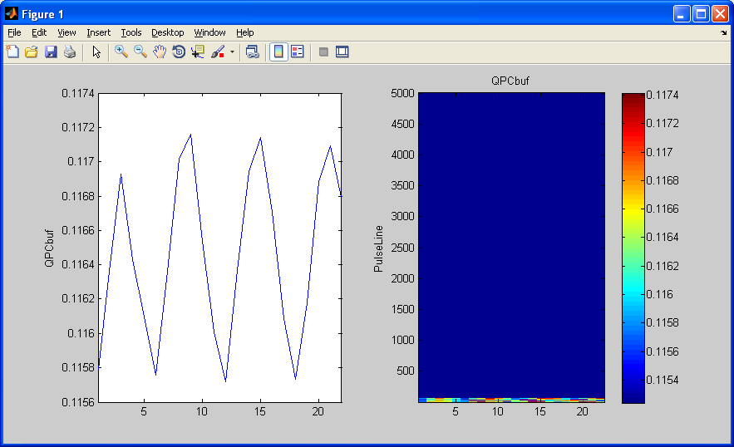
Channel value and data windows

Slide 9
Instrument and channel configuration
global smdata;
smdata =
inst: [1x13 struct]
channels: [1x31 struct]
chandisph: 1.0017
chanvals: [1x31 double]
configch: [1 2 3 4 5 6 7 8 9 10]
configfn: {}
smdata.inst(7) =
data: [1x1 struct]
datadim: [16x1 double]
cntrlfn: @smcSR830
type: [16x1 double]
device: 'SR830'
name: []
channels: [16x5 char]
Instruments
Channels
Last known channel values.
Channels to be saved in data file.
Functions to be called to read out configuration.
Each element represents one physical instrument (e.g. SR830, Yoko, …)
User data, typically the interface object.
Dimension of data block returned for each channel (# samples per readout)
Driver function
Type of each channel (1: supports ramps)
Device identifier
Device name (needed if identifier not unique)
List with names of channels provided.

Slide 10
Display instruments:
>> smprintinst(6:13)
Inst Device Dev. Name
---------------------------
6 TDS5104
7 SR830
8 HP34401A
9 AMI420
10 AWG520
11 HP1000A
12 Aux
Feedback
Channel configuration
Each channel represents one function/variable of some instrument.
Index of associated inst and its channel
Limits, max ramp rate, conversion factor
Channel name.
smdata.channels(1) =
instchan: [2 2]
rangeramp: [-0.6000 0 0.0300 11]
name: 'GateQPC'

Slide 11
>> smprintchannels
CH Name Device Dev. Name Dev. Ch.
-------------------------------------------------
1 GateQPC DecaDAC RAMP0
2 GateR DecaDAC RAMP1
3 GateL DecaDAC RAMP2
4 Nose DecaDAC RAMP4
5 Tail DecaDAC RAMP5
6 pL DecaDAC RAMP6
7 pR DecaDAC RAMP7
8 GateQPC2 DecaDAC RAMP8
9 Vbias DecaDAC RAMP9
10 B AMI420 FIELD
11 Lockin SR830 X
>> smprintrange(7:11)
CH Name Min Max Rate (1/s) Factor
---------------------------------------------------------------
7 pR -0.6 0 0.03 11
8 GateQPC2 -0.6 0 0.03 11
9 Vbias -0.001 0.001 0.001 1e+003
10 B -7.9 7.9 0.0033 1
11 Lockin -Inf Inf Inf 1

Slide 12
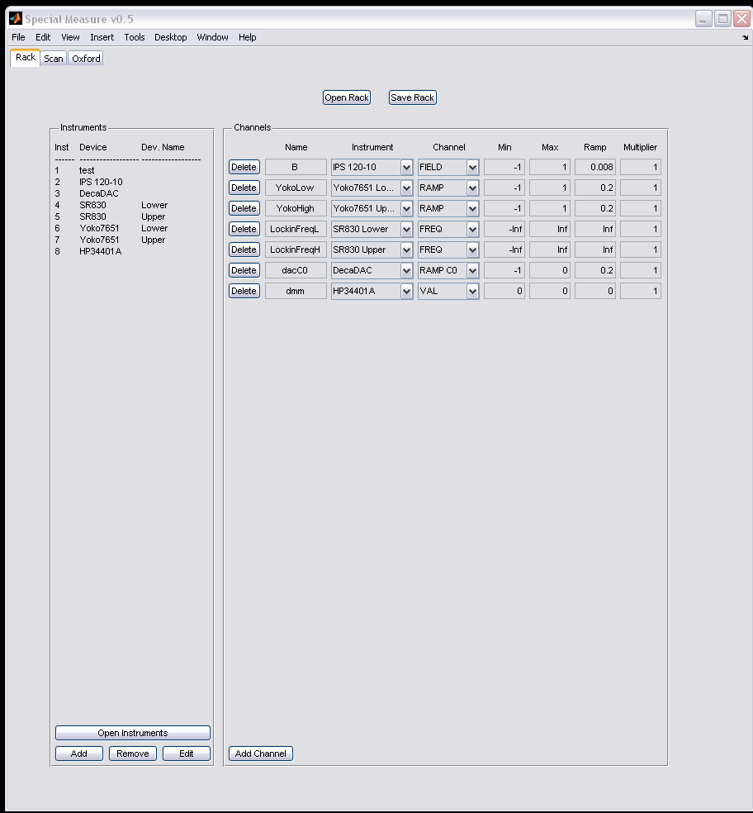
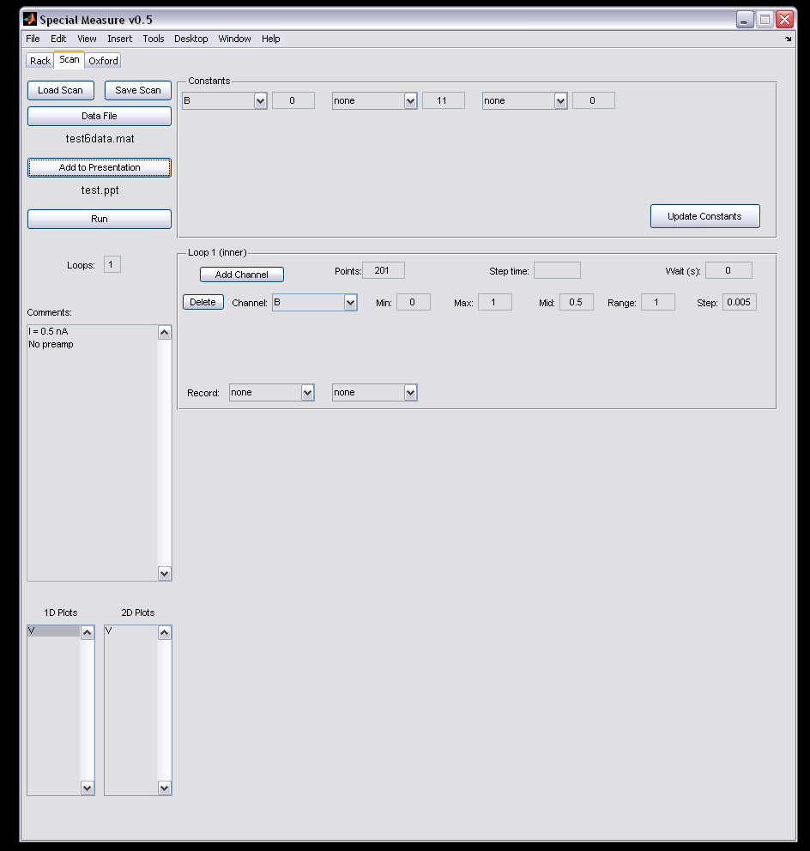
GUI
Provides an environment similar to the LabView Special Measure Front Panel

Slide 13
GUI Functions
Setting up simple scans
Ramps, linear sweeps, etc.
Only supports single scans for now
Editing previously created scans
Change ranges, channels, etc.
Log data to Powerpoint

Slide 14
Rxx_107.mat
1/27/2009 11:55 PM
LockinFreq = 11 R_{23 1 3 2} I = 4 nA No preamp

