Slide 1
O Say Can You See
Network Analysis and Relationship Exploration with Linked Data
Jessica Dussault, University of Nebraska-Lincoln

Slide 2
Introduction
Programmer / Dr. Thomas Substitute
Programmer at CDRH, University of Nebraska
BA Music and History, University of Nebraska
MSc Digital Humanities, University College London

Slide 3

Introduction
Early Washington D.C., Family & Law

Slide 4
Part I: Overview and Current Site
Part II: Make Your Own Ontology Part III: Querying Data

Slide 5
Introductions

Slide 6
The Tech Behind OSCYS

Slide 7
Part I: Linked Data
The Site, Documents, and Search
XML Encoded Documents (TEI)
Ruby on Rails
Apache Solr
The Relationships
Apache Fuseki
Linked Data

Slide 8
“It is about making links...when you have some of it, you can find other, related, data.” https://www.w3.org/DesignIssues/LinkedData.html

Slide 9
Linked Data
vs
Relational Databases

Slide 11
Triples

Slide 12
Part I: Linked Data
Benjamin Sisko has rank Captain
Sisko serves on DS9
Sisko knows Jadzia Dax
Dax has rank Lt. Commander
Dax serves on DS9
Dax has position Chief Science Officer
Worf is the son of Mogh
Mogh is a Klingon warrior

Slide 13
Part I: Linked Data
Dax has rank Lt. Commander
"Dax" refers to the same entity each time
Dax serves on DS9
Dax has position Chief Science Officer

Slide 14
Resource Description Framework

Slide 15
Resource
an entity with a URI
Literal
a single use description

Slide 16
Part I: Linked Data
Her name is a literal
#1 is named "Jadzia Dax"
#1 refers to a resource
#1 serves on DS9
These could be resources
#1 has position Chief Science Officer
#1 has rank Lt. Commander
startrek.fake/people#1
startrek.fake/people#Dax_Jadzia

Slide 17
Part I: Linked Data
Subject
Predicate
Object
Sisko
rank
Captain
Resource

Slide 18
Part I: Linked Data
Subject
Predicate
Object
starktrek.fake/people #Sisko_Benjamin
rank
startrek.fake/ranks #Captain
Resource
???
Resource

Slide 19
Part I: Linked Data
Web Ontology Language ≈ OWL
Ontology is the philosophical study of the nature of being, becoming, existence, or reality -- wikipedia

Slide 20
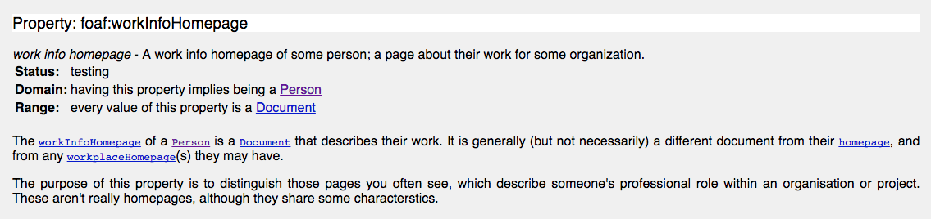
Part I: Linked Data

Slide 21
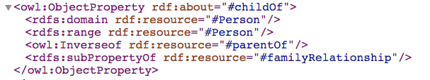
Part I: Linked Data

Slide 22

Part I: Linked Data
Sisko
rank
Captain
serves on
Deep Space 9

Slide 23
Part I: Linked Data
Lt. Commander
knows
Sisko
rank
Captain
Dax
serves on
Deep Space 9

Slide 24
Part I: Linked Data
Give me anything connected to other things
?subject ?predicate ?object
?subject | ?predicate | ?object
Sisko | knows | Dax
Dax | knows | Sisko
Sisko | rank | Captain
Dax | rank | Lt. Commander
Sisko | serves on | Deep Space 9
Dax | serves on | Deep Space 9

Slide 25
Part I: Linked Data
Lt. Commander
Worf
knows
Sisko
rank
Captain
Dax
serves on
Deep Space 9

Slide 26
Part I: Linked Data
Lt. Commander
Worf
knows
Sisko
rank
Captain
Dax
serves on
Deep Space 9
Who has ?
rank
Lt. Commander

Slide 27
Part I: Linked Data
Who has rank Lt. Commander? ?person rank Lt. Commander
?person | rank | Lt. Commander
Worf | rank | Lt. Commander
Dax | rank | Lt. Commander
?person
Worf
Dax

Slide 28
Part I: Linked Data
Lt. Commander
Worf
knows
Sisko
rank
Captain
Dax
serves on
Deep Space 9
Who has anything?
rank

Slide 29
Part I: Linked Data
Lt. Commander
Worf
knows
Sisko
rank
Captain
Dax
serves on
Deep Space 9
Who has ? Those people what vessel / station?
rank
Lt. Commander
serve on

Slide 30
Part I: Linked Data
?person | rank | Lt. Commander
Worf | rank | Lt. Commander
Dax | rank | Lt. Commander
?person | serves on | ?vessel
Worf | serves on | Deep Space 9
Dax | serves on | Deep Space 9
?person | ?vessel
Worf | Deep Space 9
Dax | Deep Space 9

Slide 31
Linked Data in OSCYS

Slide 32
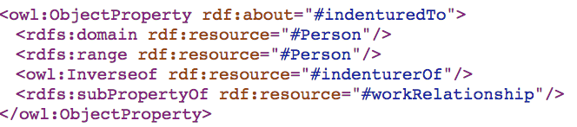
Part I: Linked Data
?person1 | ?relationship | ?person2
Lee, Edmund J. | attorneyAgainst | Thornton, Joseph
Eliza | indenturedTo | Wetzel, John

Slide 33
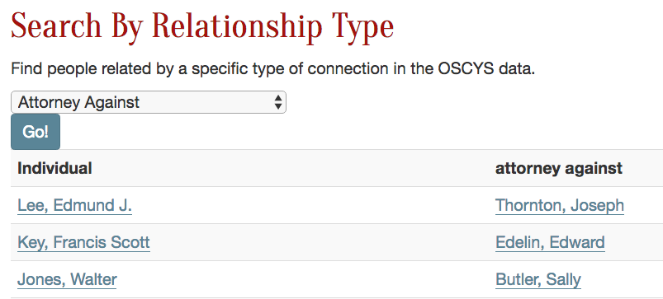
Part I: Linked Data

Slide 34
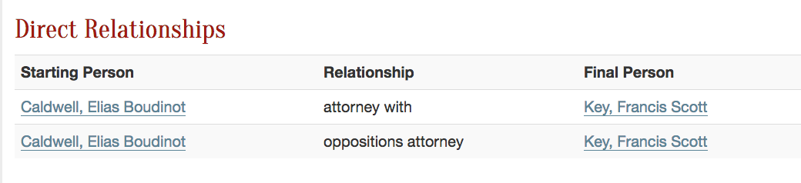
Part I: Linked Data

Slide 35
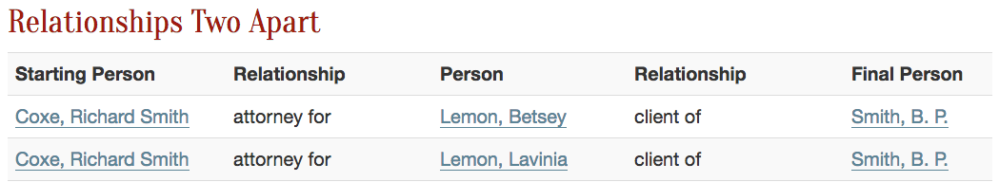
Part I: Linked Data

Slide 36
Part I: Linked Data
Coxe, Richard Smith | ?relationship1 | ?person1
Coxe, Richard Smith | attorneyFor | Lemon, Betsey
Coxe, Richard Smith | attorneyFor | Lemon, Lavinia
?person1 | ?relationship2 | Smith, B. P.
Lemon, Betsey | clientOf | Smith, B. P.
Lemon, Lavinia | clientOf | Smith, B. P.
?relationship1 | ?person1 | ?relationship2
attorneyFor | Lemon, Betsey | clientOf
attorneyFor | Lemon, Lavinia | clientOf

Slide 37
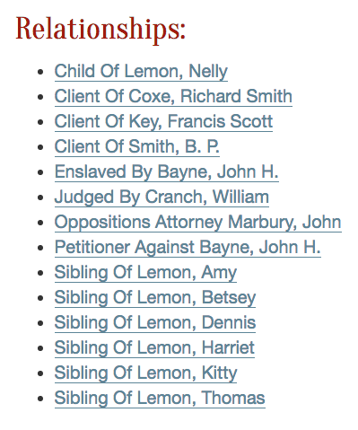
Part I: Linked Data

Slide 38
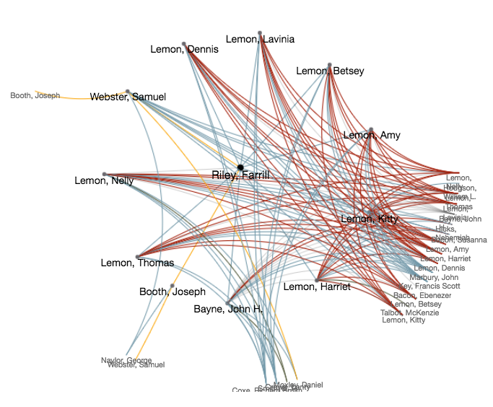
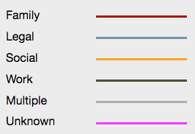
Part I: Linked Data
http://earlywashingtondc.org/people/network/per.001437

Slide 39
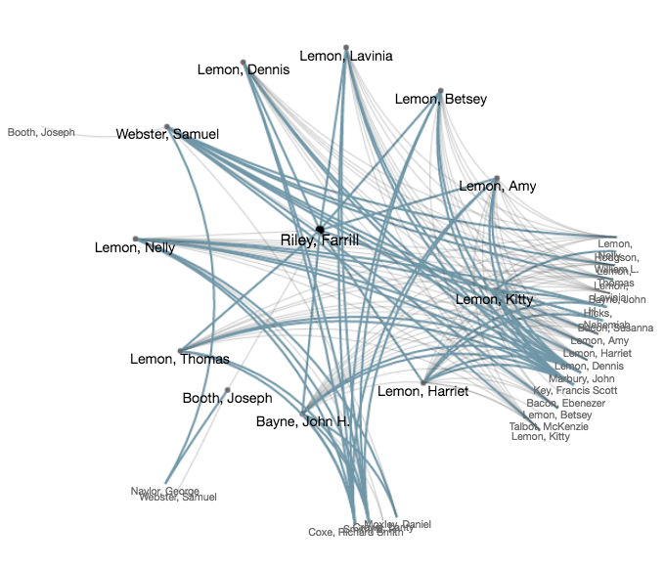
Part I: Linked Data

Slide 40
Decisions

Slide 41
Part I: Linked Data
Custom ontology
Focus on relationships, not cases
Marking relationships by hand

Slide 42
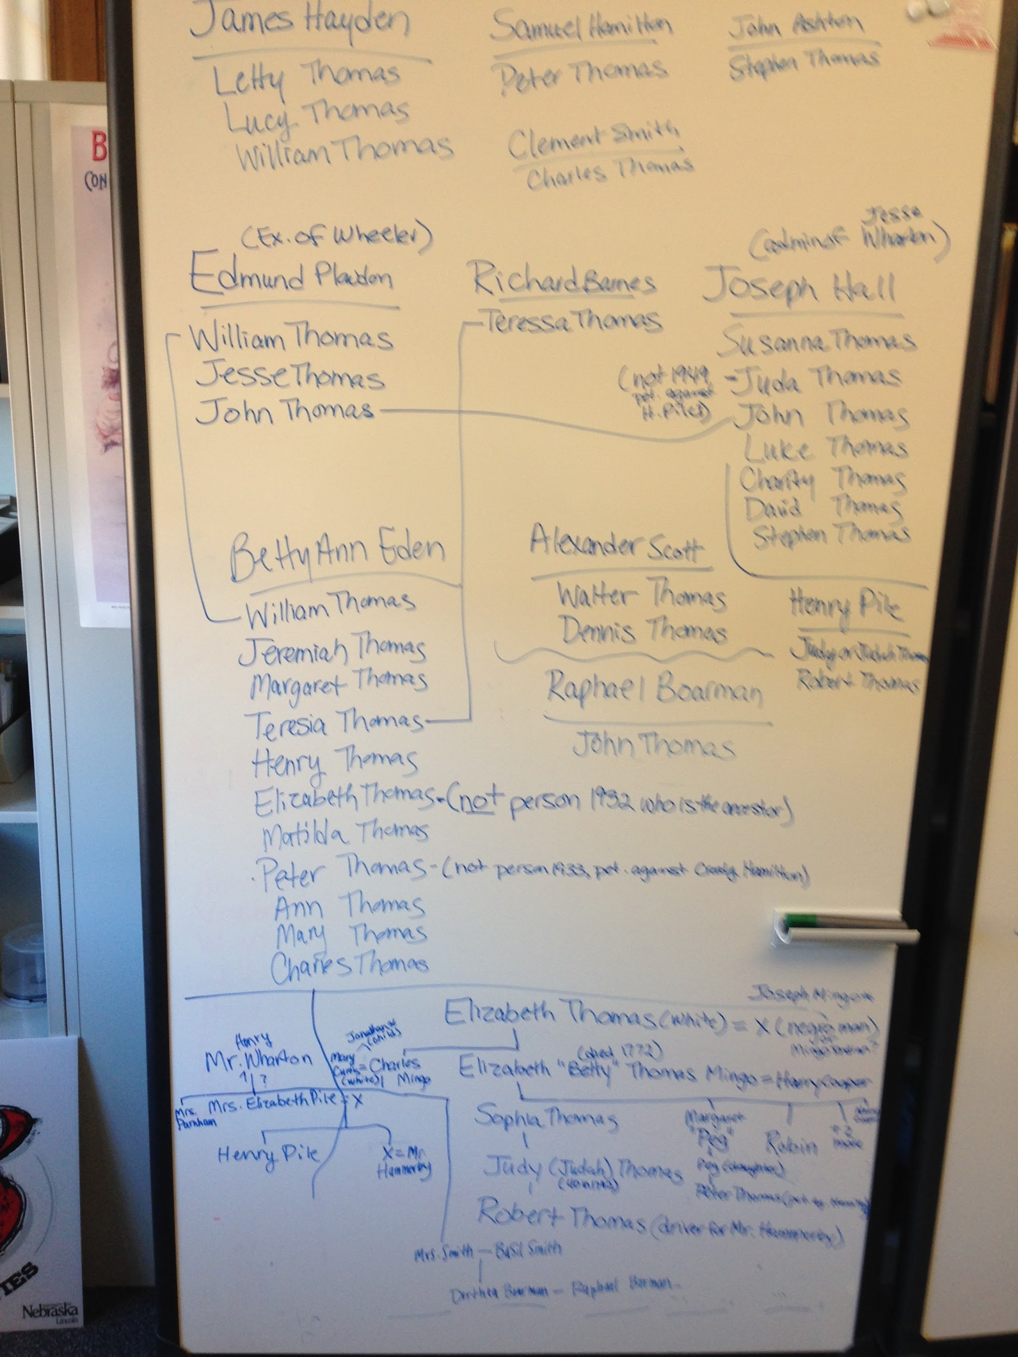
Part I: Linked Data

Slide 43
Part I: Linked Data
Visualization
Dynamic vs pregenerated content

Slide 44
Future Developments

Slide 45
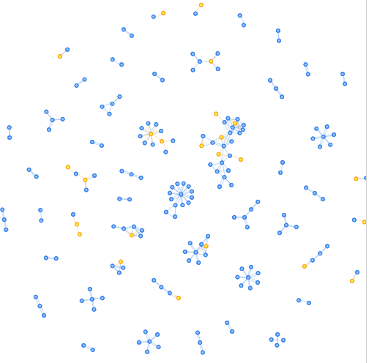
Part I: Linked Data

Slide 46
Part I: Linked Data
Link to other ontologies and resources
VIAF (http://viaf.org/viaf/36978042.rdf)

Slide 47
Part I: Linked Data
Create visualization of ALL the relationships
birds eye view of isolated individuals
family networks
social / legal networks

Slide 48
Part I: Linked Data
Analyze relationships through time and space

Slide 49
Break!

Slide 50
Ontology Workshop

Slide 51
Part II: Ontology
Look at case files
Develop questions
Design ontology that can find an answer

Slide 52
Part II: Ontology
Family
Legal
Labor
Social
parent of
judge of
enslaved by
neighbor of
child of
attorney for
had contract with
lives with
birth date
occupation
first name

Slide 53
Part II: Ontology
<owl:DatatypeProperty rdf:about="#birth"/>
<owl:DatatypeProperty rdf:about="#sex"/>
<owl:ObjectProperty rdf:about="#familyRelationship">
<rdfs:domain rdf:resource="#Person"/>
<rdf:type rdf:resource="http://www.w3.org/2002/07/owl#SymmetricProperty"/>
</owl:ObjectProperty>
<owl:ObjectProperty rdf:about="#childOf">
<owl:Inverseof rdf:resource="#parentOf"/>
<rdfs:subPropertyOf rdf:resource="#familyRelationship"/>
</owl:ObjectProperty>

Slide 54
Part II: Ontology
Example Case:
earlywashingtondc.org/cases/oscys.caseid.0181 Ontologies and Relationships:
earlywashingtondc.org/about/data

Slide 55
Break!

Slide 56
Querying Datasets

Slide 57
Part III: Queries
dbpedia
http://catalog.data.gov/dataset
earlywashingtondc.org

Slide 58
Part III: Queries
http://dbpedia.org/page/Francis_Scott_Key

Slide 59
Part III: Queries
http://dbpedia.org/sparql

Slide 60
Part III: Queries
SELECT * FROM <dataset.url> WHERE { ?s ?p ?o }

Slide 61
Part III: Queries
select *
where {
<http://dbpedia.org/resource/George_Washington> ?p ?o
}
LIMIT 100

Slide 62
Part III: Queries
PREFIX db:<http://dbpedia.org/resource/>
select *
where {
db:George_Washington ?p ?o
}
LIMIT 100

Slide 63
Part III: Queries
PREFIX db:<http://dbpedia.org/resource/>
select *
where {
db:wikipedia_url ?p ?o
}
LIMIT 100

Slide 64
Part III: Queries
Examples and links here:
https://github.com/jduss4/presentations/

Slide 65
Questions and Discussion

