Slide 1
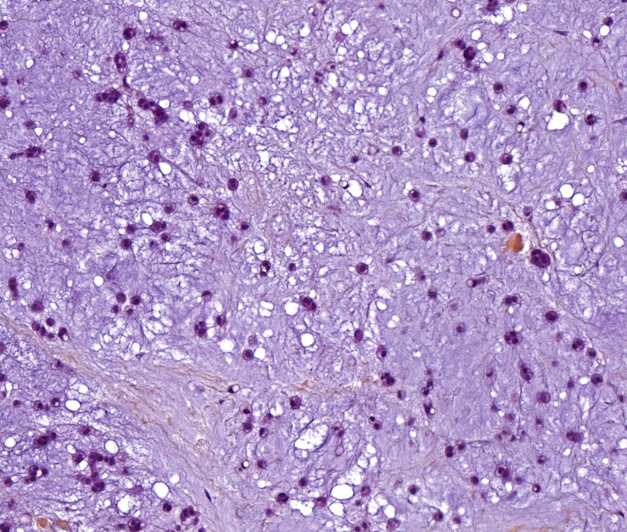
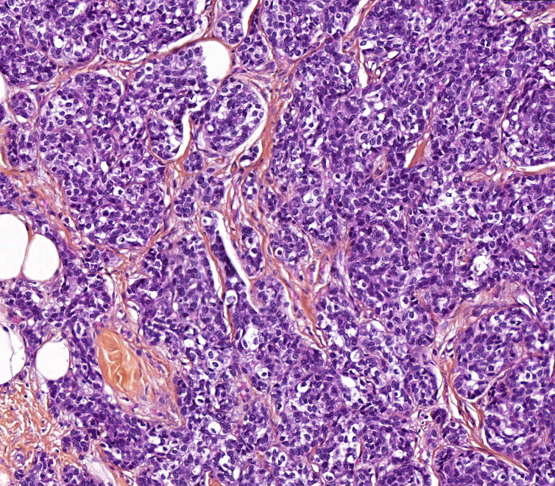
Chondroid tumoral cells
Epithelial tumoral cells

