Slide 1
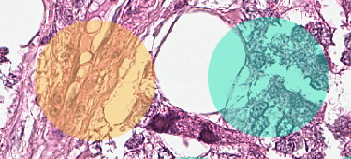
Chondroid tumor cells
Epithelial tumor cells

