Slide 1


Evolutionary determinants and trajectories of metaplastic breast carcinomas
Student : Jordan DUTEL
Tutor : Dr Pierre MARTINEZ
Team : Prof Pierre SAINTIGNY
Oral presentation - ED CanBioS
July 03, 2025

Slide 2
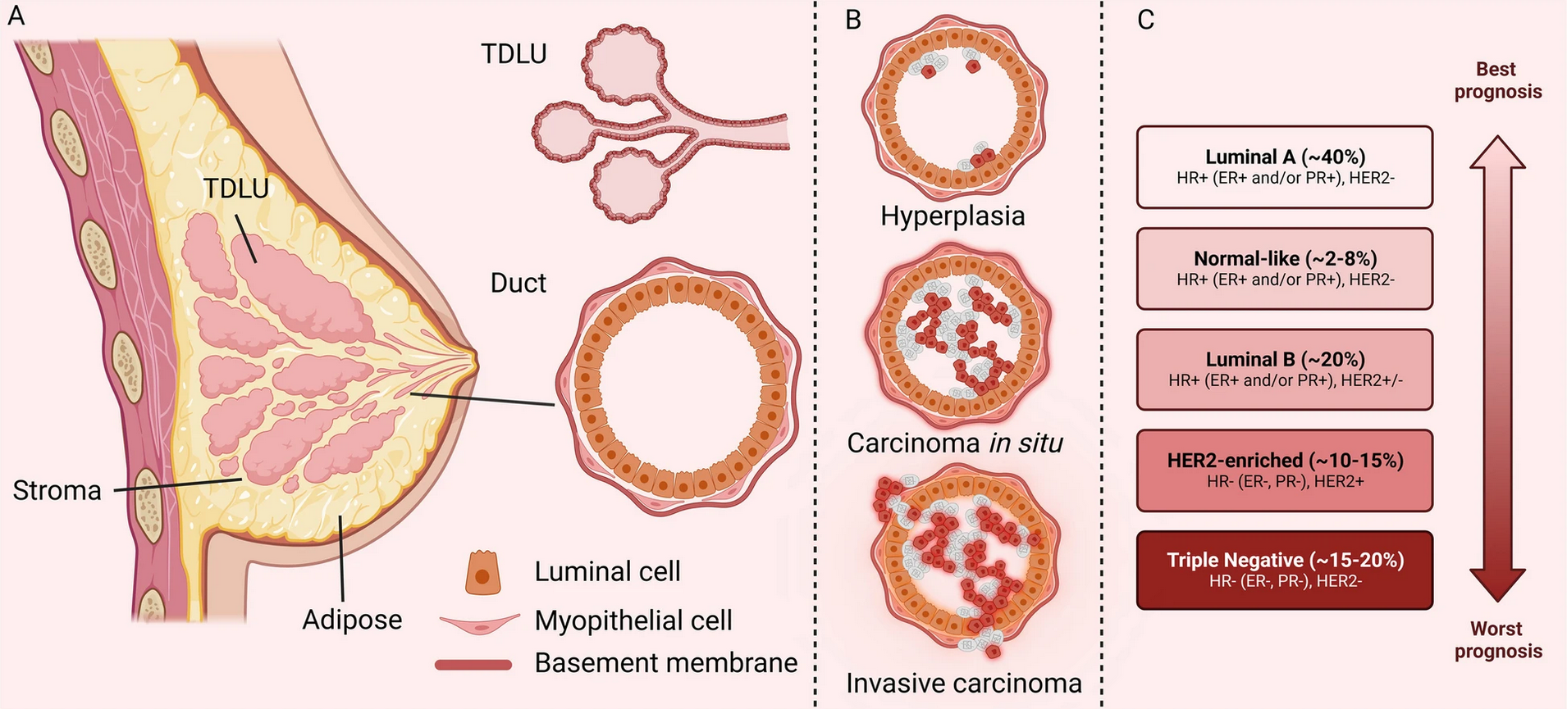
Introduction
TNBC: Triple-Negative Breast Cancer
TDLU: Terminal Duct Lobular Units
Taken from:
Chang-Yun Li
biomedcentral.com
(CC BY 4.0)
⇒ MpBC (Metaplastic Breast Carcinomas) are rare forms of TNBC, lacking molecular diagnostic markers and specific therapies
Notes:
Les MpBC (Metaplastic Breast Carcinomas) sont : Formes rares, agressives et invasives du cancer sein triple négatif -Absence d’expression des récepteurs à l’œstrogène (ER), progestérone (PR) et HER2 - Thérapies classiques du cancer du sein inefficaces.
Les MpBC (Metaplastic Breast Carcinomas) sont :
Très mal caractérisés
Uniquement diagnostiqués histopathologiquement
Aucun marqueur moléculaire spécifique

Slide 3
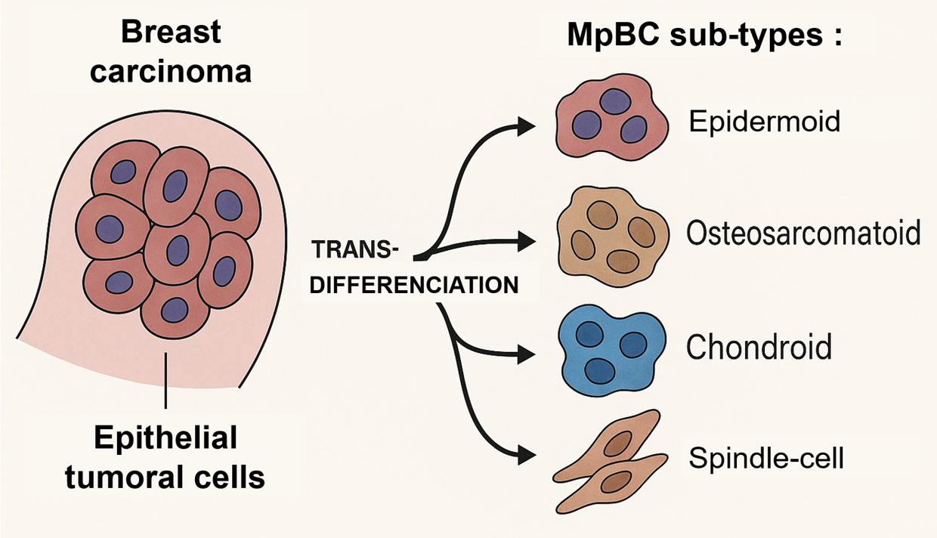
Introduction
⇒ MpBC can transdifferentiate into various aggressive tumor subtypes

Slide 4
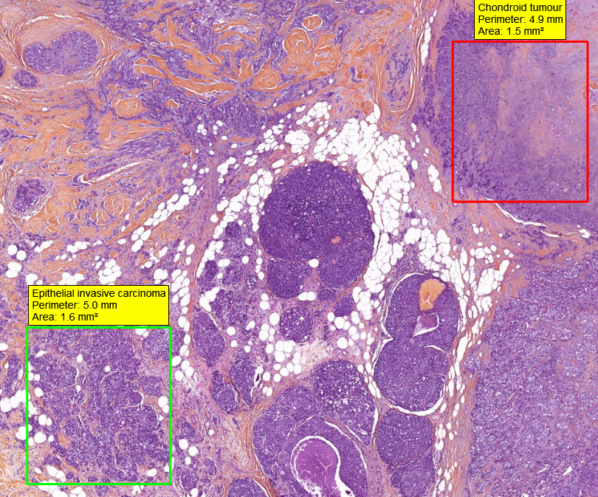
Introduction
MpBC exhibits a remarkable plasticity
Transdifferenciation into multiple aggressive tumor subtypes
Mixed MpBC
Each sample contains at least 2 tumoral compartments

Slide 5
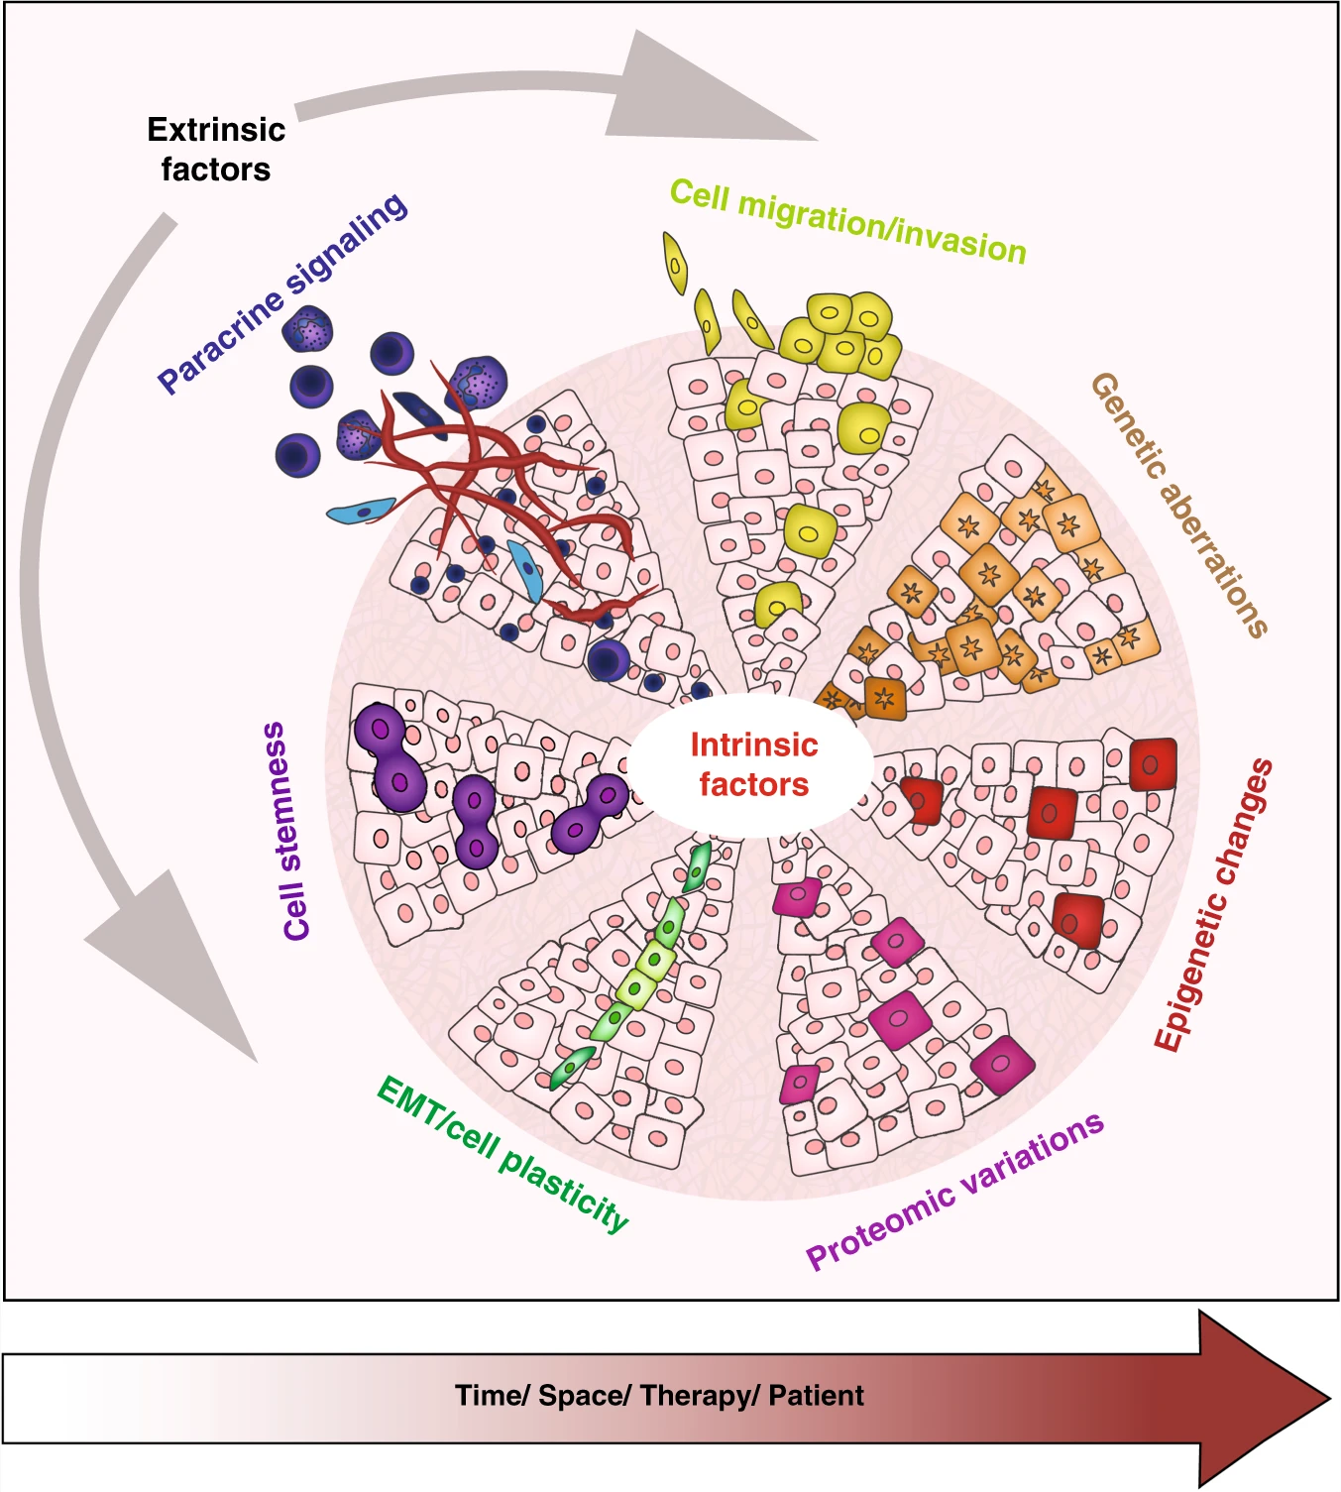
Research questions
Understanding the evolutionary trajectories in MpBC
Internal determinants (genetic and epigenetic)
External determinants (tumor microenvironment)
Identify molecular biomarkers to improve diagnostic precision
Taken from: Lüönd, F., Tiede, S. & Christofori, G. (2021).

Slide 6
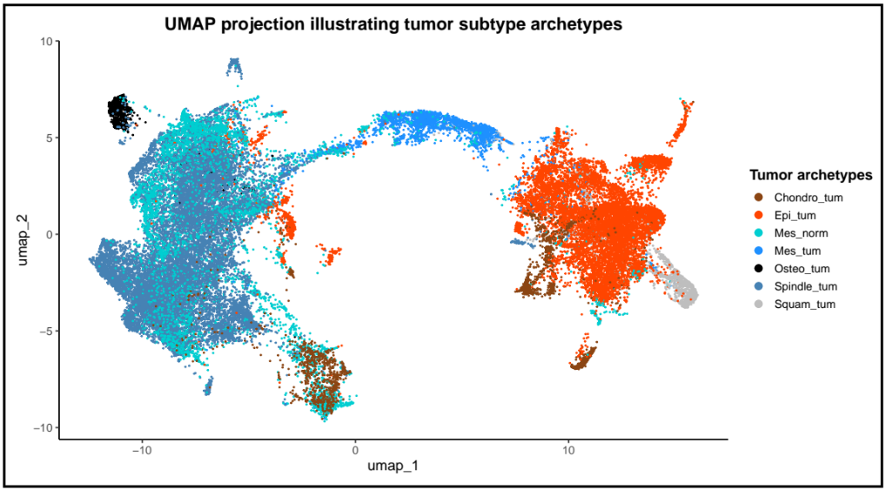
Preliminary results: Expression markers analysis
⇒ 15 mixed MpBC samples analysed

Slide 7
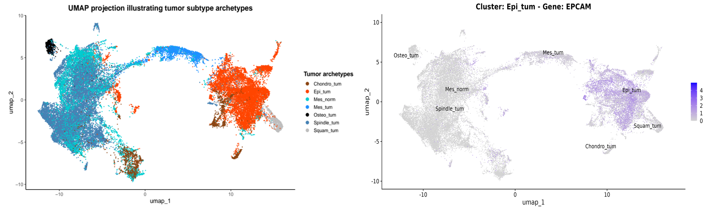
Preliminary results: Expression markers analysis
⇒ Some phenotypic markers identified are specific to clusters

Slide 8
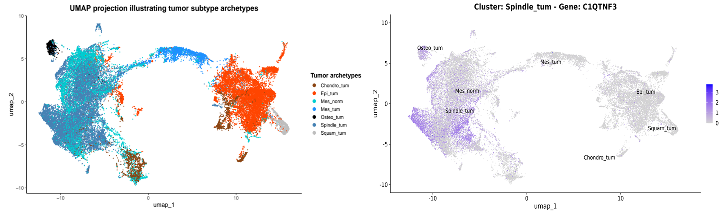
Preliminary results: Expression markers analysis
⇒ Few phenotypic markers aren’t specific enough (Visium limitations)
⇒ Different spot purity depending on the subtypes

Slide 9
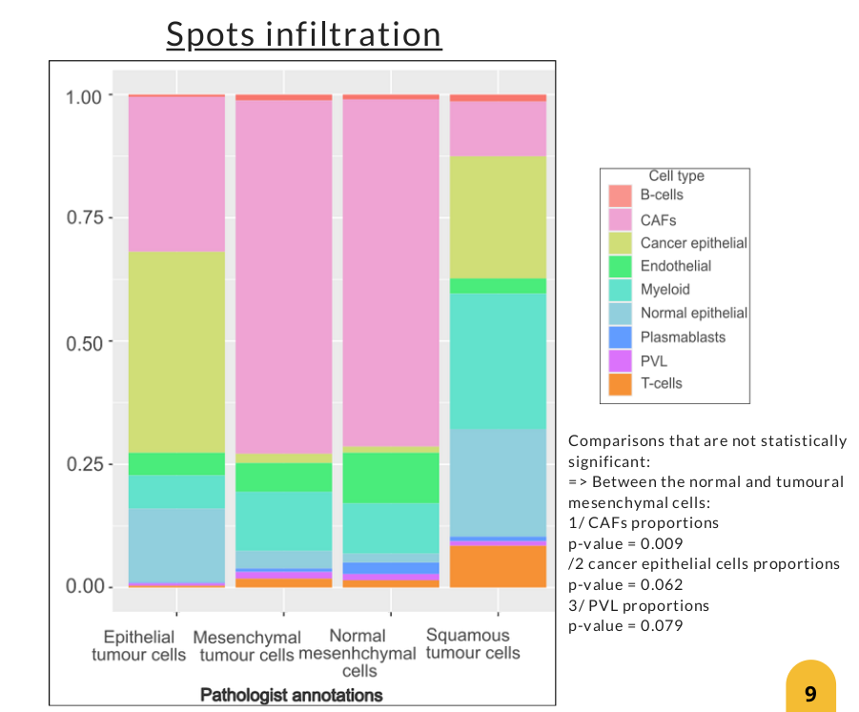
Preliminary results: Spot deconvolution & TME
Visium spots deconvolution
Misattribution of the spindle-cell subtype transcriptomic signature to the presence of fibroblasts
⇒ Necessity to build a transcriptomic atlas specific to MpBC
Epithelial tumor cells
Spindle-cell
Mesenchymal
normal cells
Squamous
tumor
cells
Adapted from:
Ines Kardous, M2 Internship (2024).

Slide 10
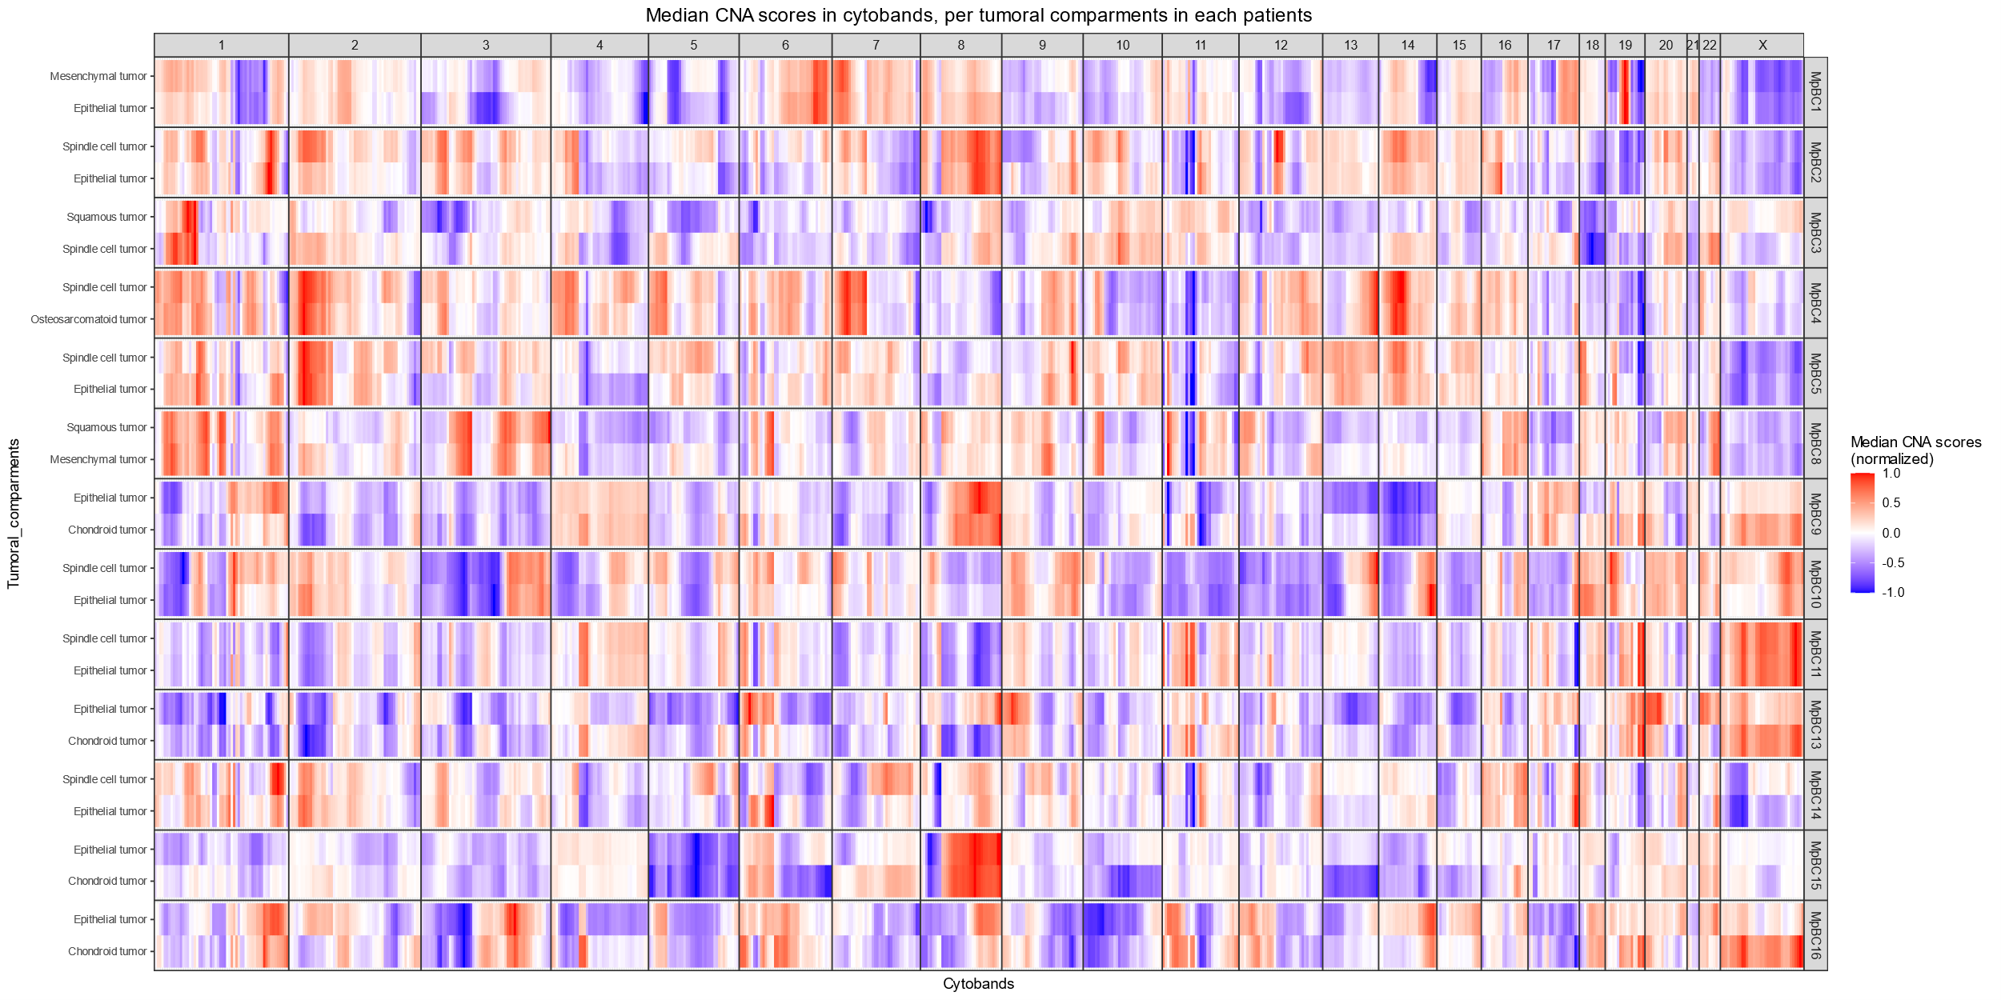
Preliminary results: Genetic determinants (CNA)
⇒ Limited genomic divergence between matched tumor compartments
CNA: Copy Number Alteration

Slide 11
Research axis
Development of a single-cell and spatially resolved transcriptomic atlas dedicated to metaplastic breast carcinomas (MpBC)
Characterization of genetic and non-genetic determinants driving transdifferentiation in MpBC
Identification of subtype-specific expression markers and signaling pathways

Slide 12
AXIS 1: Development of a single-cell and spatially resolved transcriptomic atlas dedicated to metaplastic breast carcinomas

Slide 13
Axis 1
Objectives:
Create a precise and appropriate reference dataset for decoding tumor cell heterogeneity in MpBC
Improve deconvolution of Visium data using accurate single-nucleus profiles
Enable precise cell-type annotation despite tumor heterogeneity
Methods:
Select 20 MpBC samples (5 per transdifferentiation type)
Apply snPATHO-seq for single-nucleus RNA sequencing on FFPE tissue
Detect both gene expression and CNAs from nuclei
Match single-cell markers with annotated spatial clusters in Visium data

Slide 14
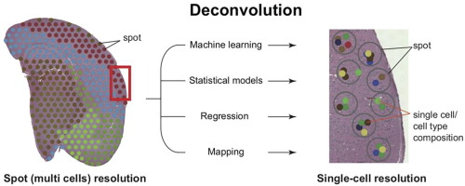
Axis 1
Spots deconvolution

Slide 15
AXIS 2: Characterization of genetic and non-genetic determinants driving transdifferentiation in MpBC

Slide 16
Axis 2
Objectifs :
Comprendre les trajectoires évolutives des cellules tumorales au sein des MpBC
Mutations génomiques drivers
Composition du TME
Méthode :
Microdissection de chaque compartiment tumoraux
WES
Méthylome
Identification de paires ligand-récepteurs

Slide 17
Bordure…

Slide 18
AXIS 3: Identification of subtype-specific expression markers and signaling pathways

Slide 19
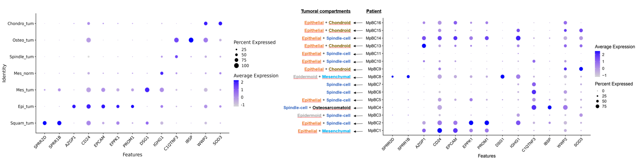
Axis 3
Identification de marqueurs spécifiques à certains sous-types mais nécessité d’avoir une plus grande résolution (single cell)

Slide 20
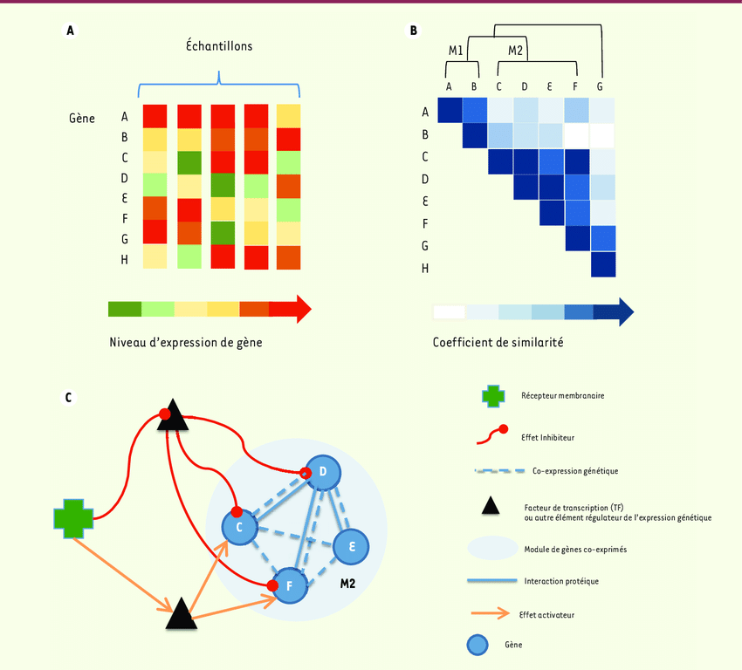
Axis 3
Objectifs :
Pour chaque sous-type des MpBC
Identification de marqueurs d’expression beaucoup plus spécifiques
Déterminer des facteurs de transcription et voies de signalisation
Méthode :
SCENIC (Single-cell regulatory network inference and clustering)

Slide 21
Conclusion

Slide 22
Thank you for listening !
Tutor : Dr Pierre Martinez
jordan.dutel@lyon.unicancer.fr

Slide 23
Backup Methodo (tous les outils)

Slide 24
Backup Methodo (tous les outils)

Slide 25
Backup Methodo (tous les outils)

Slide 26
Backup Methodo (tous les outils)

Slide 27
Backup Methodo (tous les outils)

Slide 28
Backup Methodo (tous les outils)

Slide 29
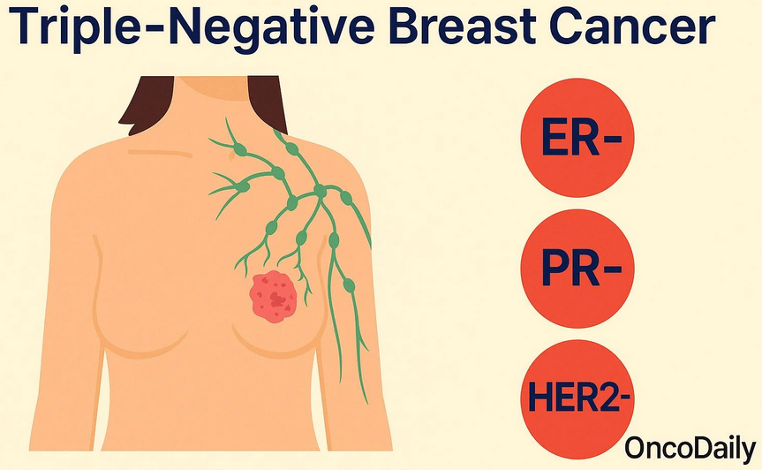

Introduction
Les MpBC (Metaplastic Breast Carcinomas) sont :
Formes rares, agressives et invasives du cancer sein triple négatif
Absence d’expression des récepteurs à l’œstrogène (ER), progestérone (PR) et HER2
Thérapies classiques du cancer du sein inefficaces

Slide 30
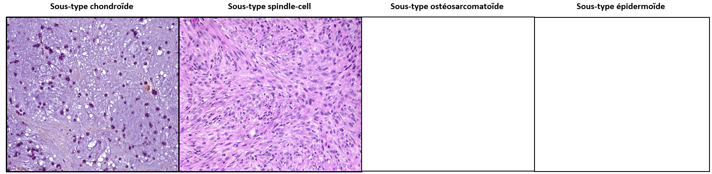
Introduction
Les MpBC (Metaplastic Breast Carcinomas) ont :
Une grande plasticité cellulaire (transdifférenciation)
Sous-types : Chondroïde / Spindle-cell / Osteosarcomatoïde / Epidermoïde

Slide 31
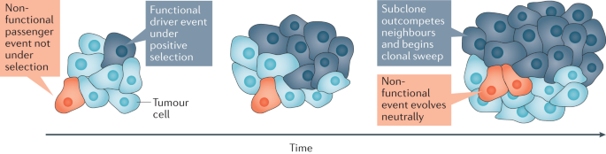
Introduction
Les MpBC (Metaplastic Breast Carcinomas) sont :
Très mal caractérisés
Uniquement diagnostiqués histopathologiquement
Aucun marqueur moléculaire spécifique

Slide 32
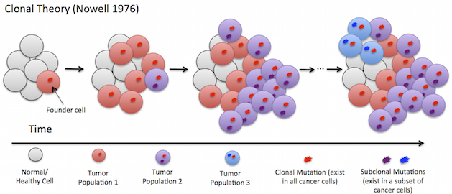
Objectifs
Understanding the evolutionary trajectories in MpBC
Internal determinants (genetic and epigenetic)
External determinants (tumor microenvironment)
Identify molecular biomarkers to improve diagnostic precision

