Slide 1
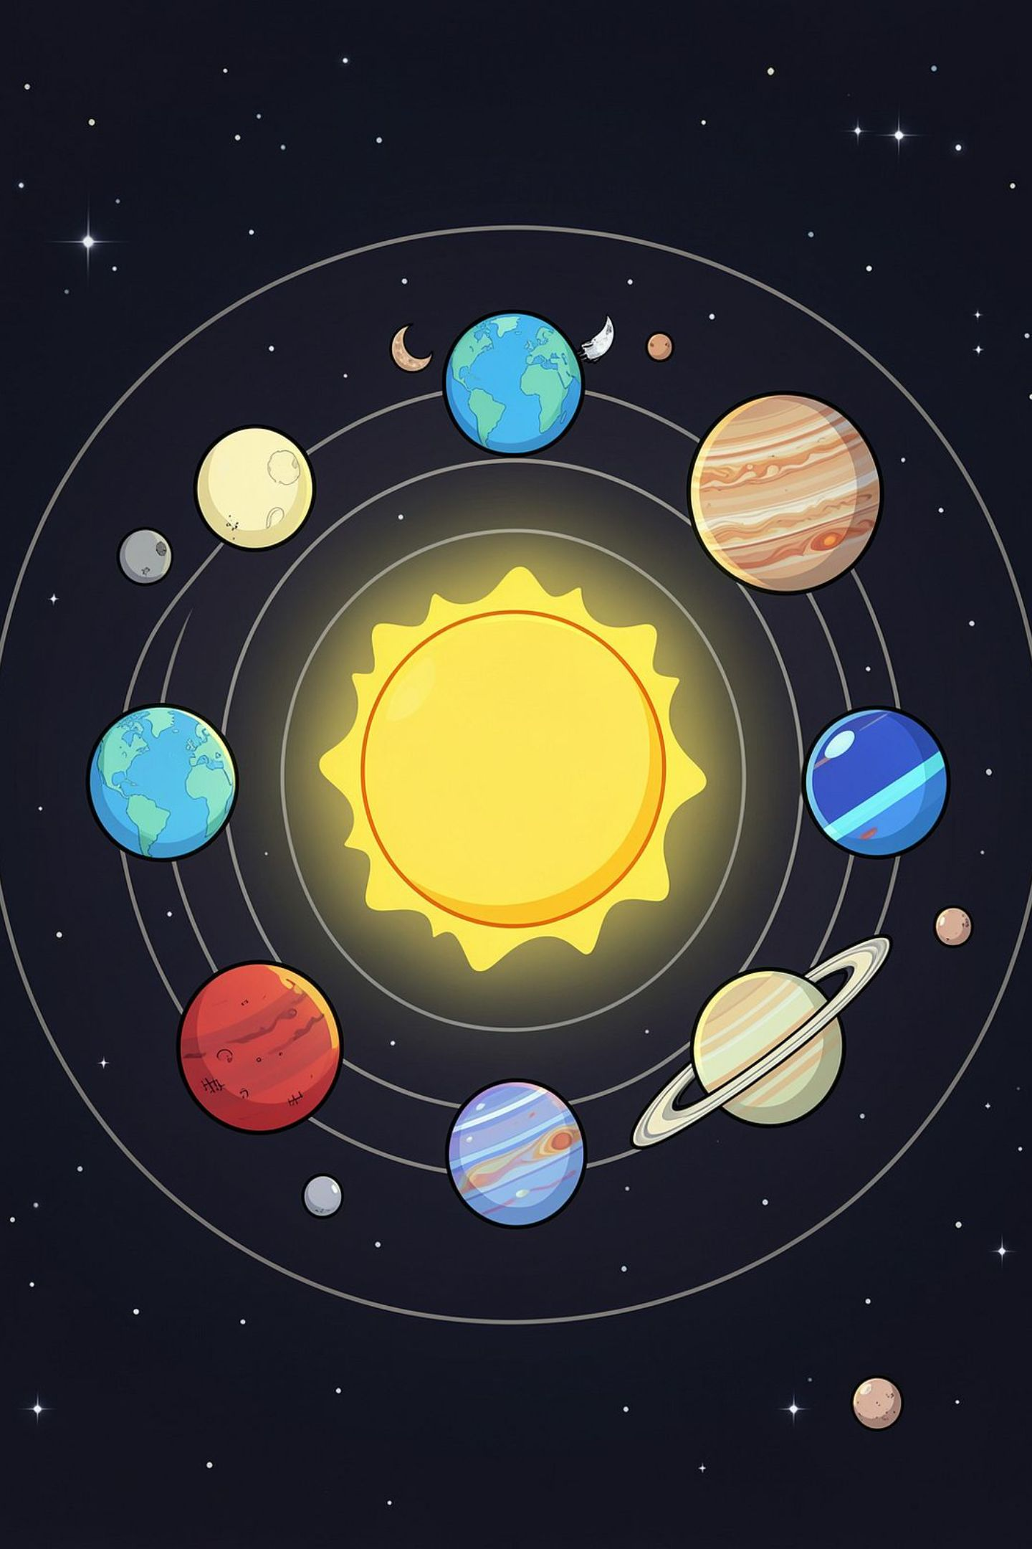
2D SOLAR SYSTEM SIMULATION
MCA Computer Graphics Project — C · SDL2
Interactive 2D simulation demonstrating core computer graphics concepts: transformations, coordinate systems, animation, camera control, and rendering using C and SDL2 on macOS.

Slide 2
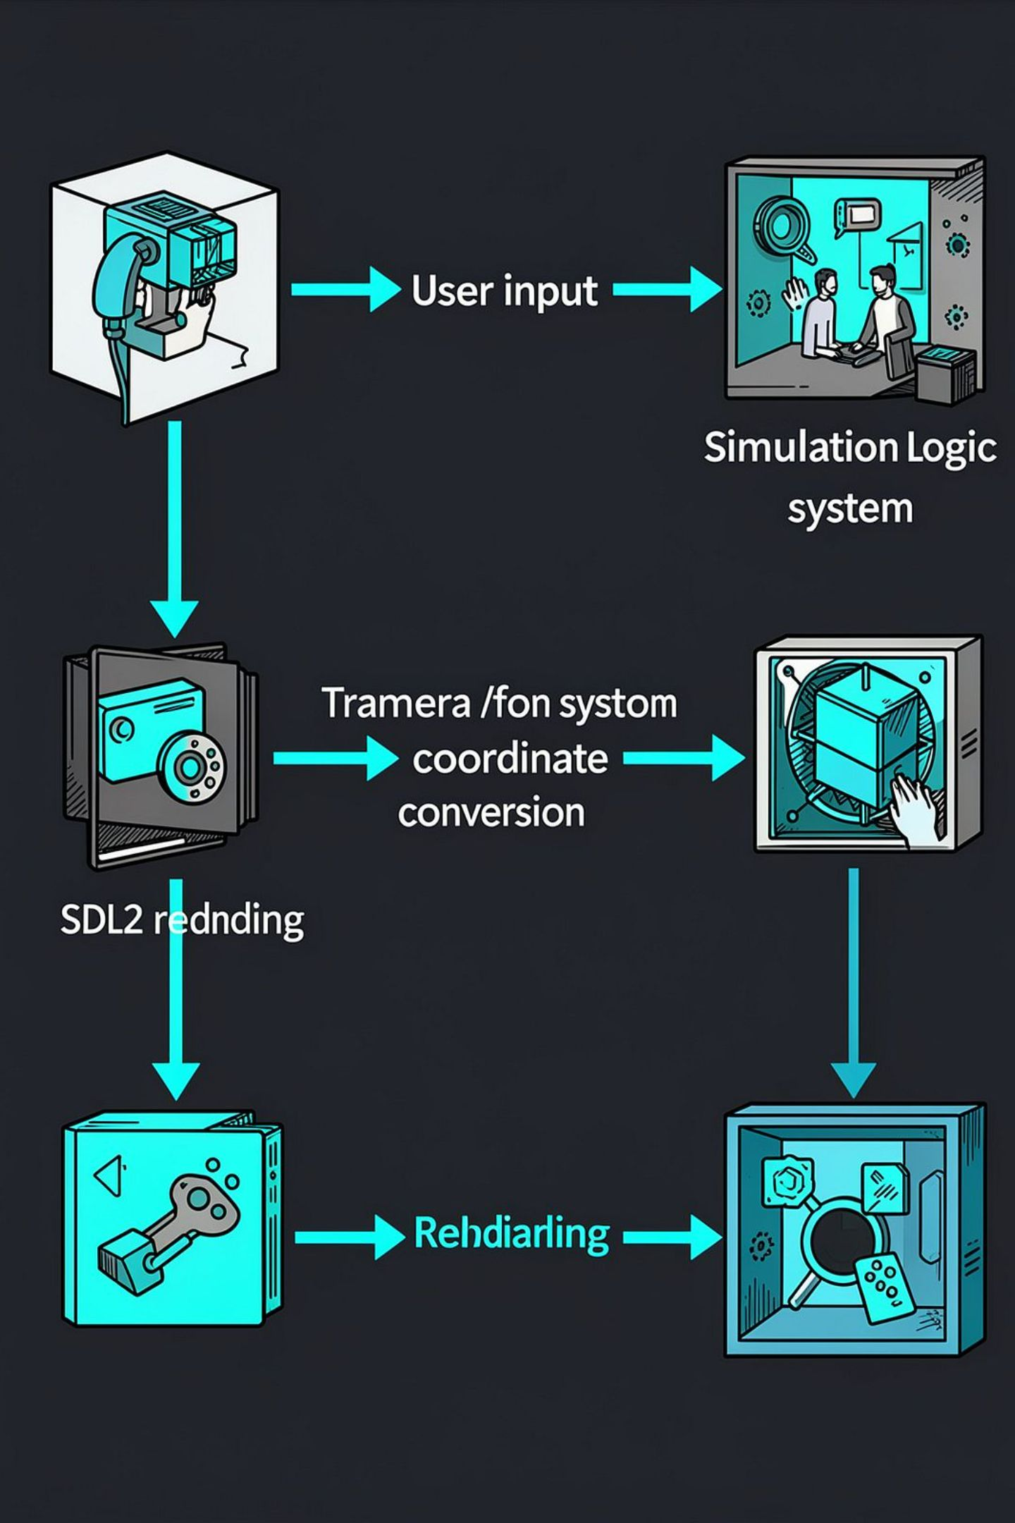
Project Overview
The project is an interactive 2D Solar System built in C with SDL2. It visualizes transformations and animation through animated planets, orbital paths, hierarchical object transforms, and camera controls.
Real-time rendering and event handling via SDL2
Mathematical motion using math.h (sin, cos)

Slide 3
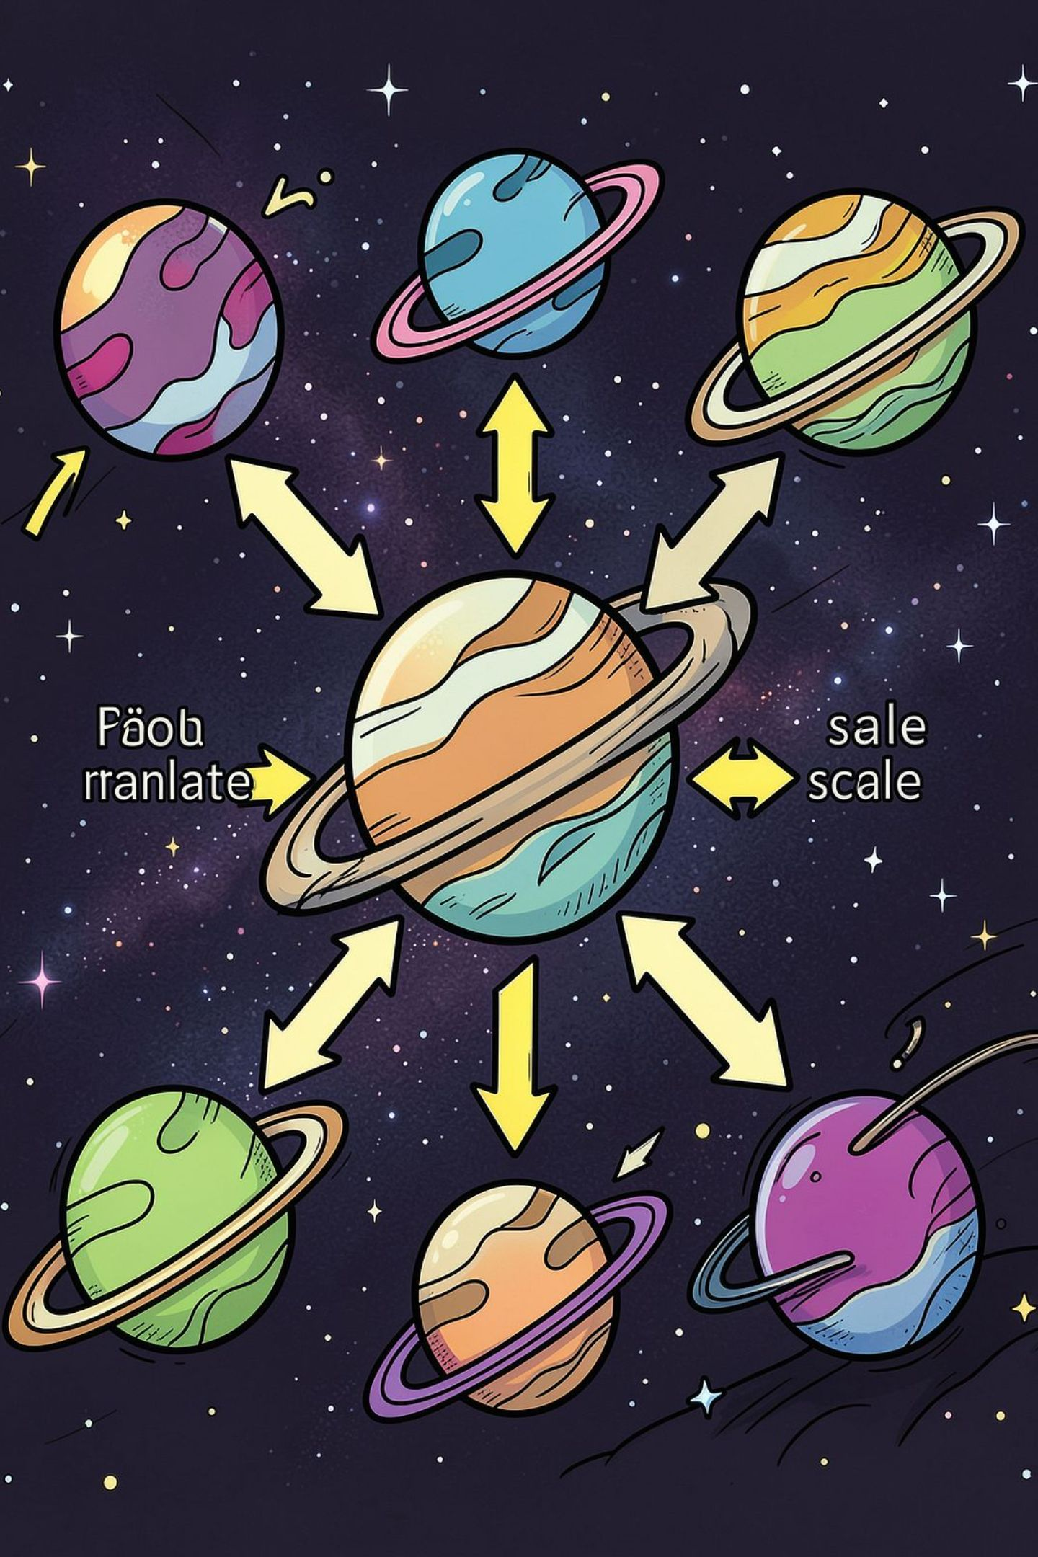
Problem Statement
Students often find it hard to internalize 2D transformations and coordinate-space concepts from equations alone. This project provides an interactive visual environment to observe and manipulate:
Translation, rotation, scaling
Coordinate conversions and camera movement
Circular and elliptical animation
Note: simulation emphasises graphics concepts, not astronomical accuracy.

Slide 4





Project Objectives
Build in C
Implement core logic and rendering in C.
SDL2 Rendering
Window, rendering, events and timing.
2D Transformations
Translation, rotation, scaling, reflection, shearing.
Animated Motion
Circular and elliptical orbits; hierarchical motion.
Camera Controls
Zoom, pan, fit-to-view and world→screen conversion.

Slide 5
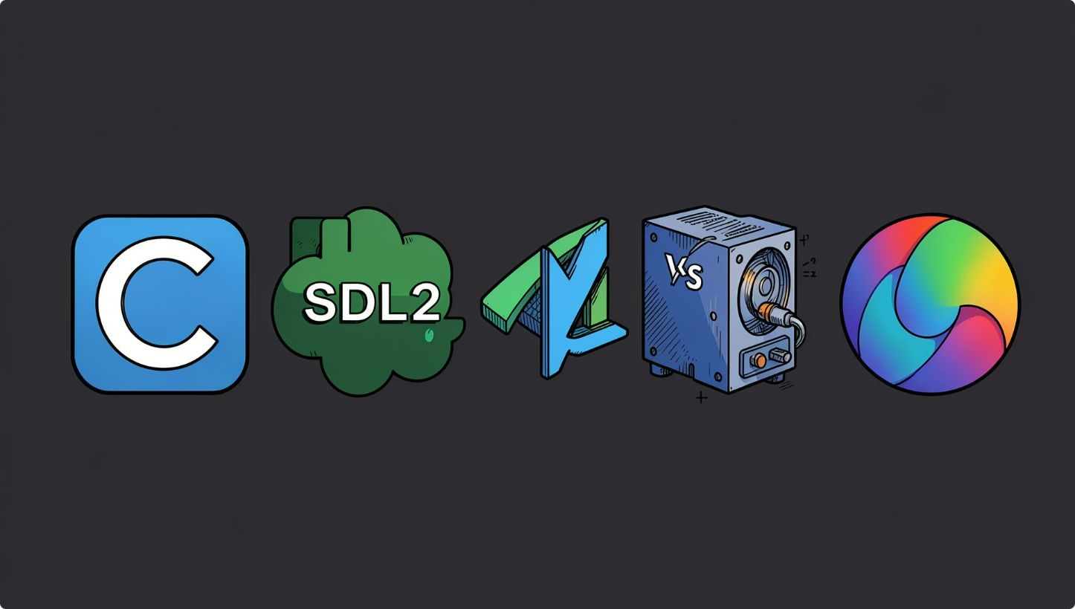
Technologies & Tools
Stack
Programming: C
Graphics: SDL2 (window, renderer, events, timing)
Math: math.h (sin, cos, sqrt)
Compiler: Clang on macOS
IDE: VS Code
SDL2 provides cross-platform 2D rendering primitives and event/timing APIs; math.h supplies trigonometric functions for orbital calculations.

Slide 6

System Architecture
User Input
Input Handler
Simulation
Transforms
Each stage has a clear responsibility: input → simulation state → transforms → camera → render. This separation keeps math, object state, and rendering decoupled.

Slide 7
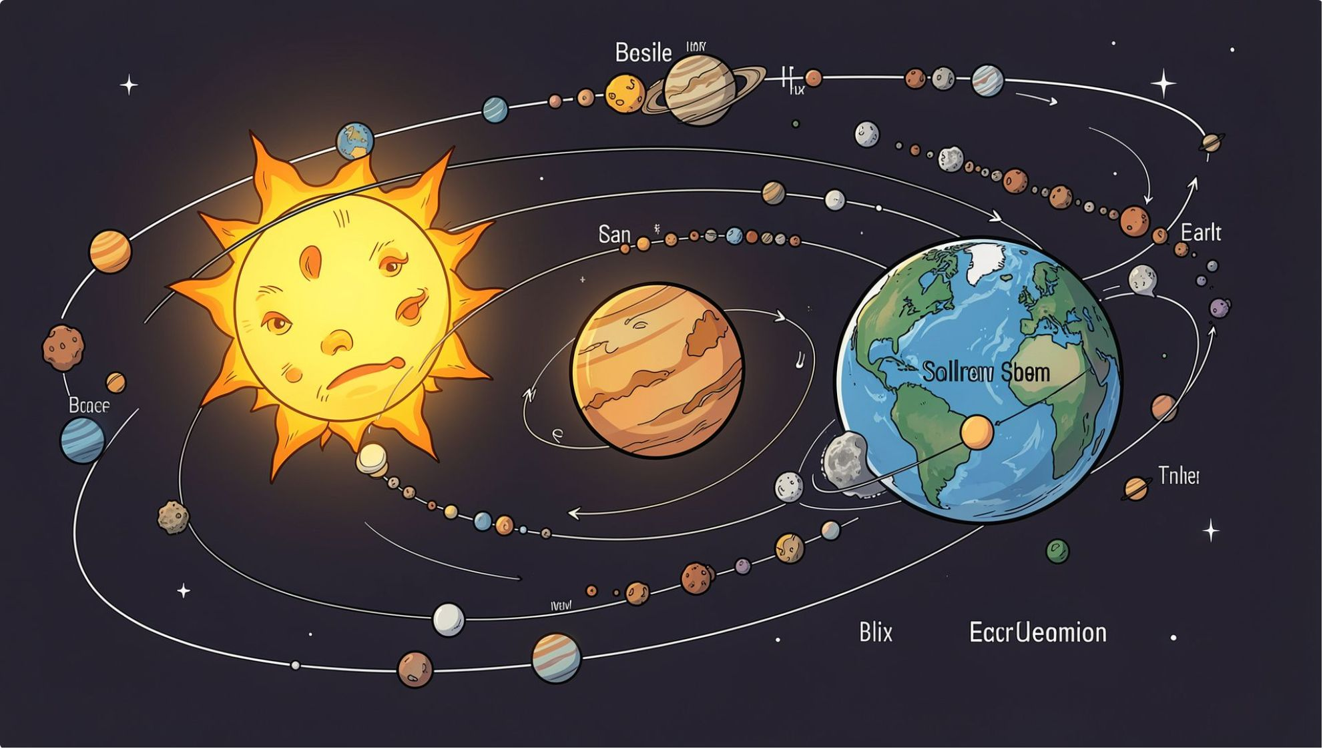
Solar System Design
Objects represented as 2D primitives (filled circles, thin orbital lines). Each object stores:
World position (cx, cy)
Local transform (translate, rotate, scale)
Orbital parameters (radius a/b, angular speed)
Render attributes (color, radius in screen units)
Orbital paths are computed mathematically; sizes and distances are scaled for visual clarity, not scientific fidelity.

Slide 8
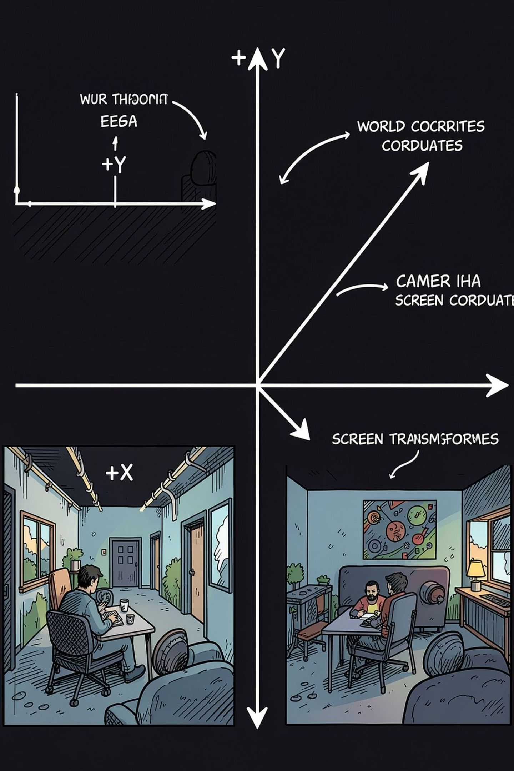
Coordinate System
Distinguish spaces:
World coordinates — logical positions for simulation (astronomical layout)
Screen coordinates — pixel positions for SDL2 rendering (origin top-left, Y down)
Pipeline: World Position → Camera Translation → Zoom/Scale → World-to-Screen conversion → SDL2 draw calls.

Slide 9
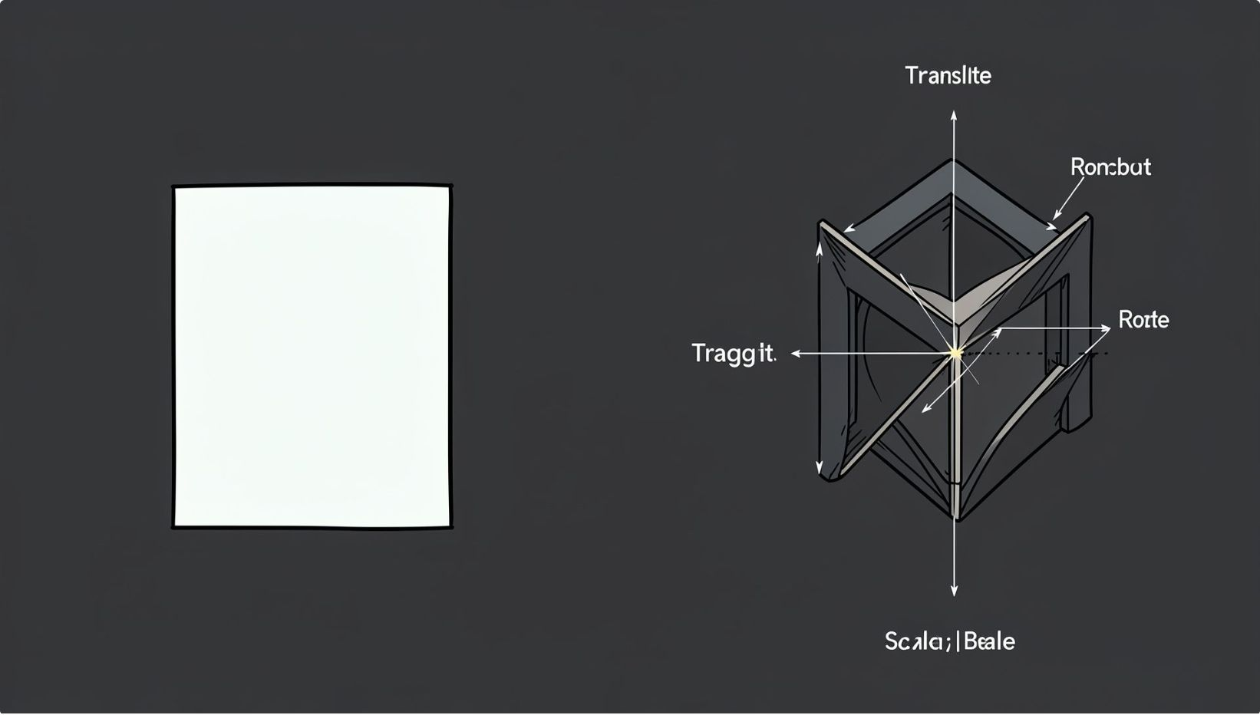
Computer Graphics Transformations
Reflection
X-axis: x' = x, y' = −y
Y-axis: x' = −x, y' = y
Shearing
X-shear: x' = x + Shx × y
Y-shear: y' = y + Shy × x
Translation
x' = x + Tx y' = y + Ty
Scaling
x' = x × Sx y' = y × Sy
Rotation (θ)
x' = x cosθ − y sinθ y' = x sinθ + y cosθ
Formulas implemented in transform utilities; combined transforms use matrix composition (applied in correct order).

Slide 10
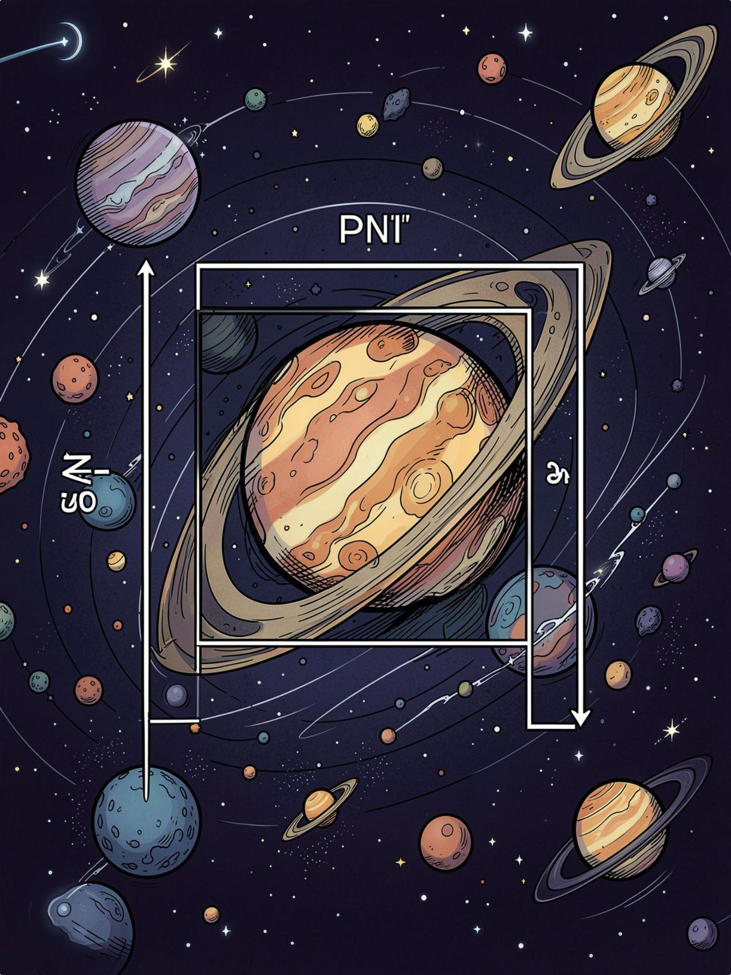

Camera Transformation — Zoom & Pan
World Scene
Camera
Fit-to-View
Viewport
Zoom modifies scale factor; pan offsets camera center. Fit-to-view computes scale to ensure entire system fits in current window while preserving aspect ratio.

