Slide 1

TASKFLOW
Task Assignment and Management System
Java Web Application · MCA Project
Student: Sneha Vishwakarma · Enrollment: 25051121010008
Student: Jaydip Vadhiya · Enrollment: 25051121010010
College / University: Parul University · Guide: Honeymam
A concise demonstration of a JSP–Servlet–JDBC based task management system.
Speaker notes: Introduce yourself and the project title. Briefly state that TASKFLOW is a completed college project implemented using core Java web technologies and designed for administrators and users.

Slide 2
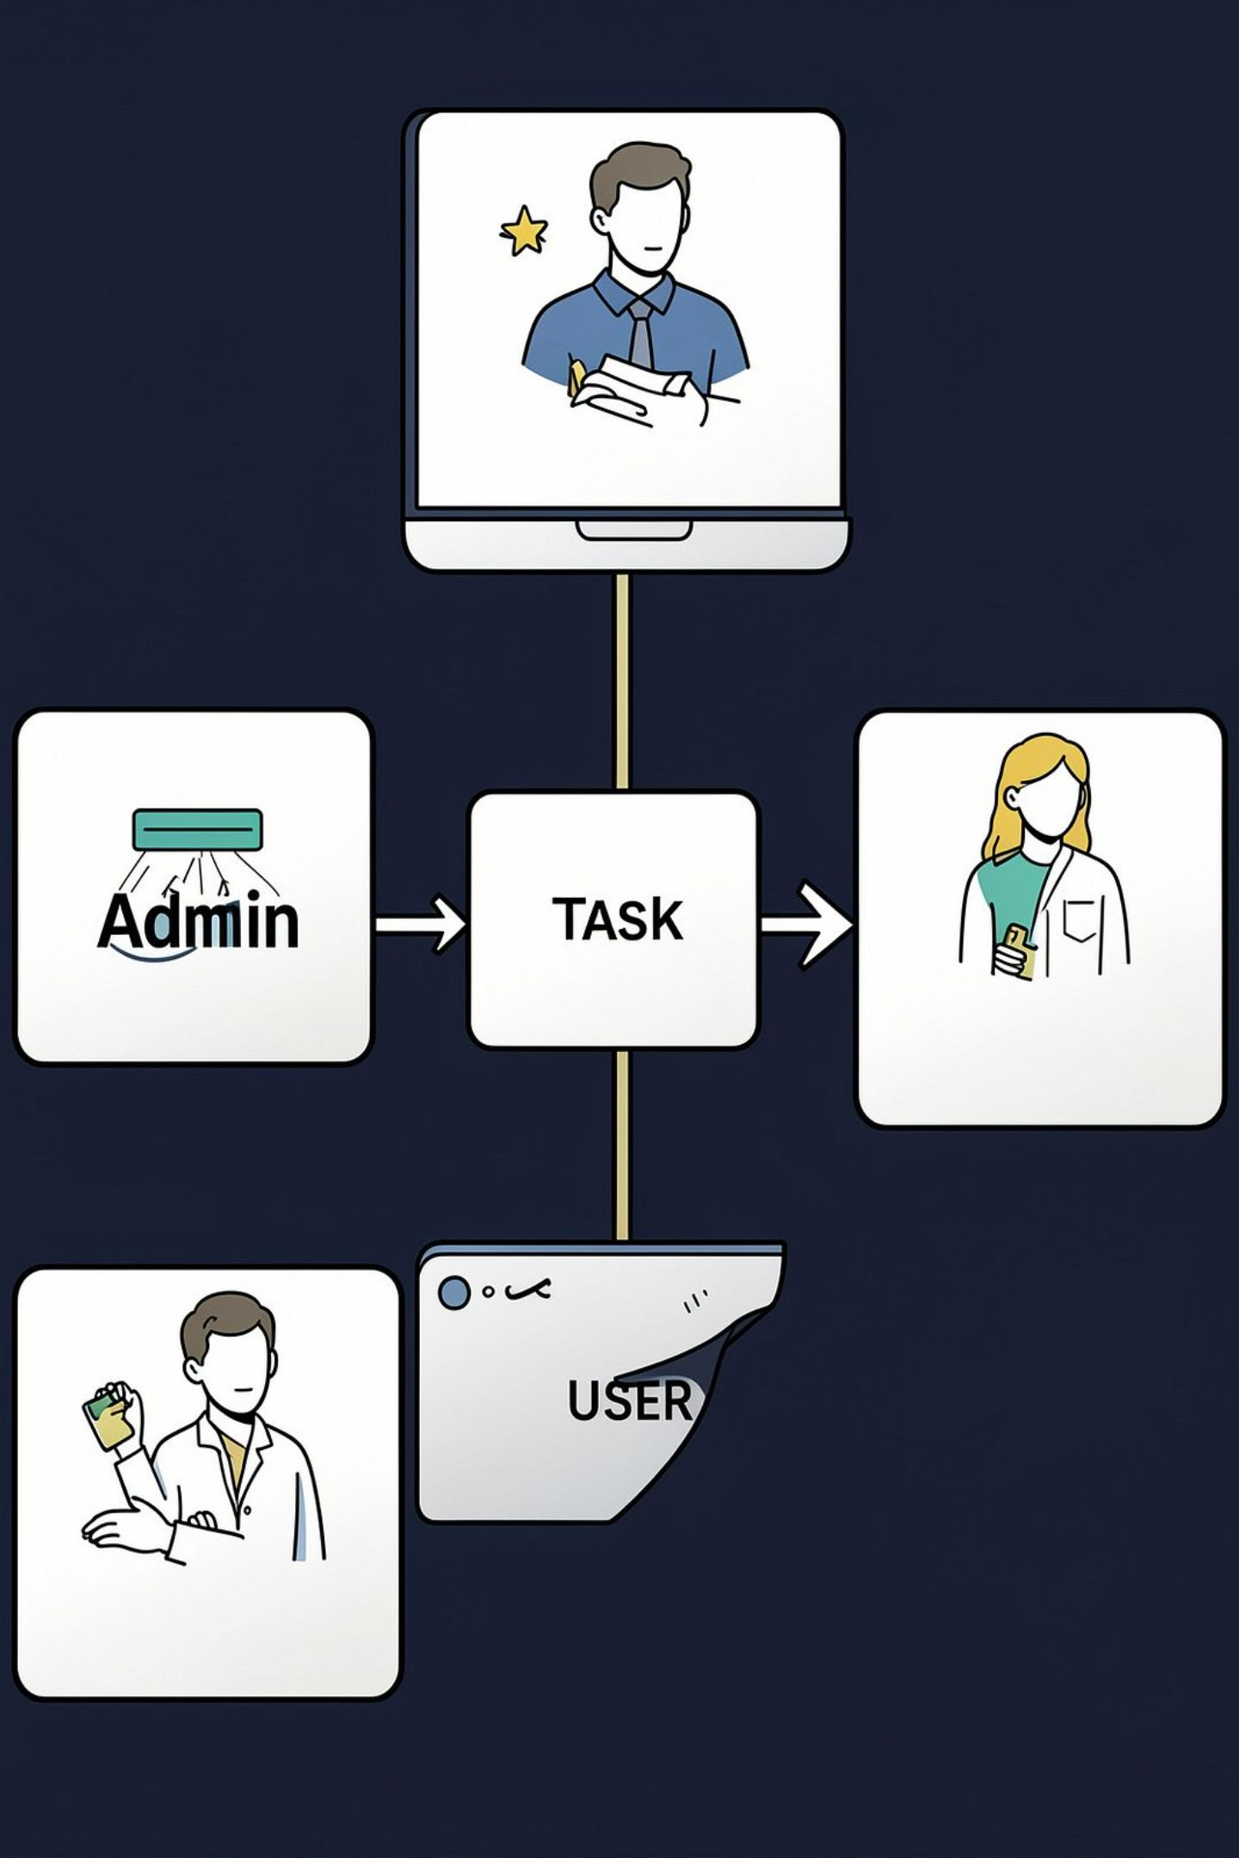
Introduction
TASKFLOW is a web-based task management system to organise task assignment, execution, tracking and communication between administrators and users.
Centralised task management
Role-based access (ADMIN / USER)
Defined task lifecycle with history
Task dependencies and postponement workflow
Notifications and search/filter/sort
Speaker notes: Summarise the problem space and the high-level capabilities. Emphasise roles and lifecycle so examiners know the scope before diving into technical details.

Slide 3

Problem Statement
Conventional/manual task management often causes missed deadlines, unclear ownership and fragmented communication.
Tasks difficult to track
Deadlines missed or unnoticed
Ownership unclear
Dependencies not visible → blocked work
Postponement requests handled ad hoc
Limited or no audit trail
TASKFLOW centralises these concerns into a single system for admins and users.
Speaker notes: Walk through each pain point with a quick real-world example — a missed deadline due to unseen dependency — then state TASKFLOW's role as the centralised solution.

Slide 4






Centralise task management
Role-based access
Single source for creating, assigning and tracking tasks.
Distinct ADMIN and USER privileges enforced at route level.
Track lifecycle
Enforce dependencies
Statuses recorded from ASSIGNED → IN_PROGRESS → COMPLETED.
Start blocked until dependent tasks are completed.
Manage deadlines & priority
Notifications & history
Admins set deadlines and priority levels at task creation.
Event notifications and an audit trail for every task.
Objectives
Speaker notes: Briefly expand each objective with one line on why it matters for project goals and evaluation criteria.

Slide 5
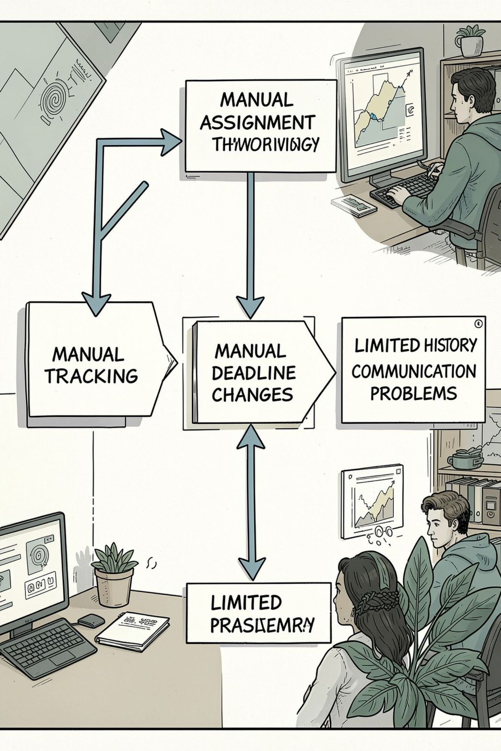
Existing System (Manual)
Typical manual workflows rely on emails, spreadsheets and meetings — resulting in latency, lost context and absent audit trails.
Speaker notes: Explain manual process limitations and why a software solution (TASKFLOW) improves reliability and traceability.

Slide 6
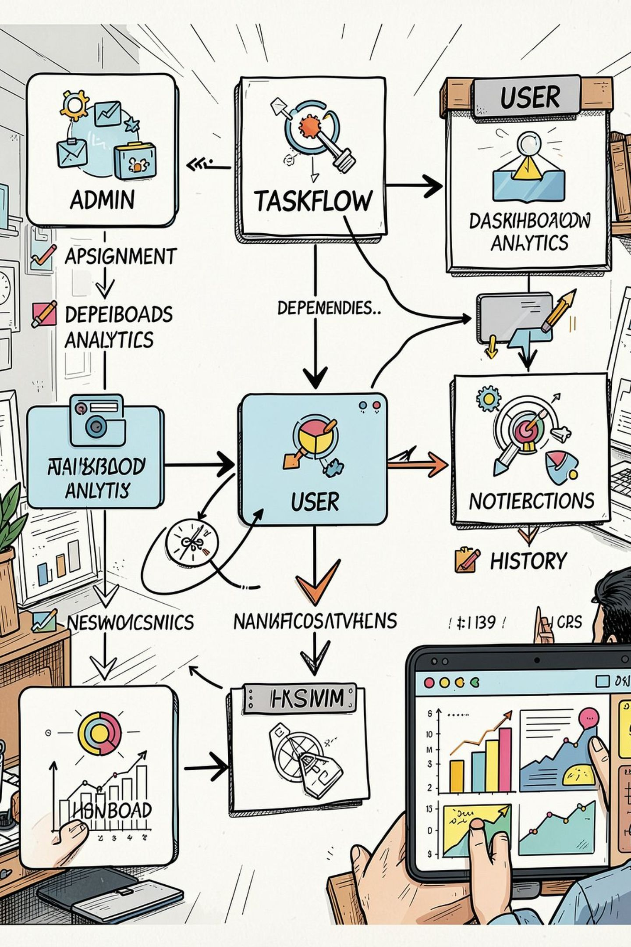
Proposed System — TASKFLOW
Admin: create, assign, set deadline & priority, manage dependencies, approve postponements
User: view assigned tasks, start/complete, comment, request postponement
Supporting: notifications, task history, search/filter/sort, dashboard
Speaker notes: Walk examiners through the central flow and mention that the system is implemented and functional per requirements.

Slide 7
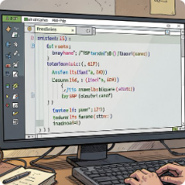


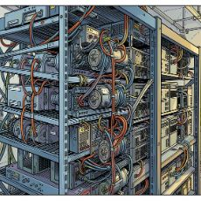
Technology Stack
Frontend
Backend
Database
Server & Build
JSP, HTML, CSS — server-rendered pages and UI templates.
Java with Jakarta Servlets and JDBC for request handling and DB access.
MySQL 8.4 for persistent storage (users, tasks, comments, history).
Apache Tomcat 10.1, build with Maven. Development using VS Code / Antigravity IDE.
Speaker notes: Emphasise that no Spring/Hibernate/JPA are used — the goal is to demonstrate core JSP/Servlet/JDBC skills.

Slide 8

DBConnection → MySQL
User / Admin
Connection management to storage
Actors initiating requests
DAO
Technical Architecture
JSP UI
CRUD and DB operations
Presentation and UI layer
AuthenticationFilter
Servlets
Request handling and flow
Protects servlet access
System Architecture
Responsibilities:
JSP — Presentation / UI
Servlet — Request handling and application flow
DAO — Database operations (CRUD)
DBConnection — Connection management to MySQL
MySQL — Persistent data storage
AuthenticationFilter — Protects restricted routes and enforces roles
Speaker notes: For viva, be ready to explain each layer's role and how servlets delegate to DAOs using JDBC and PreparedStatements.

Slide 9
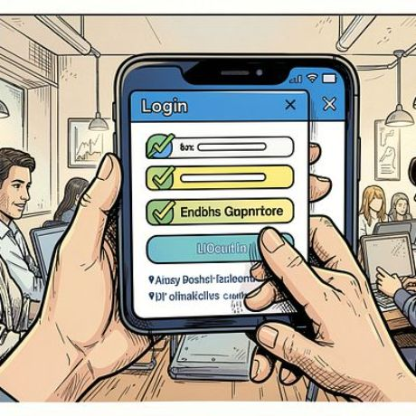
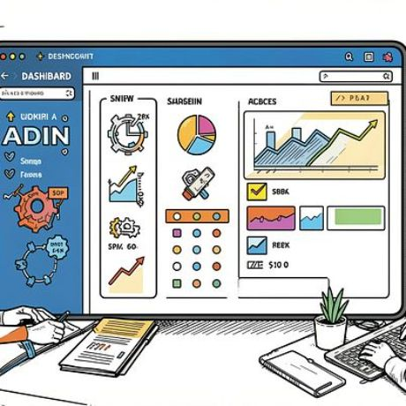

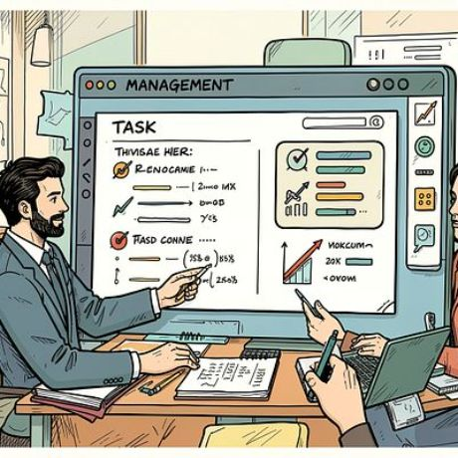
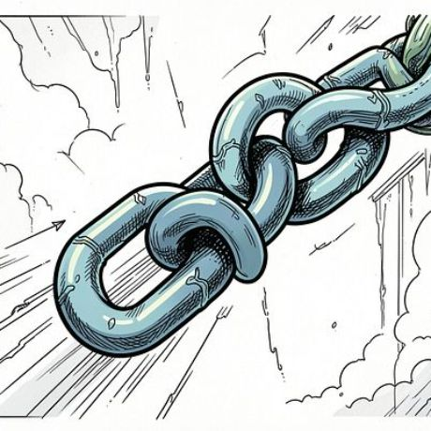



Main Modules
Authentication
Admin Dashboard
User Dashboard
Task Management
Task Lifecycle
Task Dependencies
Postponement Management
Notifications
Task History
Search / Filter / Sort
Speaker notes: Briefly describe how each module maps to servlets, JSP pages and DAO operations. Mention where notifications and history are recorded in DB tables.

Slide 10

In Progress
Work started or blocked
Check Dependencies
Are all dependencies complete?
Assigned
Assigned to a user
Task Created
New task recorded by admin
Task Workflow
Key points:
New tasks created by ADMIN and assigned to a USER
System checks dependencies before allowing START
Statuses progress: ASSIGNED → IN_PROGRESS → COMPLETED
All actions appended to task_history with timestamps
Speaker notes: Explain dependency checks (no self/duplicate/circular), how servlet validates before starting a task, and how events are saved in task_history table.

