Slide 1
Containers from Scratch using GO Language
Courtesy Liz Rice

Slide 2
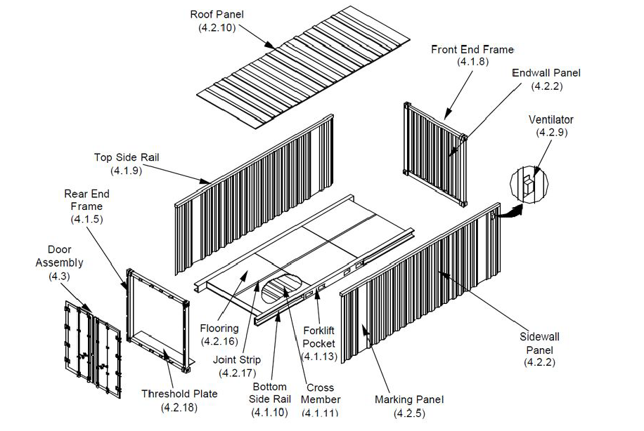
Build your own Container in Go
Namespaces
Chroot
CGroups

Slide 4
Namespaces
What you can see
Created with syscalls
Unix Timesharing System
Process IDs
Mounts
Network
User IDs
InterProcess Comms

Slide 5
CGroups
What you can use
Filesystem interface
Memory
CPU
I/O
Process numbers
…

Slide 6
Live Demonstration Build
https://github.com/lovellbrian/dockerdemo
Use branches to step through the building process
Step 1, Step 2, …

