Slide 1
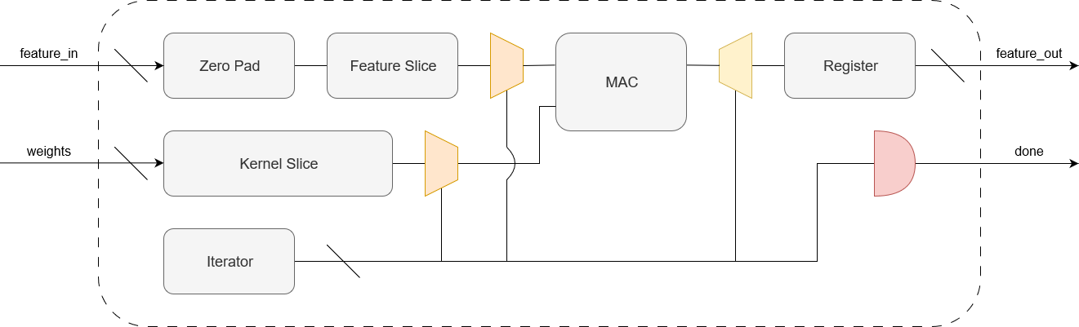
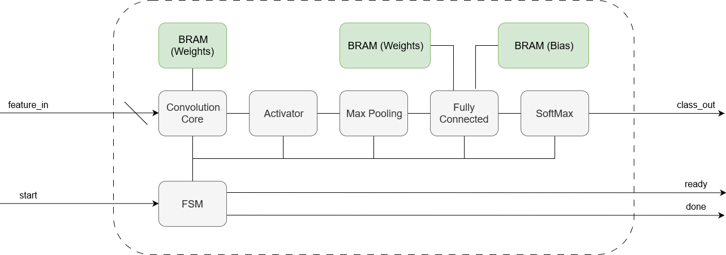
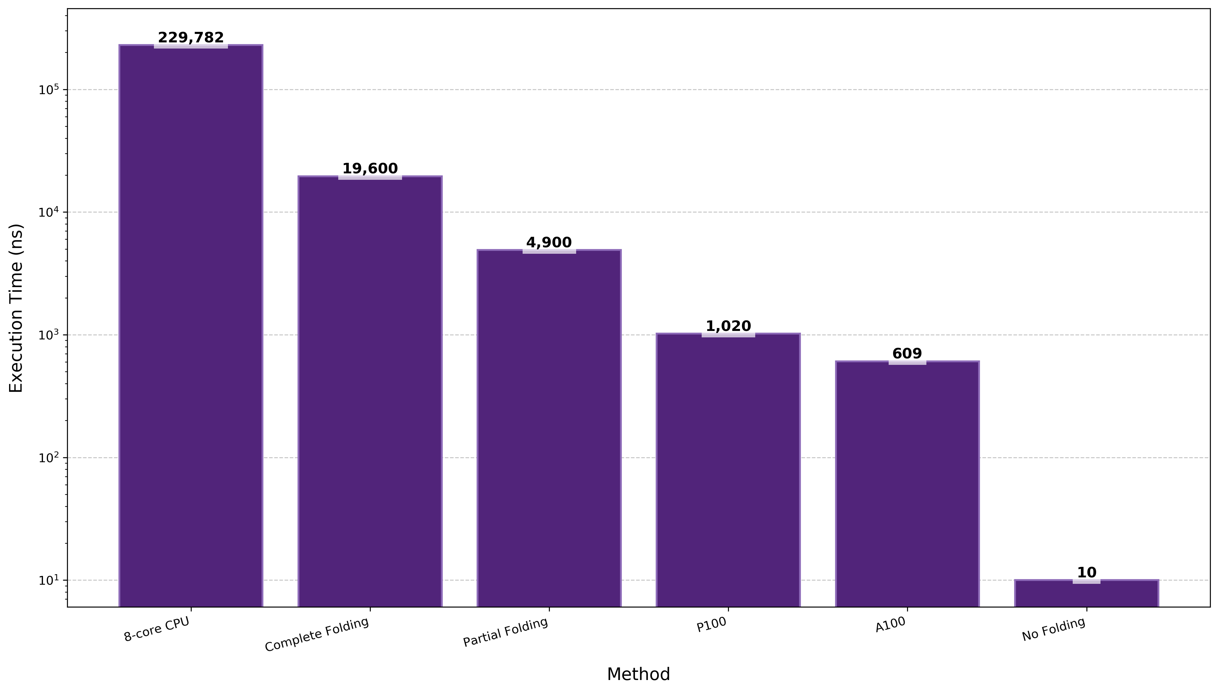


Image Processing with RISC-V Processor on FPGA
Joshua Wallace, Supervised by Matthew D’Souza
Background
Design
Embedded and IoT devices are regularly used to perform real-time image processing but have low throughput
Virtually all image processing techniques utilise convolutional kernels to extract features or down-sample an image
Convolution requires a large number multiple-accumulate (MAC) operations which is compute and resource intensive
GPUs are used to parallelise these repetitive calculations to decrease latency and increase throughput
FPGAs are reconfigurable and can implement parallelisation with a lower power consumption but more resource constraints
Image processing techniques are moving towards machine learning approaches
Convolutional neural networks offer a method to perform classification with minimal weights → ideal for resource-constrained FPGA
Digilent Basys 3 development board with clock speed of 100MHz
Digit dataset (8x8, grayscale) with 10 classifications used as dataset
Single convolutional layer with fully connected layer used as the embedded machine learning core with quantised weights
Generic blocks for convolution, activation, max pooling and fully connected layers with FSM control allow for extensibility
NeoRV32 softcore processor with Wishbone B4 interface
Weights and biases stored on-chip through BRAM and IP core
Figure 2: Internals of the convolution core which uses a hybrid dataflow-control architecture.
Trade-off: The gains from using a single MAC are negated by the additional logic needed to slice the input data.
Convolution results are verified in Python and the feature output is lossless
Results
Aim: Demonstrate the feasibility and benefits of FPGA-based hardware acceleration for image processing algorithms.
Able to synthesise a partially-unrolled convolutional neural network in hardware with quantized network parameters stored in BRAM
Images can be processed in constant time → if resources permit
Partially folded approach can process a 64-byte image in 4.9us and is well within resource constraints of Basys 3
Orders of magnitude faster than 8-core CPU processing
5x slower than state-of-the-art GPUs for synthesisable approach
NeoRV32 consumes <10% of LUTs and 16% of BRAM tiles
FPGA reconfigurability allows for reduced overhead per operation as the number of bits can be set at the hardware level
Quantisation of the neural network parameters post-training can truncate bits to reduce the size of an operation with minimal loss
Convolution benefits from asynchronous hardware as each MAC is independent → could be done in one clock cycle
Folding can be used to reduce resource utilisation by sharing hardware resources to operations executed at different intervals but increases latency
RISC-V provides a solution to control and interface with the system in software whilst being able to delegate expensive compute tasks to dedicated hardware
Figure 1: Single-engine machine learning core with neural network blocks.
Limitation: Large convolution kernels will struggle to reach timing closures due to addition operations in a single clock.
3 convolution approaches to balance resources versus throughput
No folding: A single clock cycle using dataflow architecture
Partial folding: Partitions convolution over multiple clock cycles to reuse resources using hybrid architecture
Complete folding: A single MAC unit using control architecture
Convolution Approach | Clock Cycles | LUTs | Registers
No Folding | 1 | 144061 (692.60%) | 3430 (8.25%)
Partial Folding | 490 | 1622 (7.80%) | 3456 (8.31%)
Complete Folding | 1960 | 2551 (12.26%) | 9611 (23.10%)
Metrics: Resource utilization, scalability, throughput, latency
CRICOS 00025B • TEQSA PRV12080
s4580997@uq.edu.au
Joshua Wallace
School of Electrical Engineering and Computer Science

