Slide 1

{
WEB APPLICATION PROGRAMMING (CB2001105-062)
*
1
Web Design Assignment
2
Air Quality Monitoring Dashboard
3
4
5
201924569
Dawon Jeong
6

Slide 2





CONTENTS
1
PART
01
① Project Overview
2
3
PART
02
② Project Requirements and Code
4
5
PART
03
③ Future Work
6

Slide 3

Temperature, Humidity, PM2.5, PM10, NOx, NH3, CO2, SO2, VOC
PART 1
*
Project Overview
1
Responsive Web Application for Real-Time Air Quality Monitoring
2
Displays key metrics
Responsive Web Application for Real-Time Air Quality Monitoring
3
Built with
HTML, CSS, JavaScript
4
5
Features
Real-Time Data
UpdatesInteractive Charts using Chart.js
6

Slide 4



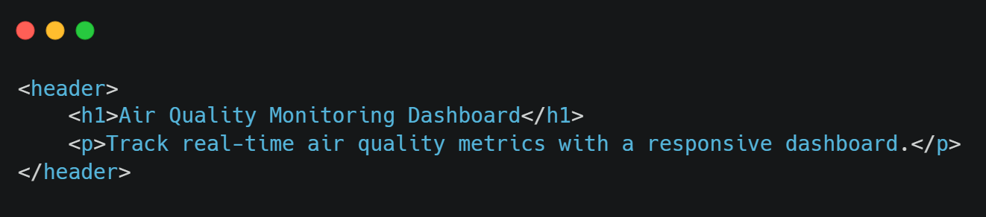
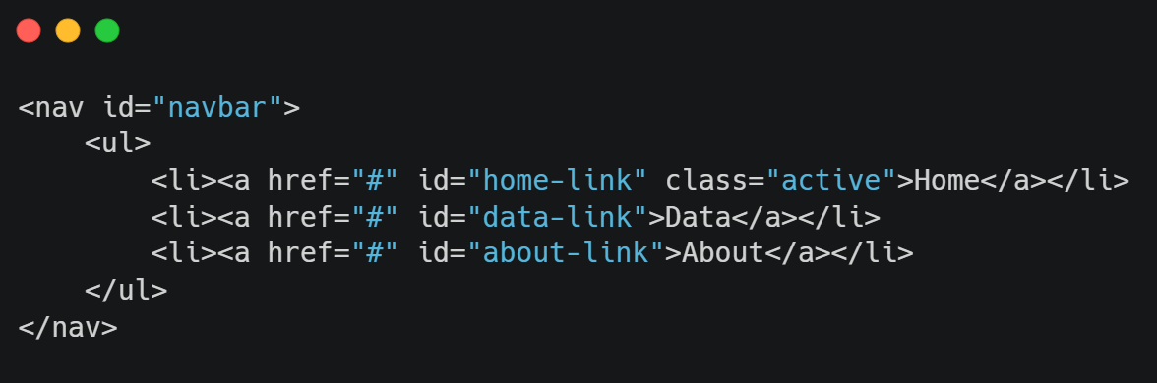


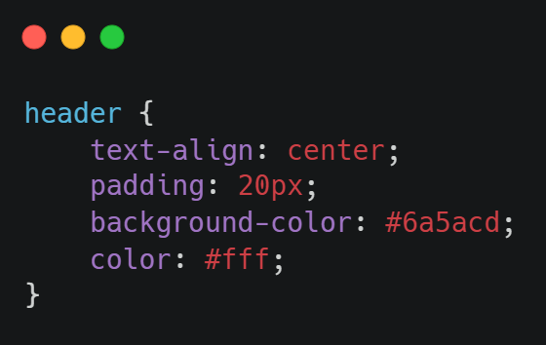
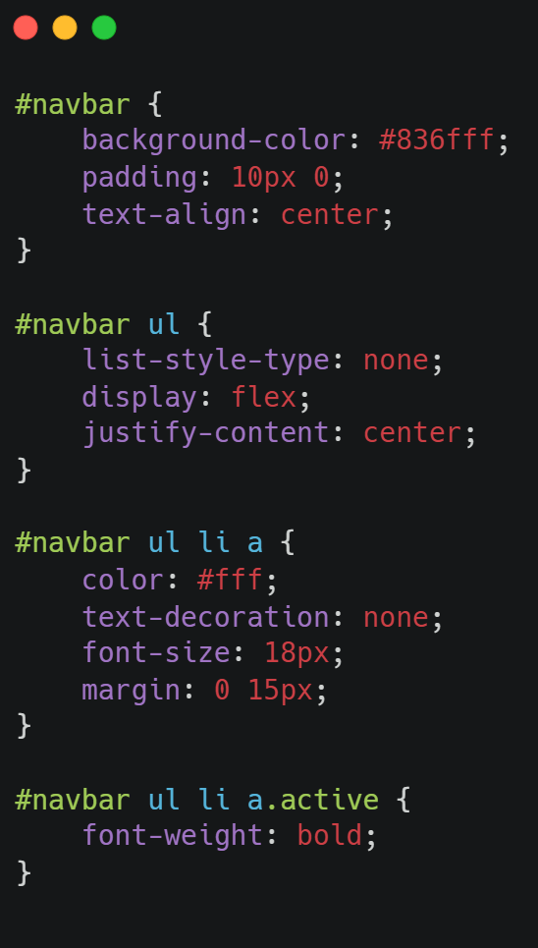
PART 2
*
Project Requirements and Code
1
User Interface Design - Header
User Interface Design - Navigation Bar
2
3
4
5
6

Slide 5
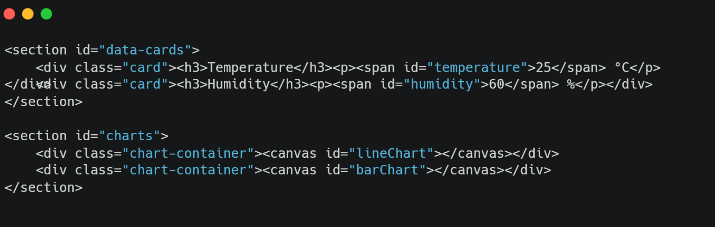
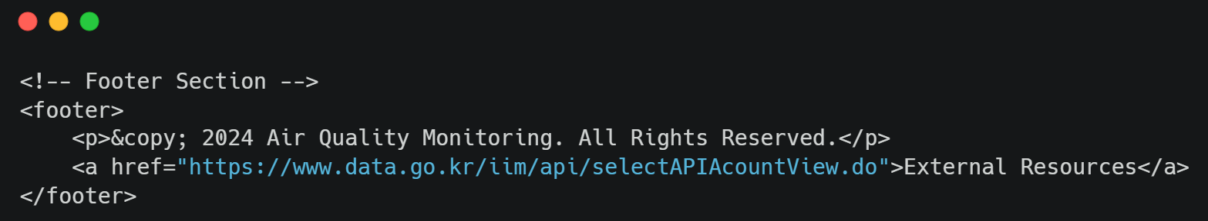
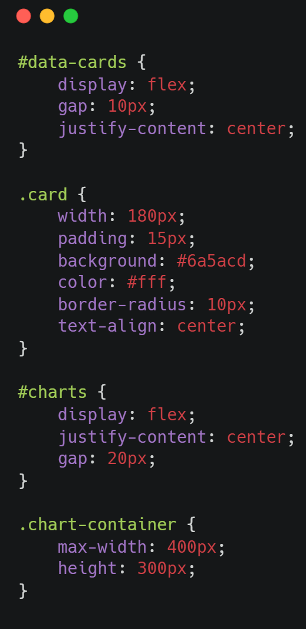
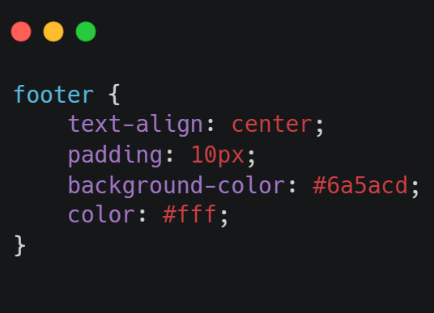
PART 2
*
Project Requirements and Code
1
User Interface Design - Main Dashboard
User Interface Design - Footer
2
3
4
5
6

Slide 6
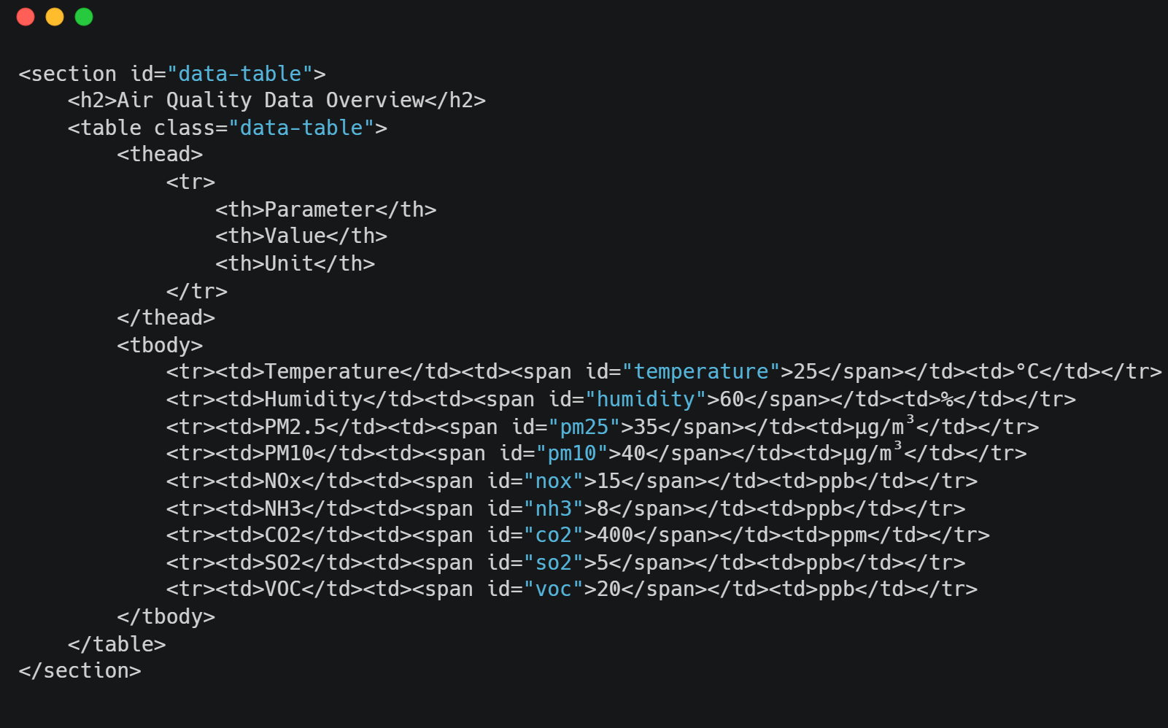
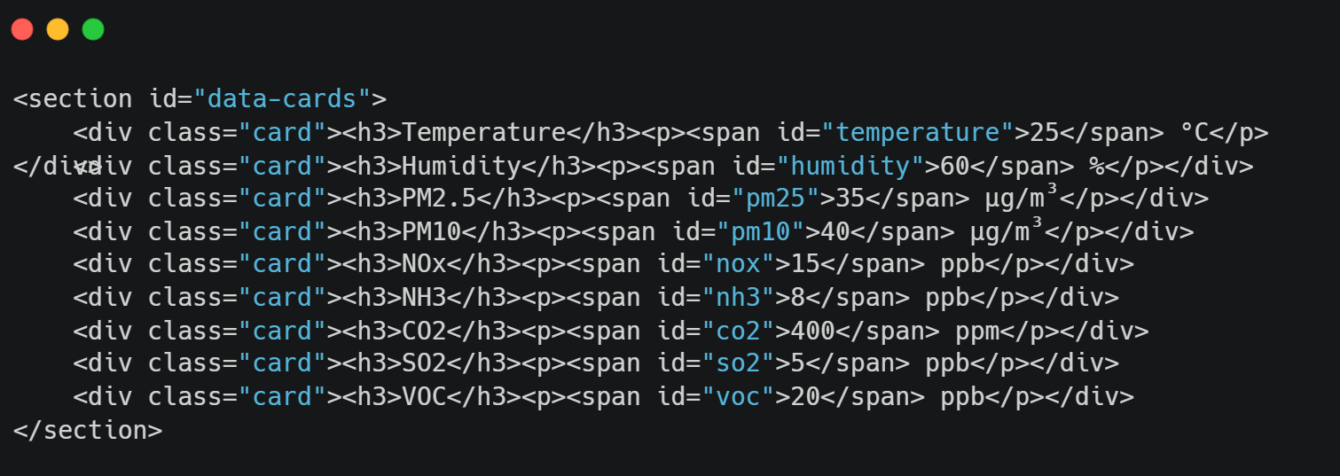
PART 2
*
Project Requirements and Code
1
Data Display - Data Cards Layout
Data Display - Data Table Layout
2
3
4
5
6

Slide 7
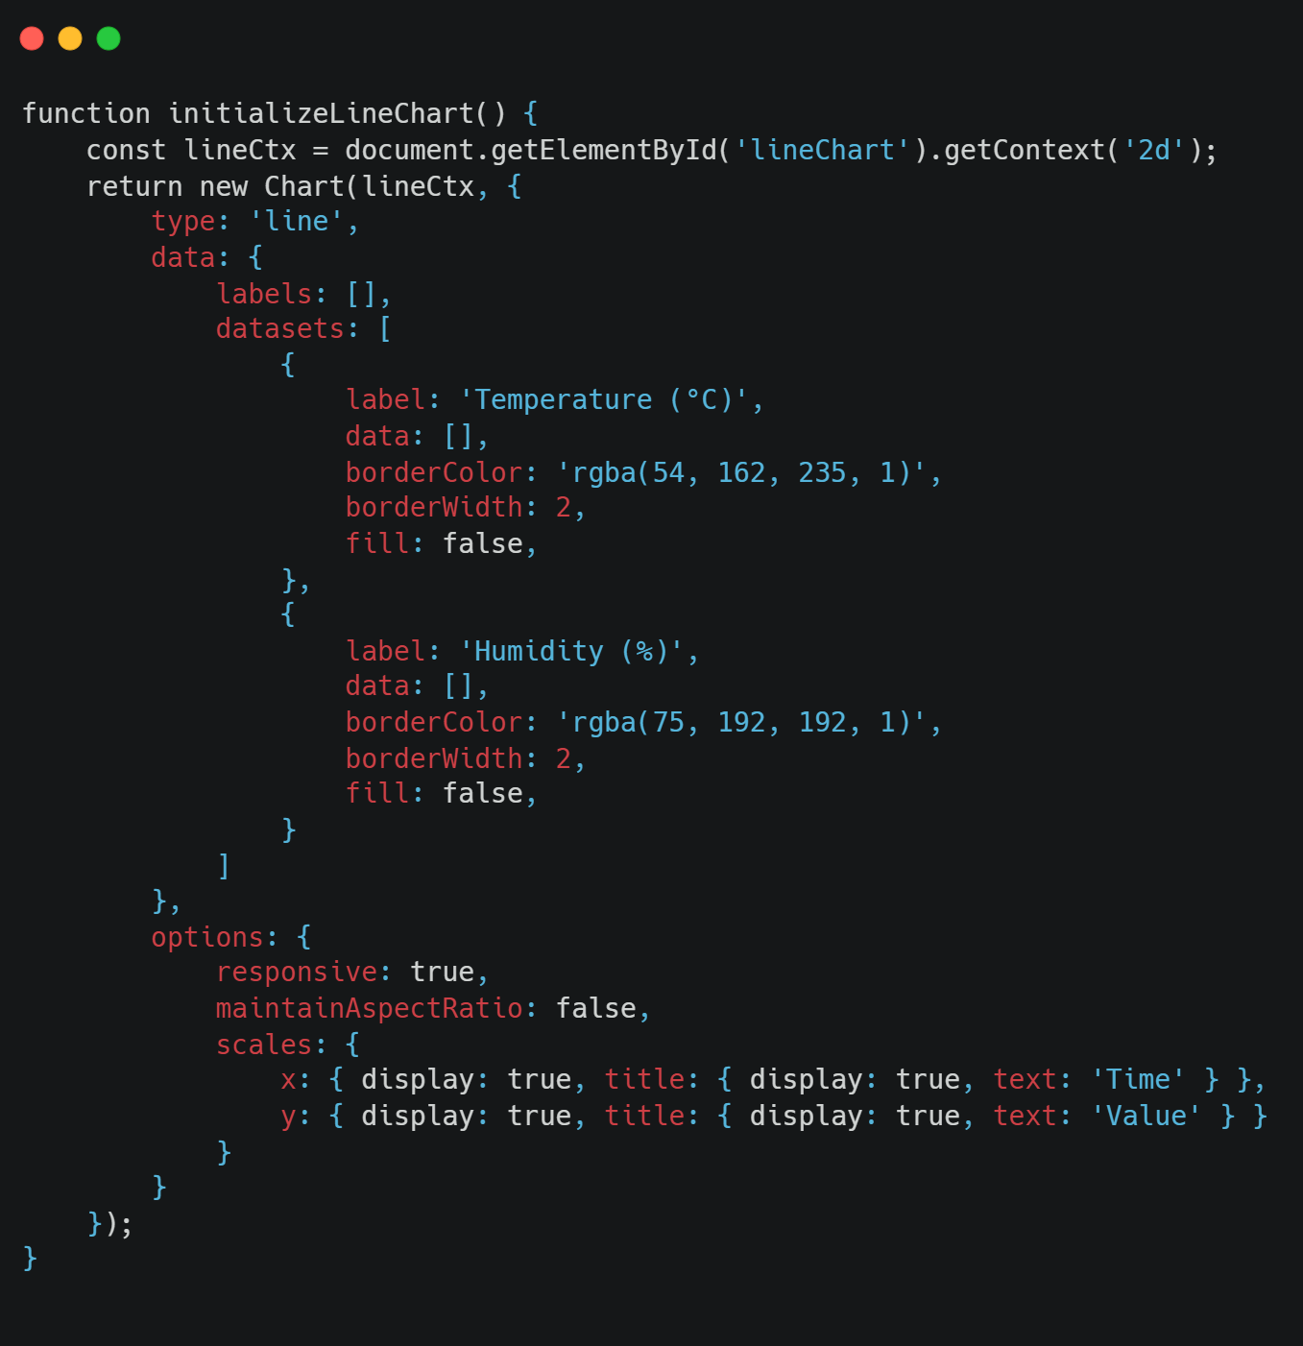
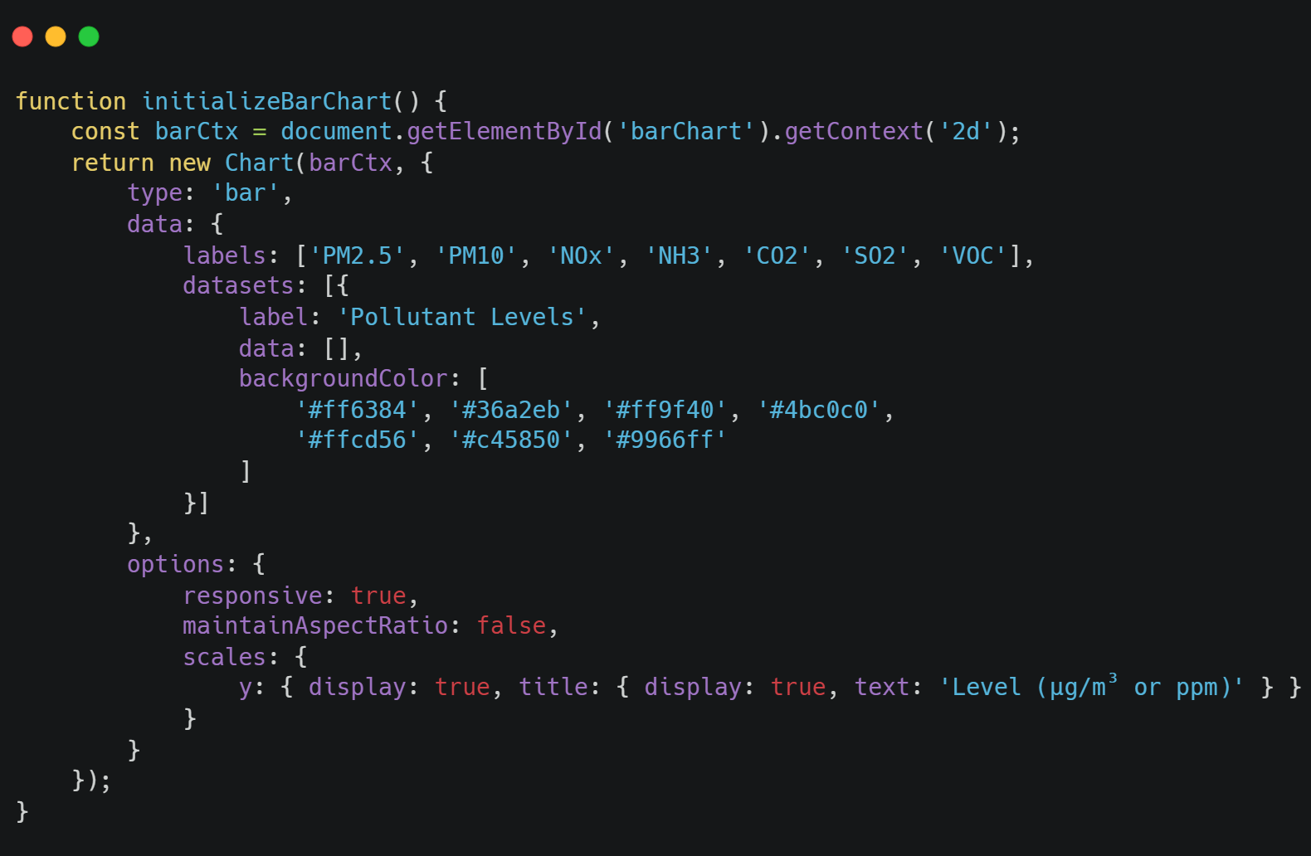
PART 2
*
Project Requirements and Code
1
Visual Representation – Line Chart
Visual Representation – Bar Chart
2
3
4
5
6

Slide 8
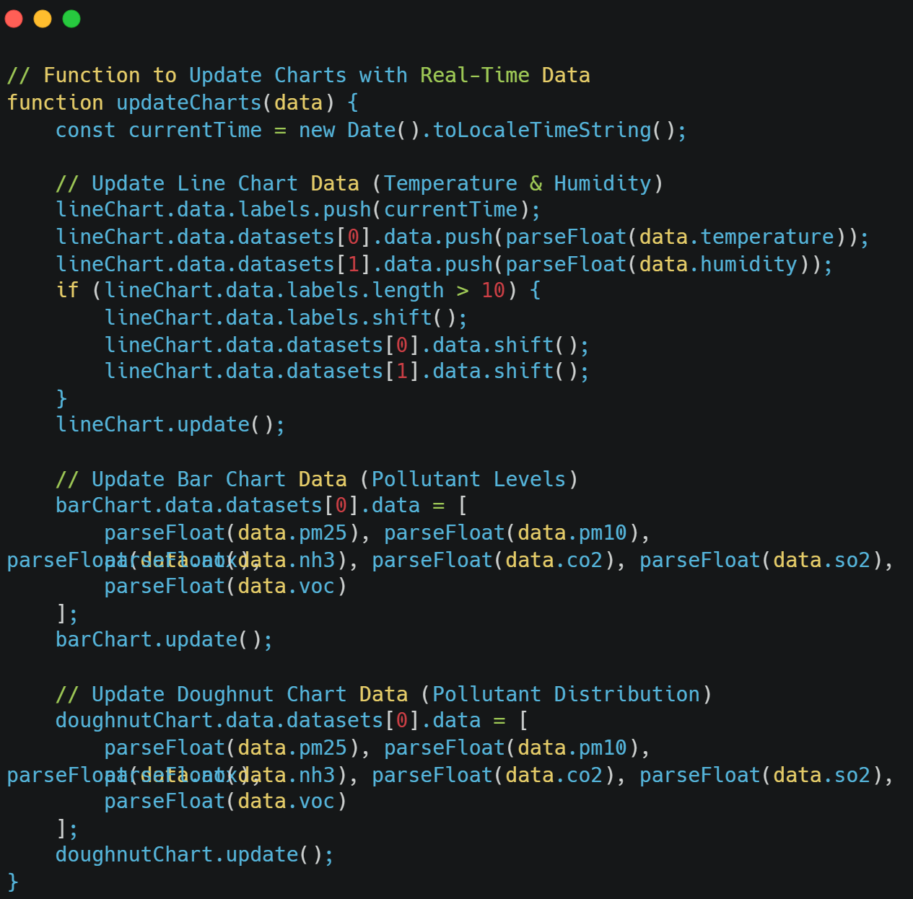
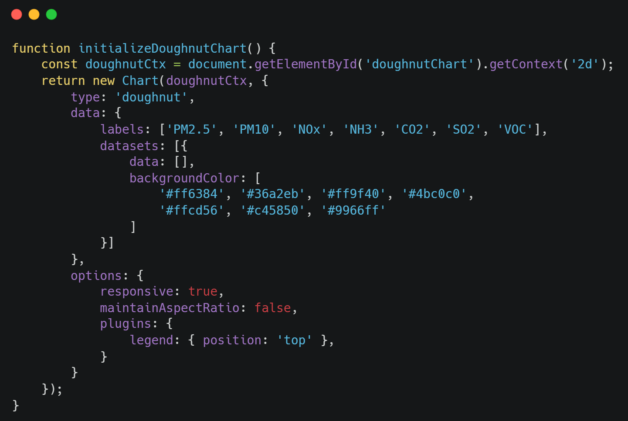
PART 2
*
Project Requirements and Code
1
Visual Representation – Doughnut Chart
Real-time Data Updates
2
3
4
5
6

Slide 9
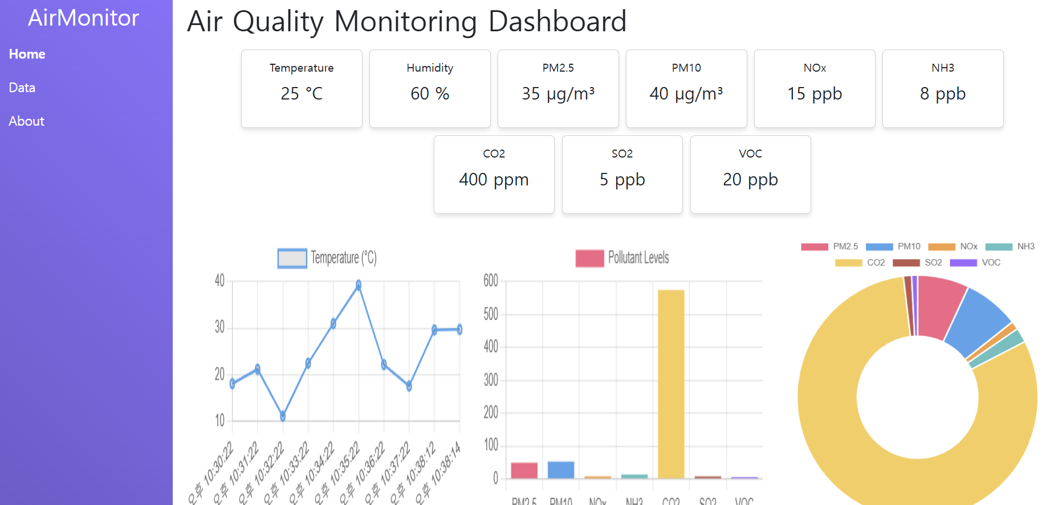
PART 2
*
Project Requirements and Code
1
2
3
4
5
6

Slide 10




PART 3
*
Future Work
1
Using Korea Environment Corporation API
Improving Visual Appeal and Usability
Adaptive and Responsive Design
2
3
Data Source
Accurate Monitoring
Enhanced Functionality
Enhanced UI Design
Responsive Design
Clear Data Visualization
User-Friendly Interface
Device Compatibility
Dynamic Layout Adjustments
Responsive UI
4
5
6

Slide 11


Thank you
201924569 Dawon Jeong

