Slide 1
Oh Kusto You Didn’t! (but probably should): Kusto Query Language 101
Joshua Weaver

Slide 2
Agenda
Download Kusto Explorer and connect to sample database
About Kusto Query Language
Kusto Query Language (KQL) Basics
Joining data in KQL
Tips n’ Tricks for using KQL
Kusto in Python: Python Kusto SKD, Kqlmagic for Jupyter

Slide 3
Disclaimers
Not all capabilities of Kusto will be demonstrated
Content is introductory and not intended for an expert audience

Slide 4


Why learn Kusto Query Language?
Kusto is on the rise.
Kusto handles lots of data.
Kusto useful for data science.
Notes:
Point 1. Kusto clusters are increasingly being used as data sources internally; meaning in likelihood you will have to use Kusto at some point
Point 2. Kusto was designed to scale terabytes of data and visualize data in real-time e.g. IoT, real-time clickstream data etc.
Point 3. Add to your data scientist toolkit. Plus, Kusto has some neat built-in user analytics and time series analysis functions

Slide 5
Part 1. Getting started with Kusto

Slide 6
Download and Install Kusto and Sample Database
Download Kusto Explorer with sample database: https://help.kusto.windows.net/Samples
If you already have Kusto connect to the Samples Cluster: https://help.Kusto.windows.net

Slide 7

Step 2. Get familiar with Kusto Query Language (KQL)
Working with data at scale
User friendly analytics
Familiar and powerful query language
Notes:
Kusto was built to query log / event data at scale → Efficient at processing millions of records of data
User friendly → Built with analysts in mind, Includes out-of-the-box functions for user analytics and time series analysis
Familiar language → SQL / RedShift like query language
Useful functions for visualizing data, working with time stamps and time data etc.

Slide 8
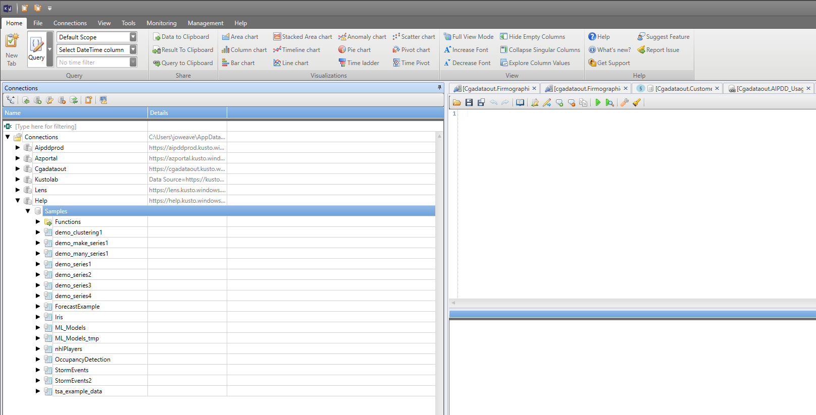
Kusto Data Explorer
Some light syntax editing tools
Run code with Shift+Enter
Clusters→Database→Tables
The database you highlight in the left hand nav is the database context your query is operating in.
Use the lock button to lock the context

Slide 9
Part 2. Hands on with Kusto

Slide 10
Over to Kusto Data Explorer & Python!

