Slide 1
Working with whole-genome sequencing data
Jacky Dwiyanto, PhD
Min Yi Lau

Slide 2
What is whole-genome sequencing (WGS)
Complete (or almost) coverage of an organism’s genome sequences
Complete coverage: complete genome
Incomplete coverage: draft genome

Slide 3
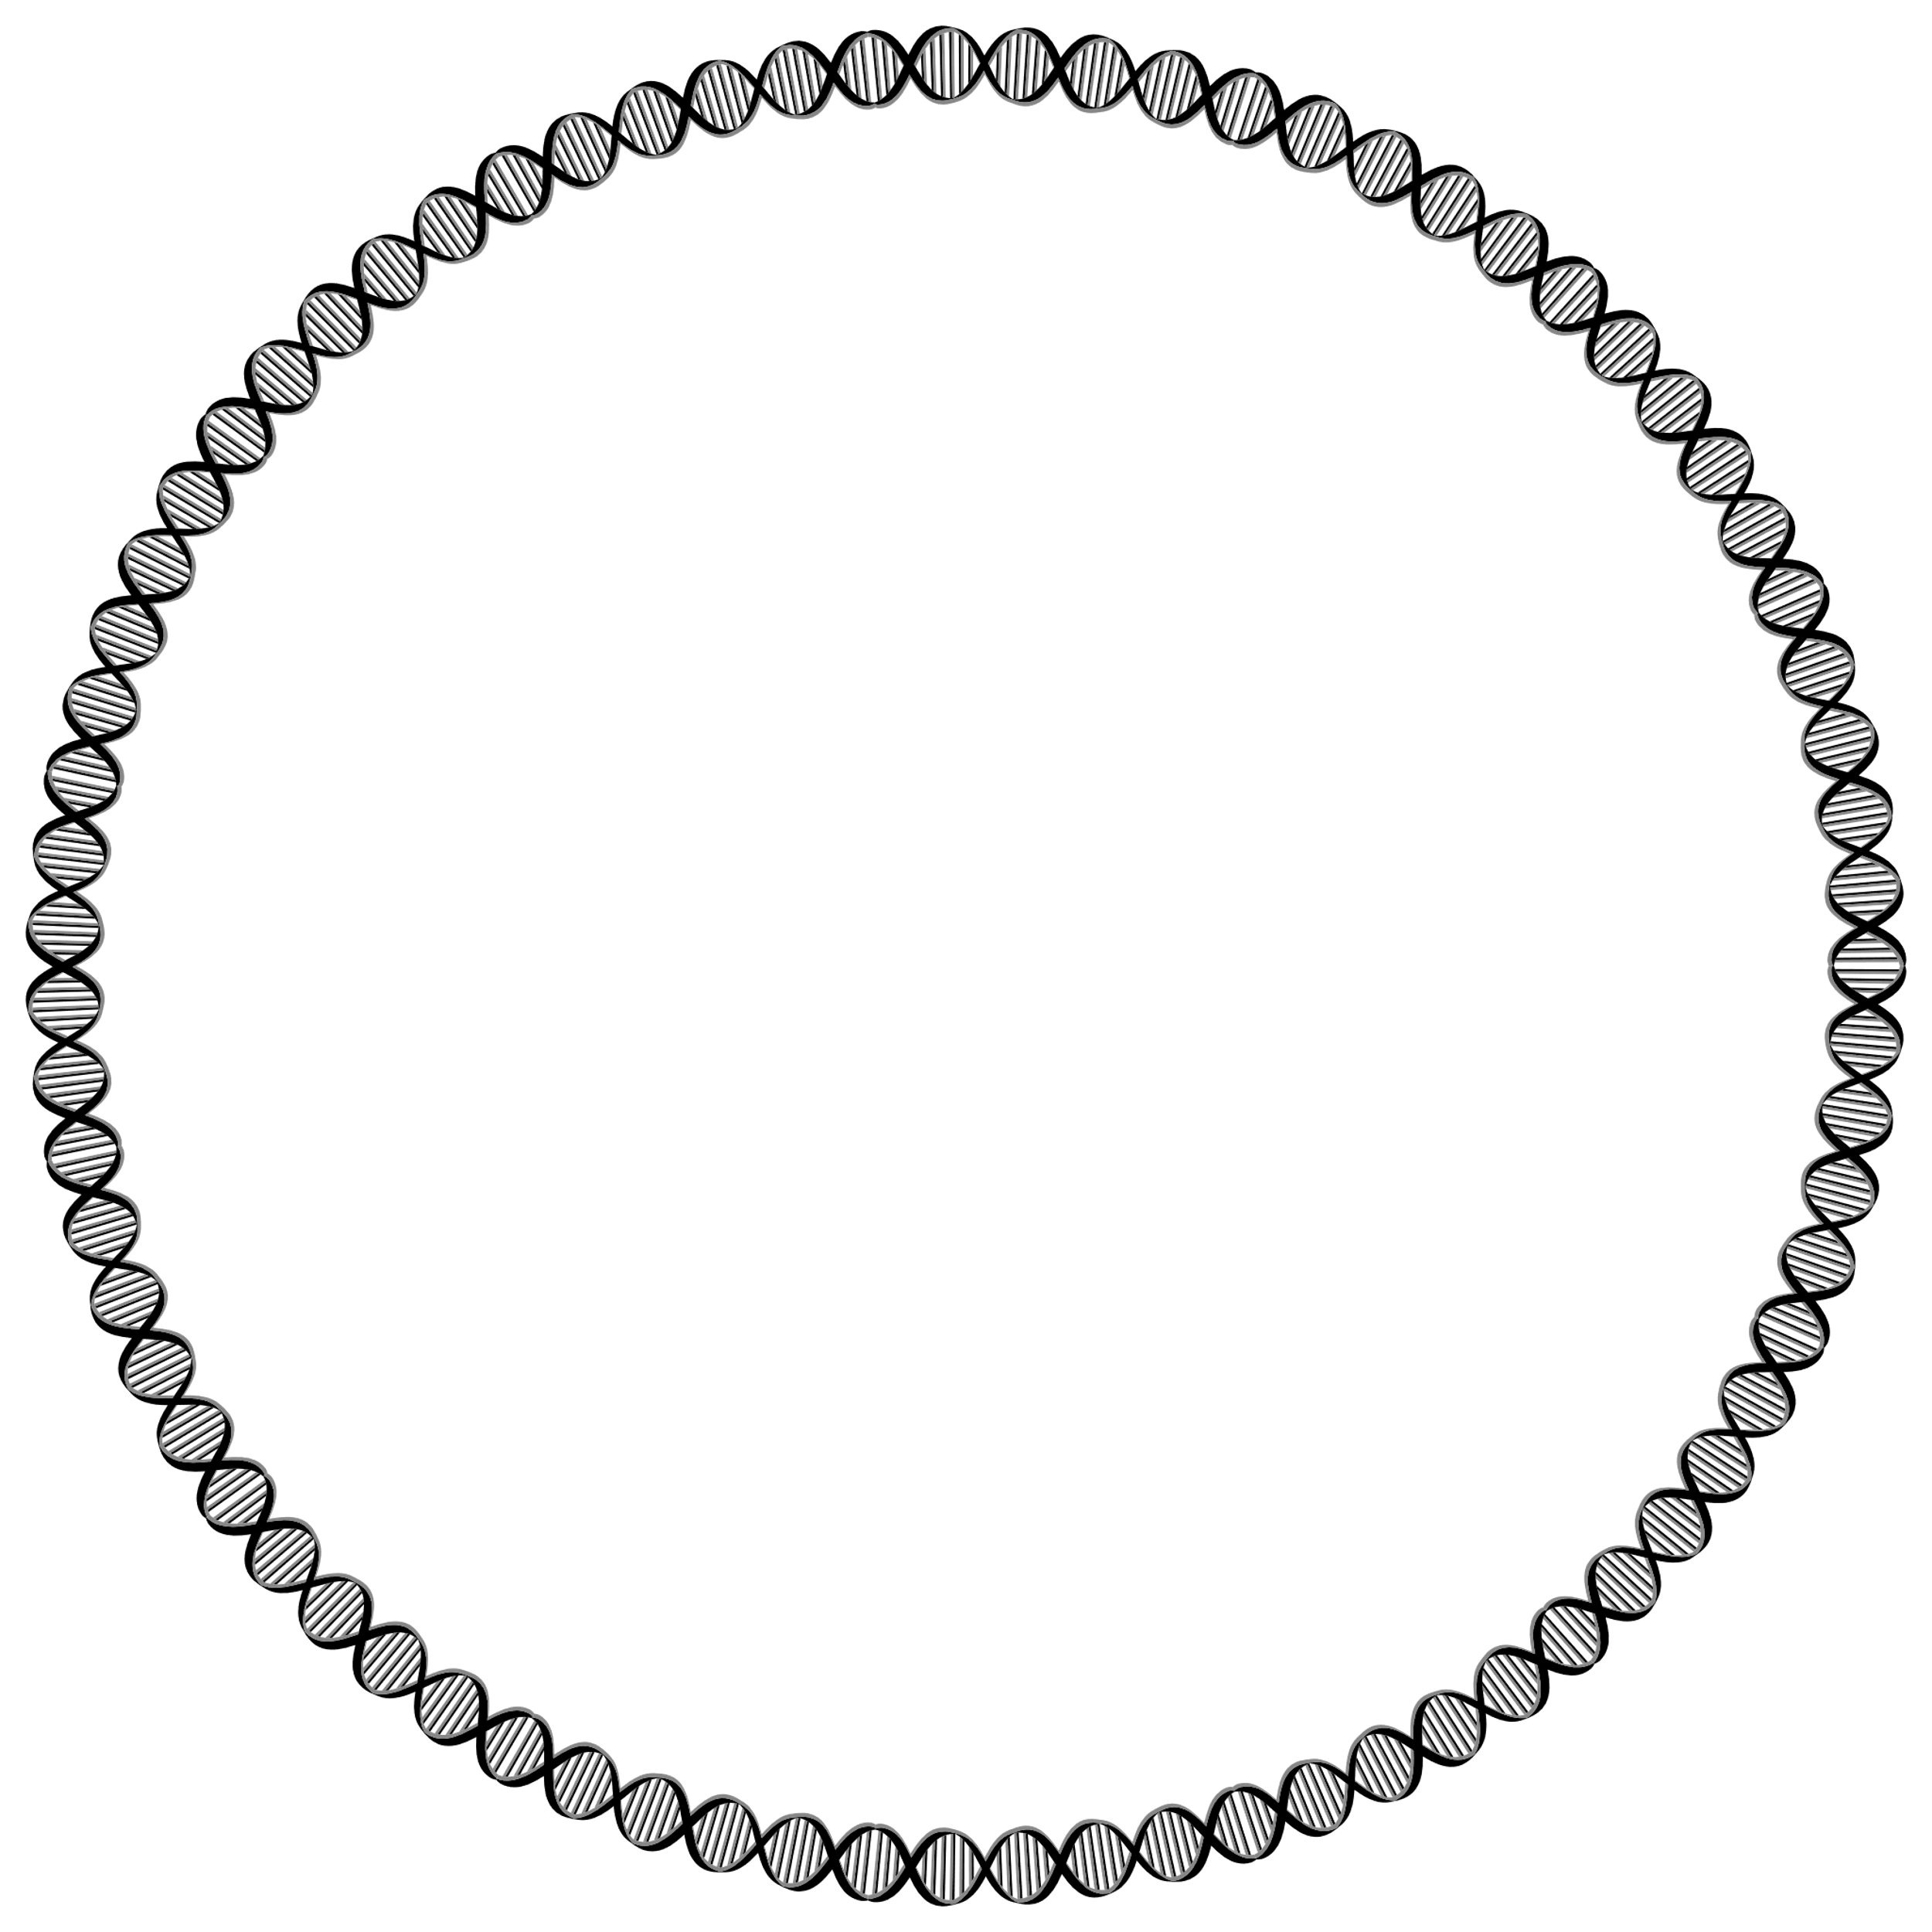
Illustration of complete vs draft genome
Complete WGS
Draft genome
Bacterial genome
Bacterial genome
Sequenced
Not sequenced

Slide 4
Draft genome or whole genome?
Depends on study aim:
Complete genome:
Hereditary and genome location critical
Lower error rates (high sequencing depth, hybrid short/long reads)
Costly
Draft genome:
Relatively cheaper
Higher error rates (lower sequencing depth, unresolved regions, gaps)
Sufficient for marker screening and basic comparative genomics

Slide 5
Types of WGS
Short reads
Illumina
100bp – 800 bp reads
most common
Accurate (high read depths)
Cannot resolve repetitive regions
Long reads
Oxford Nanopore, PacBio
5000 – 30000 bp reads
Not so common (but increasing adaptation)
Prone to errors (shallow read depths)
Can resolve repetitive regions

Slide 6
Types of WGS
Short reads
Illumina
100bp – 800 bp reads
most common
Accurate (high read depths)
Cannot resolve repetitive regions
Long reads
Oxford Nanopore, PacBio
5000 – 30000 bp reads
Not so common (but increasing adaptation)
Prone to errors (shallow read depths)
Can resolve repetitive regions
This workshop

Slide 7
Illustration of non-repetitive genome assembly using short-read sequencer
AAACCCTTTGGGTTTGGGCCCAAA
Non-repetitive genome region
Fragment and sequence
AAACCCTT
Short-read sequence fragments
GTTTGGGC
TTTGGGTT
GGCCCAAA
Resolved assembly
AAACCCTT
Genome assembly
TTTGGGTT
GTTTGGGC
GGCCCAAA
AAACCCTTTGGGTTTGGGCCCAAA
Correct sequencing result

Slide 8
Illustration of repetitive genome assembly failure using short read sequencer
CCCCCAACGAACGAACGAACGAACGTTTTT
Repetitive genome region
Fragment and sequence
CCCCCAAC
ACGTTTT
AACGAAC
GAACGAA
Short-read sequence fragments
ACGAACG
CGAACGA
CGTTTTT
Incorrect assembly
CCCCCAAC
AACGAAC
Genome assembly
GAACGAA
CGAACGA
ACGAACG
ACGTTTT
CGTTTTT
Incorrect sequencing result
CCCCCAACGAACGAACGTTTTT

Slide 9
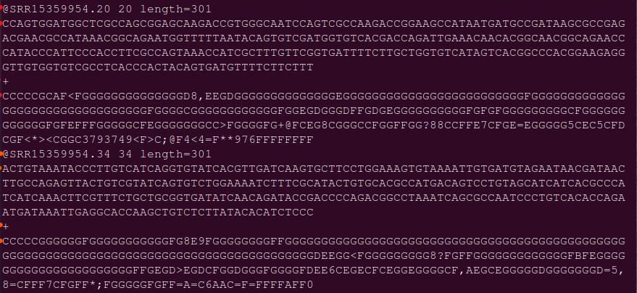
WGS file format
FASTQ files

Slide 10
WGS file format
Read 1
Read 2
Typically, 10,000 – 100,000 reads per sample

Slide 11
WGS file format
Sample identifier
Sequence
+ sign
Phred score

Slide 12
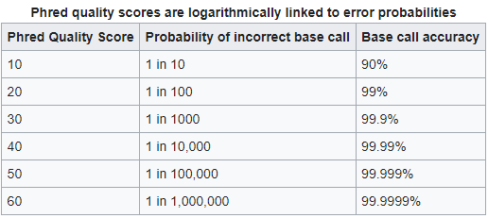
WGS file format
Phred Q score:
Quality of DNA sequence
Table adapted from https://en.wikipedia.org/wiki/Phred_quality_score

Slide 13
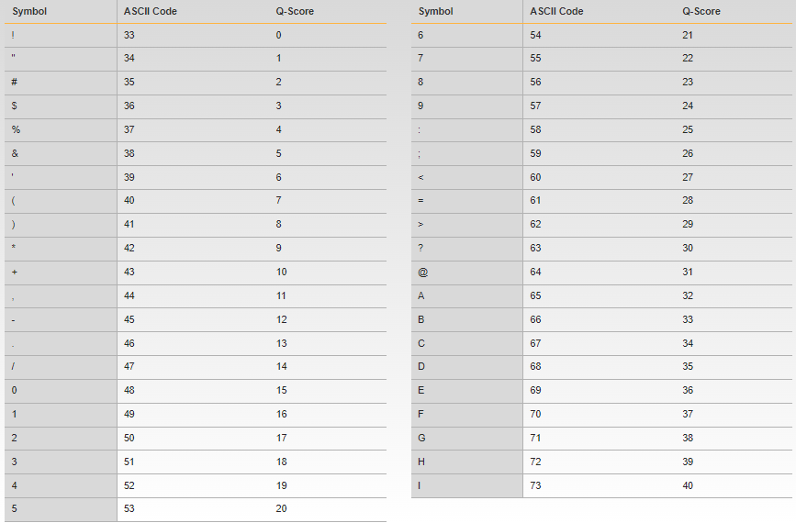
WGS file format
Phred Q score:
Quality of DNA sequence
Table adapted from https://support.illumina.com/help/BaseSpace_OLH_009008/Content/Source/Informatics/BS/QualityScoreEncoding_swBS.htm

Slide 14
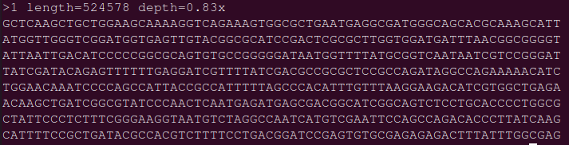
WGS file format
FASTA
FASTQ without quality information

Slide 15
Quality control for WGS
Conducted on FASTQ files
Contained Q score information
Common QC managers:
FastQC
Comprehensive
Manual
Fastp
Fast, scalable
Automated

Slide 16
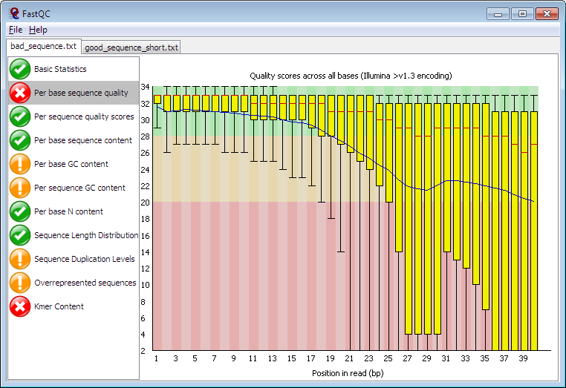
Image obtained from https://www.bioinformatics.babraham.ac.uk/projects/fastqc/

Slide 17
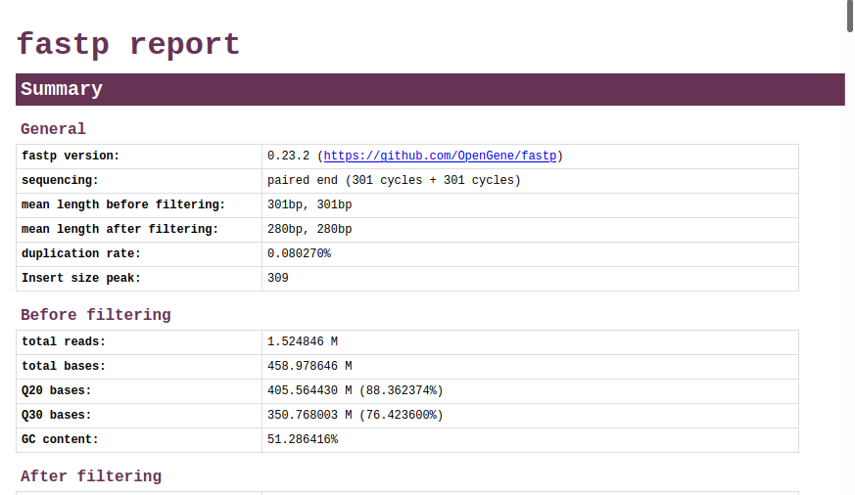

Slide 18
Quality control for WGS
Important metrics:
Q score distribution
GC content
Sequencing adapters

Slide 19
QC: Q score distribution
Score drops as sequencing proceeds
No fixed threshold of good/bad quality, depends on user to set threshold
Personal preference: trim sequences once Q < 20

Slide 20
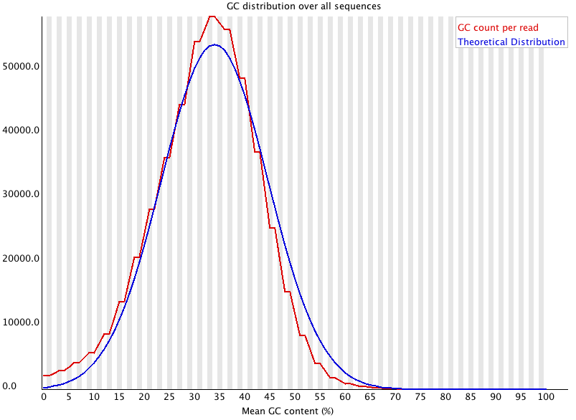
QC: GC content
Indicator of sequencing contamination
Confirms correct biological samples
Salmonella spp = ~50%
Escherichia coli = ~50%
Ehrlichia chaffeensis = ~30%
Streptomyces griseus = ~70%
Image taken from https://www.bioinformatics.babraham.ac.uk/projects/fastqc/Help/3%20Analysis%20Modules/5%20Per%20Sequence%20GC%20Content.html

Slide 21
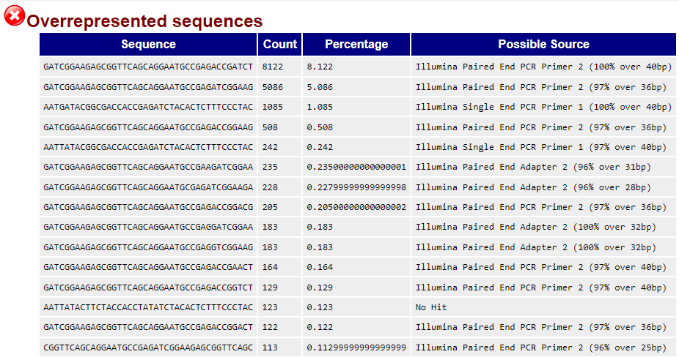
QC: Sequencing adapters
Detects contaminating sequencing adapters

Slide 22
WGS application
WGS is rapidly replacing traditional molecular techniques
Marker screening (conventional PCR)
Epidemiology (PFGE, PCR MLST)

Slide 23
WGS Application: Marker screening
Identify presence of nucleotide markers (replaces PCR)
MLST
Antibiotic resistance
Plasmid replicon groups

Slide 24
Illustration of marker screening with WGS data
WGS short read sequence typer (SRST)
Marker reference database
Pattern Gene
CTX-M-27
CTX-M-15
GyrA
Sample | Genes
A | QnrS, CTX-M-15
B | ParC, CTX-M-27
ParC
QnrS
Genome A
Genome B

Slide 25
WGS Application: Pan-genome analysis
Epidemiology
Outbreak tracing
Replaces PFGE
Comparative genomics
Core-genome
Pan-genome
FASTQ sequence data
Assembly
Annotation
Genome Alignment
Phylogenetic Tree

Slide 26
Illustration of comparative genomics with WGS
AAACCCTT
GTTTGGGC
TTTGGGTT
Genome annotation
GGCCCAAA
WGS reads (FASTQ)
A
B
C
Genome alignment
AAACCCTT
TTTGGGTT
GTTTGGGC
A
GGCCCAAA
B
AAACCCTTTGGGTTTGGGCCCAAA
Genome assembly
C
Tree construction

Slide 27
Working with WGS data
Graphical User Interface platform
Websites, Windows software
Easy to use
No coding
Lack configuration
Not scalable
Not reproducible
Some requires purchase/subscription

Slide 28


Slide 29
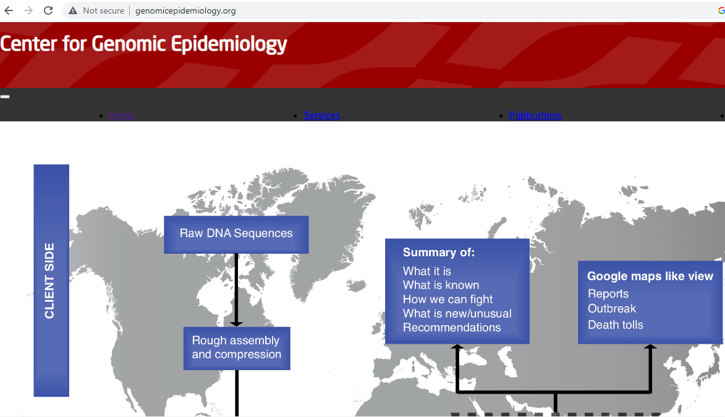

Slide 30
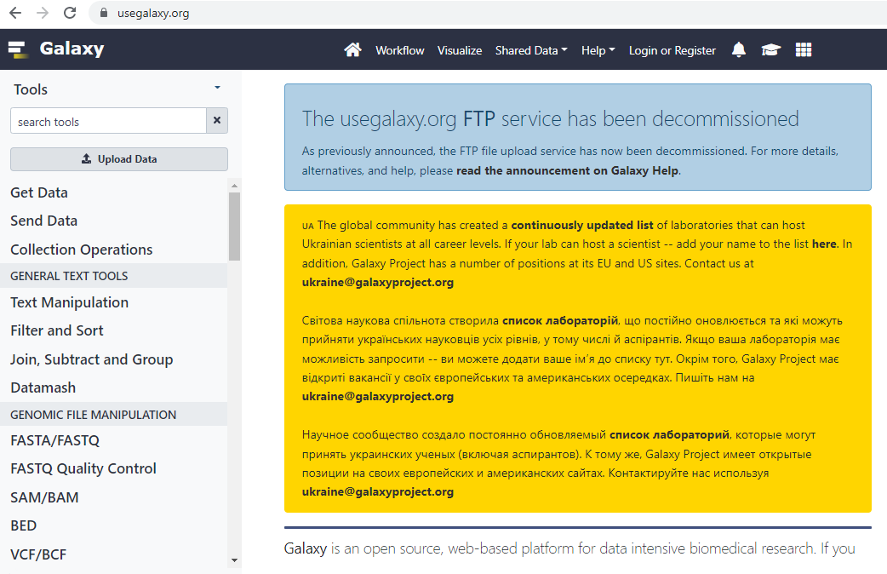

Slide 31
Working with WGS data
Command Line Interface (CLI)
Ubuntu platform
Free/Open-source
Requires knowledge of computer languages
Scalable
Reproducible
Automation ready once properly set up.

Slide 32
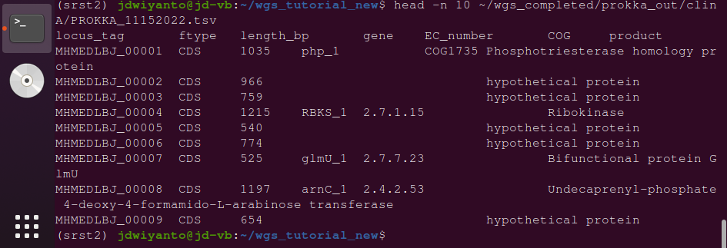

Slide 33
Bioinformatics workshop
Processing WGS files
Screening for MLST, antibiotic resistance genes, and plasmid groups
Comparative genomics
Sequence assembly
Sequence annotation
Sequence alignment
Tree construction
R statistical language
Data cleaning
Data visualisation

