Slide 1






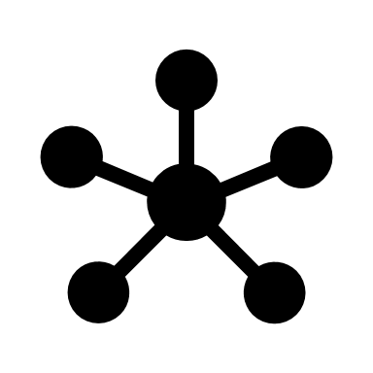


Blockchain Project Management Application Continuous Delivery Pipeline
DEVELOP
CONTINUOUS INTEGRATION
TeamCity
Slack
JIRA
Version tag and push binaries to artefact
repository.
Build Report
Solidity Compiler
Build unit tested contracts to binaries.
Truffle and GanacheCLI
Build and unit test (against in memory
Blockchain.
Pull down source code (.sol) on check-in.
GitHub

Slide 2
Blockchain Project Management Application Continuous Delivery Pipeline
AUTOMATED DEPLOYMENT
???
Truffle
Production
Migrate contract binaries into target blockchain.
UAT
QA
Pull versioned contract binaries down from
artefact repository.
Development

