Slide 1
Weyland-Yutani
Reserve Intelligence Proposal
Exploring Global Financial Reserves to Identify Strategic Expansion Opportunities
Dylan Beckham

Slide 2
TOC
Project Overview
Data Visualizations
Strategic Actions
Understanding the IMF Dataset
Global Reserves Over Time
Summary
Preparing Data for Analysis
Proposed solution
Team
Exploratory SQL Analysis
Opportunities for Weyland-Yutani
Dylan Beckham

Slide 3

Project Overview
Weyland-Yutani shareholders desire to understand world domination more clearly.
They have asked for an analysis of the world's international reserves to identify global financial buffers in support of investment and policy development to become a more perfect "Global Company."
Dylan Beckham

Slide 4
Understanding the IMF Dataset
Source: International Monetary Fund (IMF)
Years Covered: 2020–2023
1
3
2
Scope: Global Financial Reserves by Country and Indicator
4
Key Fields: Country, Indicator, Year, Value
Dylan Beckham

Slide 5
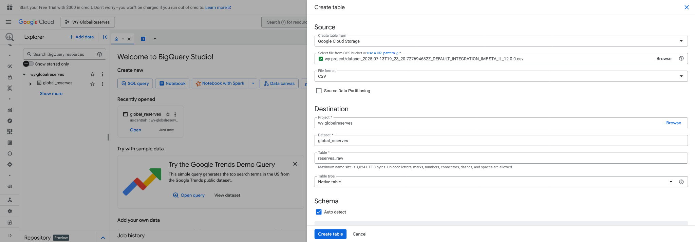
Preparing Data for Analysis
Creating the Project in Google Cloud
Dylan Beckham

Slide 6
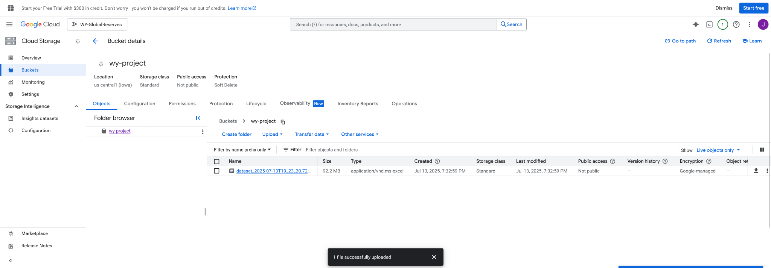
Preparing Data for Analysis
Uploading to Google Cloud Storage
Dylan Beckham

Slide 7
Exploratory SQL Analysis
• Validated years 2020–2023 are populated in dataset
• Identified key indicators: gold reserves, foreign asset claims
• Confirmed tidy structure using SQL and `UNPIVOT`
Dylan Beckham

Slide 8
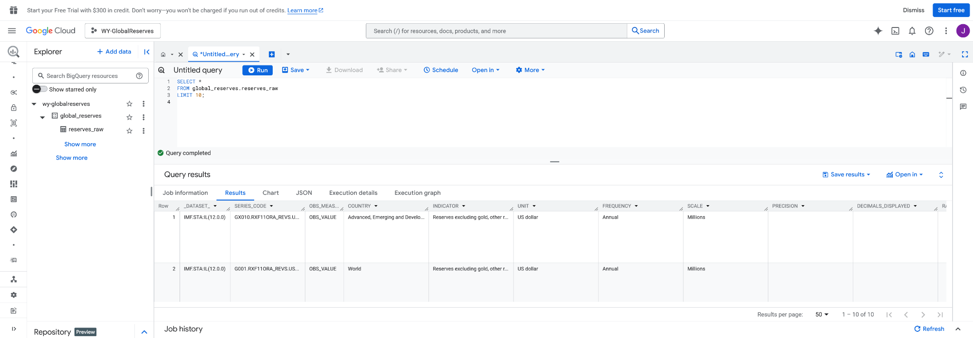
Preparing Data for Analysis
Shaping the data with SQL Inquiries
Dylan Beckham

Slide 9
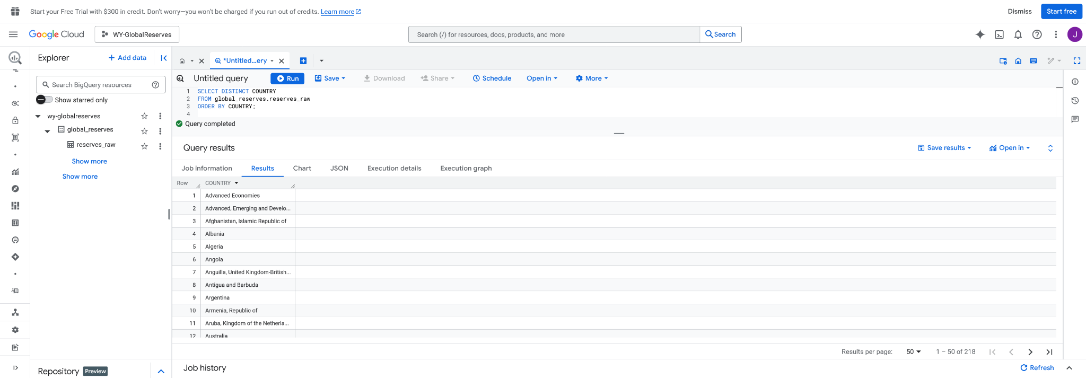
Preparing Data for Analysis
Shaping the data with SQL Inquiries
Dylan Beckham

Slide 10
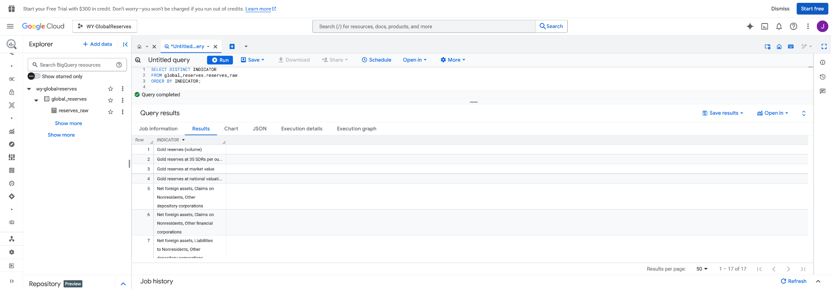
Preparing Data for Analysis
Shaping the data with SQL Inquiries
Dylan Beckham

Slide 11
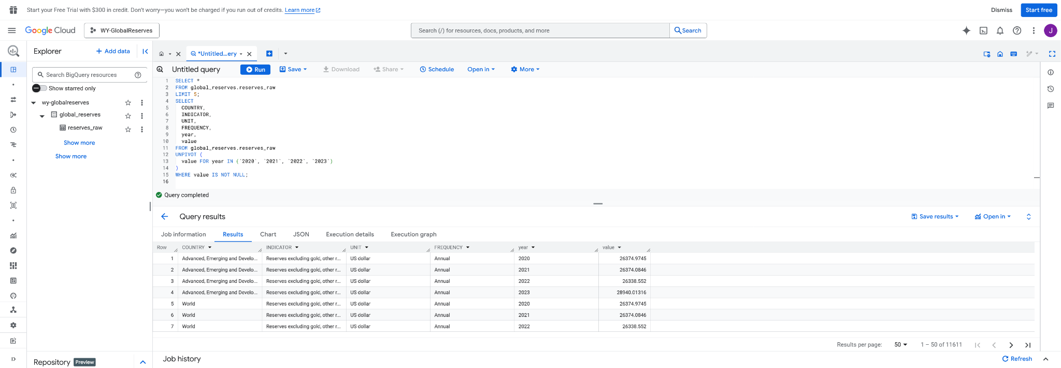
Preparing Data for Analysis
Shaping the data with SQL Inquiries
Dylan Beckham

Slide 12
Understanding the data
Dylan Beckham

Slide 13
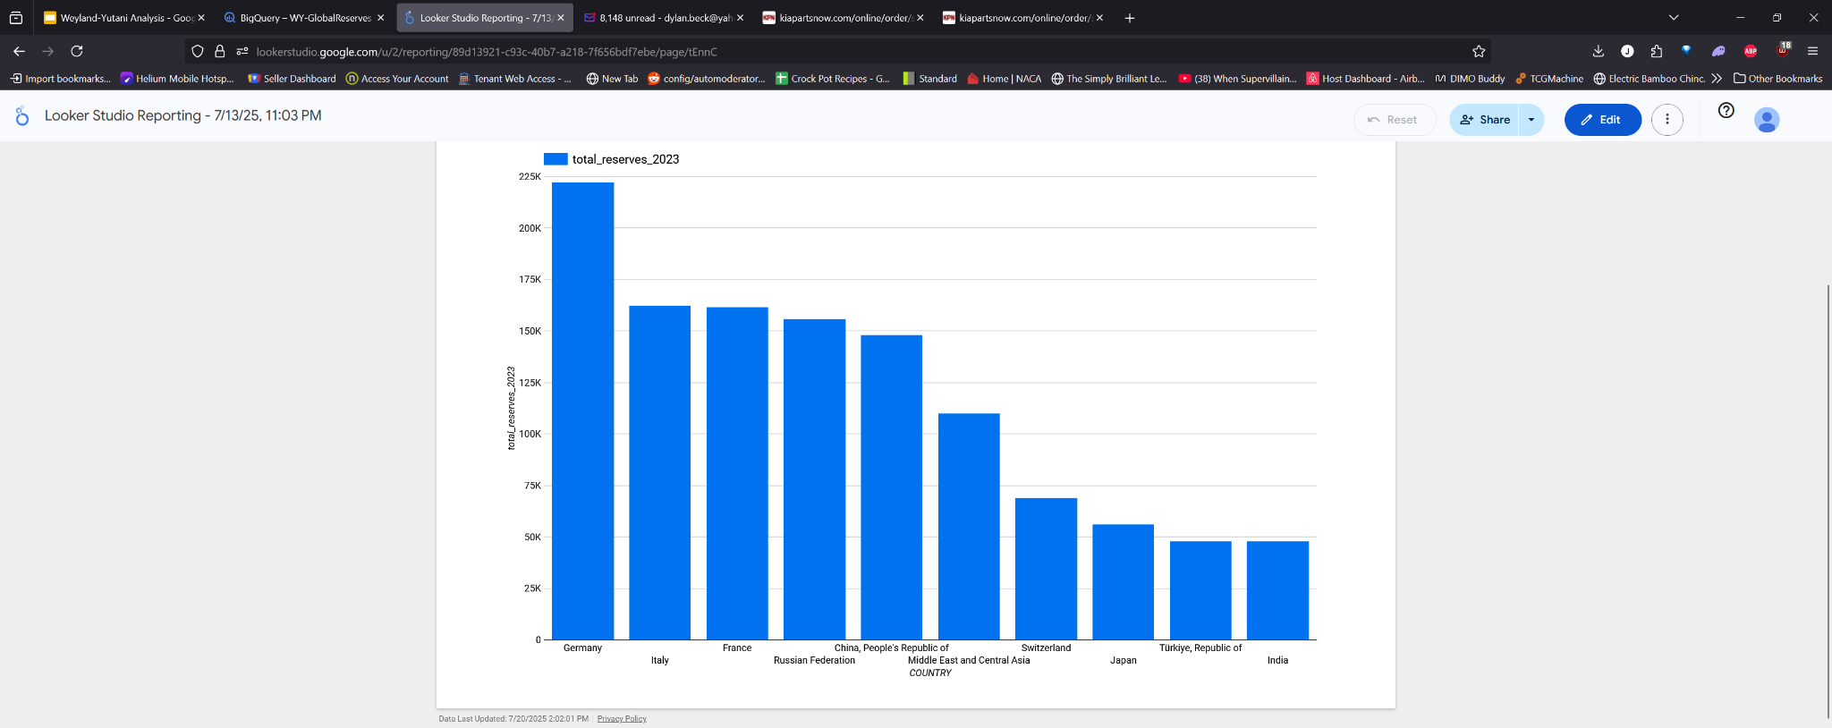
Market trends
Top Reserve Holders (2023)
Dylan Beckham

Slide 14
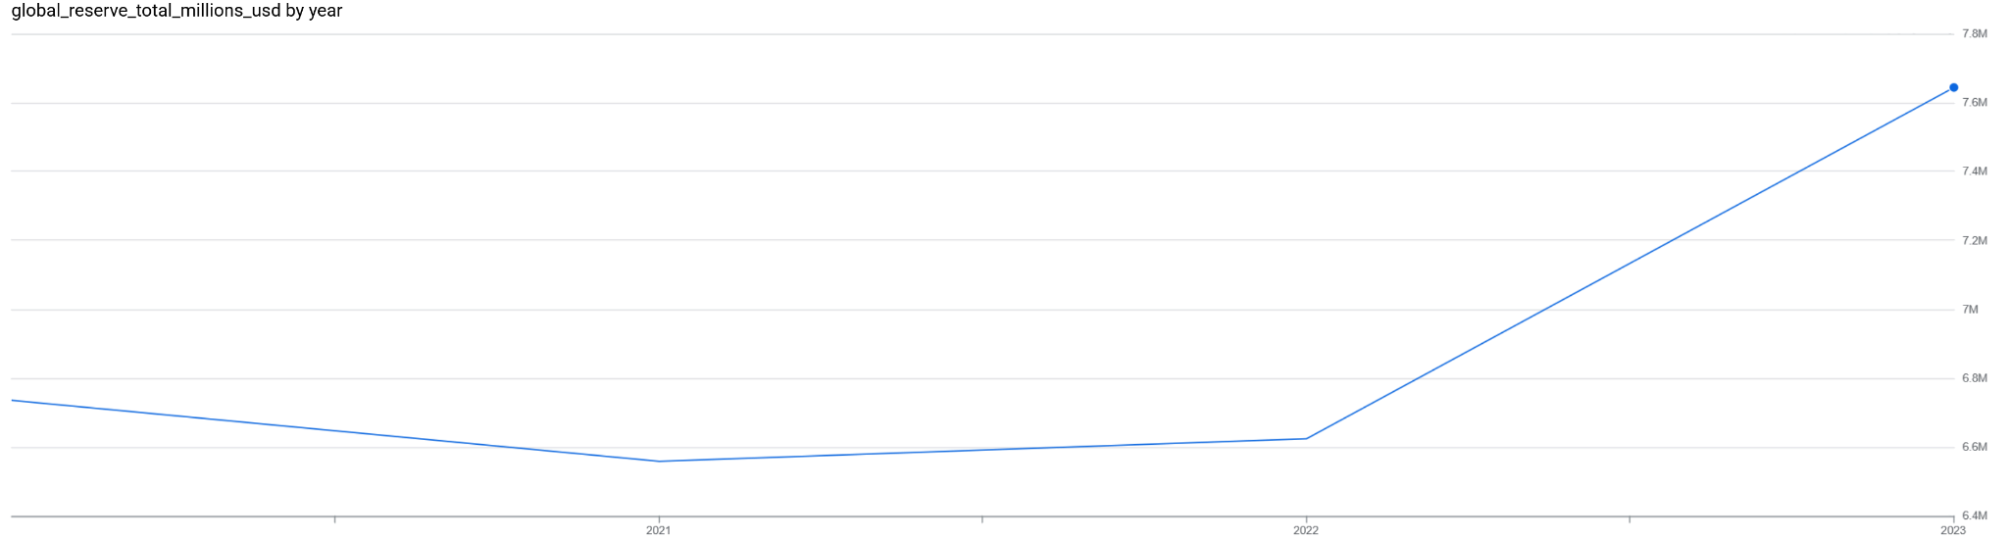
Market trends
Global Reserves (2020-23)
Dylan Beckham

Slide 15



Insights
Empires of history may hold a great key to future growth as post colonialism still leaves it’s mark decades later, while technology and oil still drive much of the financial markets.
01 | Germany, Italy, & France hold the greatest reserves
02 | East Asia & Middle East have sharpest growth levels
03 | Stagnation plagues Sub-Saharan Africa & Eastern Europe
Dylan Beckham

Slide 16
Strategic Actions
1. Target regions with stagnant reserves for partnerships
2. Invest in rising economies like India & Brazil
3. Monitor reserve trends as early warning market signals
Dylan Beckham

Slide 17
In Conclusion
This analysis leverages IMF data to guide Weyland-Yutani’s global strategy with the following key takeaways:
Disaggregated reserve data reveals national stability patterns
Identified target regions with strategic potential
Informed expansion, risk mitigation, and market positioning
“Informed expansion builds lasting dominance”
Dylan Beckham

Slide 18
Team
All Slides & Materials
J. Dylan Beckham
CEO
CFO
Sales Director
Berry Books
Vinny Viewer
Wendy Writer
Dylan Beckham

Slide 19
Thank you.
Dylan Beckham

