Slide 1

“Parallel Graph Analytics”
Zhaoming Yin @ Intel® Labs
Mentors: Satish Nadathur
& Narayanan Sundaram
Aug 1st 2013

Slide 2

Graph Problems

Slide 3
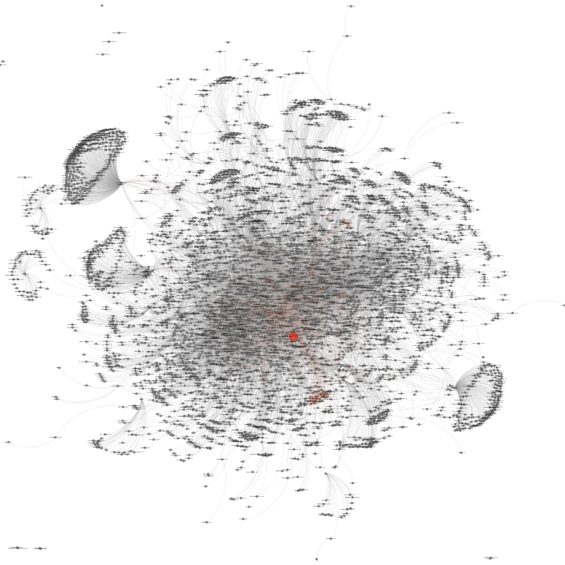

Large Scale Graph Analysis
GraphLab,
Galois,
KDT,
Giraph,
SociaLite.
No good baseline
Our goal is good native implementation
Notes:
web: http://graphlab.org/
web: http://iss.ices.utexas.edu/?p=projects/galois
web: http://sourceforge.net/projects/kdt/
web: http://giraph.apache.org/
web: http://mobisocial.stanford.edu/

Slide 4
Graph Algorithms Considered
Breadth First Search (BFS)
Pagerank
Single Source Shortest Path (SSSP)
Betweeness Centrality (BC)
Collaborative Filtering SGD
Approximate Diameter
Notes:
web: http://graphlab.org/
web: http://iss.ices.utexas.edu/?p=projects/galois
web: http://sourceforge.net/projects/kdt/
web: http://giraph.apache.org/
web: http://mobisocial.stanford.edu/

Slide 5
Native Graph Framework
We use Compressed Sparse Row (CSR) as the basic graph structure, because the vertices and edges are organized sequentially which helps save memory and time for traverse.
Our program can read graph format of both GTGraph and Graph 500. Supporting both text and binary graph formats.
We have a MPI enabled graph partition (1-D partitioning) interface that helps us to partition single/multiple graph file into multiple graph files that: evenly distributes edges between each file.

Slide 6




Pagerank Algorithm

Slide 7

Pagerank Computation
PR(a)
PR(b)
Given page x with inlinks t₁…t_{n}, where
  C(t) is the out-degree of t
  α is probability of random jump
  N is the total number of nodes in the graph
PR(c)
PR(x)=PR(a)/2 +
PR(b) + PR(c)/3

Slide 8
Computing PageRank
Properties of PageRank
  Can be computed iteratively
  Effects at each iteration are local
Sketch of algorithm:
  Start with seed PR_{i} values
  Each page distributes PR_{i} “credit” to all pages it links to
  Each target page adds up “credit” from multiple in-bound links to compute PR_{i+1}
  Iterate until values converge

Slide 9


Single Node PR Implementation

Slide 10
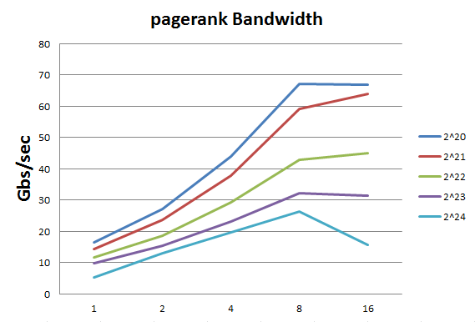
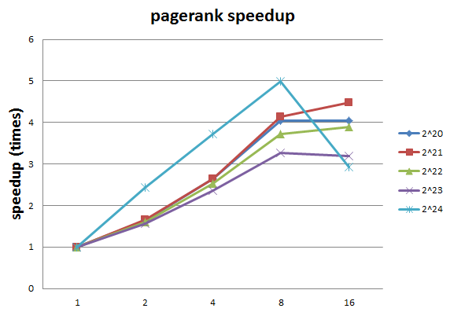
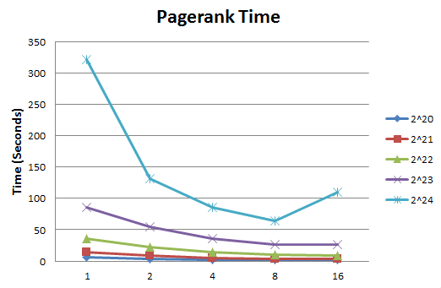
Single Node PR Results
#vertices: 2^20~2^24
avg degree: 16
Single socket SNB
Notes:
Add lables and titles, and remove 32 threads

Slide 11
Multiple Node PR Implementation (1)
msg
msg
Notes:
On incremental update

Slide 12
Multiple Node PR Implementation (2)
Incremental update of PR values, so we only need to send delta(PR), in the future we can do some optimizations based on this strategy.
Do some message reduction to avoid contention or locking.
Asynchronous message passing.
Parallelized message packing and redistribution.
Notes:
On msg packing, incremental, msg local reduction, asynchronous msg passing.

Slide 13
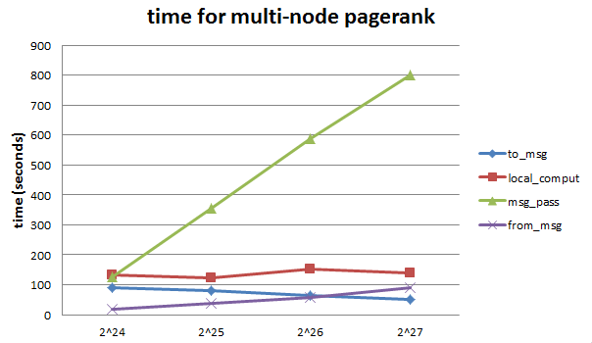
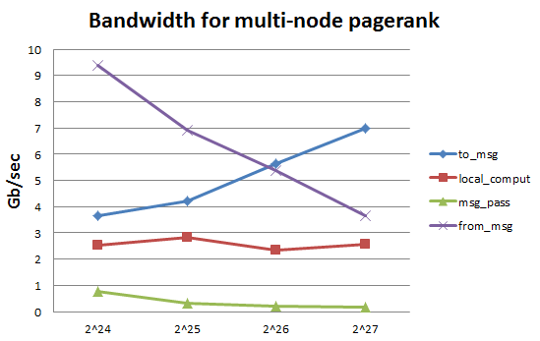
Multiple Node PR Results
Weak scaling, each node has 2^23 vertices.
Running on Endeavor NM with interactive mode.
Notes:
On msg packing

Slide 14
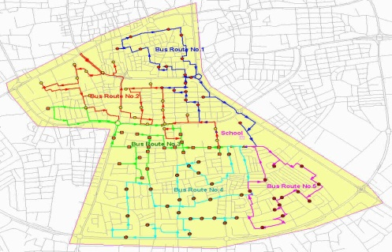
Single Source Shortest Path Algorithm

Slide 15
Single Source Shortest Path
Djkstra algorithm: every iteration start with the best vertex, and continue search. (minimum work, but no parallelism)
Bellman-Ford algorithm: every iteration, compute every vertex. (a lot of parallelism at the cost of much more work by roughly O(V))
Delta stepping algorithm: lies between Djkstra and Bellman-ford, it has parallelism while not adding too much work.

Slide 16
∆ - stepping Algorithm Schetch
Label-correcting algorithm: Can relax edges from unsettled vertices also
∆ - stepping: “approximate bucket implementation of Dijkstra’s algorithm”
∆: bucket width
Vertices are ordered using buckets representing priority range of size ∆
Each bucket may be processed in parallel

Slide 17
∆ - stepping algorithm: illustration
∆ = 0.1 (say)
0.05
One parallel phase
while (bucket is non-empty)
  Inspect light edges
  Construct a set of “requests” (R)
  Clear the current bucket
  Remember deleted vertices (S)
  Relax request pairs in R
Relax heavy request pairs (from S)
Go on to the next bucket
3
0.56
6
0.07
0.01
2
0.15
4
0.23
0
0.13
0.02
0.18
1
5
d array
0 1 2 3 4 5 6
∞
∞
∞
∞
∞
∞
∞
Buckets

Slide 18
∆ - stepping algorithm: illustration
0.05
One parallel phase
while (bucket is non-empty)
  Inspect light edges
  Construct a set of “requests” (R)
  Clear the current bucket
  Remember deleted vertices (S)
  Relax request pairs in R
Relax heavy request pairs (from S)
Go on to the next bucket
3
0.56
6
0.07
0.01
2
0.15
4
0.23
0
0.13
0.02
0.18
1
5
d array
0 1 2 3 4 5 6
0
∞
∞
∞
∞
∞
∞
Buckets
Initialization:
Insert s into bucket, d(s) = 0
0
0

Slide 19
∆ - stepping algorithm: illustration
One parallel phase
while (bucket is non-empty)
  Inspect light edges
  Construct a set of “requests” (R)
  Clear the current bucket
  Remember deleted vertices (S)
  Relax request pairs in R
Relax heavy request pairs (from S)
Go on to the next bucket
0.05
3
0.56
6
0.07
0.01
2
0.15
4
0.23
0
0.13
0.02
0.18
1
5
d array
0 1 2 3 4 5 6
0
∞
∞
∞
∞
∞
∞
R
Buckets
2
0
0
.01
S

Slide 20
∆ - stepping algorithm: illustration
0.05
One parallel phase
while (bucket is non-empty)
  Inspect light edges
  Construct a set of “requests” (R)
  Clear the current bucket
  Remember deleted vertices (S)
  Relax request pairs in R
Relax heavy request pairs (from S)
Go on to the next bucket
3
0.56
6
0.07
0.01
2
0.15
4
0.23
0
0.13
0.02
0.18
1
5
d array
0 1 2 3 4 5 6
0
∞
∞
∞
∞
∞
∞
Buckets
2
R
0
.01
0
S

Slide 21
∆ - stepping algorithm: illustration
0.05
One parallel phase
while (bucket is non-empty)
  Inspect light edges
  Construct a set of “requests” (R)
  Clear the current bucket
  Remember deleted vertices (S)
  Relax request pairs in R
Relax heavy request pairs (from S)
Go on to the next bucket
3
0.56
6
0.07
0.01
2
0.15
4
0.23
0
0.13
0.02
0.18
1
5
d array
0 1 2 3 4 5 6
0
∞
.01
∞
∞
∞
∞
Buckets
R
0
2
0
S

Slide 22
∆ - stepping algorithm: illustration
0.05
One parallel phase
while (bucket is non-empty)
  Inspect light edges
  Construct a set of “requests” (R)
  Clear the current bucket
  Remember deleted vertices (S)
  Relax request pairs in R
Relax heavy request pairs (from S)
Go on to the next bucket
3
0.56
6
0.07
0.01
2
0.15
4
0.23
0
0.13
0.02
0.18
1
5
d array
0 1 2 3 4 5 6
0
∞
.01
∞
∞
∞
∞
Buckets
R
1
3
0
2
.03
.06
0
S

Slide 23
∆ - stepping algorithm: illustration
0.05
One parallel phase
while (bucket is non-empty)
  Inspect light edges
  Construct a set of “requests” (R)
  Clear the current bucket
  Remember deleted vertices (S)
  Relax request pairs in R
Relax heavy request pairs (from S)
Go on to the next bucket
3
0.56
6
0.07
0.01
2
0.15
4
0.23
0
0.13
0.02
0.18
1
5
d array
0 1 2 3 4 5 6
0
∞
.01
∞
∞
∞
∞
Buckets
R
1
3
0
.03
.06
S
0
2

Slide 24
∆ - stepping algorithm: illustration
0.05
One parallel phase
while (bucket is non-empty)
  Inspect light edges
  Construct a set of “requests” (R)
  Clear the current bucket
  Remember deleted vertices (S)
  Relax request pairs in R
Relax heavy request pairs (from S)
Go on to the next bucket
3
0.56
6
0.07
0.01
2
0.15
4
0.23
0
0.13
0.02
0.18
1
5
d array
0 1 2 3 4 5 6
0
.03
.01
.06
∞
∞
∞
Buckets
R
0
1
3
S
0
2

Slide 25
∆ - stepping algorithm: illustration
0.05
One parallel phase
while (bucket is non-empty)
  Inspect light edges
  Construct a set of “requests” (R)
  Clear the current bucket
  Remember deleted vertices (S)
  Relax request pairs in R
Relax heavy request pairs (from S)
Go on to the next bucket
3
0.56
6
0.07
0.01
2
0.15
4
0.23
0
0.13
0.02
0.18
1
5
d array
0 1 2 3 4 5 6
0
.03
.01
.06
.16
.29
.62
Buckets
R
1
4
2
5
S
0
2
1
3
6
6

Slide 26
Parallel ∆ - stepping Algorithm: Optimization Methods
There is contentions when multiple threads are relaxing edges that has the same end vertex.
We use parallel partition method, partition edges to request array into 256 bins, and process the bins in parallel.

Slide 27
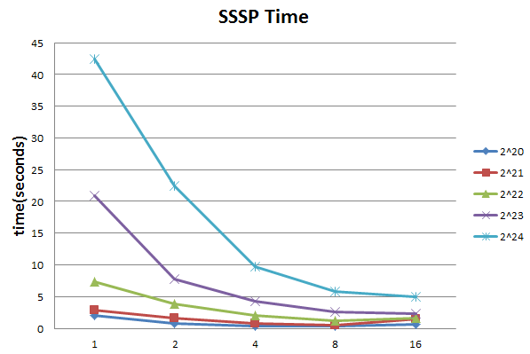
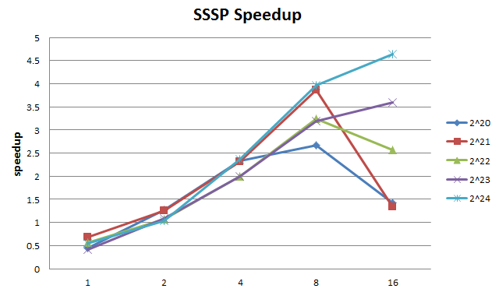
Parallel ∆ - stepping Algorithm: Single Node results

Slide 28

Q&A?

