Slide 1

StreamNet: A DAG System with
Streaming Graph Computing
Zhaoming Yin

Slide 2


Problem Statement?
Coin/Speed | BTC | BCH | LTC | ETH | ETC | XRP
TPS | 4.6 | 116 | 61 | 15 | 15 | 1500
HashRate | 162 | 2.86 | 0.28 | 0.26 | 0.0026 | N/A
Price | 10500 | 214 | 43.7 | 347 | 4.83 | N/A
P/H | 64.8 | 74 | 156 | 1334 | 1857 | N/A
Transaction Slow
Most public chains have slow transaction speed, though XRP is fast, they are permissioned chain

Slide 3
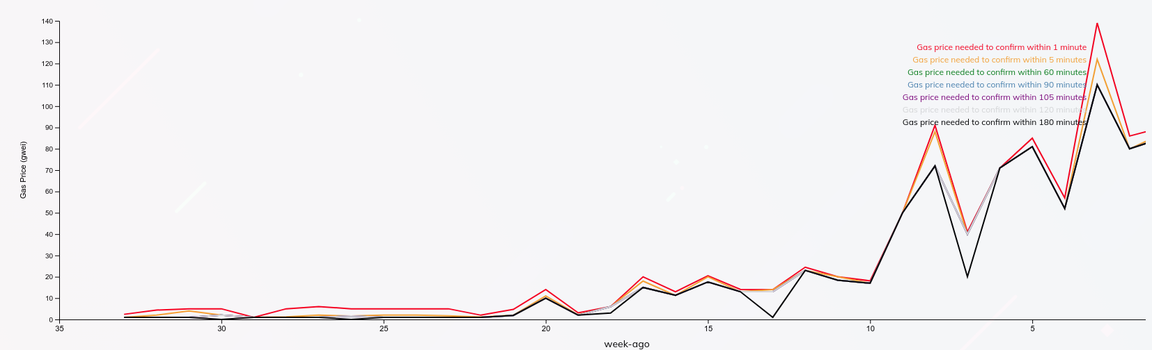
Problem Statement?
GAS Price High
With DeFi projects goes wild, the ETH gas price becomes sky-rocketing high.

Slide 4



Our Solution
We need a fast and cheap public block chain.
A low cost block-chain.
Algorithm to ensure consistency.
Fast block synchronization

Slide 5
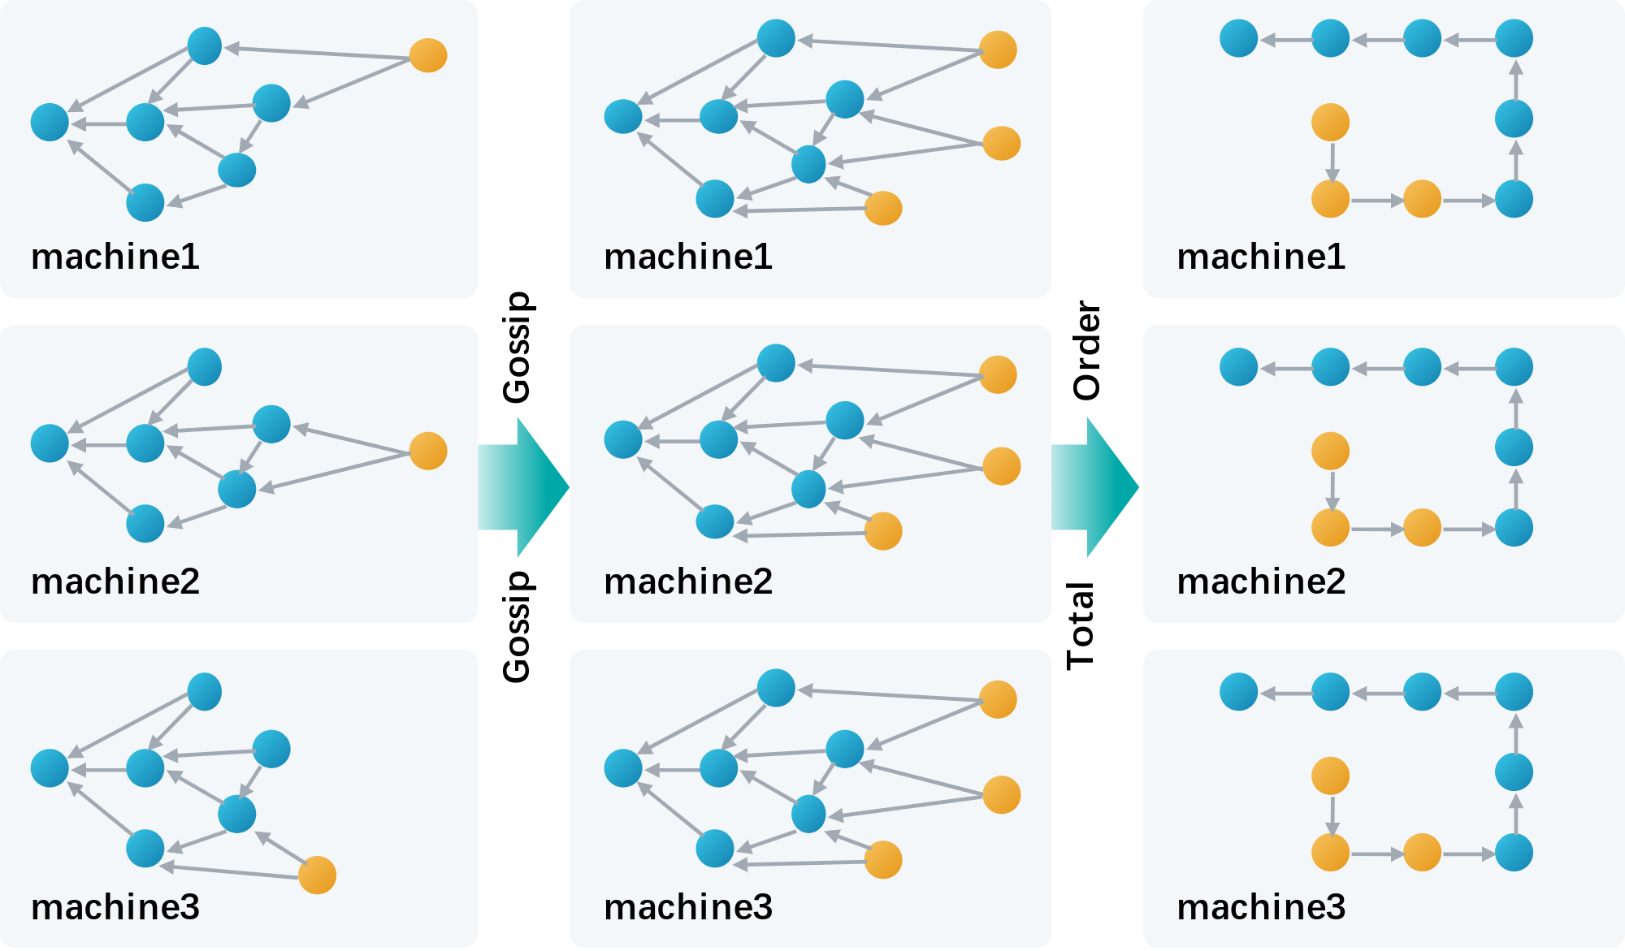
General Idea

Slide 6

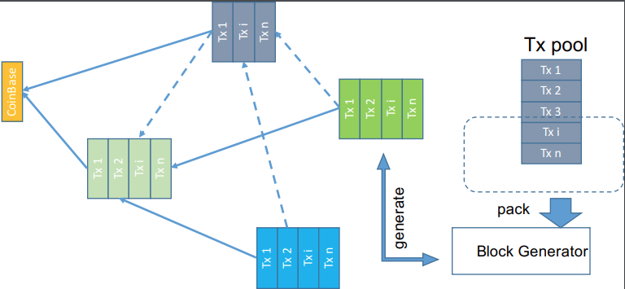
Local Architecture

Slide 7
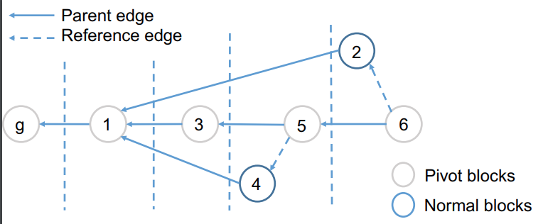
Consensus Algorithm

Slide 8
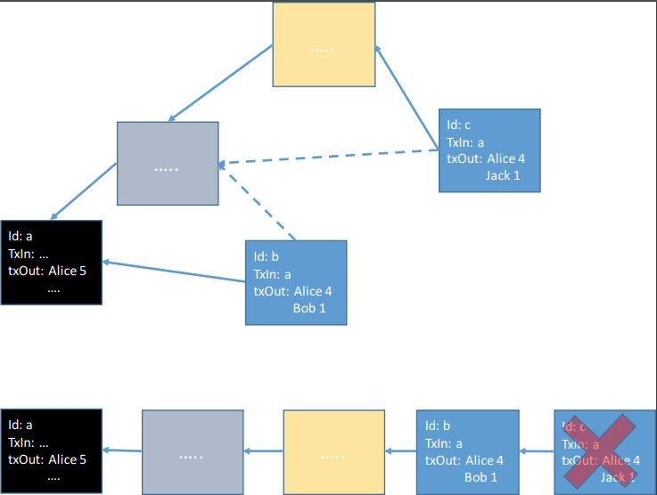
Double spending

Slide 9
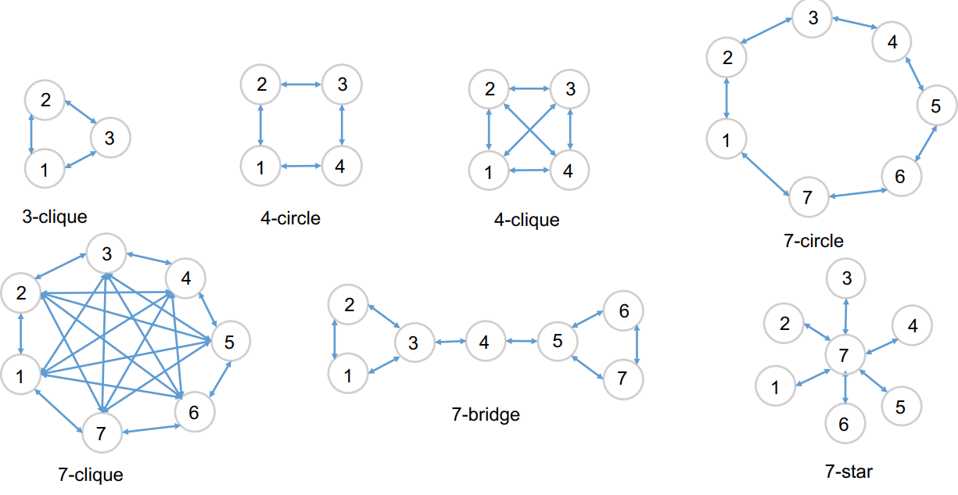
Gossip algorithm

Slide 10
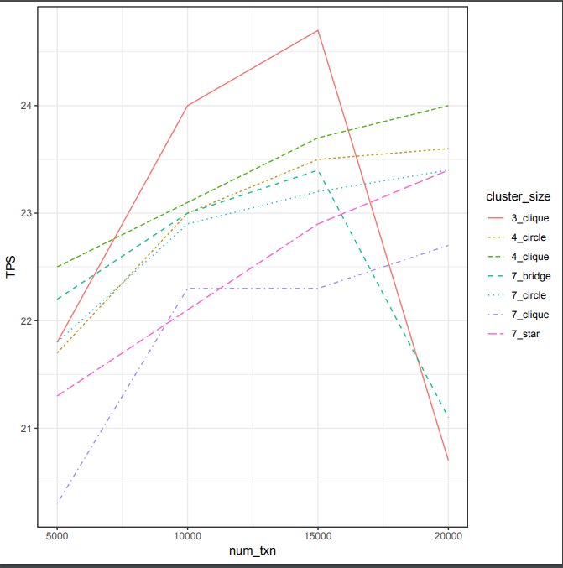
Results

Slide 11
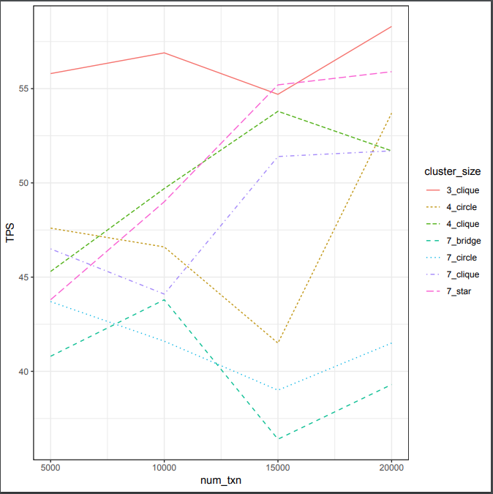
Results

