Slide 1
A Tile-based Parallel Viterbi Algorithm for Biological Sequence Alignment on GPU with CUDA
Zhihui Du¹, Zhaoming Yin², David A. Bader³
1, Department of Computer Science, Tsinghua University.
2, School of Software and Microelectronics, Peking University.
3, School of Computing, Georgia Institute of Technology

Slide 2
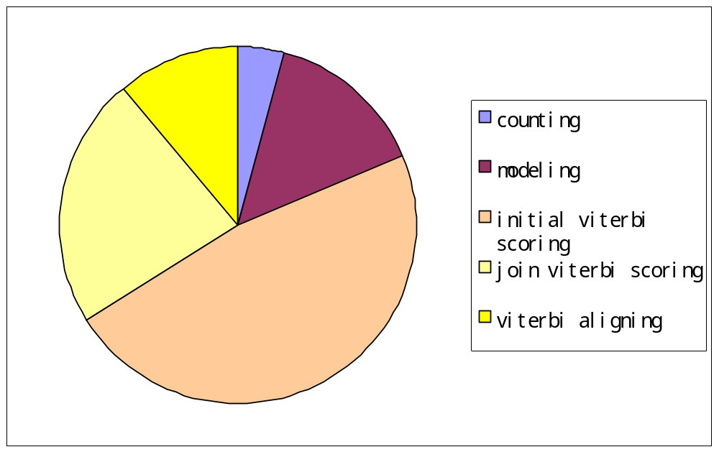
The Importance of Accelerating Viterbi Algorithm

Slide 3
A Hidden Markov Model
Suppose there are only two elements H⁺ and H⁻:
Delete₁
Delete₂
Delete₃
_{null}
_{prob}
H⁺
0.5
Insert₀
Insert₁
Insert₂
Insert₃
H⁻
0.5
Transfer prob
0.5
BEGIN
Match₁
Match₂
Match₃
0.3
H⁺
0.7
H⁺
0.3
H⁺
0.2
0.2
H⁻
0.3
H⁻
0.7
H⁻
0.8
0.1

Slide 4
Dynamic Programming Matrix
 |  |  |  | H+ |  |  | H- |  |  | H-
 | -∞ | -∞ | -∞ | -∞ | -1.0 | -∞ | -∞ | -2.0 | -∞ | -∞ | -3.0 | -∞
 | N/A | N/A | N/A | N/A | л | N/A | N/A | DE | N/A | N/A | DE | N/A
H- | -∞ | -∞ | -1.3 | -0.8 | -2.1 | -1.8 | -1.85 | -1.4 | -2.6 | -2.4 | -2.2 | -3.8
 | N/A | N/A | л | л | IN | DE | DE | MA | DE | DE | DE | DE
H- | -∞ | -∞ | -2.6 | -2.6 | -3.9 | -1.8 | -1.45 | -2.6 | -2.0
 | N/A | N/A | IN | IN | IN | MA | MI | IN | DE
-1.85 + log(0.5) + log(0.8)
= -2.25
-2.25 | -2.45 | 3.0
MA | MA | DE
-1.4 + log(0.1) + log(0.5)
= -2.7
-2.6 + log(0.3) + log(0.5)
= -3.4

Slide 5
Trace Back
 |  |  |  | H+ |  |  | H- |  |  | H-
 | N/A | N/A | N/A | N/A | л | N/A | N/A | DE | N/A | N/A | DE | N/A
H-
 | N/A | N/A | л | л | IN | DE | DE | MA | DE | DE | DE | DE
H- |  |  |  |  |  |  |  |  |  | -2.25 | -2.45 | -3.0
 | N/A | N/A | IN | IN | IN | MA | MI | IN | DE | MA | MA | DE
0:H⁻
H⁻
result
1:
H⁻
H⁻
H⁺
H⁻
H⁻
H⁻
H⁻
-
H⁻
2:
H⁻
H⁻
H⁻
H⁺
H⁻
-
H⁻

Slide 6
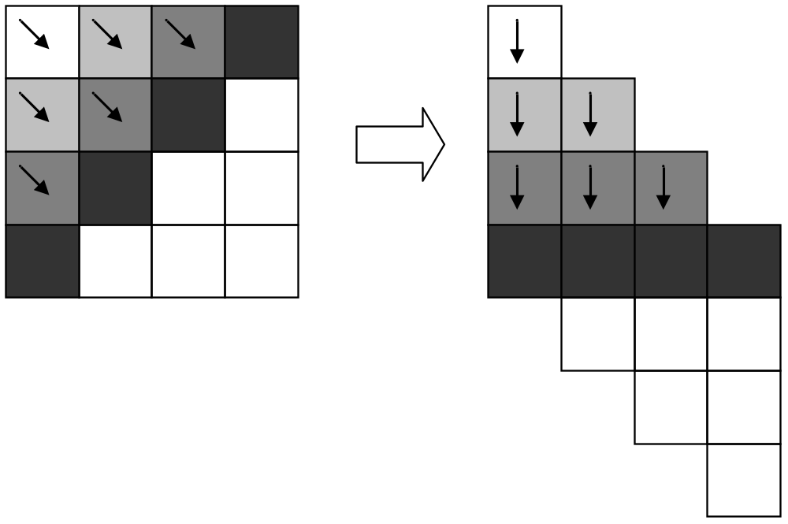
Parallel Strategy
wave-front algorithm:
The computing procedure
is similar to a frontier of a
wave to fill a matrix, where
each block’s value in the
matrix is calculated based
on the values of the
previously-calculated blocks.

Slide 7
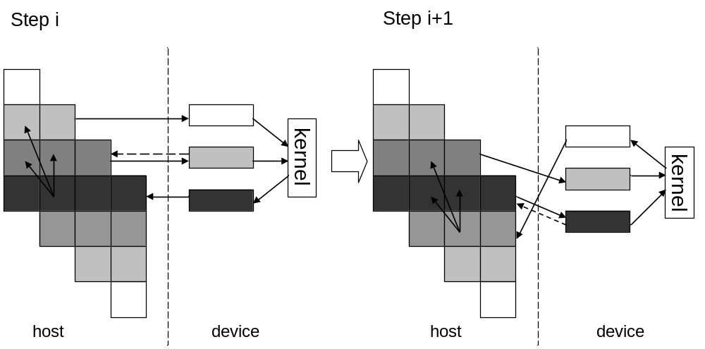
If the Sequence Length is Too Long!
Streaming Algorithm:
Transfering data between
Host and Device.

Slide 8
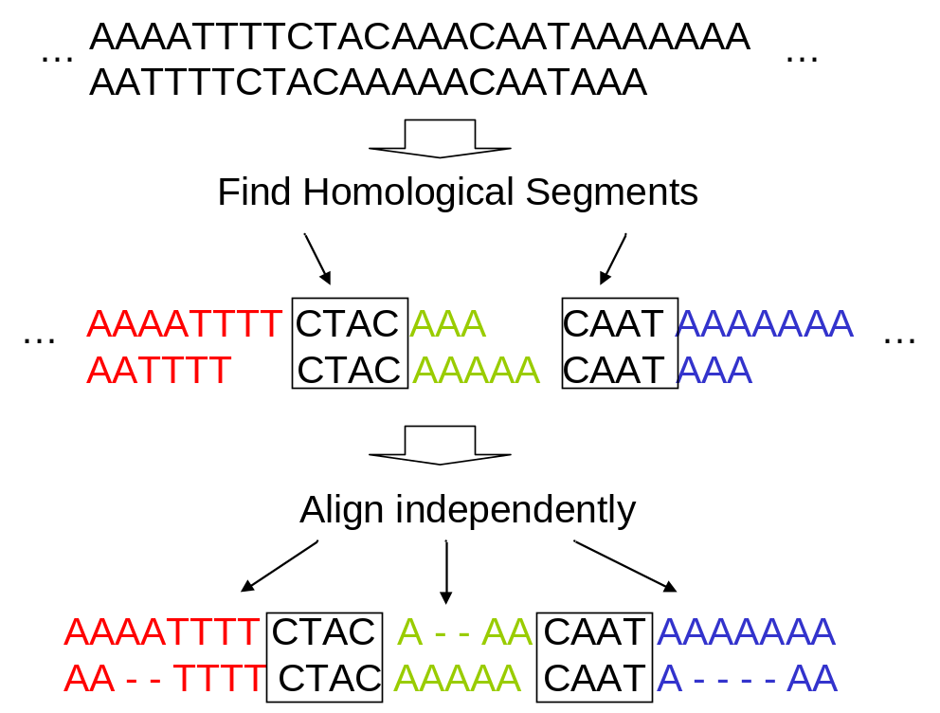
The Tile Based Algorithm
Step1:
Utilizing Homological Segments
to divide long sequence

Slide 9
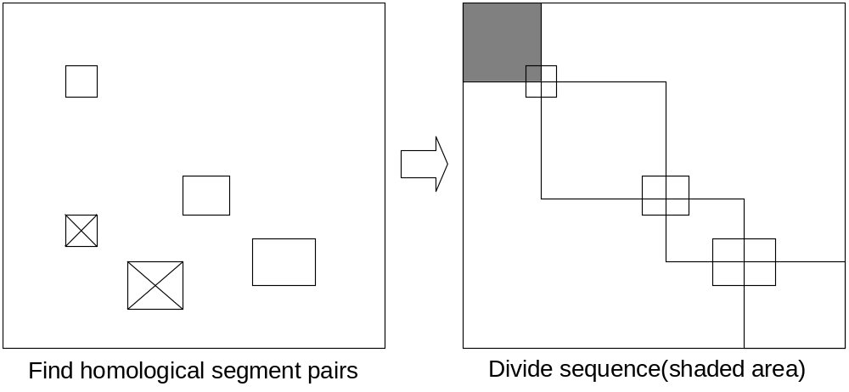
The Tile Based Algorithm
Step2:
Align sub-matrices

Slide 10

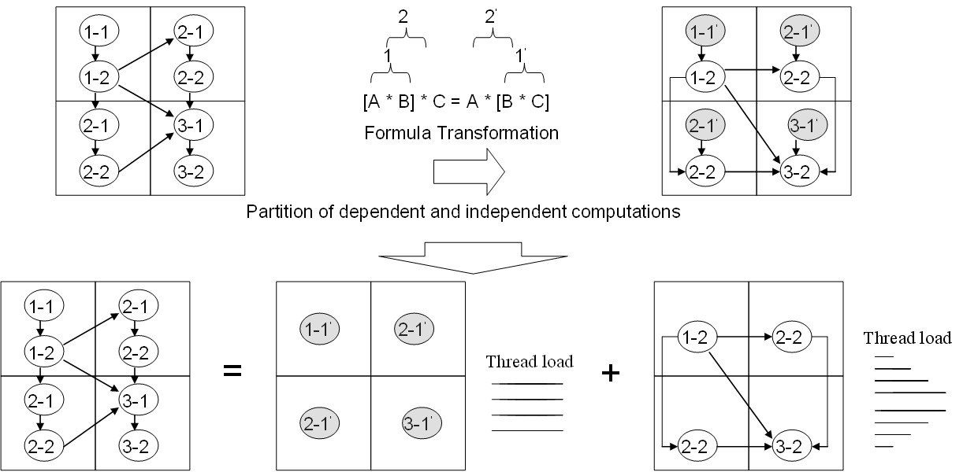

Slide 11
Results
Seq-Length |  | Execution Time (Second)/Speedup
 |  | serial | Simple Wave-front |  | Streaming |  | Tile-based
100 | DW | 0.73 | 0.37 | 1.97 | 0.38 | 1.92 | 0.28 | 2.61
 | RW | 0.017 | 0.007 | 2.42 | 0.02 | 0.85 | 0.006 | 2.83
 | DL | 0.063 | 0.008 | 7.87 | 0.023 | 2.74 | 0.007 | 9
 | RL | 0.027 | 0.007 | 3.86 | 0.023 | 1.17 | 0.007 | 3.86
200 | DW | 2.34 | 0.39 | 6 | 0.44 | 5.32 | 0.39 | 6
 | RW | 0.05 | 0.03 | 1.67 | 0.061 | 0.82 | 0.028 | 1.79
 | DL | 0.324 | 0.035 | 9.26 | 0.065 | 4.98 | 0.029 | 11.17
 | RL | 0.142 | 0.035 | 4.06 | 0.065 | 2.18 | 0.029 | 4.9
300 | DW | 5.89 | 0.42 | 14.02 | 0.46 | 12.8 | 0.43 | 13.7
 | RW | 0.12 | 0.068 | 1.76 | 0.1 | 1.2 | 0.055 | 2.18
 | DL | 0.647 | 0.07 | 9.26 | 0.112 | 5.78 | 0.054 | 11.98
 | RL | 0.283 | 0.068 | 4.16 | 0.116 | 2.44 | 0.054 | 5.24
400 | DW | 9.93 | 0.50 | 19.86 | 0.52 | 19.1 | 0.45 | 22.07
 | RW | 0.21 | 0.13 | 1.61 | 0.159 | 1.32 | 0.098 | 2.14
 | DL | 1.112 | 0.12 | 9.27 | 0.2 | 5.56 | 0.099 | 11.23
 | RL | 0.485 | 0.122 | 3.98 | 0.174 | 2.79 | 0.097 | 5
500 | DW | 15.9 | 0.54 | 29.44 | 0.54 | 29.44 | 0.52 | 30.58
 | RW | 0.34 | 0.19 | 1.78 | 0.239 | 1.42 | 0.174 | 1.95
 | DL | 1.783 | 0.198 | 9 | 0.262 | 6.8 | 0.155 | 11.5
 | RL | 0.783 | 0.191 | 4.10 | 0.251 | 3.12 | 0.153 | 5.12
1000 | DW | 62.1 | 0.99 | 62.73 | 1.10 | 56.45 | 0.86 | 72.21
 | RW | 1.34 | 0.64 | 2.09 | 0.686 | 1.95 | 0.554 | 2.42
 | DL | 6.98 | 0.64 | 10.91 | 0.725 | 9.63 | 0.53 | 13.17
 | RL | 3.07 | 0.635 | 4.83 | 0.62 | 4.952 | 0.512 | 6.0

Slide 12
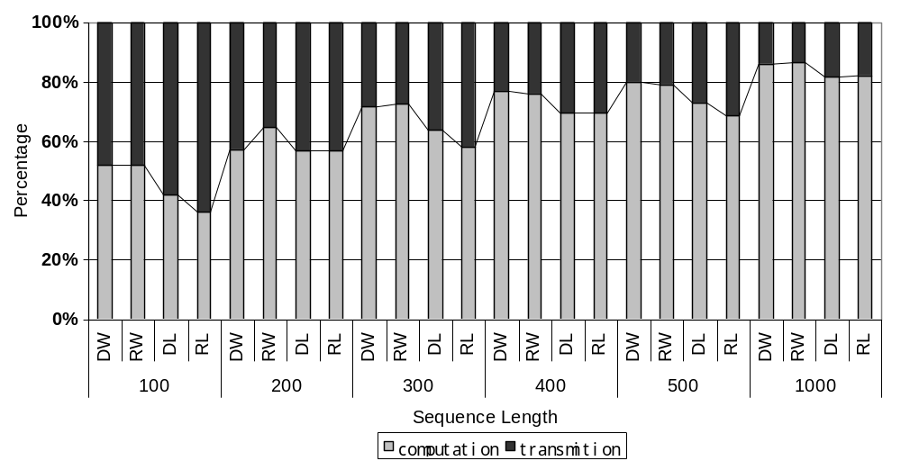
Test of Streaming Algorithm

Slide 13
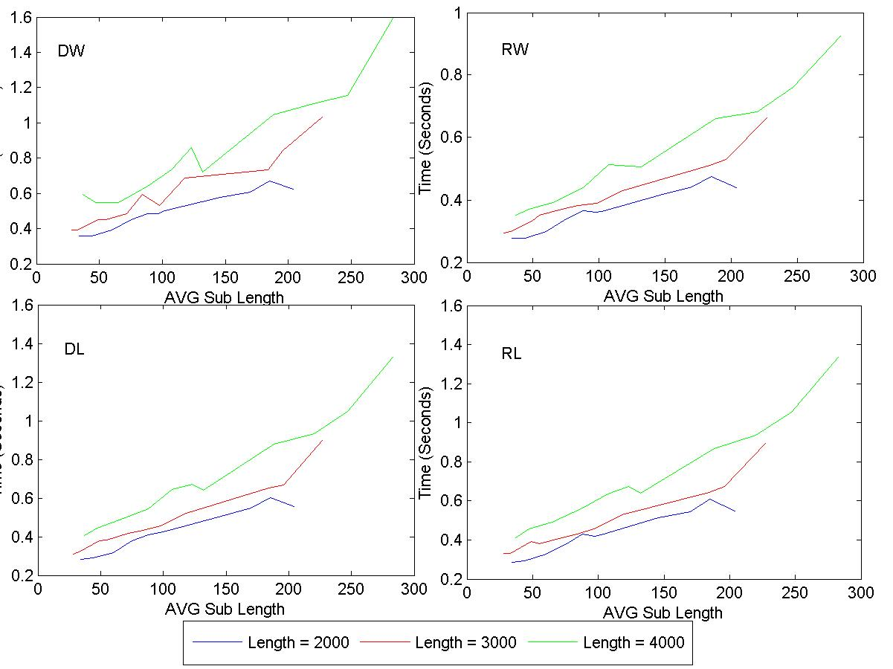
Test of Tile based Algorithm

Slide 14
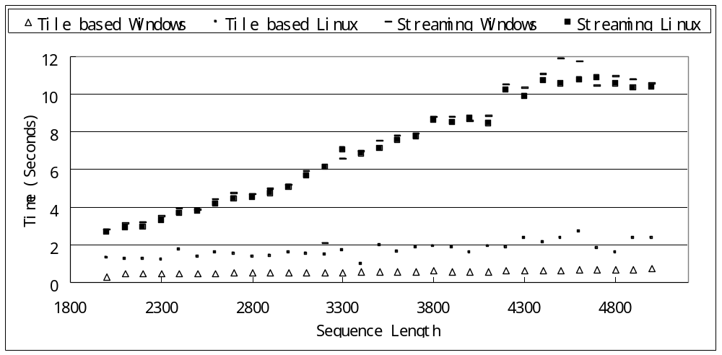
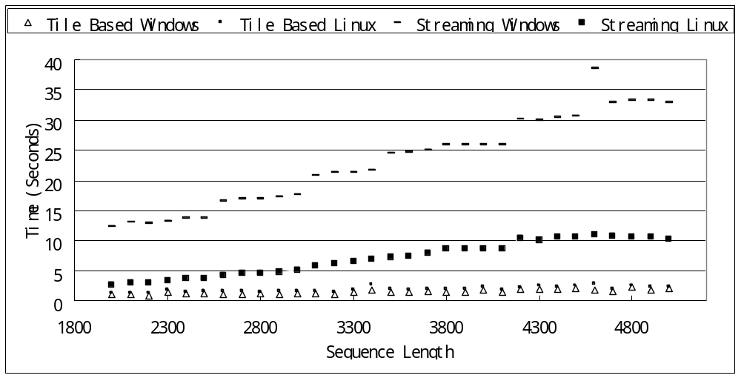
Test of Long Sequences

Slide 15
Things to Do
1: experiments on multiple GPUs
2: Accuracy Test
3: Better Architectures such as TESLA
4: Object Oriented Programming
Q&A?

