Slide 1
Data Dojo: (Plant)UML
JON DOWNING
DEC 2018

Slide 2
Unified Modelling Language (UML)
“…is a standard language for specifying, visualizing, constructing, and documenting the artifacts of software systems. UMLwas created by the Object Management Group (OMG) and UML 1.0 specification draft was proposed to the OMG in January 1997.”
https://www.tutorialspoint.com/uml/

Slide 3
Unified Modelling Language (UML)
“A tool to communicate ideas”
(and maybe data pipelines, process and software systems)
(programmatically, with version control)

Slide 4
A tool to communicate ideas (make diagrams)
Concepts
Decisions / flows
Sequences

Slide 5
Setup
Use Visual Studio Code + Java + PlantUML plugin
OR
Use PlantUML.jar + command line
How?
See: https://github.com/valtech-uk/data-team-common/

Slide 6
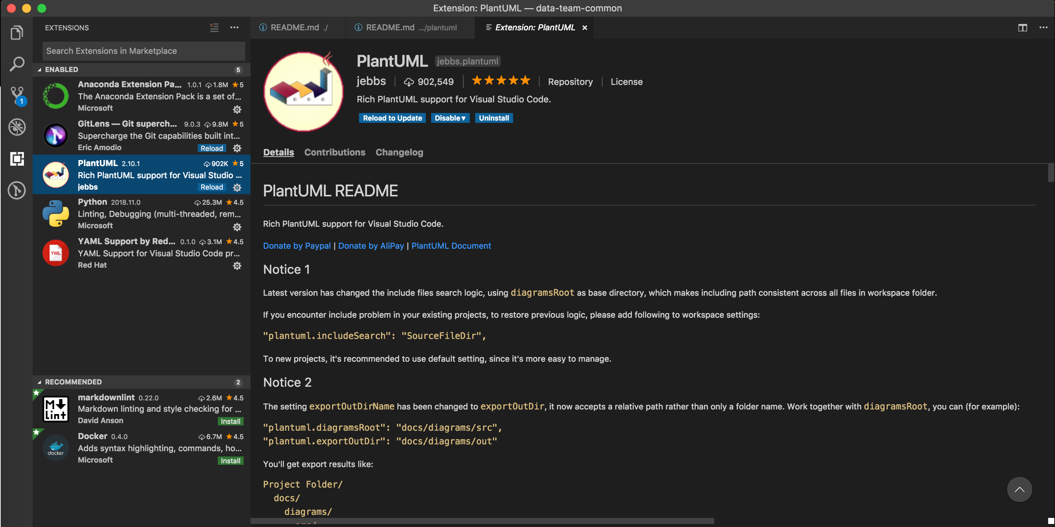

Slide 7
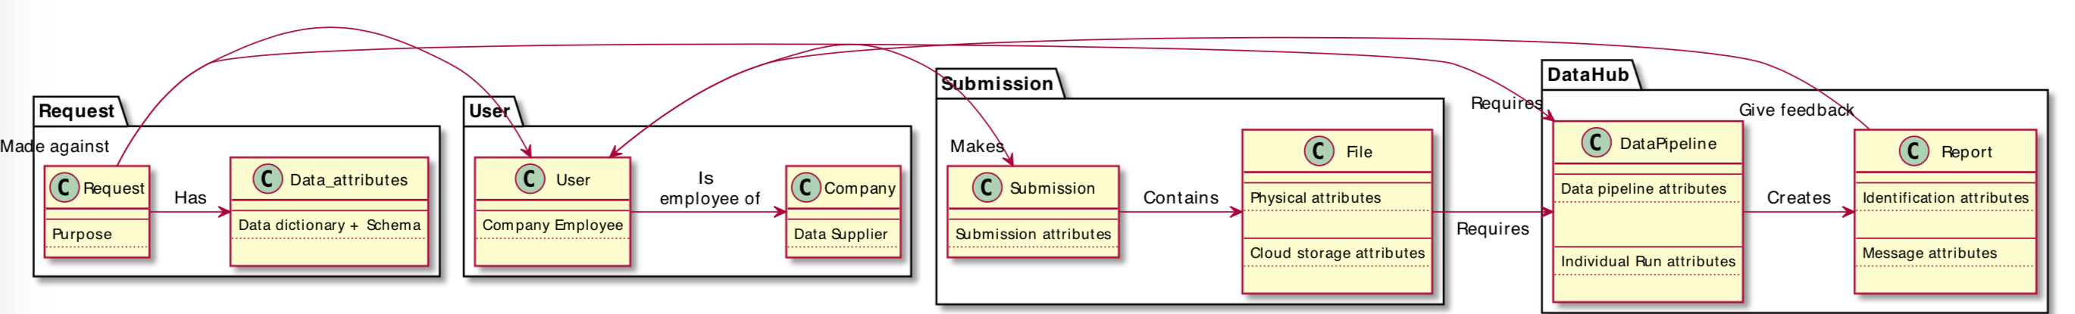
Conceptual Diagrams

Slide 8
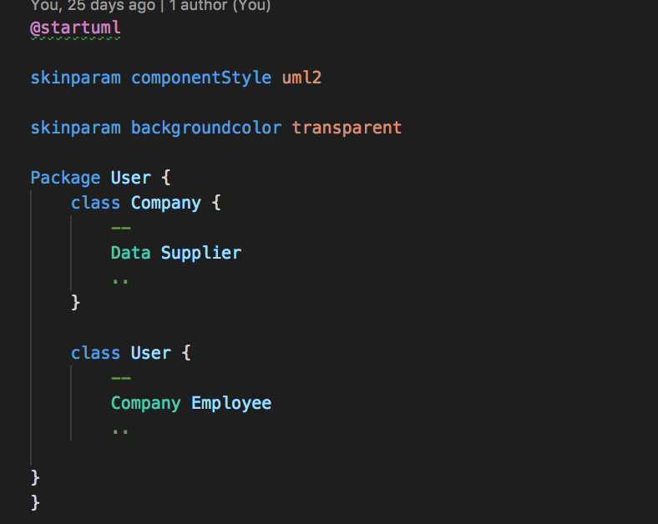
Conceptual Diagrams

Slide 9
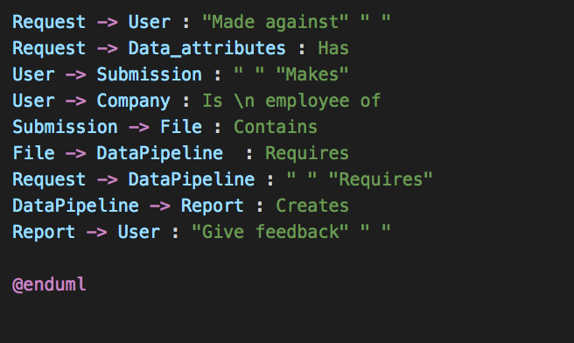
Conceptual Diagrams

Slide 10
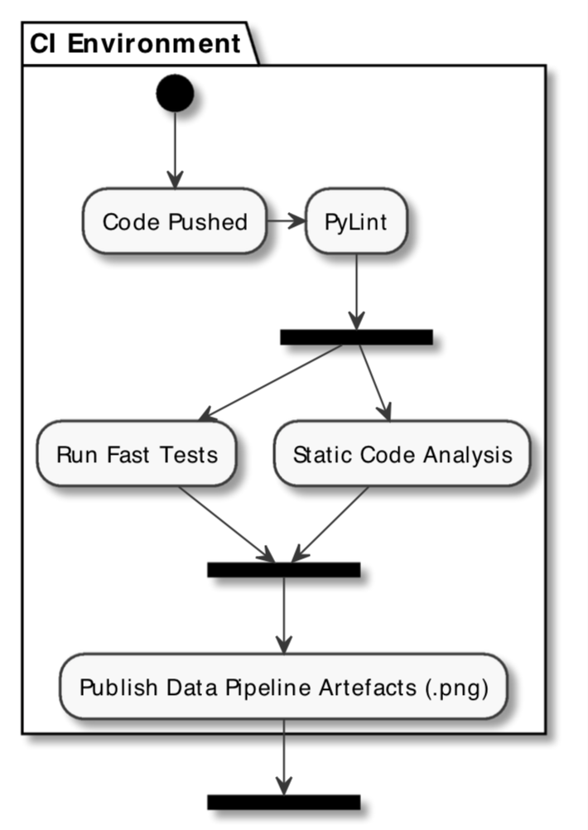
Decision and Flow Diagrams

Slide 11
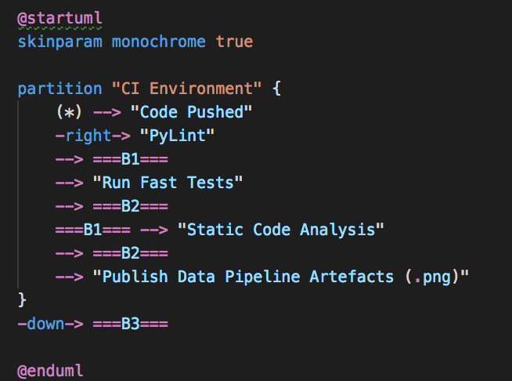
Decision and Flow Diagrams

Slide 12
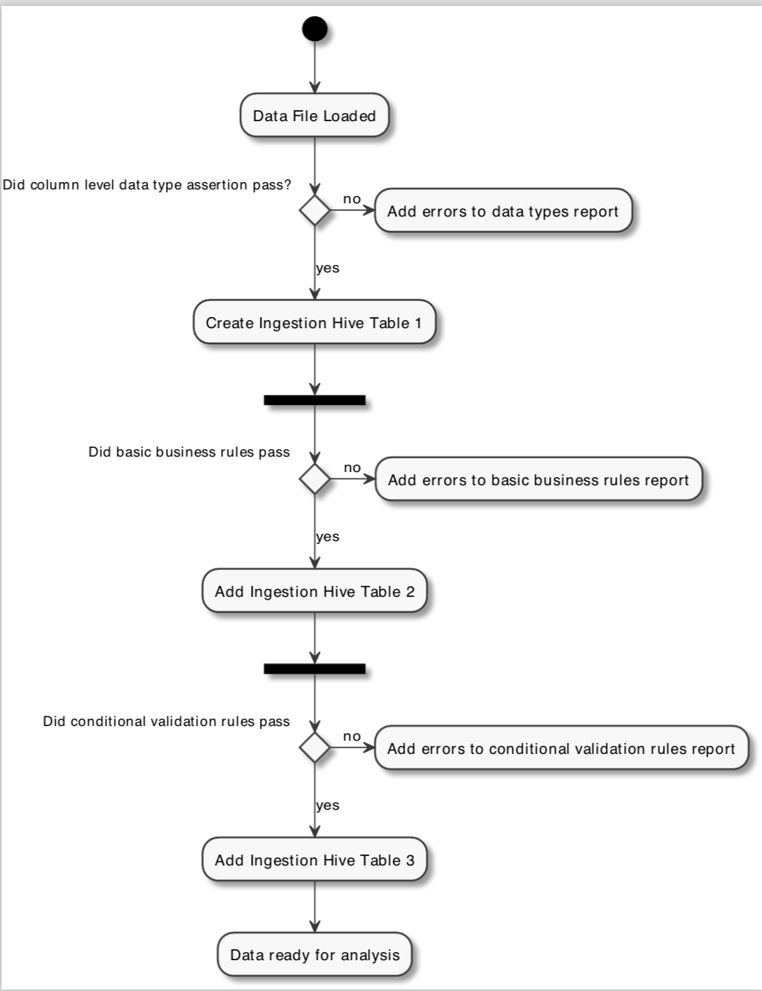
Decision and Flow Diagrams

Slide 13
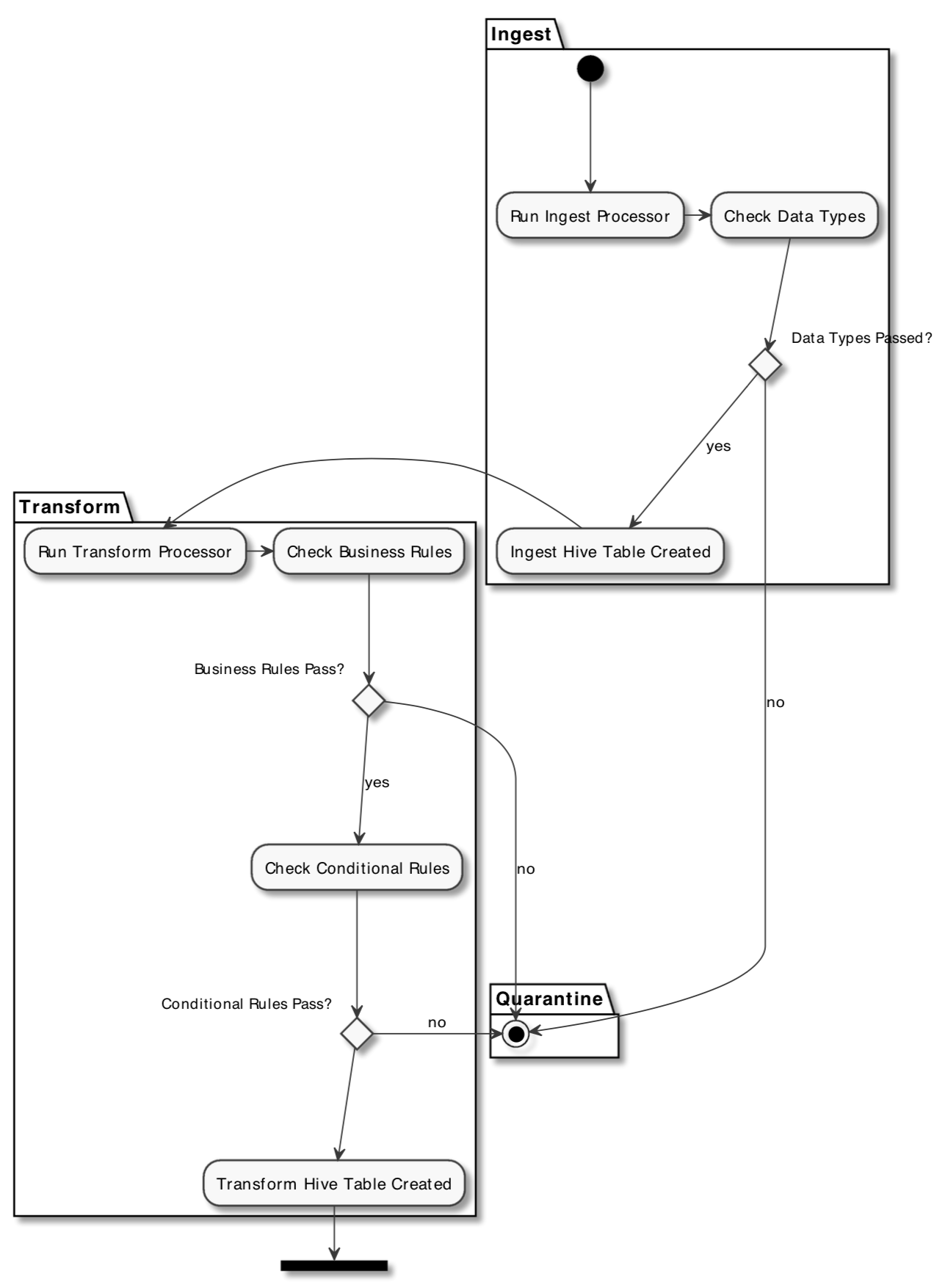
Decision and Flow Diagrams

Slide 14
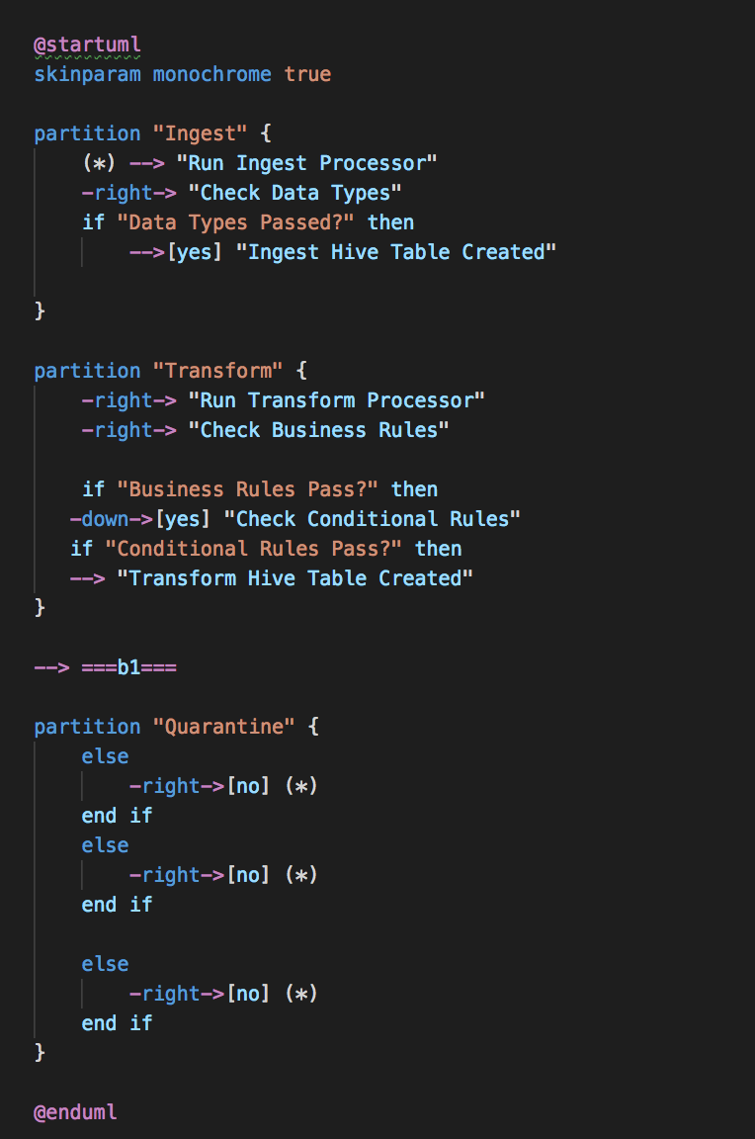
Decision and Flow Diagrams

Slide 15
thank you

Slide 16
questions?

