Slide 1
DATA DOJO: Gathering Data Requirements
JON DOWNING
2020

Slide 2
Gathering Data Requirements
SIPOC Model
Appropriate Team Structure
Team Roles and Responsibilities

Slide 3
Gathering Data Requirements
For data analysis, why is a methodology helpful?
To understand the basics topics
To define roles and responsibilities among team members
To enable good knowledge management
To enable communication about project progress
We will borrow ideas from:
Six Sigma
Lean Manufacturing
Process Improvement (Kaizen)

Slide 4
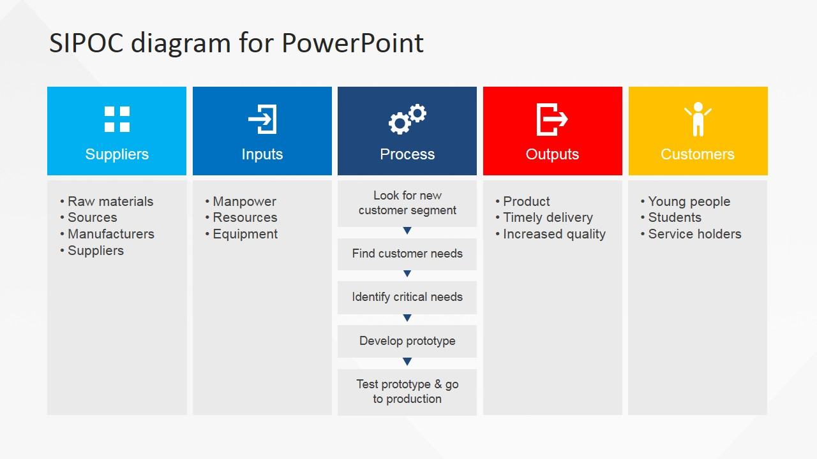
Suppliers internal or external to the organization
Inputs may be materials, services, or information
Outputs may be materials, services, or information
Customers / end users internal or external to the organization

Slide 5
Once inputs & outputs are understood, the process follows
Suppliers internal or external to the organization
Inputs may be materials, services, or information
Outputs may be materials, services, or information
Customers / end users internal or external to the organization
Focus on capturing the set of inputs and outputs rather than the individual steps in the process.

Slide 6
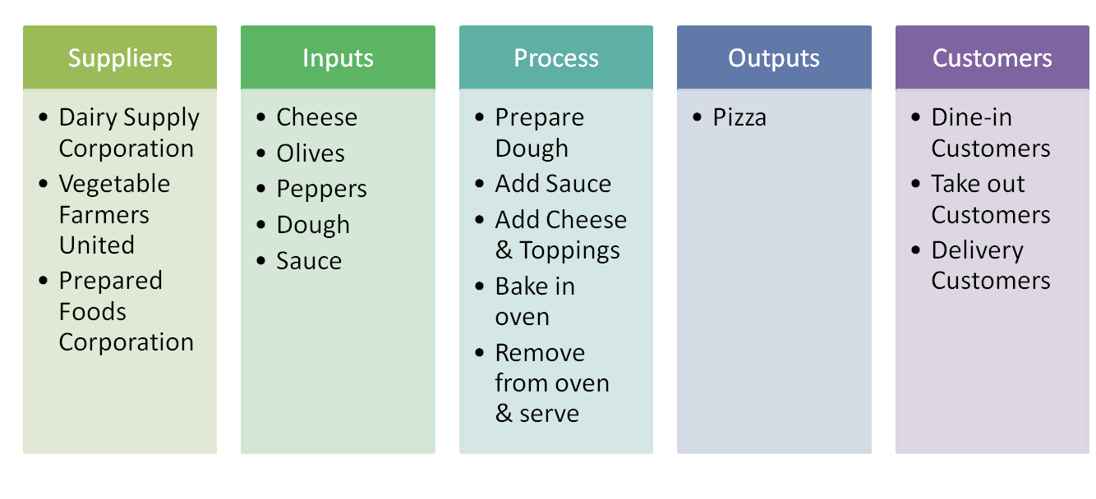
Process Example: Making Pizza

Slide 7
User Researchers
I am interested in:
Data Suppliers who provide information to the organisation
The needs of the Customers / End Users of our data
I am keen to understand the user outcomes of your work

Slide 8
Business Analysts
I am interested in:
Understanding the as-is business process
Who is involved, their interaction and the use of outputs towards business aims
Any existing documentation of the business process
I am keen to understand the business outcomes of your work

Slide 9
Data Business Analysts / Data Scientists
We are interested in:
The as-is data process
Examples of the existing process and data
The rationale behind the current methodology
Your input in shaping any process improvement
We are keen to understand the data outcomes of your work

Slide 10
Team actions are loosely defined by the SIPOC process
Suppliers internal or external to the organization
Inputs may be materials, services, or information
Outputs may be materials, services, or information
Customers / end users internal or external to the organization
User Research
Business Analysis
Business Analysis
Data Business Analysis
Data Business Analysis
Data Science
Data Business Analysis
Business Analysis
User Research

Slide 11
User Research → User Outcomes
Business Analysis → Business Outcomes
Data Business Analysis → Data Outcomes

Slide 12






Infrastructure has the most information but is the least accessible
 | Current / up to date | Scale of information | Ease of access
People
Documented
Process
Existing
Infrastructure

Slide 13
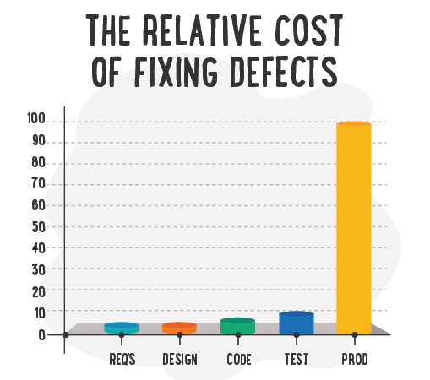
Time spent to closely define requirements is time well spent

Slide 14
Business Analysis
Focuses on Business Outcomes
Explore the as-is process:
What is the aim?
(The business context, the existing process)
Who is involved?
(Engage stakeholders)
Are there existing documentation?
(If not, map business process at high-level)

Slide 15
Data Business Analysts / Data Scientists
Focus on creating the data to achieve defined business outcomes
How do inputs best map to expected outputs?
(a.k.a figure out the process)
Then:
Optimize, rationalize, innovate, improve both the process methodology and output (if appropriate)

Slide 16
A process for mapping inputs to outputs
Understand the available information (inputs and outputs)
Know the degree of accuracy required (outputs)
Use tools (LucidCharts, PlantUML) and frameworks (see later) to structure thinking and create documentation for engineering teams (logical, physical maps)
Dig into infrastructure when required but automate
Test business and data assumptions (upfront work upfront has lower cost)
Consider the wider picture (are there common functions or architectures)
Continue engaging with business and stakeholders (continuous feedback)

Slide 17
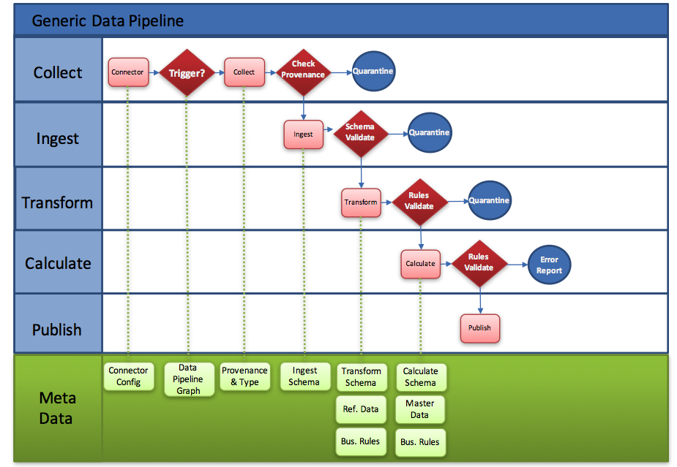
Example of logical map
Swim lanes shows:
where functionality should exist (within data architecture)
Where data should be stored
Create clear interfaces between functional components (allows co-development)
Connections between functionality shows timing and dependencies

Slide 18
Physical map
Convert logical map into physical map: to describe how data are used / created / removed:
In build: this is a valuable guide to data engineers
In user: this is a valuable guide to analysts to understand what is stored where (and the links between each table)
To create a logical and physical map, data architecture must already be described.

Slide 19
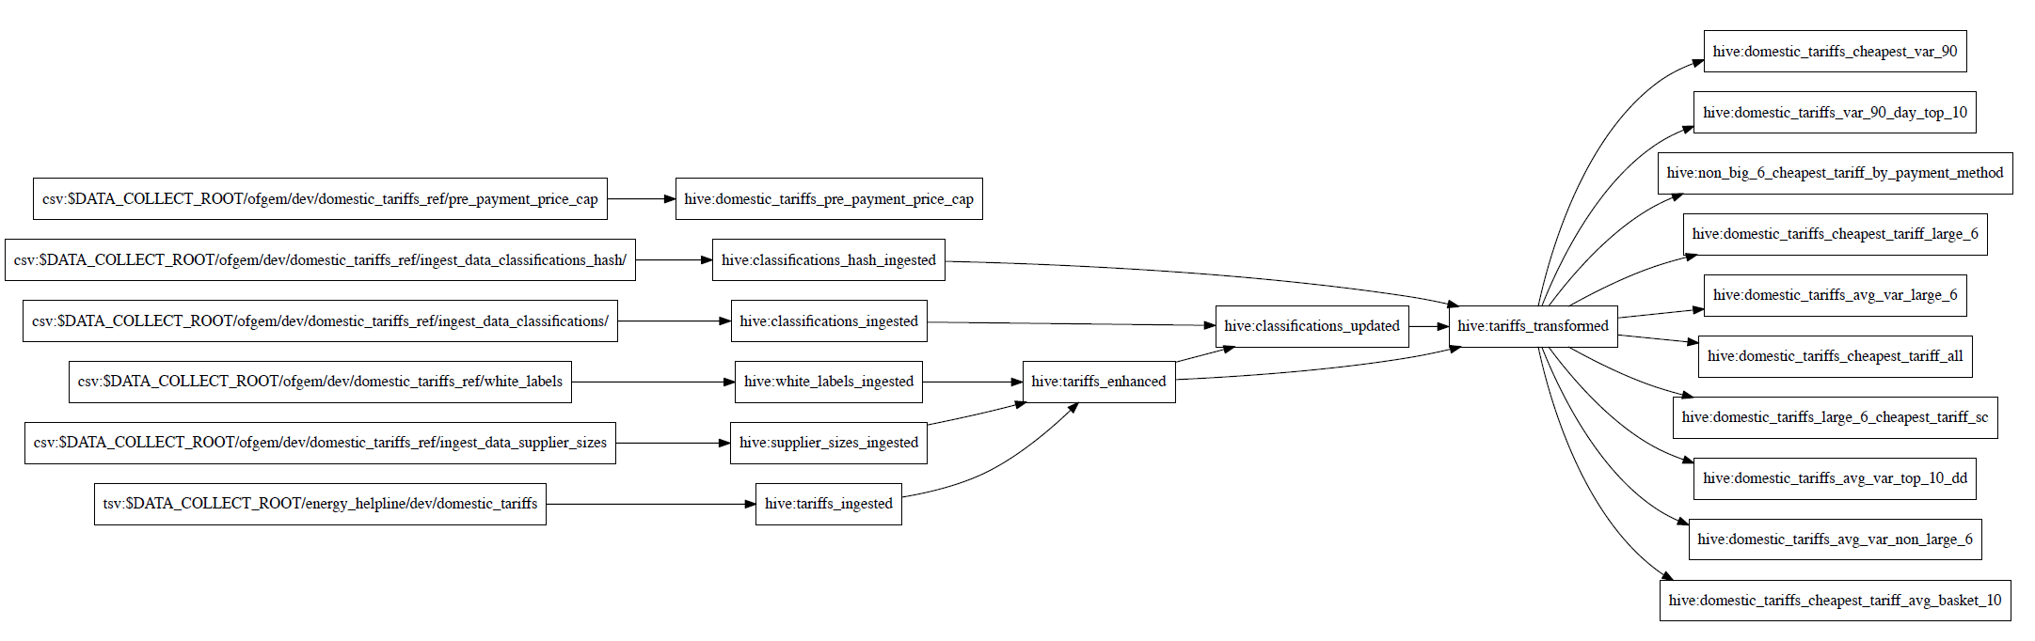
Physical map
Boxes represent tables for data, arrows represent transformations or calculations
INGEST
TRANSFORM
CALCULATE

Slide 20
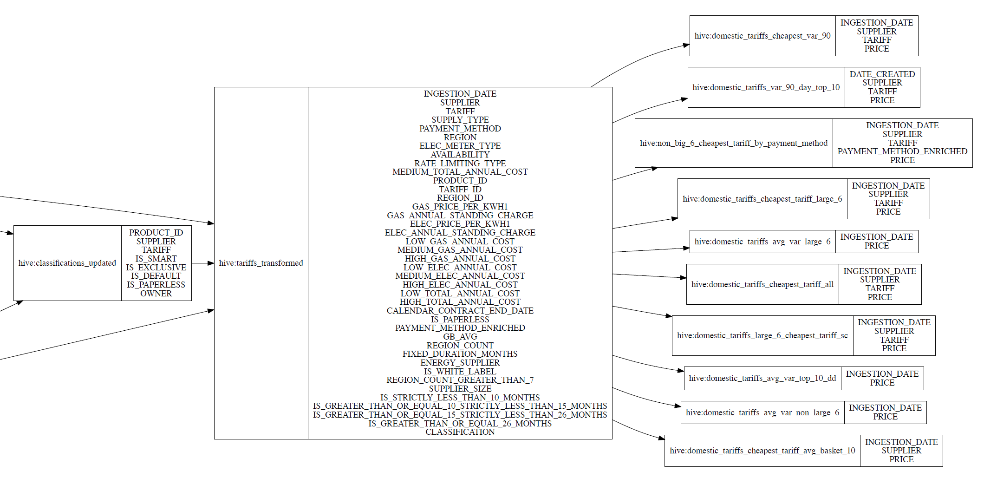
Physical map
Each table should be described down to the column level… or lower!

Slide 21
Finally, be a responsible statistical practioner
Impartiality, objectivity, transparency, privacy, sound methodology and procedure. Many guides to statistical best practice:
Recommendation of the OECD Council on Good Statistical Practice
UN Fundamental Principles of Official Statistics
European Statistics Code of Practice
IMF Standards for Data Dissemination
National Statistical Offices (NSOs)

Slide 22
thank you

Slide 23
questions?

