Slide 1
Meet Stratoshark: Wireshark’s Baby Brother
Josh Clark
https://github.com/je-clark/self-25-stratoshark

Slide 2
Agenda
Introduction
What are system calls?
What data do Wireshark and Stratoshark examine?
Demo
https://github.com/je-clark/self-25-stratoshark

Slide 3
Introduction
B.S. and M.S. in Computer Engineering
Spent several semesters breaking Linux trying to optimize networking
Principal Performance Engineer
Uses expertise in network protocols and Linux internals to identify bottlenecks in distributed systems
www.jeclark.net | www.github.com/je-clark

Slide 4
What are System Calls?
With open(r’./file.txt’) as file:
contents = read(file)

Slide 5
What are System Calls?
#include <stdio.h>
#include <stdlib.h>
int main() {
FILE *file = fopen("./file.txt", "r");
char *contents = malloc(filesize + 1);
fread(contents, 1, filesize, file);
contents[filesize] = '\0';
fclose(file);
return 0;
}

Slide 6
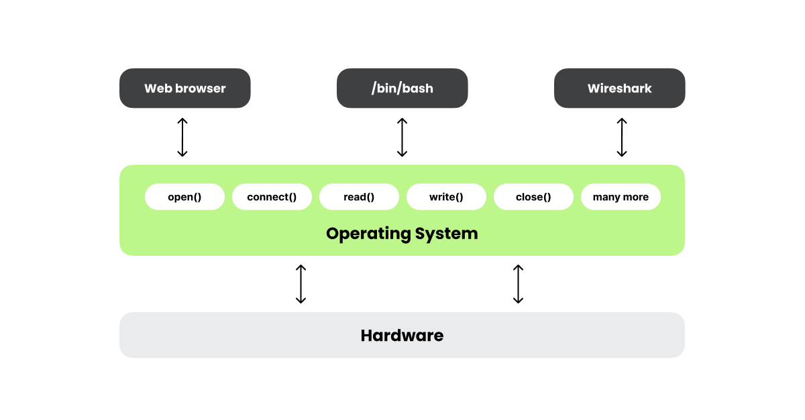
What are System Calls?
https://blog.wireshark.org/2025/01/those-arent-packets/

Slide 7
What System Calls Are Out There?
https://filippo.io/linux-syscall-table/

Slide 8
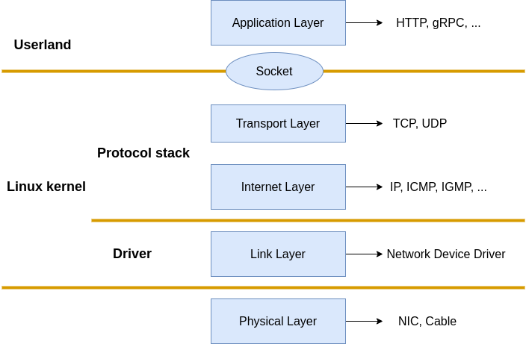

How Do We Capture Packets?
libpcap
BPF

Slide 9
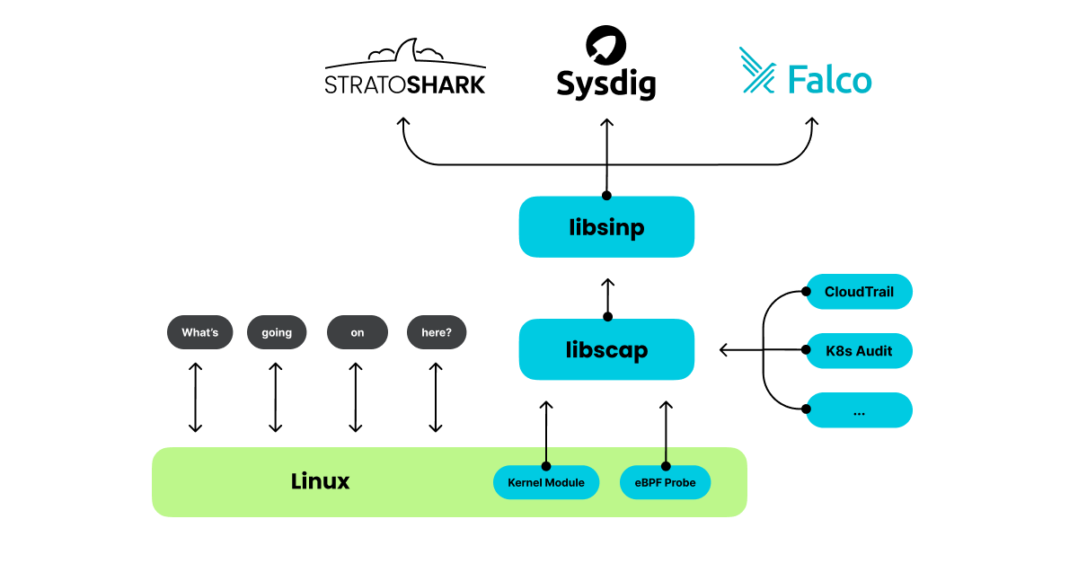
How Do We Capture System Calls?
https://blog.wireshark.org/2025/01/those-arent-packets/

Slide 10
How Do We Capture System Calls?
https://github.com/draios/sysdig
https://blog.wireshark.org/2025/01/those-arent-packets/

Slide 11
Demo 1: HTTP
http_packets.pcapng
http_syscalls.scap

Slide 12
Demo 2: SCP File Transfer
scp_packets.pcapng
scp_syscalls.scap

Slide 13
Current Limitations
Unable to see some inter-process and kernel communication
Statically linked libraries (e.g. nginx and openssl)
Shared memory locations (e.g. getdents64())
sysdig missing features that other syscall tools include
Strace gives you more data for getdents64() than sysdig
No Windows or MacOS support
Gitlab issue is open for Windows procmon support

Slide 14

Questions & Feedback

