Slide 1
Using Packets to Guide Server Optimization
Josh Clark Distributed Performance Engineer
https://github.com/je-clark/sf24_eu_server_optimization

Slide 2
About Me
M.S. in Computer Engineering
Focus on networking, protocol design, and security
Distributed Performance Engineer
Using packets to solve complex performance issues
https://www.jeclark.net
https://github.com/je-clark
https://github.com/je-clark/sf24_eu_server_optimization

Slide 3
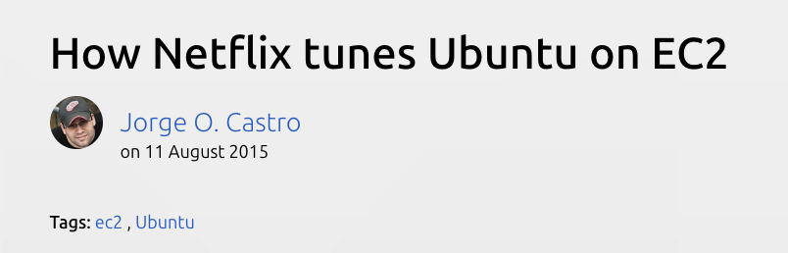

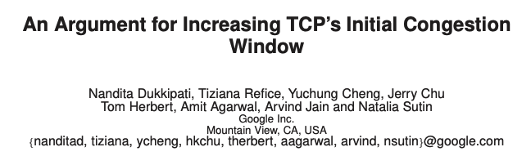
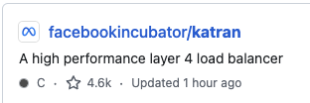
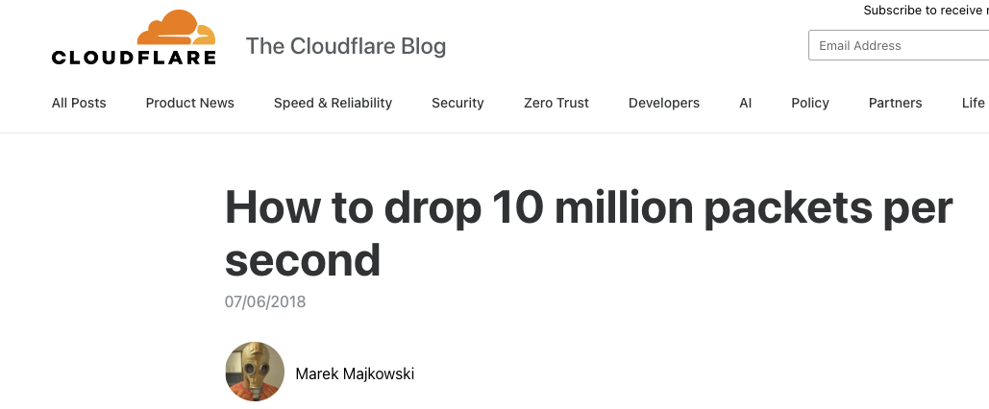
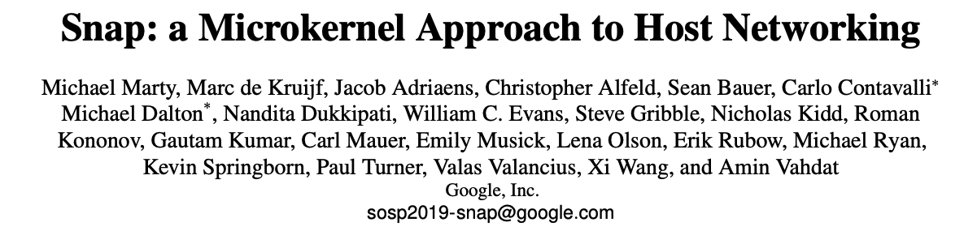
Tech Companies Optimize Networking
https://www.androidpolice.com/quic-protocol-guide/
https://ubuntu.com/blog/how-netflix-tunes-ubuntu-on-ec2
https://github.com/facebookincubator/katran
https://research.google/pubs/an-argument-for-increasing-tcps-initial-congestion-window/
https://research.google/pubs/snap-a-microkernel-approach-to-host-networking/
https://blog.cloudflare.com/how-to-drop-10-million-packets/

Slide 4
Today’s Agenda
TCP Windowing Review
Baseline TCP Settings to Enable
Evaluating and Optimizing Long TCP Flows
Evaluating and Optimizing Short TCP Flows

Slide 5
TCP Windowing Review

Slide 6
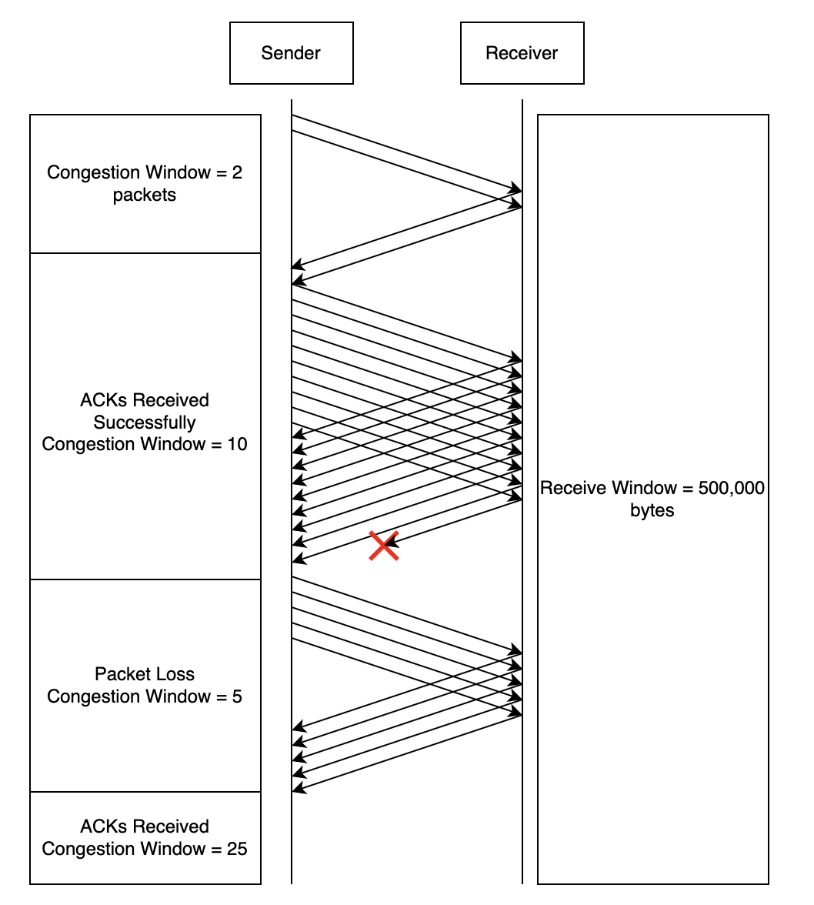
TCP Windowing

Slide 7
Baseline TCP Settings

Slide 8
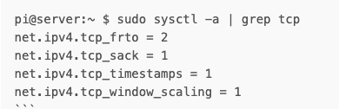
Baseline TCP Settings

Slide 9
Long TCP Flow Optimization

Slide 10
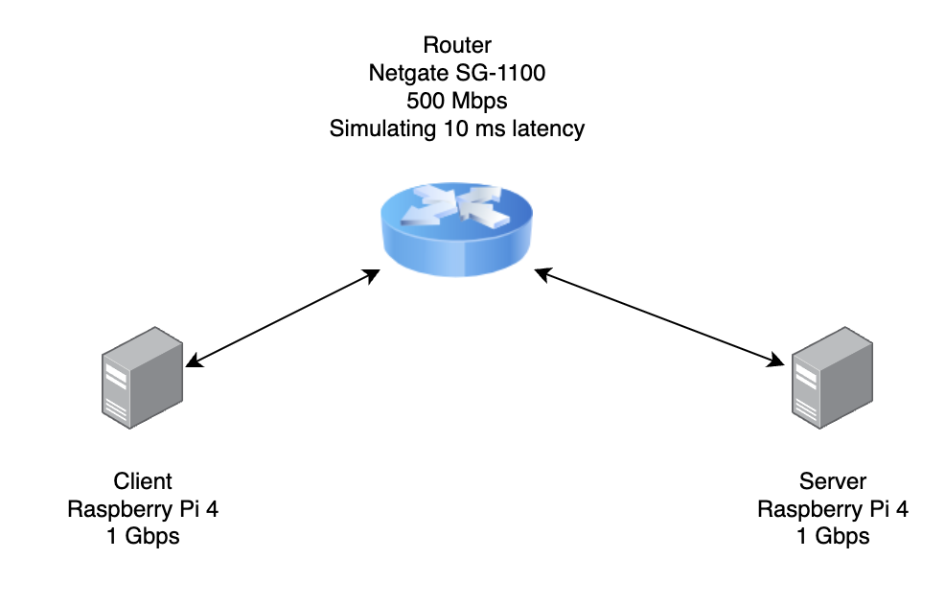
Bandwidth Delay Product
BDP = bandwidth x latency

Slide 11
Receive Window Settings
Minimum
Default
Maximum
Test Network BDP = 625 KB
Linux can use up to 3x more memory than the receive window value
Receive memory should be at least 1.8 MB

Slide 12
Capture 0
0_scp_200MB.pcap

Slide 13
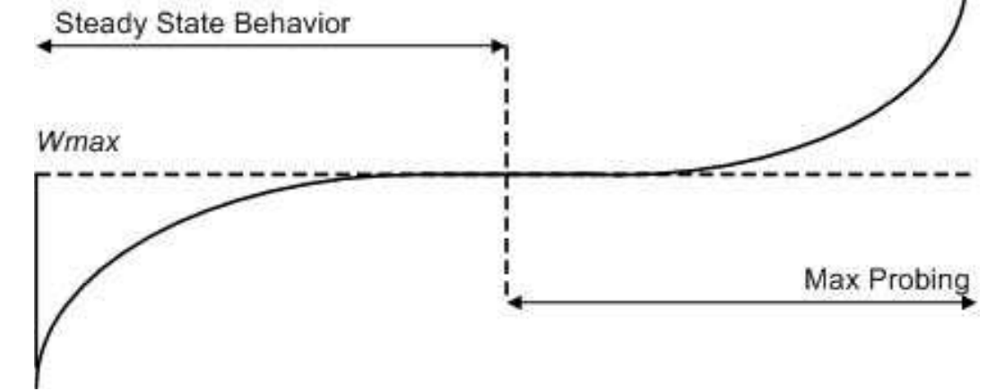
Congestion Control - CUBIC
Tracks a max window where loss occurs
Logarithmic increase to max window, then cubic above max window
Window x 0.2 when loss occurs
https://www.cs.princeton.edu/courses/archive/fall16/cos561/papers/Cubic08.pdf

Slide 14
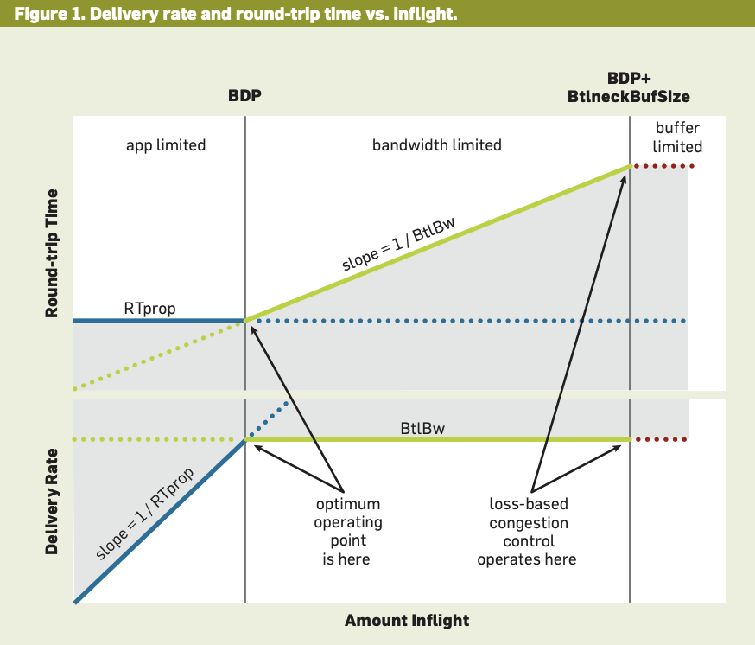
Congestion Control - BBR
Existing algorithms use packet loss to measure congestion, but that isn’t accurate
Packet loss can happen randomly without congestion
Congestion-induced packet loss is a lagging metric for congestion
https://dl.acm.org/doi/pdf/10.1145/3009824

Slide 15
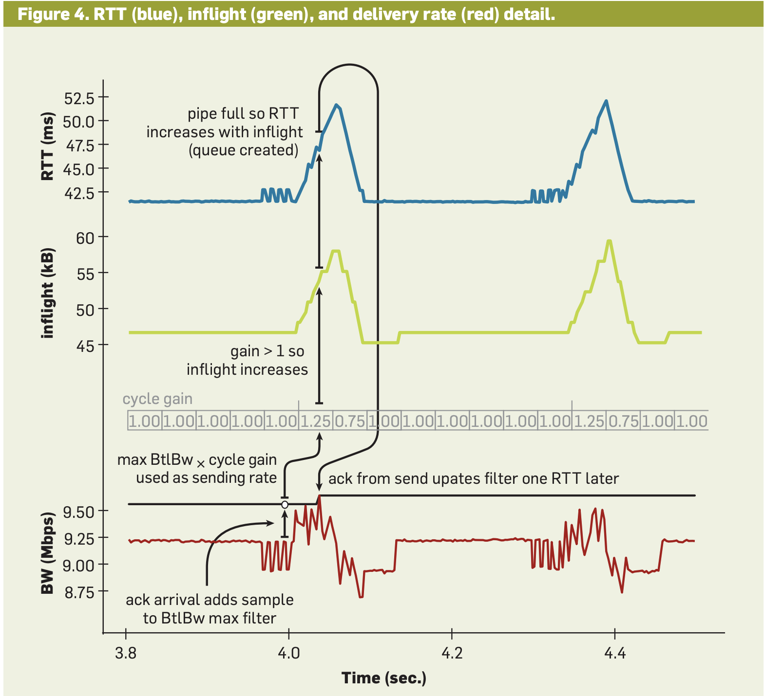
Congestion Control - BBR
Estimates BDP using RTT variance
Sends data at BDP rate
Periodically attempts a pacing_gain to see if bottleneck bandwidth has changed
Ignores small amounts of packet loss
https://dl.acm.org/doi/pdf/10.1145/3009824

Slide 16
Capture 1
1_scp_200MB_bbr.pcap

Slide 17
Capture 2
2_scp_mystery.pcap

Slide 18
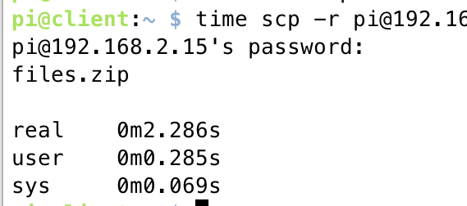
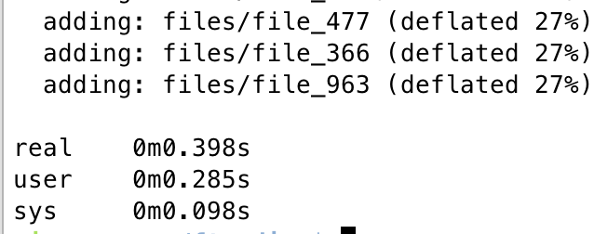
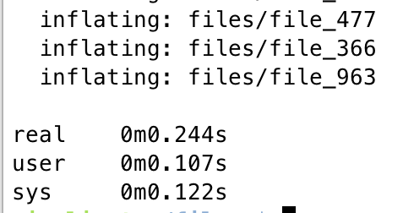
Dealing with Small Files

Slide 19
Short TCP Flow Optimization

Slide 20
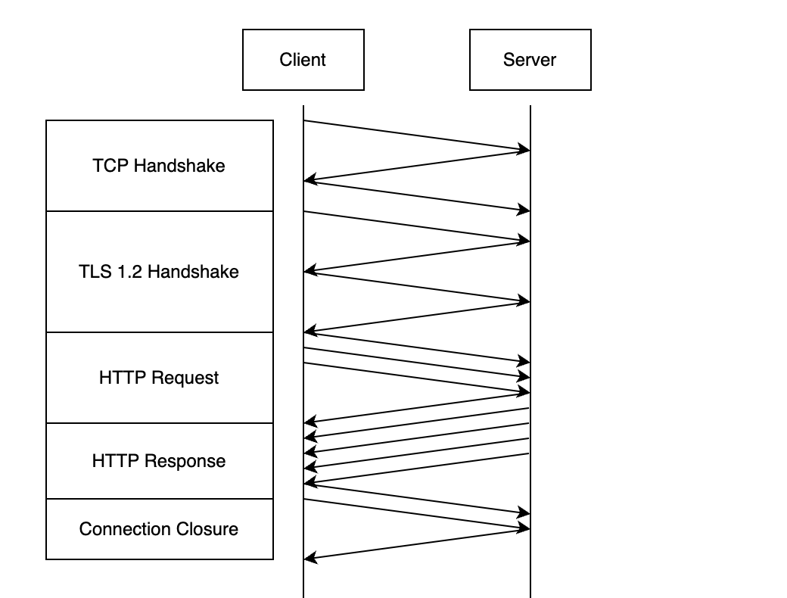
It’s All About the Turns

Slide 21
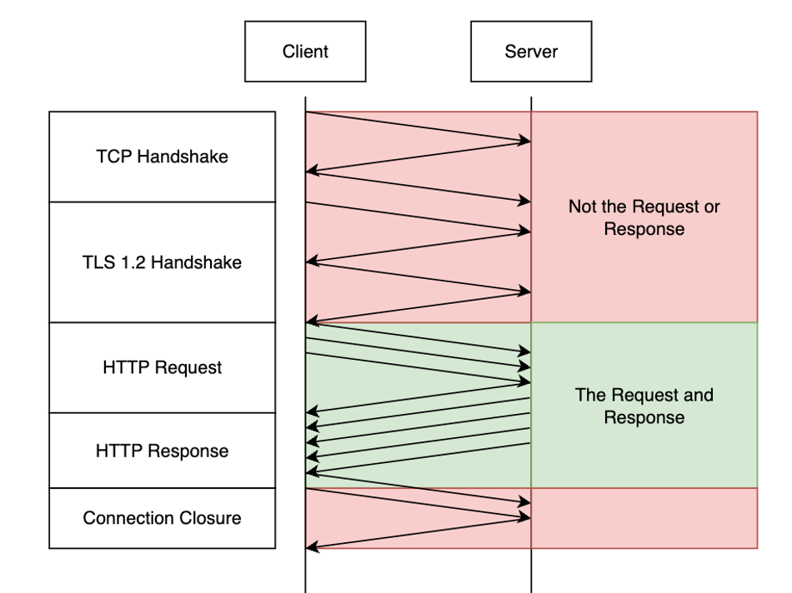
It’s All About the Turns

Slide 22
Capture 3
3_small_http_request.pcap

Slide 23
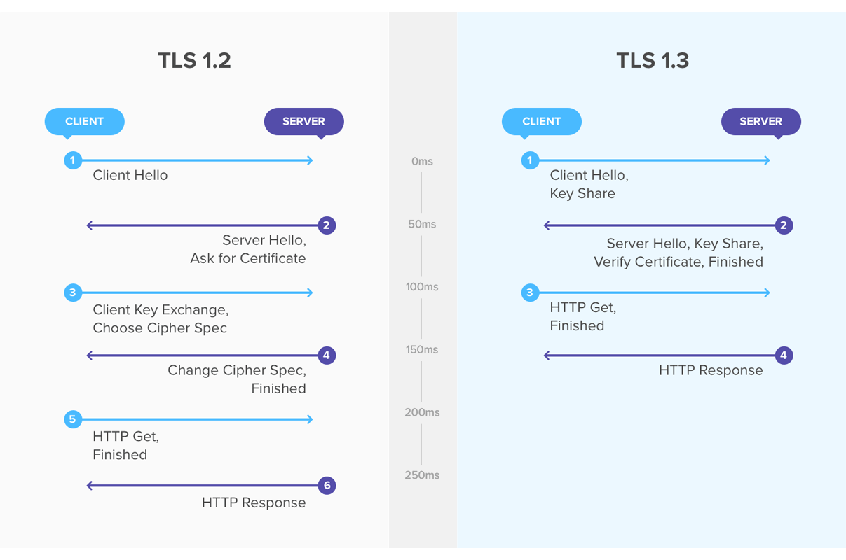
TLS 1.2 vs TLS 1.3
https://www.eyerys.com/articles/news/improved-internet-security-protocol-tls-13-has-been-approved

Slide 24
Capture 4
4_small_http_request_tls13.pcap

Slide 25
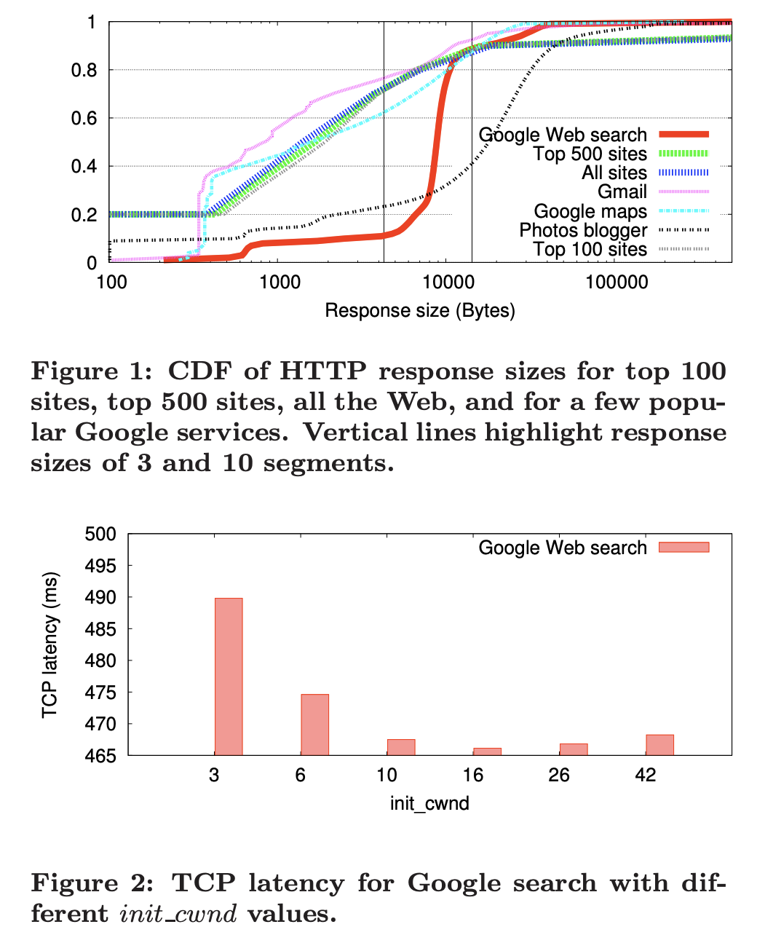
init_cwnd
In 2011, Google changed init_cwnd to fit 90% of responses in 1 RTT
https://research.google/pubs/an-argument-for-increasing-tcps-initial-congestion-window/

Slide 26
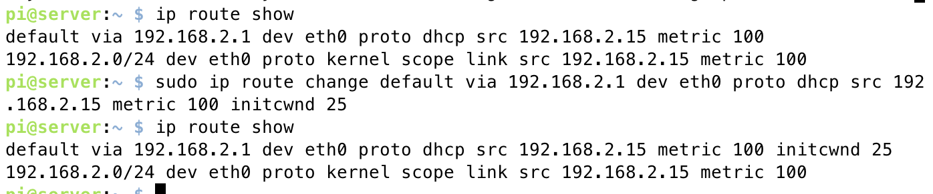
init_cwnd

Slide 27
Capture 5
5_small_http_request_initcwnd_45.pcapng

Slide 28
Potential Pitfalls

Slide 29
Potential Pitfalls
Increased CPU utilization
Increased memory utilization
TCP Zero Windows

Slide 30
Conclusion

Slide 31

Feedback

