Slide 1

Beyond Network Latency
Chasing Latency Up the Stack
Josh Clark
Huntington National Bank

Slide 2
Who Am I?
Distributed Performance Engineer – 2018-now
Performance and Latency Analysis
Collaborate with technical teams to identify bottlenecks in complex applications
M.S. in Network Engineering – 2016
Theory of protocol design
Performance analysis of internet protocols

Slide 3
Testing Architecture - AWS
Normal internet network latency of 30ms simulated on client using tc
Python script (request_code.py) deployed on client to simulate a user
All packets captured via tcpdump on the client

Slide 4
Defining Terms
We’ll be using these terms throughout the talk, so let’s define them
Network Delay – the time it takes for a packet to travel between client and server, measured as round trip time
Application Delay – the time it takes for an application to respond to a request. This is measured between the application process receiving a message and sending a response to the local server’s network stack
Server Delay – the time it takes a server to transfer messages between the NIC and an application process
Client Wait Time – the client’s version of server + application delay. For user applications, this is usually influenced by the user interacting with the application

Slide 5
Capture 1: Fast Response
Normal_fast_clear.pcapng
Normal_fast_cipher.pcapng

Slide 6
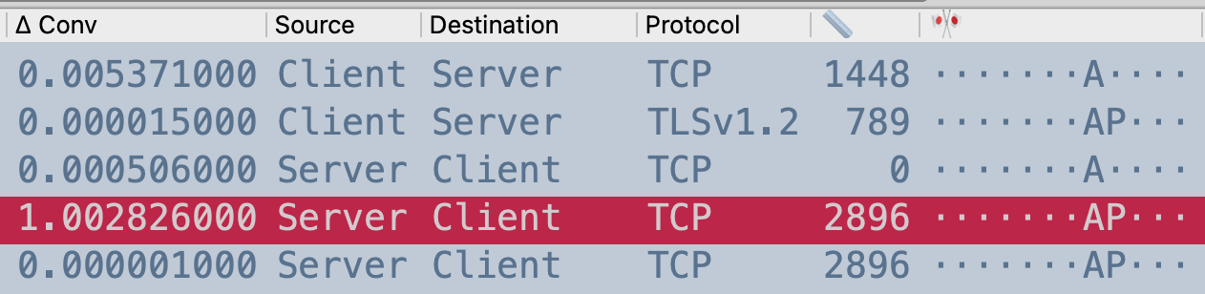
Interlude: THE PATTERN
Payload = MSS, no PSH | client REQ
Payload < MSS, PSH | end of REQ
Payload = 0, ACK | network delay
Payload > 0 | server + app delay
If you only learn one thing from this talk, let it be this pattern

Slide 7
Capture 2: Network Latency
See the following captures
Net_delay_clear.pcapng
Net_delay_cipher.pcapng

Slide 8
Capture 3: Application Latency
See the following captures
Normal_slow_clear.pcapng
Normal_slow_cipher.pcapng

Slide 9
Testing Architecture – Raspberry Pi
Switched to Raspberry Pis to reduce overall capacity of server
Switched to Apache as it does not handle load as well as nginx
Added my laptop to add load to the server without cluttering up client’s tcpdumps

Slide 10
Capture 4: Raspberry Pi, GET Flood
See the following capture
Get_flood_fast.pcap

Slide 11
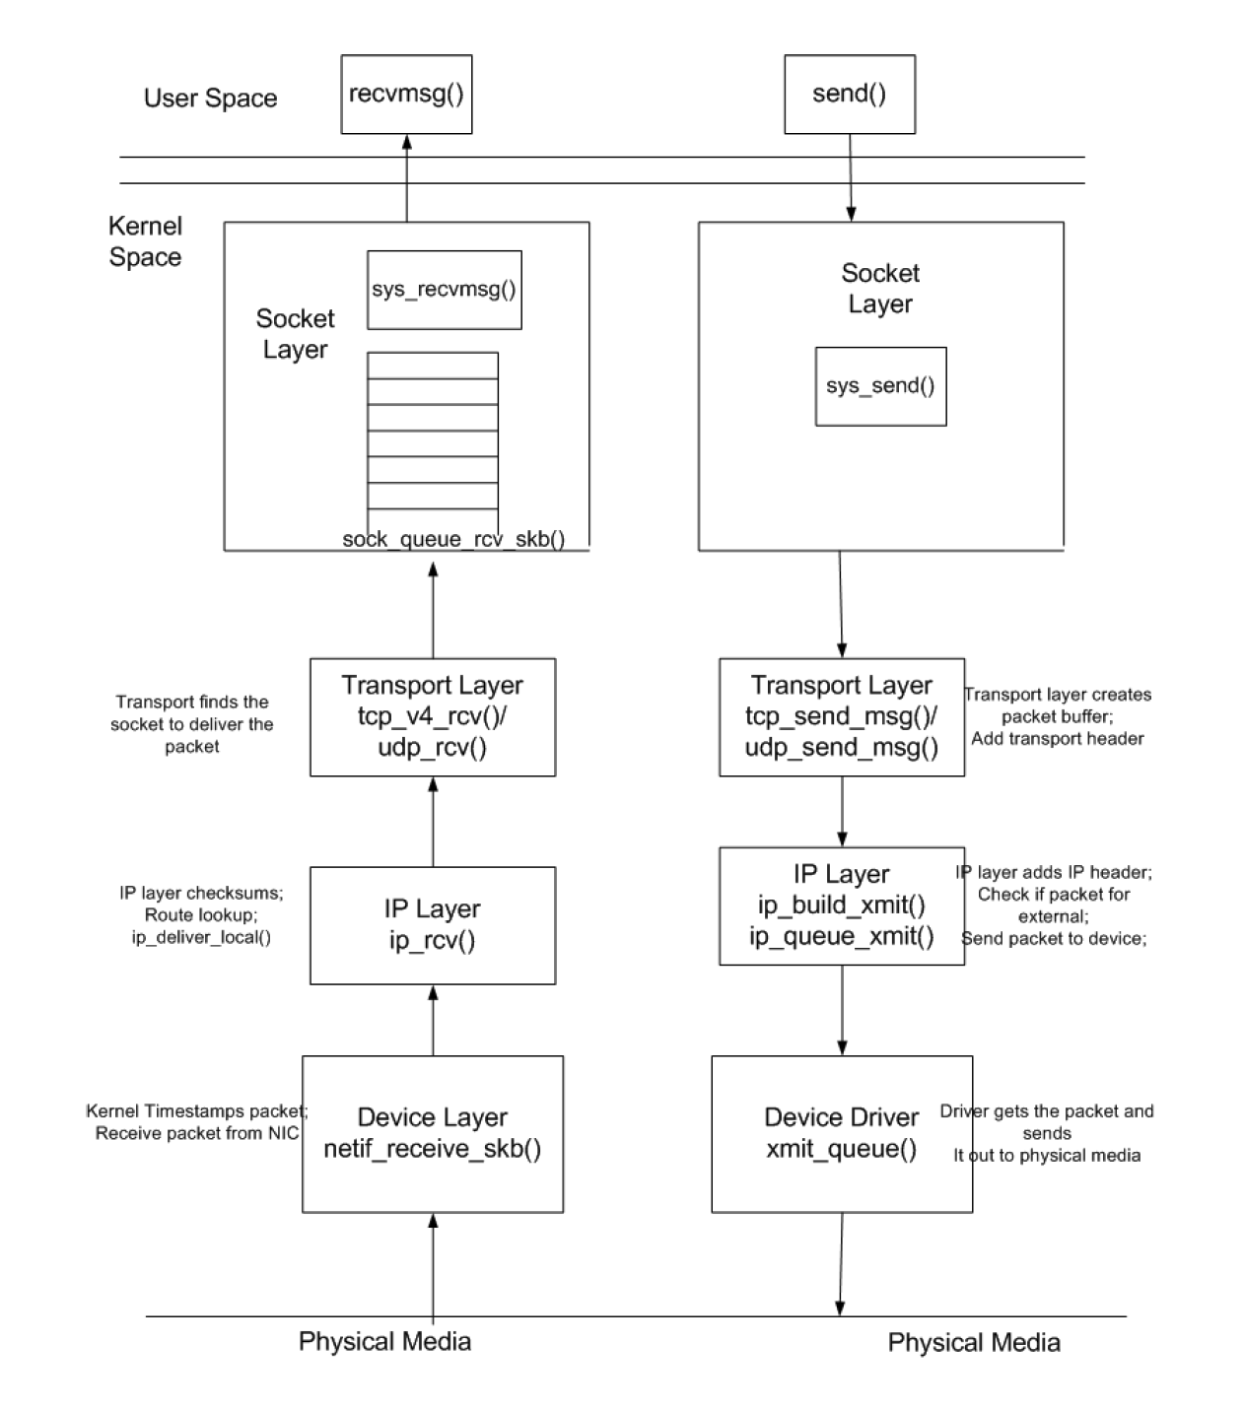
Why This Happened
R. Krishnamurthy, “A Framework for Evaluating Server Performance: Application to SIP Proxy Servers”, 2016. Available ramekris.wixsite.com/research

Slide 12
Why This Happened
K_sockq
K_stack
R. Krishnamurthy, “A Framework for Evaluating Server Performance: Application to SIP Proxy Servers”, 2016. Available ramekris.wixsite.com/research

Slide 13
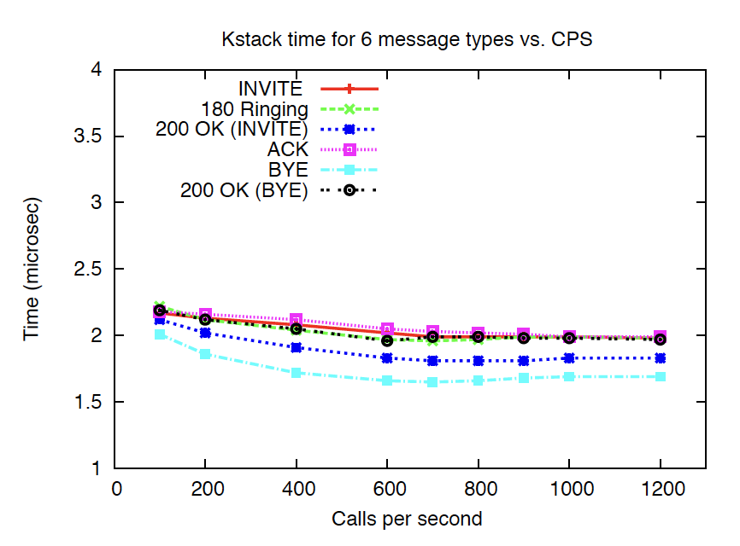
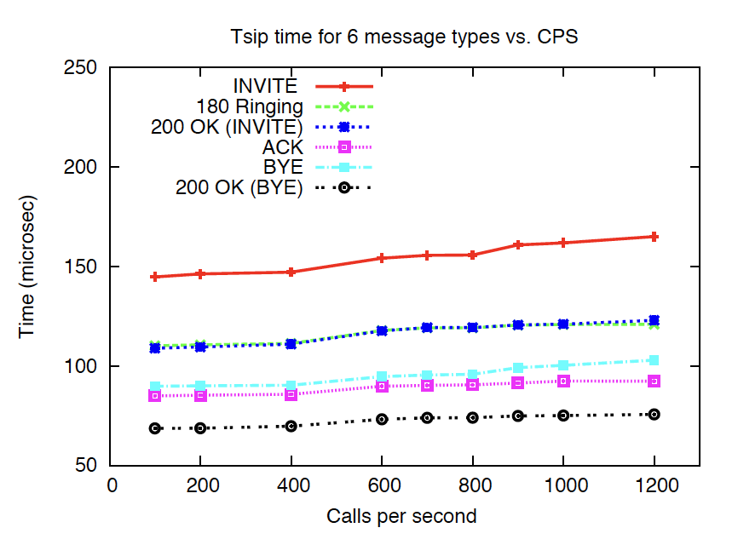
Why This Happened
R. Krishnamurthy, “A Framework for Evaluating Server Performance: Application to SIP Proxy Servers”, 2016. Available ramekris.wixsite.com/research

Slide 14
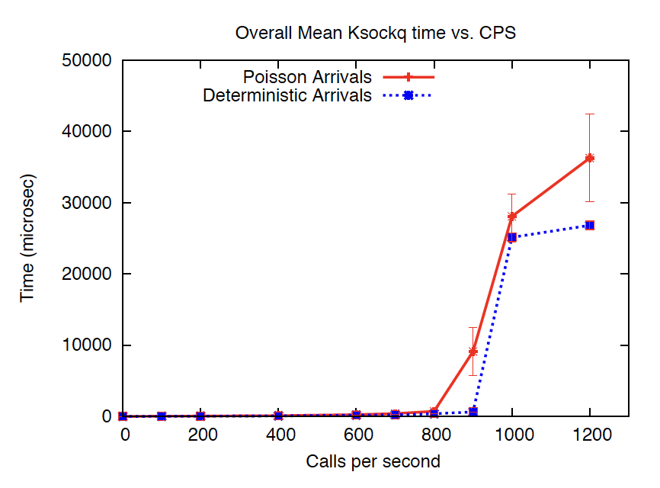
Why This Happened
When an application is busy, it can take a long time for the kernel to get the application to pull a message from the socket buffer
R. Krishnamurthy, “A Framework for Evaluating Server Performance: Application to SIP Proxy Servers”, 2016. Available ramekris.wixsite.com/research

Slide 15
Capture 5: Raspberry Pi, SYN Flood
See the following capture
Syn_flood_fast.pcap

Slide 16
Why This Happened
To get a packet to the kernel, the NIC must send a soft interrupt to the CPU
The process that handles that interrupt is ksoftirqd. Ksoftirqd calls netif_receive_skb()

Slide 17
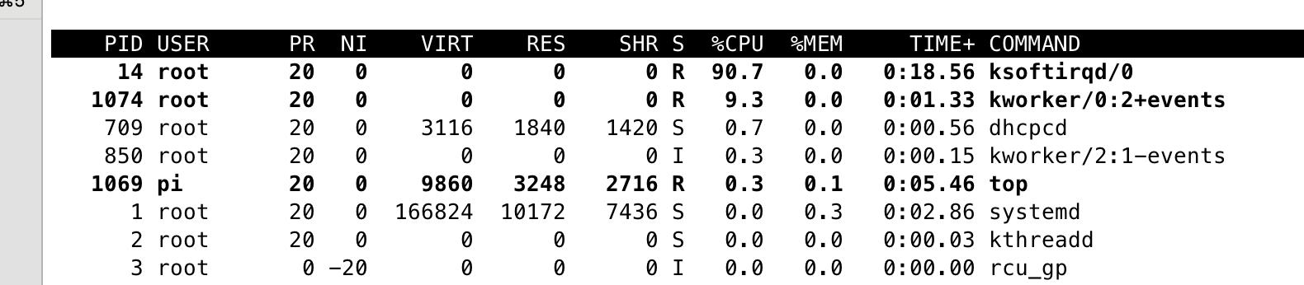
Why This Happened
This is from the top command on the server during the SYN flood

Slide 18
Applications – Three Tier Application
Packet captures from a given layer let us perform latency analysis on both sides of that layer.

Slide 19
Applications – Internet Facing
In a modern internet-facing application, any one of these devices can be causing latency, including devices deployed as appliances. Getting packet captures at multiple layers is critical to isolating a problematic layer.

Slide 20
Applications – CDN Fronted
With a CDN in the mix, it’s difficult to determine any latency at the client. Because CDNs operate at Layer 7, we don’t even get a good understanding of network latency.

Slide 21
Questions?

