Slide 1
Beyond Network Latency
Josh Clark Distributed Performance Engineer
https://github.com/je-clark/sf24eu_latency

Slide 2
About Me
M.S. in Computer Engineering
Focus on networking, protocol design, and security
Distributed Performance Engineer
Using packets to solve complex performance issues
https://www.jeclark.net
https://github.com/je-clark
https://github.com/je-clark/sf24eu_latency

Slide 3
Defining Terms
Network Delay – the time it takes for a packet to travel between client and server, measured as round trip time
Application Delay – the time it takes for an application to respond to a request. This is measured between the application process receiving a message and sending a response to the local server’s network stack
Server Delay – the time it takes a server to transfer messages between the NIC and an application process
Client Wait Time - the client’s version of server + application delay, usually influenced by user interaction

Slide 4
Latency in Normal Operation

Slide 5
Testing Architecture - AWS
Normal internet latency of 30ms simulated on client using tc
Python script (request_code.py) deployed on client to simulate a user
All packets captured via tcpdump on the client

Slide 6
Capture 1: Fast Response
0_normal_fast_clear.pcapng
1_normal_fast_cipher.pcapng

Slide 7
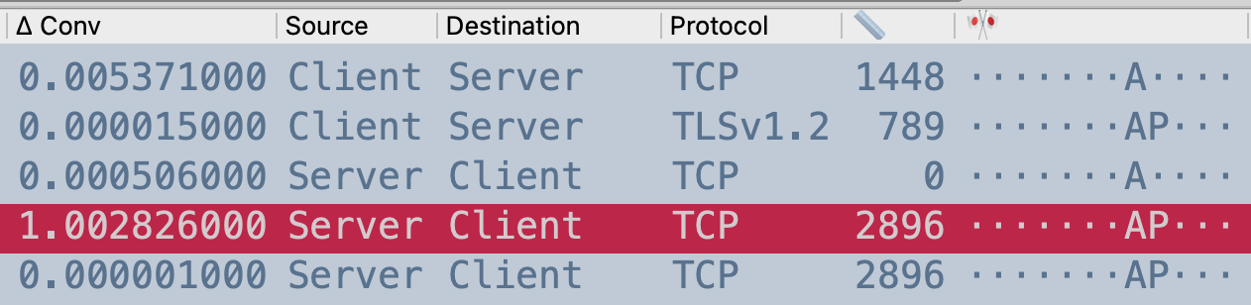
THE PATTERN
Payload = MSS, no PSH | client REQ
Payload < MSS, PSH | end of REQ
Payload = 0, ACK | network delay
Payload > 0 | server + app delay
If you only learn one thing from this talk, let it be the pattern

Slide 8
Capture 2: Network Latency
2_net_delay_clear.pcapng
3_net_delay_cipher.pcapng

Slide 9
Capture 3: Application Latency
4_normal_slow_clear.pcapng
5_normal_slow_cipher.pcapng

Slide 10
Latency Under Attack

Slide 11
Testing Architecture – Raspberry Pi
Switched to Raspberry Pis to reduce overall server capacity
Switched to Apache because it’s less efficient
Used laptop to add load to the server

Slide 12
Capture 4: HTTP GET Flood
6_get_flood_fast_filtered.pcapng

Slide 13
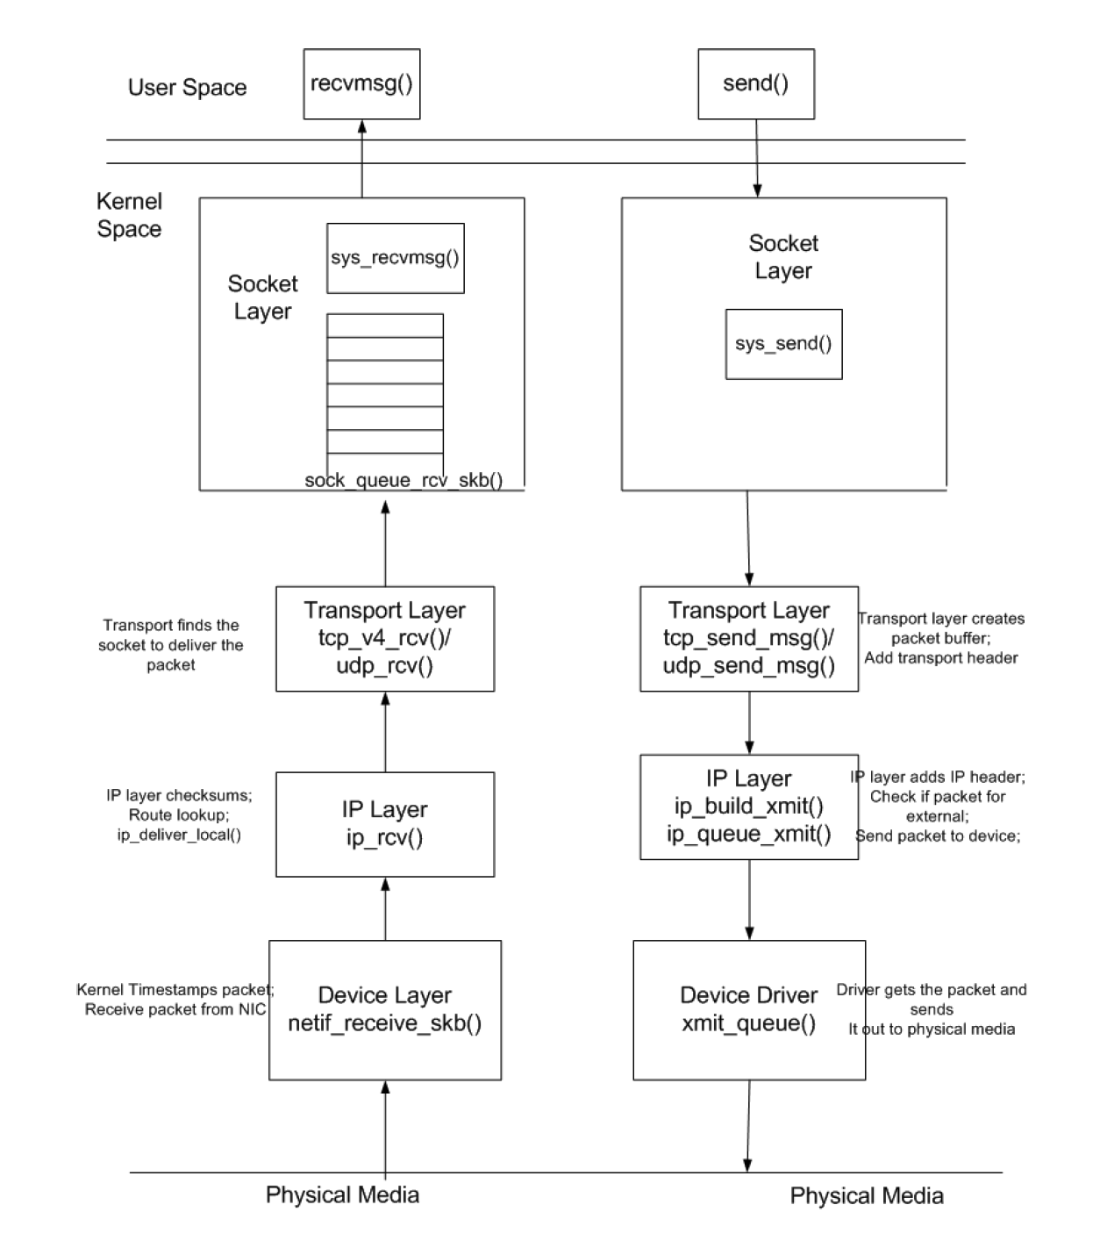
Why This Happened
R. Krishnamurthy, “A Framework for Evaluating Server Performance: Application to SIP Proxy Servers”, 2016. Available ramekris.wixsite.com/research

Slide 14
Why This Happened
K_sockq
K_stack
R. Krishnamurthy, “A Framework for Evaluating Server Performance: Application to SIP Proxy Servers”, 2016. Available ramekris.wixsite.com/research

Slide 15
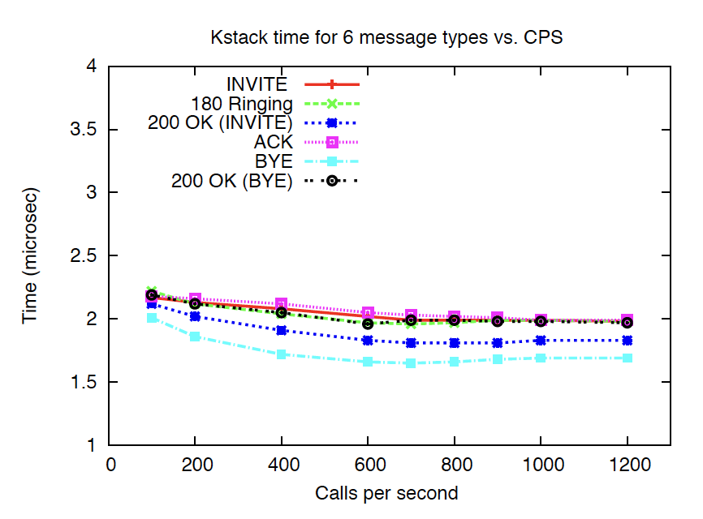
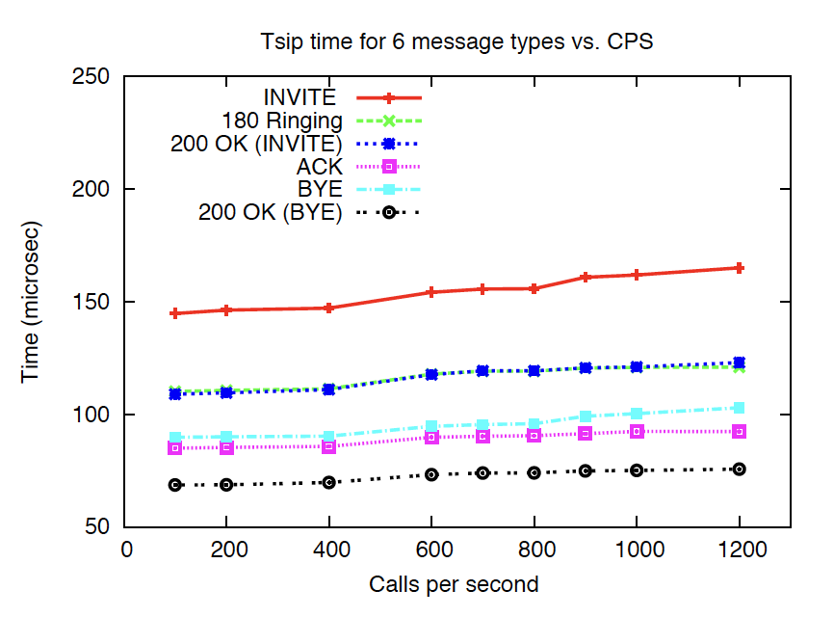
Why This Happened
R. Krishnamurthy, “A Framework for Evaluating Server Performance: Application to SIP Proxy Servers”, 2016. Available ramekris.wixsite.com/research

Slide 16
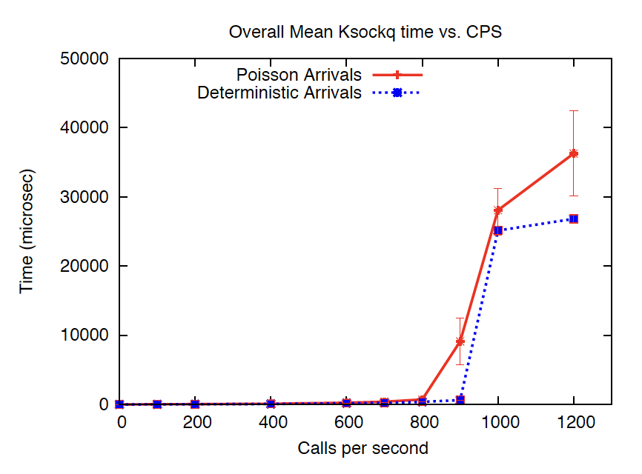
Why This Happened
When an application is busy, it can take a long time for the kernel to get the application to pull a message from the socket buffer
R. Krishnamurthy, “A Framework for Evaluating Server Performance: Application to SIP Proxy Servers”, 2016. Available ramekris.wixsite.com/research

Slide 17
Capture 4: TCP SYN Flood
7_syn_flood_fast_filtered.pcapng

Slide 18
Why This Happened
To get a packet to the kernel, the NIC must send an interrupt to the CPU
The process that handles that interrupt is ksoftirqd

Slide 19
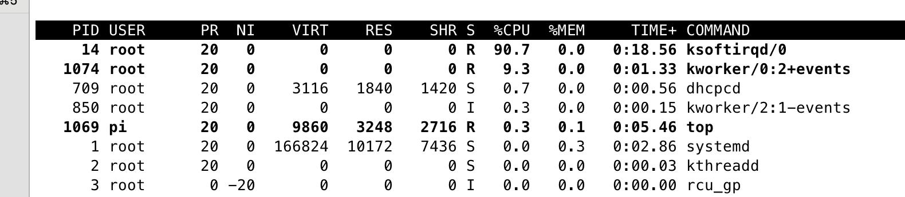
Why This Happened

Slide 20
Real World Application

Slide 21
Three Tier Application
Packet captures from a given layer let us perform latency analysis on both sides of that layer

Slide 22
Modern Application
In a modern internet-facing application, any one of these devices can be causing latency, including devices deployed as appliances. Getting packet captures at multiple layers is critical to isolating a problematic layer.

Slide 23
CDN Fronted Application
With a CDN in the mix, it’s difficult to determine any latency at the client. Because CDNs operate at Layer 7, we don’t even get a good understanding of network latency.

Slide 24

Feedback

