Slide 1
Tales of a System Call Spelunker
An Introduction to System Call Analysis with Stratoshark
https://github.com/je-clark/sharkfest-25-us-stratoshark

Slide 2
Agenda
Introduction
What are system calls?
How do Wireshark and Stratoshark capture data?
What does a Stratoshark capture look like?
Demo – HTTP Analysis
BREAK
Practice – HTTPS Analysis
Demo – SCP Analysis
Practice – SFTP Analysis
Practice – Distributed System Troubleshooting
https://github.com/je-clark/sharkfest-25-us-stratoshark

Slide 3
Introduction
B.S. and M.S. in Computer Engineering
Spent several semesters breaking Linux trying to optimize networking
Principal Performance Engineer
Uses expertise in network protocols and Linux internals to identify bottlenecks in distributed systems
Wireshark Certified Analyst
https://github.com/je-clark/sharkfest-25-us-stratoshark

Slide 4
What are System Calls?
Opening and reading a file in Python
With open(r’./file.txt’) as file:
contents = read(file)

Slide 5
What are System Calls?
Opening and reading a file in C
#include <stdio.h>
#include <stdlib.h>
int main() {
FILE *file = fopen("./file.txt", "r");
char *contents = malloc(filesize + 1);
fread(contents, 1, filesize, file);
contents[filesize] = '\0';
fclose(file);
return 0;
}

Slide 6
What are System Calls?
Playing Music in MATLAB
[y, Fs] = audioread('success.wav’);
sound(y, Fs);

Slide 7
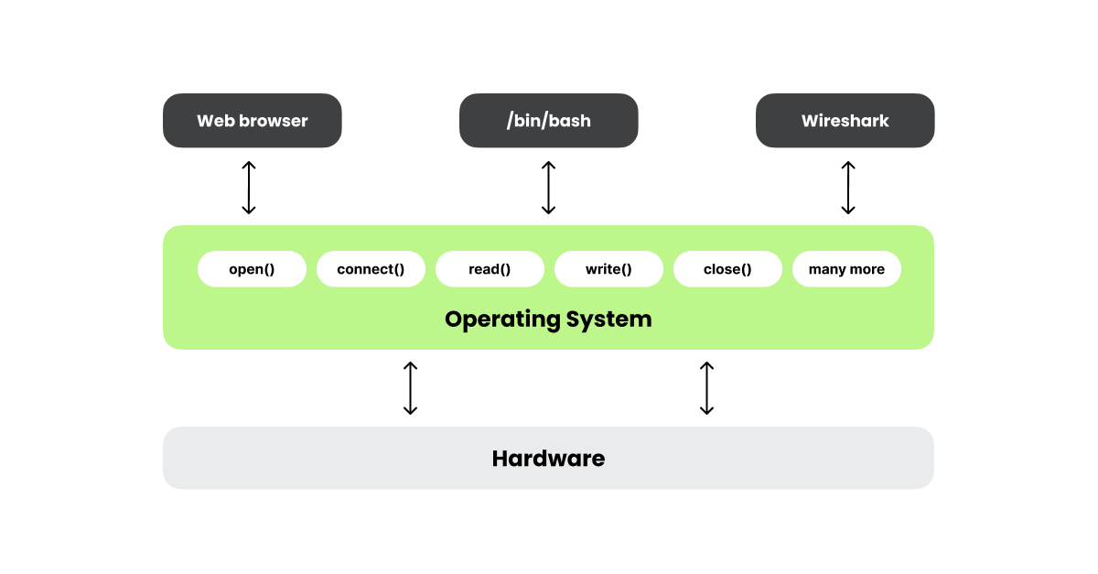
What are System Calls?
https://blog.wireshark.org/2025/01/those-arent-packets/

Slide 8
Where Can I Learn About System Calls?
https://filippo.io/linux-syscall-table/

Slide 9
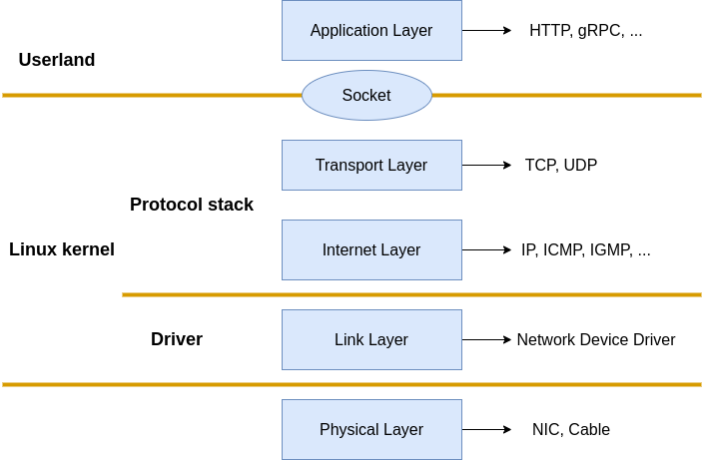

How Does Wireshark Capture Packets?
libpcap
BPF

Slide 10
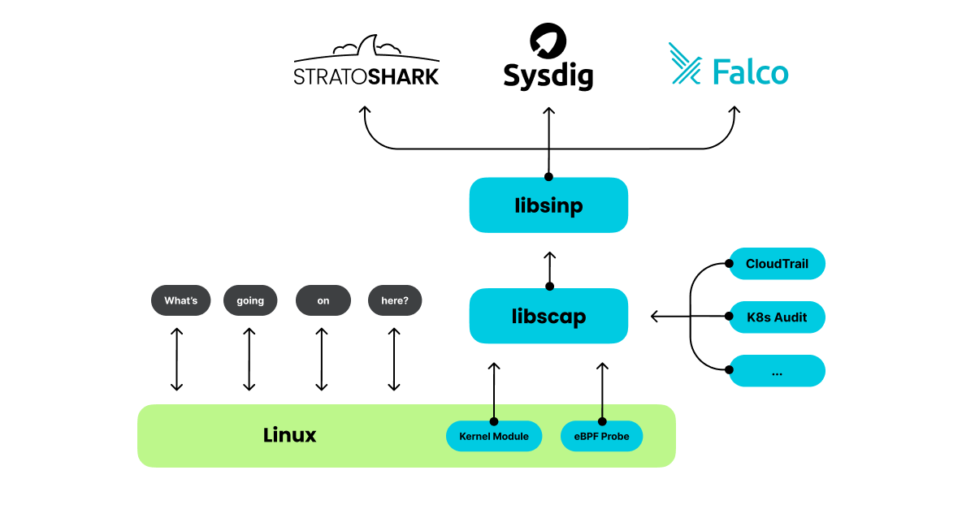
How Can I Capture System Calls?
https://blog.wireshark.org/2025/01/those-arent-packets/

Slide 11
Getting Started with sysdig – Installing sysdig
https://github.com/draios/sysdig/wiki/How-to-Install-Sysdig-for-Linux
curl -s https://download.sysdig.com/stable/install-sysdig | sudo bash

Slide 12
Getting Started with sysdig – Basic Capture
Sudo sysdig -w capture.scap

Slide 13
Getting Started with sysdig – Get more event data
Sudo sysdig –s 1000 -w capture.scap

Slide 14
Getting Started with sysdig – Filter on Processes
Sudo sysdig -w capture.scap proc.name=nginx or proc.name=python3

Slide 15
Getting Started with sysdig – Filter on Call Types
Sudo sysdig -w capture.scap evt.type=open

Slide 16
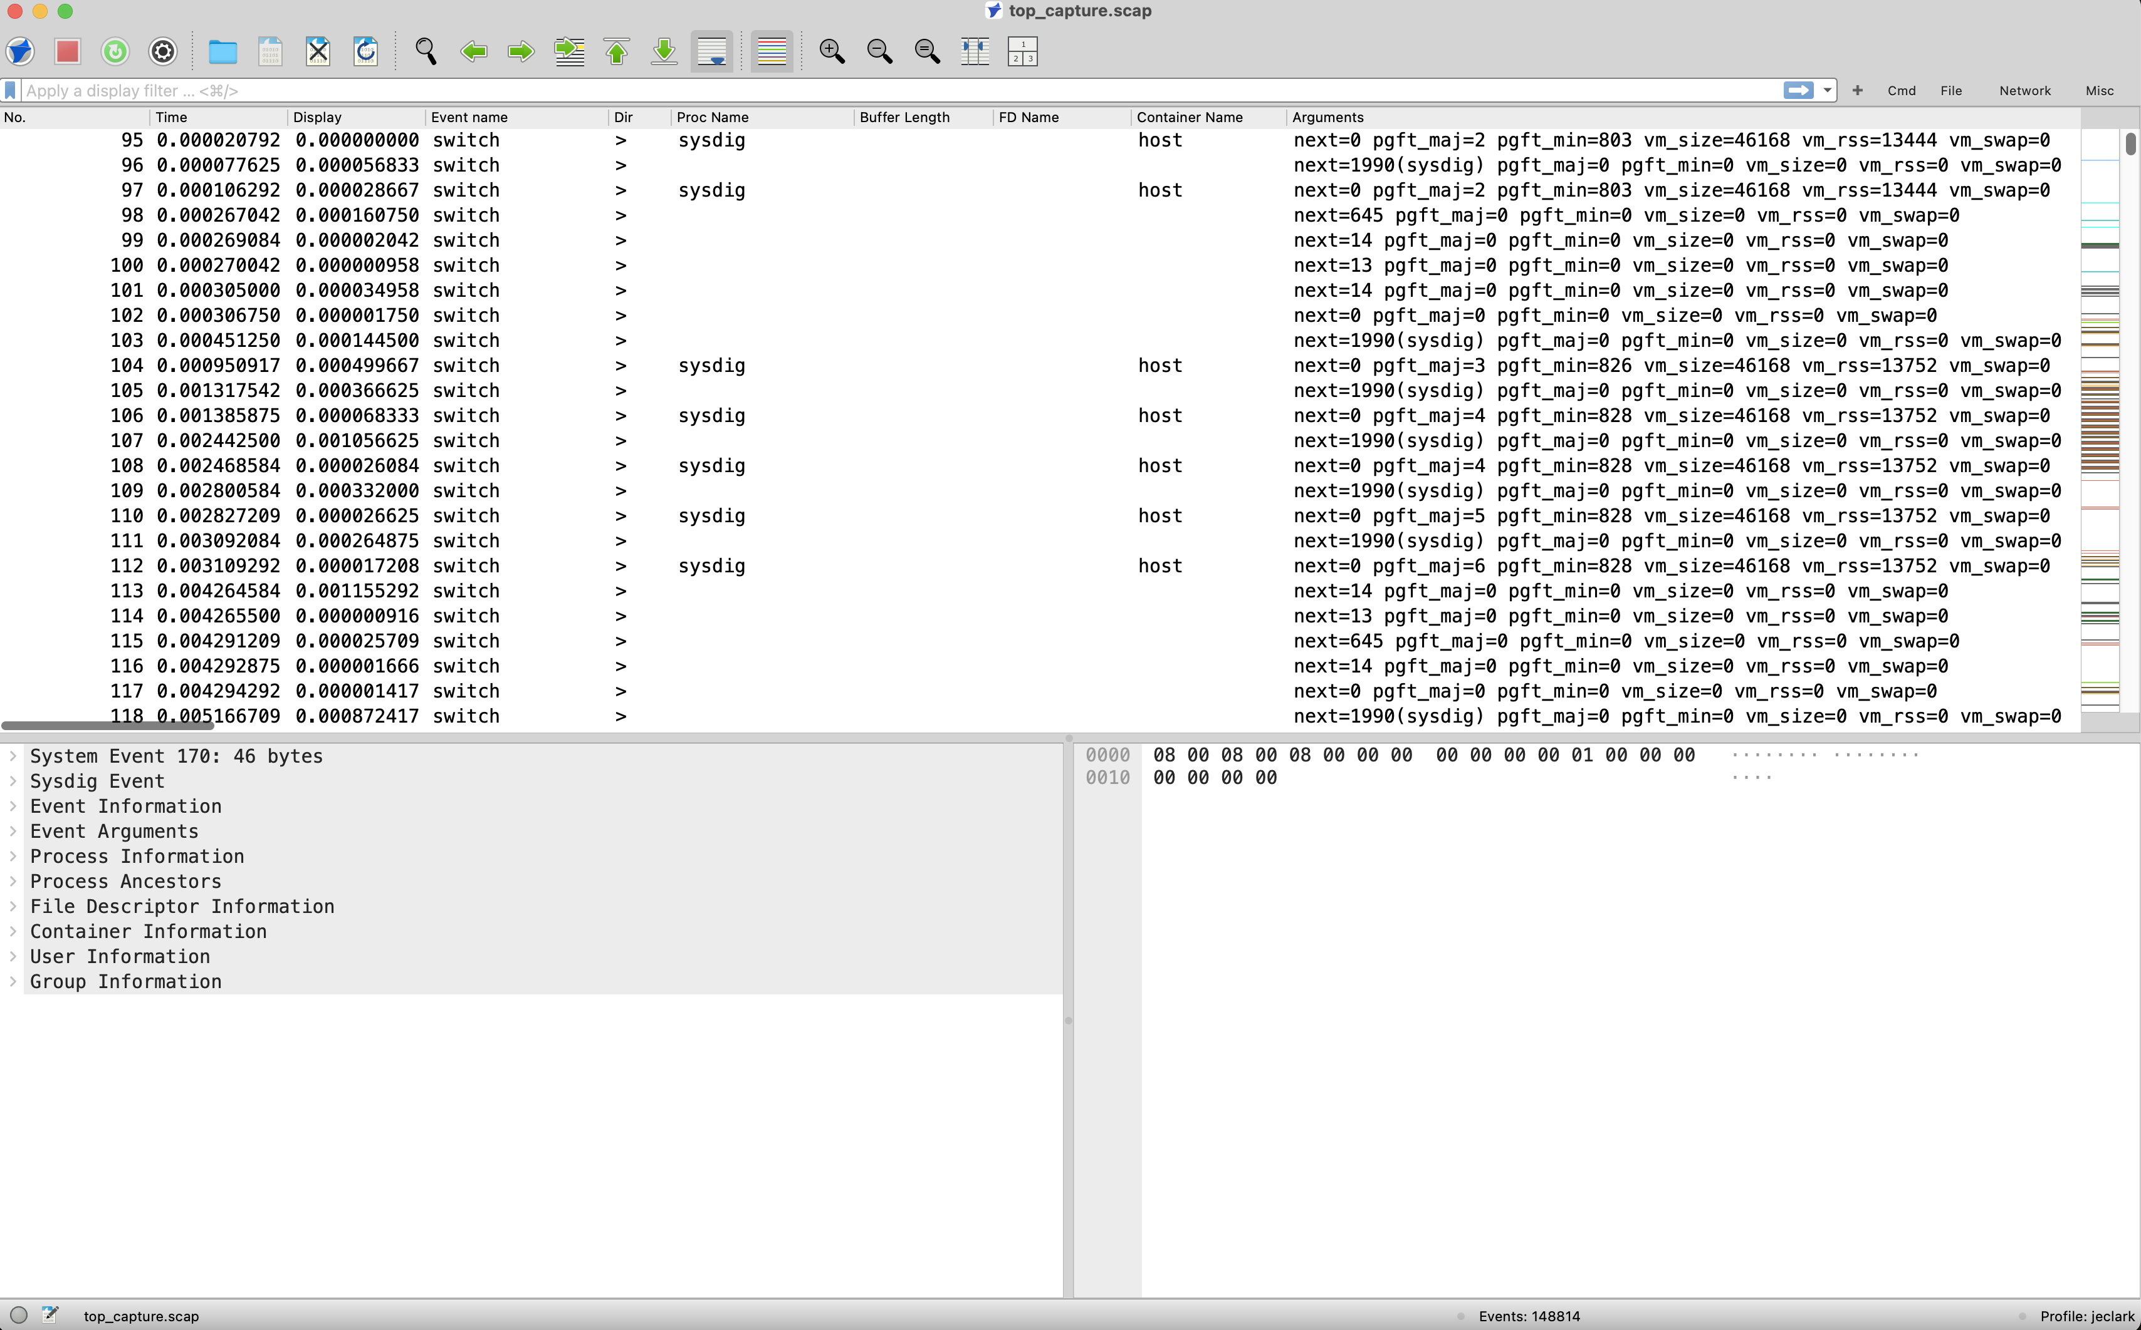
Stratoshark Interface
Event list
Event details
Event bytes

Slide 17
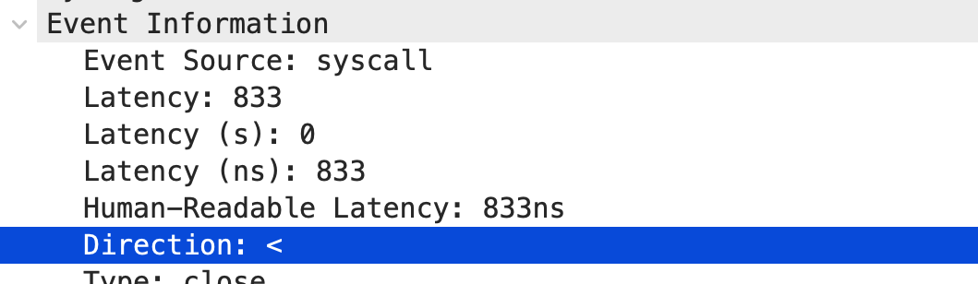
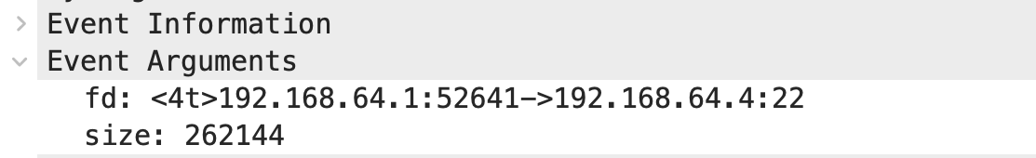
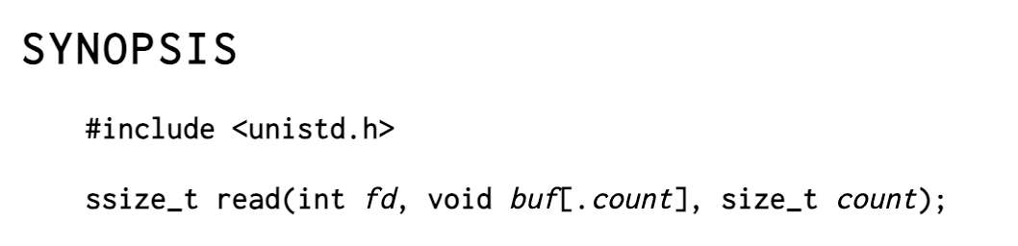
Stratoshark Interface – New Fields
Direction:
> Enters a syscall
< Exits a syscall
Arguments:
Syscall-specific
Discoverable in reference docs

Slide 18
Capture 1
1_top.scap

Slide 19
Capture 1 Findings
Use the ‘in {}’ filter syntax as a first choice
execve() returns to the new process, but is called by the parent process
/proc is a directory where the kernel writes process and system statistics
getdents64() writes information about contents of a directory to a memory map created with the mmap() call
The terminal window uses the file descriptor /dev/pts/0

Slide 20
Capture 2
2_http_packets.pcapng
2_http_syscalls.scap

Slide 21
Capture 3
3_https_packets.pcapng
3_https_syscalls.scap
3_https_worksheet.pdf

Slide 22
Capture 4
4_scp_packets.pcapng
4_scp _syscalls.scap

Slide 23
Capture 5
5_sftp_packets.pcapng
5_sftp_syscalls.scap
5_sftp_worksheet.pdf

Slide 24
Distributed Systems Troubleshooting
Distributed_system_worksheet.pdf
If you feel confident, try using only page 1
If you want a guided tour, use the entire worksheet
Josh_web_store.har
Web_packets.pcapng
Web_syscalls.scap
Nas_packets.pcapng
Nas_syscalls.scap
Db_packets.pcapng
Db_syscalls.scap

Slide 25
Current Limitations
Unable to see some inter-process and kernel communication
Statically linked libraries (e.g. nginx and openssl)
Shared memory locations (e.g. getdents64())
sysdig missing features that other syscall tools include
Strace gives you more data for getdents64() than sysdig
No Windows or MacOS support
Gitlab issue is open for Windows procmon support

Slide 26
Conclusion
In this session, we
Learned what system calls are and how to capture them with sysdig
Learned the basic Stratoshark interface
Examined several common Linux applications in both Wireshark and Stratoshark
Found the bottlenecks in a distributed system using both Wireshark and Stratoshark

Slide 27

Feedback

