Slide 1
Q-Learning
순천향대학교
컴퓨터시스템연구실
김재진
21.01.26

Slide 2
Q-Learning
특징
Off-policy
Target policy : p(a_{t+1}|s_{t+1}) = δ(a_{t+1}-a*_{t+1}), a*_{t+1}=argmax_{at+1}Q(S_{t+1},A_{t+1}) ↳Greedy(Optional policy)
Behavior policy : ε – Greedy
α(Learning rate)
Q(S_{t},A_{t}) ← Q(S_{t},A_{t}) + α(R_{t+1} + γmaxQ(S_{t+1},ά) – Q(S_{t},A_{t}))
= Q(S_{t},A_{t})(1- α) + α(R_{t+1} + γmaxQ(S_{t+1},ά))
Q(s_{t},a_{t}) = ∫_{st+1,at+1}(R_{t}+γQ(s_{t+1},a_{t+1}))p(s_{t+1}|s_{t},a_{t})ds_{t+1,}a_{t+1}
=∫ _{st+1}(R_{t}+γmaxQ(s_{t+1},a_{t+1}))p(s_{t+1}|s_{t},a_{t})ds_{t+1}
⩯ _{N+1} = _{n}+ α(R_{t+1} + γmaxQ(S_{t+1},ά) – _{n})
TD target(sampling) : R_{t+1} + γmaxQ(S_{t+1},ά)

Slide 3
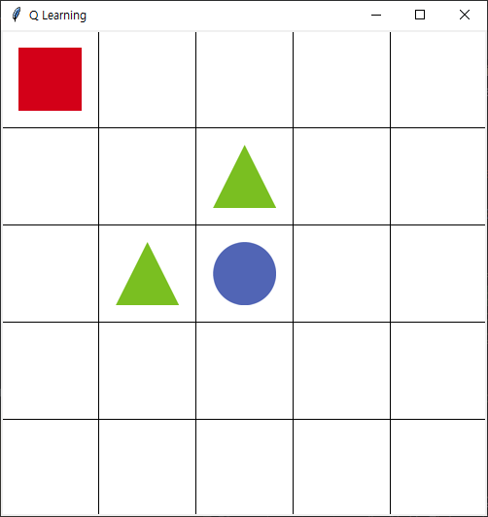
Q-Learning
그리드 월드
구성:
agent : Rectangle
reward: Triangle(-100), Circle(100)
state : Coordinate(x, y)
action : [0, 1, 2, 3] //up, down, left, right
Agent가 Env에게 s_{t}, a_{t}를 전달하면 Env으로 부터 s_{t+1}을 전달 받음

Slide 4
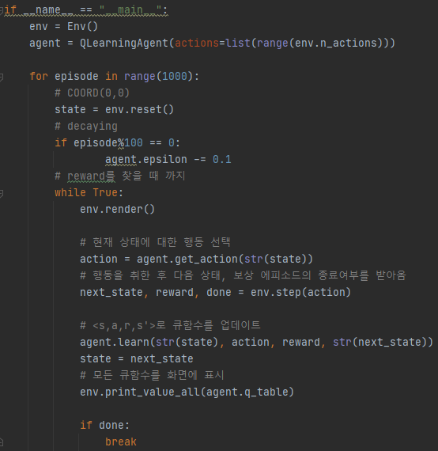
Q-Learning
Main – Q_Learning
Init
Env
Agent
Episode <1000
reset(좌표(0,0))
decaying
render: drawing
get_action: Coord
step :s_{t}, R_{t}, done
learn: update
If(done)

Slide 5
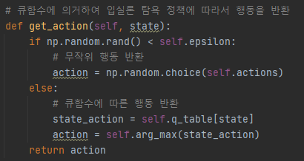

Q-Learning
get_action – Q_Learning
Behavior policy : (decaying)ε – Greedy
ε : random action
1- ε : Greedy
Decaying
ε ⩬ 1 - episode/1000

Slide 6
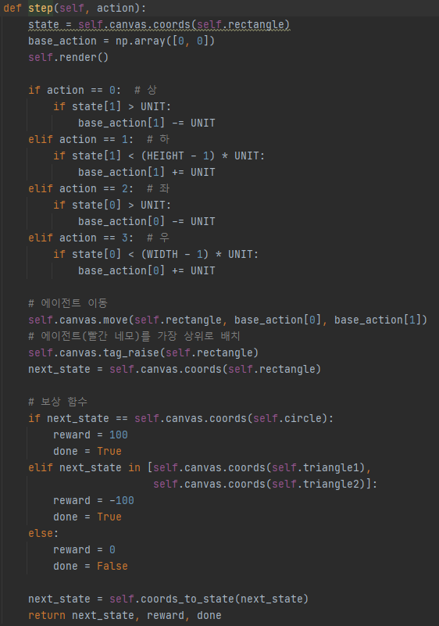
Q-Learning
step– Q_Learning
transition
1{E}(s_{t+1}|s_{t},a_{t})
reward
circle : 100
triangle : -100
done : true

Slide 7
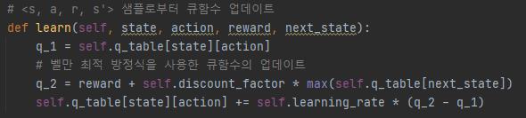
Q-Learning
learn– Q_Learning
q_1: Behavior policy :Q(S_{t},A_{t})
q_2: Rt + λ(Target policy) : R_{t+1} + γmaxQ(S_{t+1},ά)
self.q_table[state][action] += self.learning_rate * (q_2 - q_1)
q_1 + α(R_{t+1} + γmaxQ(S_{t+1},ά) - q_1
Q(s_{t}, a_{t}) + α(R_{t+1} + γmaxQ(s_{t+1},ά) - Q(s_{t}, a_{t})
Q(s_{t}, a_{t})(1- α) + α(R_{t+1} + γmaxQ(s_{t+1},ά))

