Slide 1
RxJS in depth (Part 1)
The basics
Cloud Teamblocker @ SBB - 12.09.2019 - Jean André Gauthier

Slide 2
A simple (asynchronous) task
1. /checkCredentials
✔ / X
2. /getUser
Client
Server
{ … }
3. Display user

Slide 3
Solution #1: Callbacks
function checkCredentialsCB(
username: string,
password: string,
callback: (credentialsOk: boolean) => void
): void {
setTimeout(() => {
callback(username == "test" && password == "1234");
}, 2000);
}
function getUserCB(
credentialsOk: boolean,
callback: (user?: string) => void
): void {
if (!credentialsOk) {
callback(undefined);
} else {
setTimeout(() => { callback("CALLBACK"); }, 2000);
}
}
checkCredentialsCB("test", "1234", credentialsOk => {
getUserCB(credentialsOk, console.log);
});
How to deal with errors?
How to write tests?
Why should checkCredentials / getUser be responsible to call the next operation?
What if we change the signature of getUserCB?
Would that still be readable if we had 10 other nested callbacks?

Slide 4
These problems are referred to as callback hell

Slide 5
Solution #2: Promises
function checkCredentialsP(
username: string,
password: string
): Promise<boolean> {
return new Promise(resolve => {
setTimeout(() => {
resolve(username == "test" && password == "1234");
}, 2000);
});
}
function getUserP(credentialsOk: boolean): Promise<string> {
return new Promise(resolve => {
if (!credentialsOk) {
resolve(undefined);
} else {
setTimeout(() => { resolve("PROMISE"); }, 2000);
}
});
}
checkCredentialsP("test", "1234")
.then(getUserP)
.then(console.log)
.catch(console.log);
checkCredentials / getUser do not call the next operation anymore
Easier error handling
Flat instead of nested code

Slide 6
What if we want to execute the credential check multiple times (e.g. after a button click)?

Slide 7
Solution: Observables (RxJS)
function checkCredentialsO(
username: string,
password: string
): Observable<boolean> {
return of(username == "test" && password == "1234").pipe(delay(2000));
}
function getUserO(credentialsOk: boolean): Observable<string> {
return of("OBSERVABLE").pipe(delay(2000));
}
fromEvent(document.querySelector('button'), 'click‘).pipe(
switchMap(() => { return checkCredentialsO("test", "1234"); }),
switchMap(getUserO)
).subscribe(console.log);

Slide 8
Observables are lazy collections of multiple values over time.

Slide 9
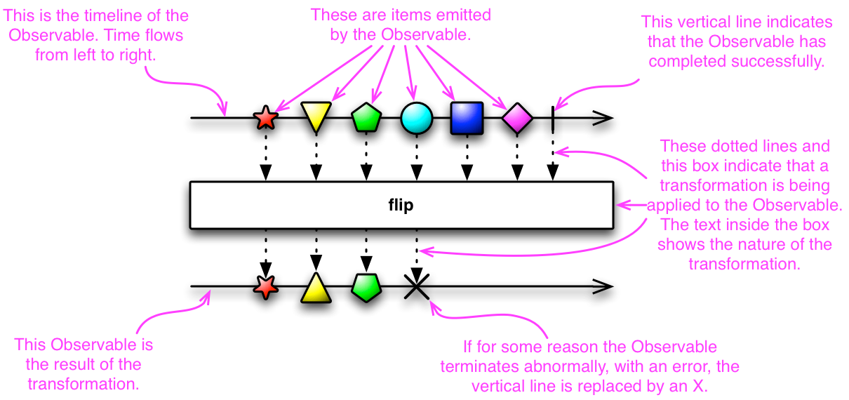
Observables
Source

Slide 10
map operator
“Apply projection with each value from source.”

Slide 11
zip operator
“After all observables emit, emit values as an array”

Slide 12
switchMap operator
“Map to observable, complete previous inner observable, emit values.”

Slide 13
concatMap operator
“Map values to inner observable, subscribe and emit in order.”

Slide 14
Map operators - mergeMap
“Map to observable, emit values.”

Slide 15
Filter operators - debounceTime
“Discard emitted values that take less than the specified time between output”

Slide 16
Filter operators - debounceTime
const keyup$ = fromEvent(document.getElementById('input'), 'keyup‘);
keyup$ .pipe(
map((i: any) => {return "Sending request to server: " + i.currentTarget.value;}),
debounceTime(500)
) .subscribe(console.log);
Example

Slide 17
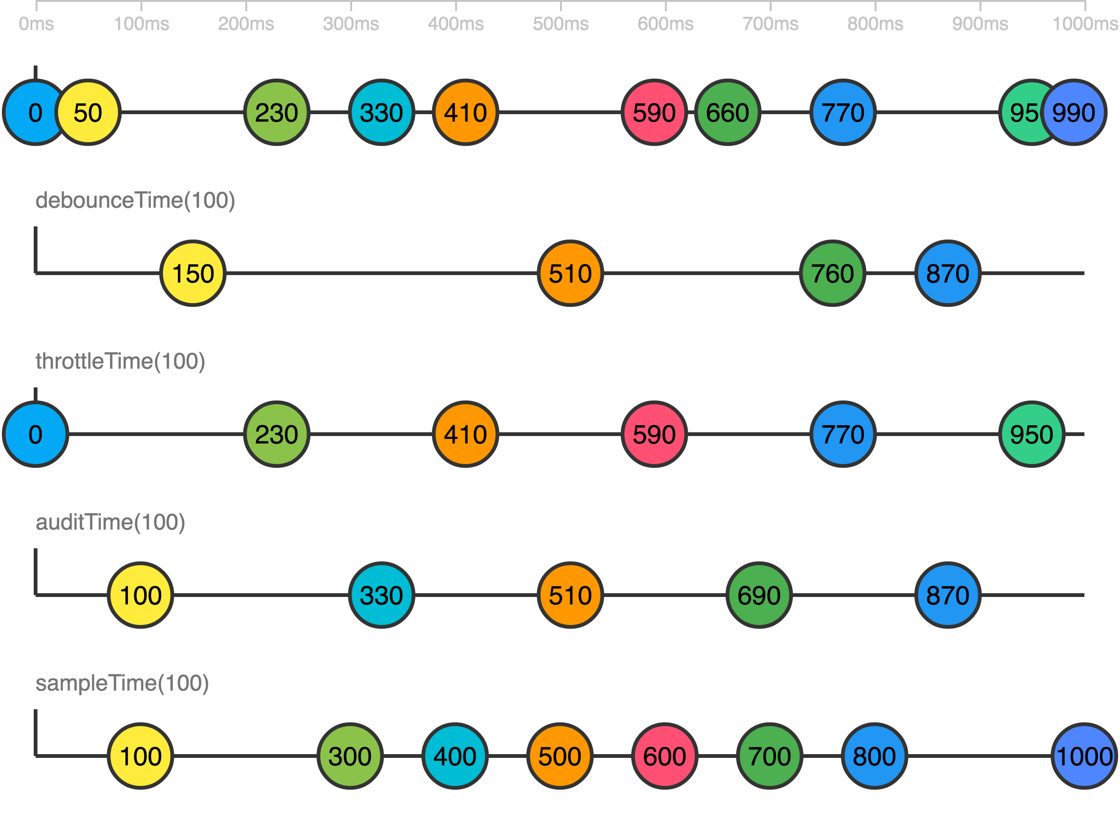
Backpressure
Source

Slide 18
Error handling
const observable$ = interval(1000).pipe(
tap((i) => {
if (i > 3) {
throw "error";
}
})
);
observable$.subscribe(
(value) => { console.log("next: " + value); },
(error) => { console.log("error: " + error); },
() => { console.log("complete"); }
);
jsfiddle

Slide 19
Error handling – catch & replace
observable$.pipe(
catchError((error) => {
return of("replacement");
})
).subscribe(
(value) => { console.log("next: " + value); },
(error) => { console.log("error: " + error); },
() => { console.log("complete"); }
);
jsfiddle

Slide 20
Error handling – catch & rethrow
observable$.pipe(
catchError((error) => {
return throwError("replacement error");
})
).subscribe(
(value) => { console.log("next: " + value); },
(error) => { console.log("error: " + error); },
() => { console.log("complete"); }
);
jsfiddle

Slide 21
Error handling – catch & retry
observable$.pipe(
retryWhen((errors) => {
return errors.pipe(
delayWhen((error) => {
return timer(3000);
}),
tap(() => {
console.log("retrying...")
})
);
})
).subscribe(
(value) => { console.log("next: " + value); },
(error) => { console.log("error: " + error); },
() => { console.log("complete"); }
);
jsfiddle

