Slide 1
WTF.js
javascript corner cases and pitfalls
Cloud Teamblocker @ SBB - 14.11.2019 - Jean André Gauthier

Slide 2
Quiz

Slide 3
#1: n/a
What is the result of the following expression?
"N" + "a" + +"a" + "a"
a) “NaNaNa” b) SyntaxError c) 370 d) “Naaa”
Notes:
Answer: a

Slide 4
#1: n/a
The expression is evaluated as ”N” + “a” + (+”a”) + “a”
The unary + operator converts (+”a”) to NaN
The addition operator (+) converts NaN to “NaN”

Slide 5
#2: To the infinity and beyond
What is the result of the following expression?
parseInt("Infinity", 19)
a) 18 b) Infinity c) NaN d) undefined
Notes:
REPL:
> parseInt("1")
> parseInt("1337")
> parseInt("ff")
> parseInt("ff", 16)
> Infinity
> parseInt("Infinity")
> parseInt("Infinity", 16)
Answer: a

Slide 6
#2: To the infinity and beyond
18.2.5 parseInt ( string, radix )
The parseInt function produces an integer value dictated by interpretation of the contents of the string argument according to the specified radix. Leading white space in string is ignored. If radix is undefined or 0, it is assumed to be 10 except when the number begins with the code unit pairs 0x or 0X, in which case a radix of 16 is assumed. If radix is 16, the number may also optionally begin with the code unit pairs 0x or 0X.
[…]
NOTE
parseInt may interpret only a leading portion of string as an integer value; it ignores any code units that cannot be interpreted as part of the notation of an integer, and no indication is given that any such code units were ignored.
Always read the fine print!

Slide 7
#3: The trinity operator
What is the result of the following expression?
[] == "0"
a) NaN b) false c) true d) undefined
Notes:
REPL intro:
> 0 == 0
> "0" == "0"
> [] == []
> [] == 0
> 0 == "0"
Answer: b

Slide 8
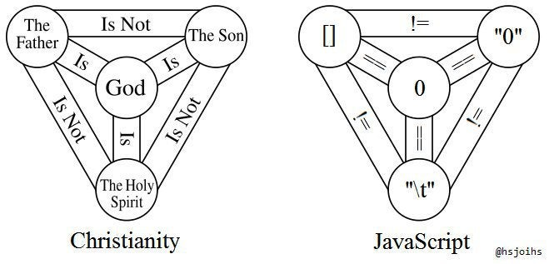
#3: The trinity operator
Source

Slide 9
#3: The trinity operator
7.2.14 Abstract Equality Comparison
The comparison x == y, where x and y are values, produces true or false. Such a comparison is performed as follows:
If Type(x) is the same as Type(y), then
Return the result of performing Strict Equality Comparison x === y.
If x is null and y is undefined, return true.
If x is undefined and y is null, return true.
If Type(x) is Number and Type(y) is String, return the result of the comparison x == ! ToNumber(y).
If Type(x) is String and Type(y) is Number, return the result of the comparison ! ToNumber(x) == y.
If Type(x) is Boolean, return the result of the comparison ! ToNumber(x) == y.
If Type(y) is Boolean, return the result of the comparison x == ! ToNumber(y).
If Type(x) is either String, Number, or Symbol and Type(y) is Object, return the result of the comparison x == ToPrimitive(y).
If Type(x) is Object and Type(y) is either String, Number, or Symbol, return the result of the comparison ToPrimitive(x) == y.
Return false.
Don’t use the == operator !

Slide 10
#4: Revolution 9
What is the result of the following expression?
9999999999999999 + 1.1
a) 10000000000000000 b) 10000000000000000.1
c) 10000000000000001 d) 10000000000000002
Notes:
REPL intro:
> 999999999999999
> 999999999999999 + 1
> 999999999999999 + 1.1
Answer: d

Slide 11
#4: Revolution 9
There is only one numerical data type in JS (IEEE 754 double precision floating point number)
⇒ use integers only between Number.MIN_SAFE_INTEGER and Number.MAX_SAFE_INTEGER

Slide 12
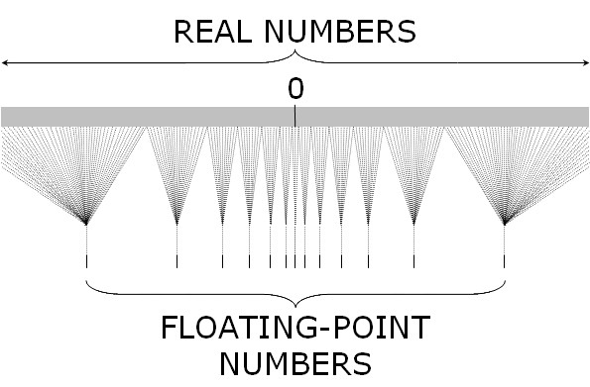
#4: Revolution 9
Source

Slide 13
#5: sort me if you can
What is the result of the following expression?
[10, 3, 2, 1].sort()
a) [] b) [10, 3, 2, 1] c) [1, 10, 2, 3] d) [1, 2, 3, 10]
Notes:
REPL
> [].sort()
> ["a"].sort()
> ["b", "a"].sort()
> [3, 2, 1].sort()
Answer: c

Slide 14
#5: sort me if you can
Array.prototype.sort()
The sort() method sorts the elements of an array in place and returns the sorted array. The default sort order is ascending, built upon converting the elements into strings, then comparing their sequences of UTF-16 code units values.
The time and space complexity of the sort cannot be guaranteed as it depends on the implementation.
Notes:
REPL
> [].sort()
> ["a"].sort()
> ["b", "a"].sort()
> [3, 2, 1].sort()
Answer: c

Slide 15
#6: lisp
What is the result of the following expression?
(![] + [])[+[]] +
(![] + [])[+!+[]] +
([![]] + [][[]])[+!+[] + [+[]]] +
(![] + [])[!+[] + !+[]];
a) “fail” b) “true” c) “lisp” d) “null”
Notes:
Answer: a

Slide 16
#6: lisp
"false"
0
false
(![] + [])[+[]] +
(![] + [])[+!+[]] +
([![]] + [][[]])[+!+[] + [+[]]] +
(![] + [])[!+[] + !+[]];
"falseundefined"
10
Notes:
Answer: a

Slide 17
#7: constructor³
What is the result of the second statement?
const c = "constructor";
c[c][c]('return "wat?"')();
a) 'return "wat?“’ b) undefined c) “constructor” d) “wat?”
Notes:
Answer: d

Slide 18
#7: constructor³
c -> "constructor„
c[c] -> f String() { ... }
c[c]("foo") -> "foo"
c[c][c] -> f Function() { ... }
c[c][c]("return 'wat?'") -> "wat?"

Slide 19
#8: timeouts
In which order will the alerts be displayed?
setTimeout(() => alert("1"));
Promise.resolve().then(() => alert("2"));
alert("3");
a) the order can change b) 3 - 2 - 1 c) 1 - 2 - 3 d) 3 - 1 - 2
Notes:
Answer: b

Slide 20
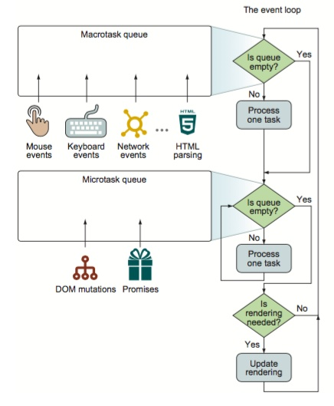
#8: timeouts
Source

Slide 21
#9: Proteus
What will be printed in the console?
var proteus = "lion";
var show = function() { console.log(this.proteus); };
var o = { proteus: "pig", show: show };
o.show();
show();
function F() { this.proteus = "snake"; this.show = show }
new F().show();
var f = new F().show;
f();
lion - lion - lion - lion b) pig - lion - snake - lion
c) pig - undefined - snake - snake d) pig - lion - snake - snake
Notes:
Answer: b

Slide 22
#9: Proteus
this: o
var proteus = "lion";
var show = function() { console.log(this.proteus); };
var o = { proteus: "pig", show: show };
o.show();
show();
function F() { this.proteus = "snake"; this.show = show }
new F().show();
var f = new F().show;
f();
this: window
this: F instance
this: window

Slide 23
#10: Did you like this talk?
a) “yes” b) “no” c) “so-so” d) undefined

Slide 24
Sources
WTFJS – Brian Leroux
What the f*ck JavaScript? – Denys Dovhan
Javascript WTF
Javascript ‘this’ Keyword, How it works? – Osama Elmashad

