Slide 1


Some Determinants of Successful Reintegration
Objective 2 : Data analysis and trend

Slide 2

INTRODUCTION
What makes reintegration successful?
In terms of:
Business success: Is the business open and functional?
Business profitability: Can the business cover the needs of the respondents and their family?
Economic Score: A series of economic indicators
Overall Reintegration Score: A series of economic, social, and psychosocial indicators
Data used to explore these questions:
The Reintegration Economic Survey (Business Success and Business Profitability)
The Reintegration Sustainability Survey (Economic Score and Overall Reintegration Score)
For some analyses, Mimosa data (Training information, assistances received)
Regression analysis was used to identify the determinants of Business Success and reintegration sustainability

Slide 3
INTRODUCTION ON REGRESSION ANALYSIS
What is regression analysis?
Suppose you find that 70% of men have a high business success, whereas only 40% of women have a high business success
Could we then conclude that men are more likely to have a successful business than women, or that their reintegration is smoother?
No! Because the apparent success of men might be due to other factors. For example, they might be engaged in activities that are more profitable, and where men are overrepresented. In other words, it is the type of activity, not the gender, that would explain the higher success
Regression analysis allows to estimate the impact of several factors on business success, while holding constant the effect of all these factors, or ‘controlling’ for the effect of each other
In the example above, regression might find that once we take into account the type of activity, men and women have the same business success
Regression analysis is therefore much more powerful than descriptive analyses, since it allows to isolate the effect of each factor, and cast light on interesting interactions

Slide 4
Business success and profitability
REINTEGRATION ECONOMIC SURVEY

Slide 5
REINTEGRATION ECONOMIC SURVEY
Sample used
1,917 interviews conducted between September 2020 and April 2023 with beneficiaries from the JI
Most respondents were interviewed in Senegal, Guinea, Ivory Coast, Burkina Faso, and Ghana
Most respondents were returning from Libya, Algeria, Niger, and Morocco
90% men, 10% women
80% were aged 14-35, 20% were aged 36+
All respondents had received Microbusiness assistance as main form of assistance, with most respondents involved in retail (41%), farming (17%), transport (14%), and agriculture/aviculture (10%)
89% of all respondents were satisfied or very satisfied with the economic reintegration support
82% of all respondents stated that returning was a good decision

Slide 6
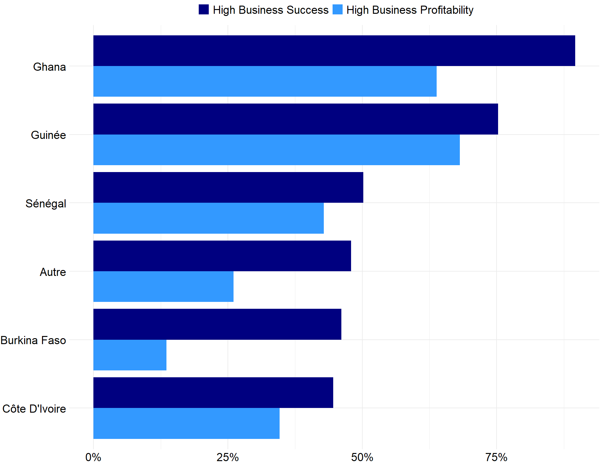
REINTEGRATION ECONOMIC SURVEY
Business Success and profitability by CO
Group definition - Business Success:
‘High’ Business Success → 57% of all respondents stating their business is open and works well
‘Low’ Business Success → 43% of all respondents including those stating that their business is open but not working well, business not opened yet, or closed.
Group definition - Business Profitability:
‘High’ Business Profitability → 42% of all respondents stating that their business allows them to cover their needs and their family needs
‘Low’ Business Profitability → 58% of all respondents stating that their business does not allow them to cover family needs, or only partly.

Slide 7
REINTEGRATION ECONOMIC SURVEY
We then used regression to identify which of the 14 factors tend to lead to a High or a Low Business Success/profitability
We considered 14 factors that might impact Business Success:
Country of origin
Country of return
Age
Gender
Migration duration
Disability
Business type
Business members
Employee number
Support type (cash, kind, etc.)
Business management training
First choice
Interview type
Covid-19 impact

Slide 8
REINTEGRATION ECONOMIC SURVEY
Business success Results
Out of the 14 variables, 8 were found to have a significant impact on Business Success
The most important ones were:
Country of origin
Employee number
Business type
First choice
Business management training
Age, Business members, and gender were also significant, but at a lower level
In contrast, the following factors do not seem to impact Business Success:
Country of return (borderline significant), Disabled, Support type, Interview type, Migration duration, and Covid-19 impact
Let us now take a closer look at some of these results

Slide 9
REINTEGRATION ECONOMIC SURVEY
Business success Results
Respondents in Ghana, Guinea, and Senegal were the most likely to report a High Business Success
Respondents who have employees are at least 2 times more likely to report a High Business Success than respondents who do not have employees
Respondents in transport or in retail are more likely to report a High Business Success than respondent in any other activity; respondents in agriculture/aviculture are less likely to report a High Business Success than respondents in any other activity
Respondents whom assistance corresponded to their first choice were 2 times more likely to report a High Business Success than their counterparts
Respondents who received Business management training were 1.5 times more likely to report a High Business Success than those who did not receive it
Men, younger respondents, and respondents who run their business on their own, are more likely to report a High Business Success than their counterparts, but at a lower level of significance
Notes:
Respondents who have a High Business success and a High business profitability are more likely to have employees than their counterparts, including after controlling for the type of activity. Also note that controlling for Business success and Business profitability, respondents in retail are less likely to have employes than respondents in agriculture and aviculture. That said, respondents in transport are less likely to have employees than respondents in retail.

Slide 10
REINTEGRATION ECONOMIC SURVEY
Business profitability Results
We get similar results as for Business Success, which is a good sign
The most important factors were, again, Country of origin, Employee number, Business type, First choice, and Business management training, with the same effects as already described
Business members was significant at a higher level for this model, with respondents running their business on their own 1.9 times more likely to report a High Business Profitability than those running it with associates
There were also interesting differences:
Men and younger respondent were not significantly more likely to report a High Business Profitability than women and older respondents
Disability was borderline significant (p = 0.053), with respondent who reported a disability less likely to report a High Business Profitability
Taking all results together, regression analysis suggest that country, factors related to business type and structure, and assistance factors (Business management training and First choice)are the strongest determinants of overall business sustainability

Slide 11
Some Determinants of Sustainable Reintegration
RSS composite score and economic score dimension

Slide 12
REINTEGRATION SUSTAINABILITY SURVEY
Sample used
1,385 interviews conducted between October 2022 and January 2023
The origin country of most respondents was Niger, Guinea-Conakry, and Mali
Most respondents were returning from Libya, Niger, and Algeria
86% men, 14% women
Median age = 28 years old (min: 15, max: 78)
Note that some variables from Mimosa were used for some analyses (for example, assistance received or Training information)

Slide 13
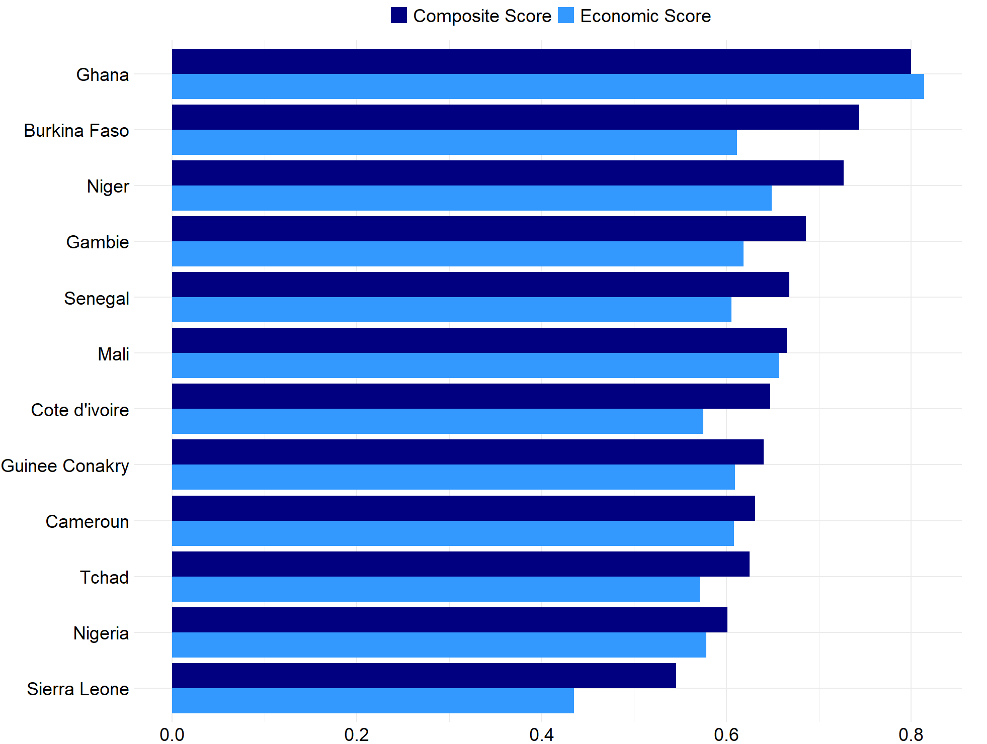
REINTEGRATION SUSTAINABILITY SURVEY
Composite Score by CO
The Composite Score ranges from 0 to 1, with 0 denoting the lowest level of sustainable reintegration, and 1 denoting the highest level of sustainable reintegration
For this sample, the average Composite Score was 0.67
Just as the Composite Score, the Economic Score ranges from 0 to 1, with 0 denoting the lowest level of economic reintegration, and 1 denoting the highest level
For this sample, the average Economic Score was 0.63

Slide 14
REINTEGRATION SUSTAINABILITY SURVEY
We used regression to identify negative or positive impact on the Composite/economic Scores
We considered 15 factors that might impact Composite Score:
Country
Country of return
Age
Gender
Migration duration
Form of assistance (cash, kind, both)
Financial services – unconditional cash transfer
Medical support
Material assistance
Psychosocial support
Social support
Training
Training duration
Micro business end date to interview date

Slide 15
REINTEGRATION SUSTAINABILITY SURVEY
Composite Score Results
Out of the 15 variables, 6 were found to have a significant impact on the Composite Score
The most important ones were:
Country
Country of return
Gender
Financial services and the form of business assistance were also significant, but at a lower level
All other variables did not significantly influence the Composite Score
Let us now take a closer look at some of these results

Slide 16
REINTEGRATION SUSTAINABILITY SURVEY
Composite Score Results
Men tend to have a significantly higher Composite Score than women
Respondents in Tchad have the lowest Composite Score (highest Score: Niger), whereas respondents returning from Niger have the lowest Composite Score (highest Score: Libya)
Respondents who received Financial services tend to have a significantly lower Composite Score than those who did not receive it

Slide 17
REINTEGRATION SUSTAINABILITY SURVEY
Economic Score Results
We get similar results as for the Composite Score, which is a good sign
The only differences were:
Men do not tend to have a significantly higher Economic Score than women
Financial service is not a significant predictor of Economic Score anymore, but Material Assistance becomes a significant predictor, with respondents who received such assistance having a significantly lower Economic Score than those who did not receive it

Slide 18
Future intentions to migrate
REINTEGRATION ECONOMIC SURVEY

Slide 19
FUTURE INTENTIONS TO MIGRATE
Sample used & Method
The sample was the same as for the determinants of Business success and Business profitability
90% of all respondents stated that they would migrate again, 10% that they would not migrate again
We used regression to identify which respondents are more likely to want to migrate again, with the same 14 predictor variables as for Business success and Business profitability

Slide 20
FUTURE INTENTIONS TO MIGRATE
Results
Respondents based in Burkina Faso are the least likely to report planning to migrate again, whereas respondents based in Guinea are the most likely to report planning to migrate again
Respondents returning from Libya are the least likely to plan migrating again, whereas respondents returning from Morocco are the most likely to plan migrating again
Respondents who run their business with other people are 1.7 times more likely to planning to migrate again than respondents who run their business on their own
Notes:
Respondents interviewed in the field or in an IOM office are 1.6 times more likely to report planning to migrate again than those interviewed on the phone

Slide 21

Thank you!
QUESTIONS?

