Slide 1
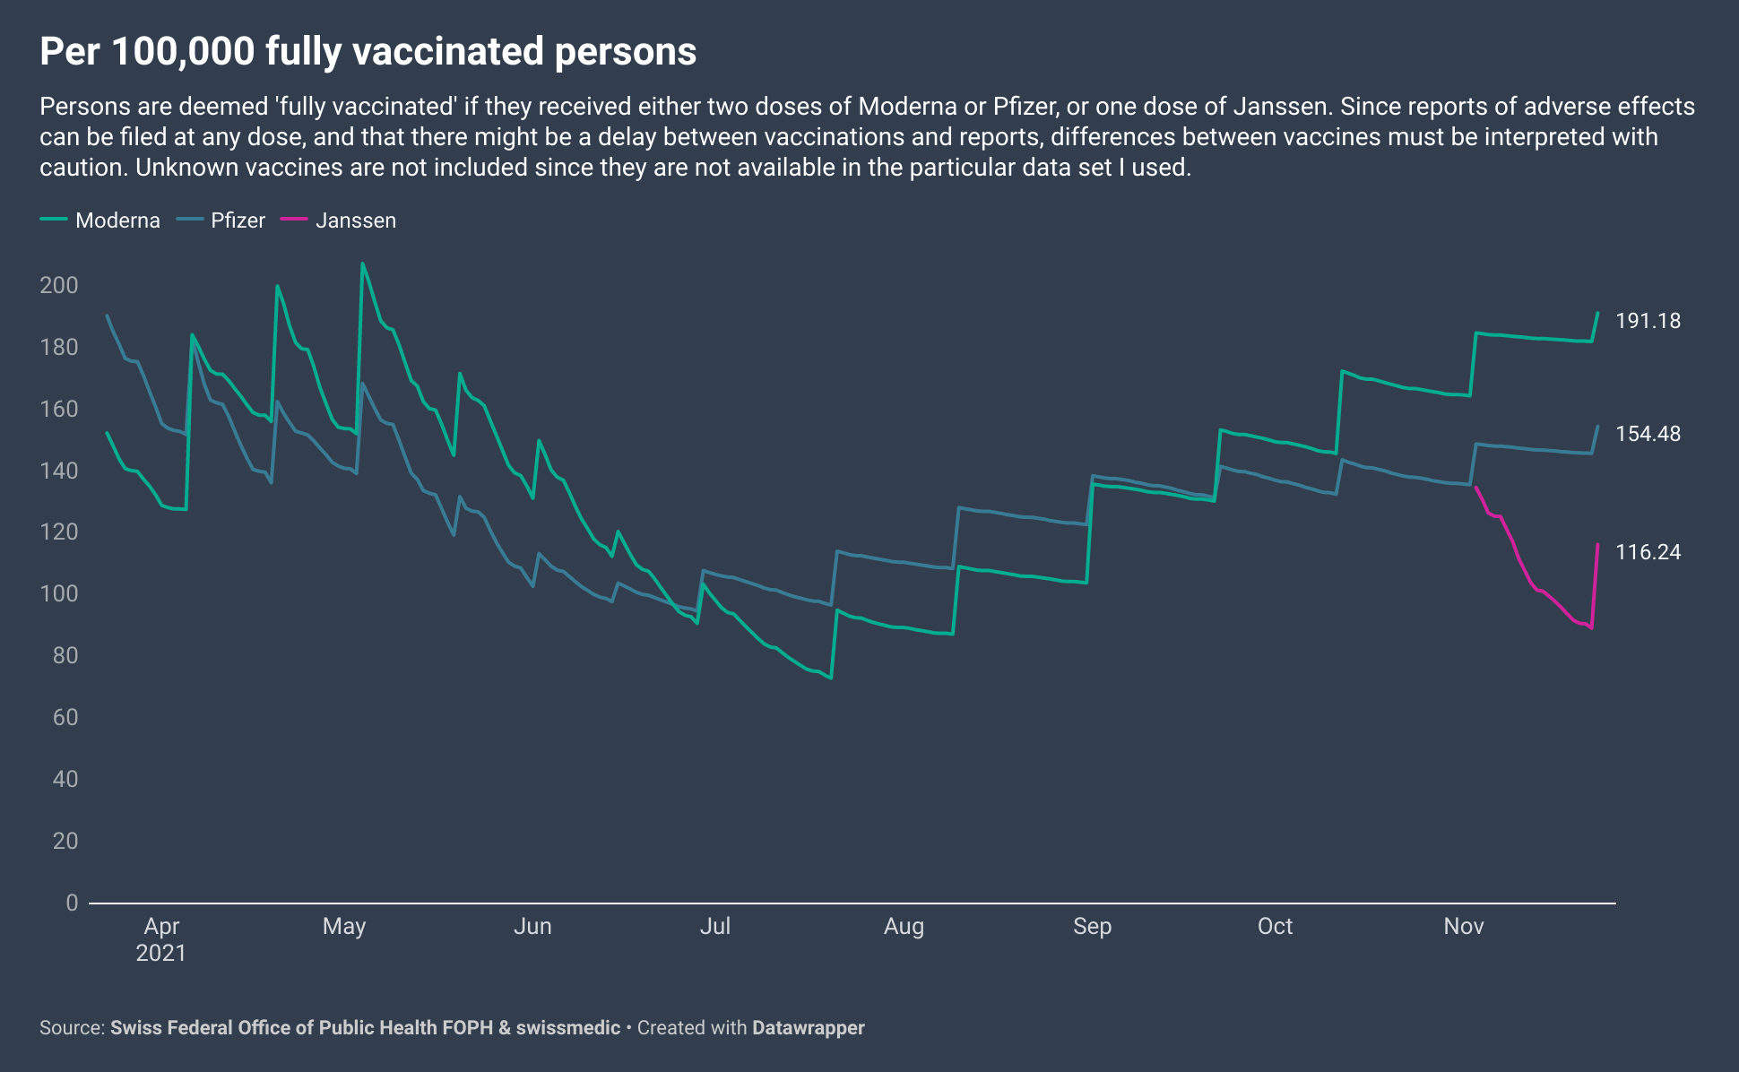
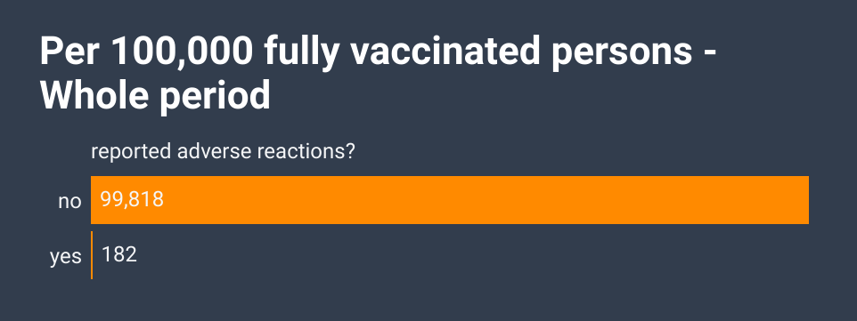
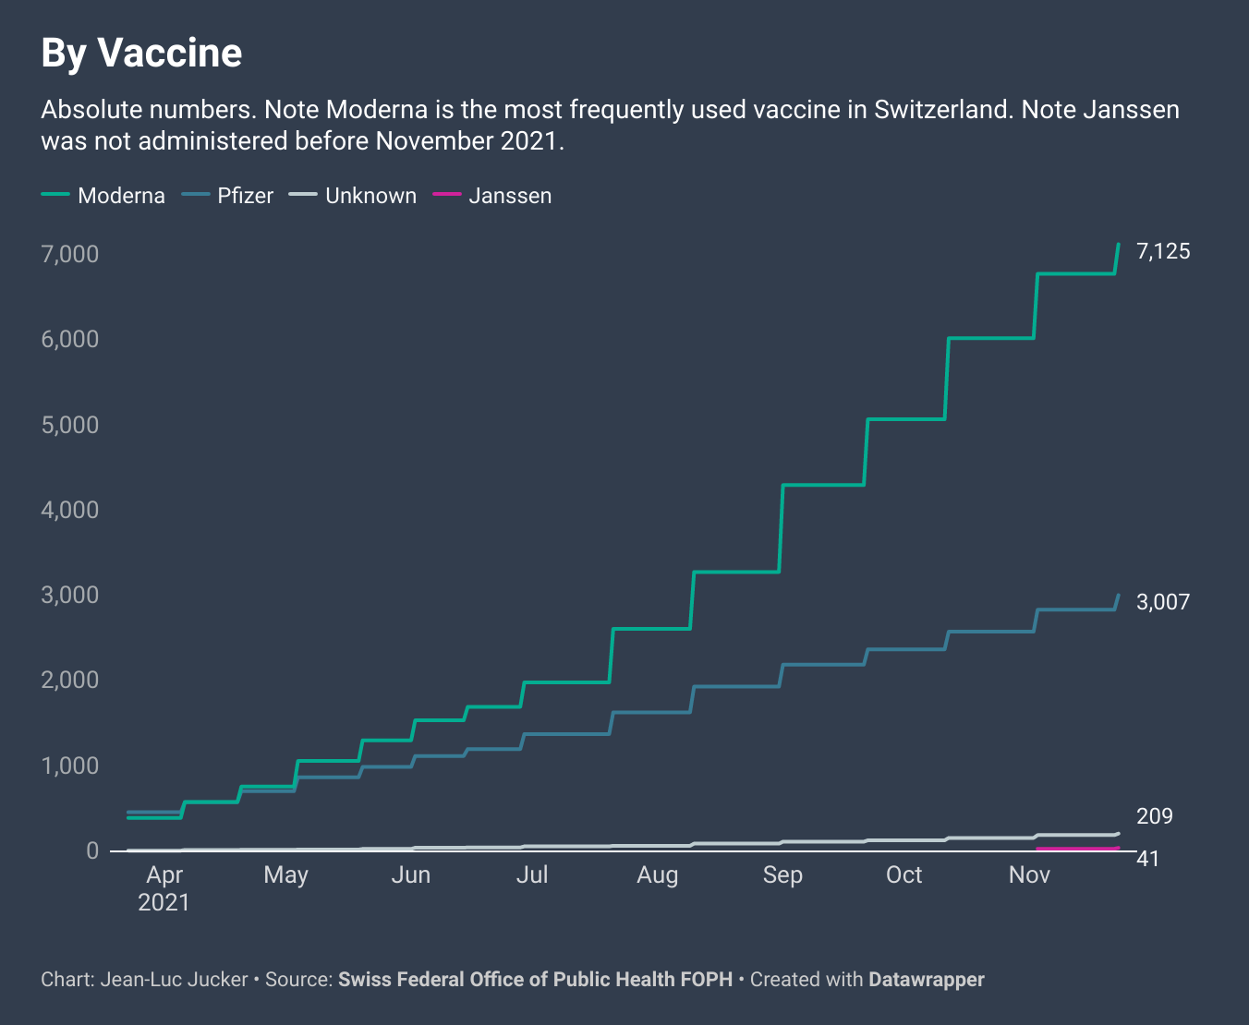
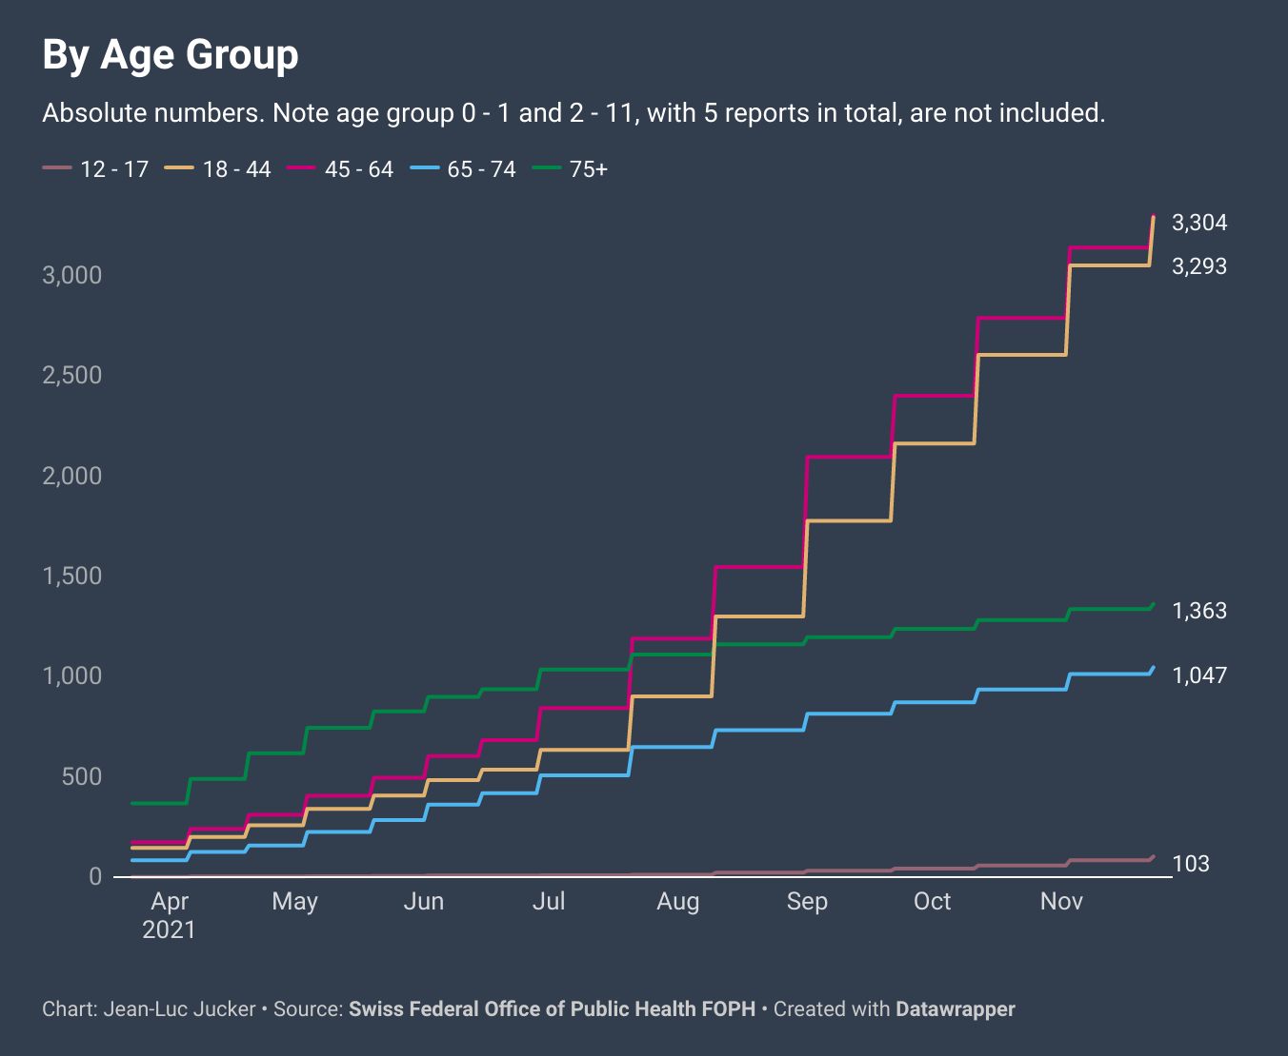
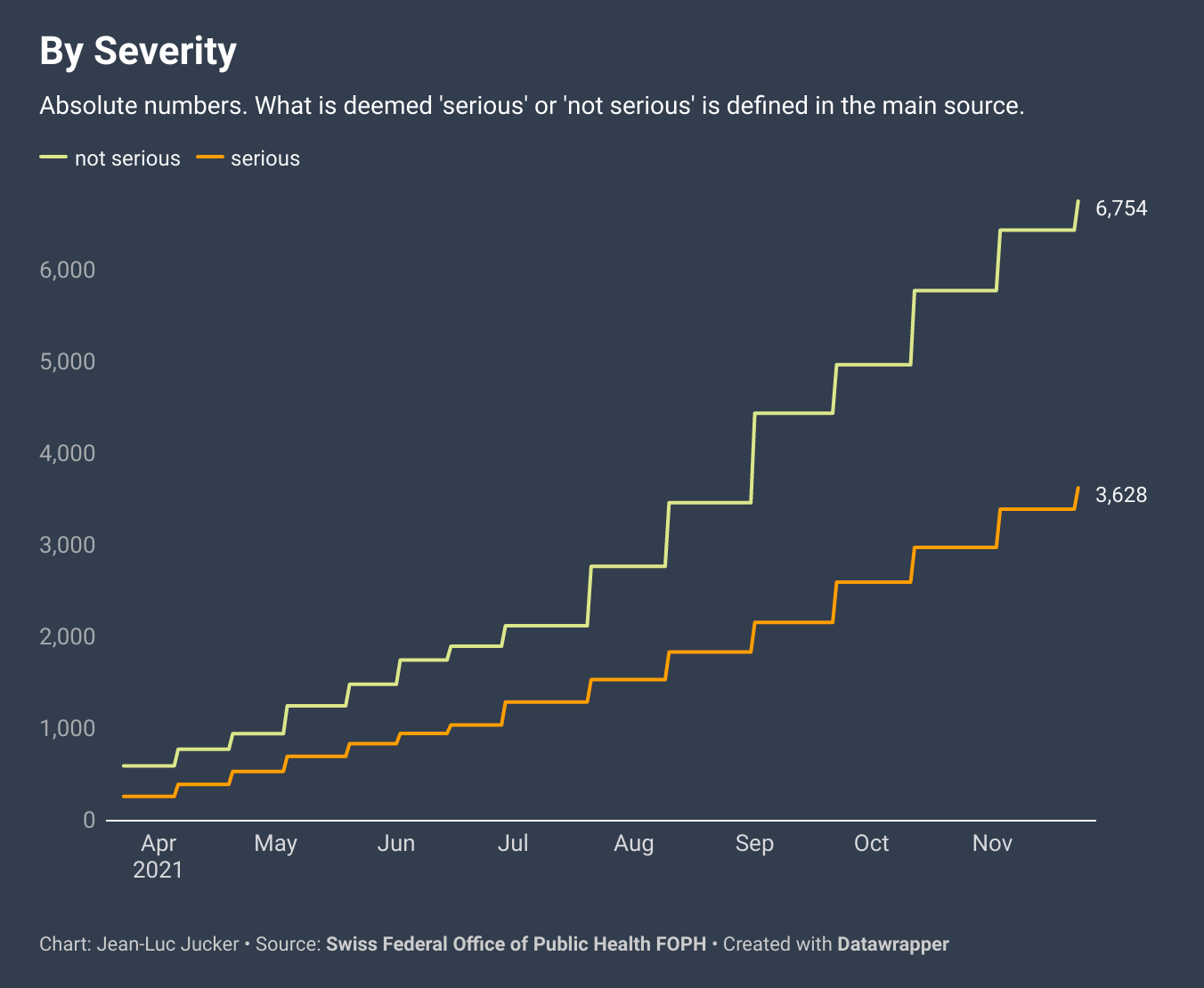
Reports of suspected adverse reactions to COVID-19 vaccines in Switzerland
Swissmedic collects the reports of suspected adverse reactions to Covid-19 vaccines in Switzerland. A report can be submitted by anyone, including patients, and it can contain more than one adverse reaction. These charts show the number of reports in absolute numbers and per 100,000 vaccinated people, from 23 March 2021 to 23 November 2021. Reports are updated every three weeks. These data and analyses have important limitations and must be interpreted with caution.

Slide 2
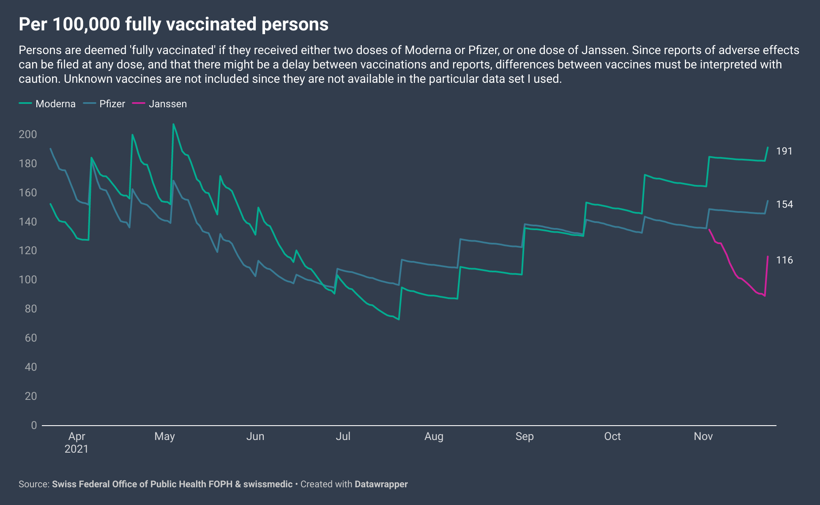
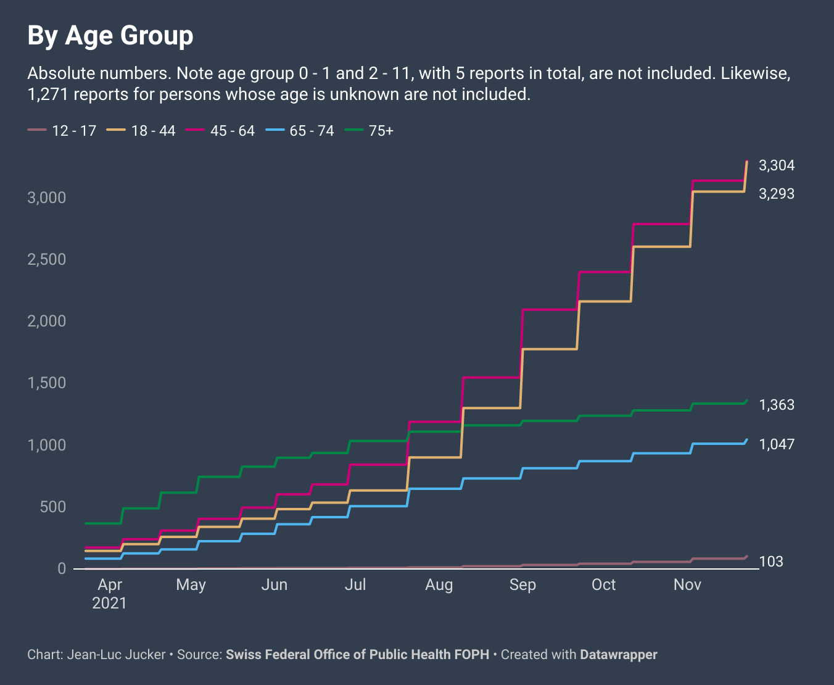
Reports of suspected adverse reactions to COVID-19 vaccines in Switzerland
Swissmedic collects the reports of suspected adverse reactions to Covid-19 vaccines in Switzerland. A report can be submitted by anyone, including patients, and it can contain more than one adverse reaction. These charts show the number of reports in absolute numbers and per 100,000 vaccinated people, from 23 March 2021 to 23 November 2021. Reports are updated every three weeks. These data and analyses have important limitations and must be interpreted with caution.

