Slide 1

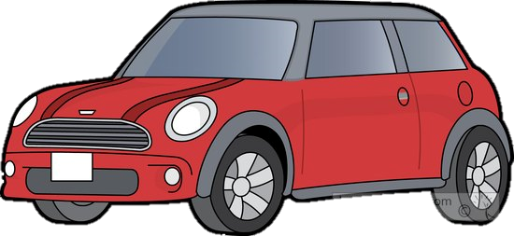
Vehicle Intersection control
Zachary Bazen
Jean-Lucas Ferreira
Alex Jackson
Justin Kapinski
Mathew Hobers
Radhika Sharma
Group 6
VIC -1
Intersection Management for autonomous
vehicles

Slide 2
The Team
Zachary Bazen | - | Software Engineering
Jean-Lucas Ferreira | - | Software Engineering
Alexander Jackson | - | Software Engineering
Justin Kapinski | - | Software Engineering
Mathew Hobers | - | Software Engineering
Radhika Sharma | - | Software Engineering – Embedded Systems

Slide 3
The Problem
1
Autonomous vehicles arrive intersection
Require method for general consensus
Require decision communication
2
Which car goes first?
3
Notes:
Zach
-
- System to allow autonomous vehicles to act at intersections
- Requirements were solving

Slide 4
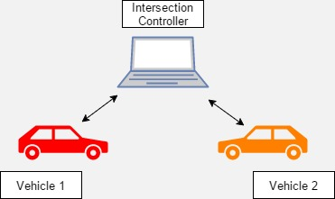
OUR Solution
Intersection Controller (IC)
Manages traffic flow
Vehicle Controller (VC)
Manages track and intersection navigation
Notes:
Zach
Independent system that operates at the intersection
Vehicles communicate with a centralized system
This system decides which vehicle goes first
Eliminates the need for general consensus → single decision maker
This system then tells each car when to proceed
Zach
Animation shows that there is two parts too the system (Intersection component and vehicle component)
The intersection controller is responsible for managing traffic flow and monitoring the intersection
This communicates with the vehicle controller
Vehicle controller sends requests and intersection controller sends back over Bluetooth communication
Vehicle controller is also for managing and navigating the vehicle on the track

Slide 5
1
1
Request
Intersection Controller
3
1
2
Proceed
2
2
3
3
Notes:
Zach

Slide 6
Intersection Controller
Why an IC?
Efficient traffic flow
Redundancy
Notes:
Radhika

Slide 7
Video of IC picking up car going by
Notes:
Radhika

Slide 8
Communication
Vehicle Controller
INTERSECTION Controller
Notes:
Alex

Slide 9
Vehicle Controller
Notes:
Alex

Slide 10


VC – Image Processing (1)
1) Captured Image
2) Cropped Image
Notes:
Justin

Slide 11

VC – Image Processing (2)
3) Binarized Image
Notes:
Justin

Slide 12

VC – Image Processing (3)
4) Edge Detection
Notes:
Justin

Slide 13
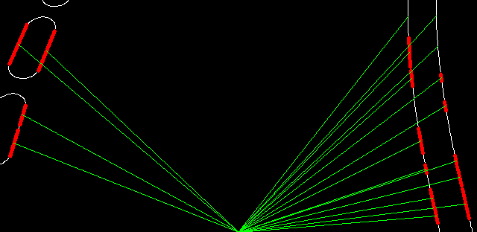
VC – Image processing (4)
Binarization
Canny Edge Detection
Probabilistic Hough Line Transform
Average line angle
Average left and right distance
Intersection detection
5) Finding Lines
Notes:
Justin

Slide 14
VC – Vehicle navigation
Controls wheel angle
Utilizes two experts:
Slope Expert
Length Expert
Sets speed
Notes:
Justin

Slide 15
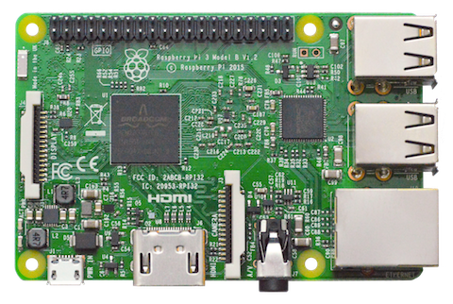
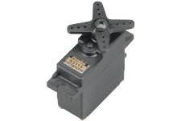
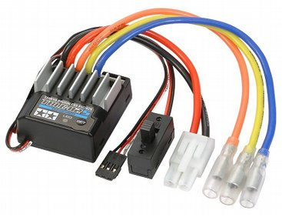
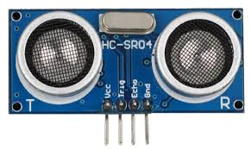
VC – Hardware Interfacing
Raspberry Pi 3
Servo
Speed Controller
Ultrasonic Sensor (HC-SR04)
Notes:
Justin

Slide 16
Video of car driving
Notes:
Alex

Slide 17
Hazard mitigation
Communication
Loss of power
Software (crashes and errors)
Notes:
Radhika

Slide 18
Features to be implemented
Bluetooth to other communication
IC vehicle detection
Obstacle detection??????????????????
Notes:
Radhika

Slide 19
DEmo

Slide 20
Questions
Group 6
VIC -1

