Slide 1

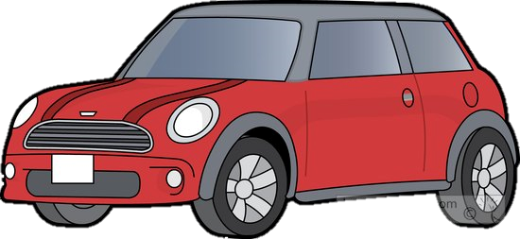
Vehicle Intersection control
Alex Jackson
Jean Lucas Ferreira
Justin Kapinski
Mathew Hobers
Radhika Sharma
Zachary Bazen
Group 6
VIC -1
Intersection Management for autonomous
vehicles

Slide 2
Members
Zachary Bazen – Software Engineering
Justin Kapinski – Software Engineering
Alexander Jackson – Software Engineering
Jean Ferrera – Software Engineering
Mathew Hobers – Software Engineering
Radhika Sharma – Software Engineering and Embedded Systems

Slide 3
The Problem
System to allow autonomous vehicles to act at intersections
Requirements were solving
Notes:
Zach

Slide 4
Animation
Notes:
Zach

Slide 5
1
1
Request
Intersection Controller
3
1
2
Proceed
2
2
3
3
Notes:
Zach

Slide 6
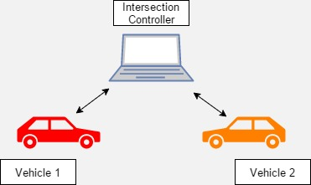
The System - IC and VC
IC – Intersection Controller
VC – Vehicle Controller
Notes:
Zach

Slide 7
Vehicle Controller
Four Main Components
Vehicle Navigation
Communication
Notes:
Alex

Slide 8
Vehicle Controller
3. Image processing
4. Hardware Interfacing (servo, speed, ultrasonic sensor)
Notes:
Justin

Slide 9
Video of car driving
Notes:
Alex

Slide 10
Intersection Controller
Why an IC?
Efficient traffic flow
Redundancy/redundant systems
How its working
Parts used
Communication
Camera
Notes:
Radhika

Slide 11
Video of IC picking up car going by
Notes:
Radhika

Slide 12
Hazard mitigation
IC fails – power generator like in real life
If ic crashes and has power, cars will stop at the intersection
Bluetooth failure, message resent from vehicle
Notes:
Radhika

Slide 13
Challenges
Lane Following
Communication
Intersection Detection
Notes:
Justin

Slide 14
Features Still to be implemented
Bluetooth to other communication
IC vehicle detection
Obstacle detection
Notes:
Radhika

Slide 15
Questions
Group 6
VIC -1

