Slide 1

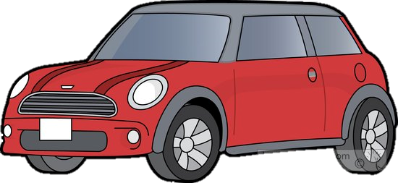
Vehicle Intersection control
Alex Jackson
Jean Lucas Ferreira
Justin Kapinski
Mathew Hobers
Radhika Sharma
Zachary Bazen
Group 6
VIC -1
Intersection Management for autonomous
vehicles

Slide 2
Members
Zachary Bazen – Software Engineering
Justin Kapinski – Software Engineering
Alexander Jackson – Software Engineering
Jean Lucas Ferreira – Software Engineering
Mathew Hobers – Software Engineering
Radhika Sharma – Software Engineering and Embedded Systems

Slide 3
The Team
Zachary Bazen | - | Software Engineering
Jean Lucas Ferreira | - | Software Engineering
Alexander Jackson | - | Software Engineering
Justin Kapinski | - | Software Engineering
Mathew Hobers | - | Software Engineering
Radhika Sharma | - | Software Engineering – Embedded Systems

Slide 4

The Team
Zachary Bazen
Software Engineering
Alexander Jackson
Software Engineering
Justin Kapinski
Software Engineering
Jean Lucas Ferreira Software Engineering
Mathew Hobers
Software Engineering
Radhika Sharma
Software Engineering – Embedded Systems

Slide 5
The Problem
1
Autonomous vehicles arrive intersection
Require method for general consensus
Require decision communication
2
Which car goes first?
3
Notes:
Zach
-
- System to allow autonomous vehicles to act at intersections
- Requirements were solving

Slide 6
The Solution
Intersection control system
Decides which vehicle goes first
Eliminates need for general consensus
Communicates decision to vehicles
Notes:
Zach
Independent system that operates at the intersection
Vehicles communicate with a centralized system
This system decides which vehicle goes first
Eliminates the need for general consensus → single decision maker
This system then tells each car when to proceed

Slide 7
1
1
Request
Intersection Controller
3
1
2
Proceed
2
2
3
3
Notes:
Zach

Slide 8
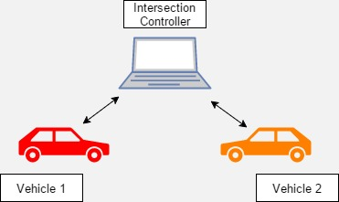
System Overview
Intersection Controller
Manages traffic flow
Vehicle Controller
Manages track and intersection navigation
Notes:
Zach
Animation shows that there is two parts too the system (Intersection component and vehicle component)
The intersection controller is responsible for managing traffic flow and monitoring the intersection
This communicates with the vehicle controller
Vehicle controller sends requests and intersection controller sends back over Bluetooth communication
Vehicle controller is also for managing and navigating the vehicle on the track

Slide 9
Vehicle Controller
Four Main Components
Vehicle Navigation
Communication
Notes:
Alex

Slide 10
Vehicle Controller
3. Image processing
4. Hardware Interfacing (servo, speed, ultrasonic sensor)
Notes:
Justin

Slide 11
Video of car driving
Notes:
Alex

Slide 12
Intersection Controller
Why an IC?
Efficient traffic flow
Redundancy/redundant systems
How its working
Parts used
Communication
Camera
Notes:
Radhika

Slide 13
Video of IC picking up car going by
Notes:
Radhika

Slide 14
Hazard mitigation
IC fails – power generator like in real life
If ic crashes and has power, cars will stop at the intersection
Bluetooth failure, message resent from vehicle
Notes:
Radhika

Slide 15
Challenges
Lane Following
Communication
Intersection Detection
Notes:
Justin

Slide 16
Features Still to be implemented
Bluetooth to other communication
IC vehicle detection
Obstacle detection
Notes:
Radhika

Slide 17
Questions
Group 6
VIC -1

