Slide 1
FRONTEND / FULL-STACK · 2026
Jean Chung
Projects 作品集
Selected work from crypto exchanges, DeFi DApps, AI learning platforms, and platform tooling.
jean619215@gmail.com · Taipei, Taiwan

Slide 2
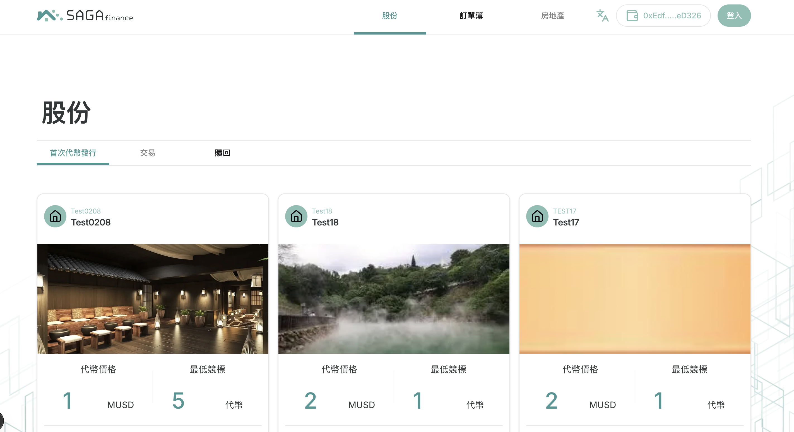
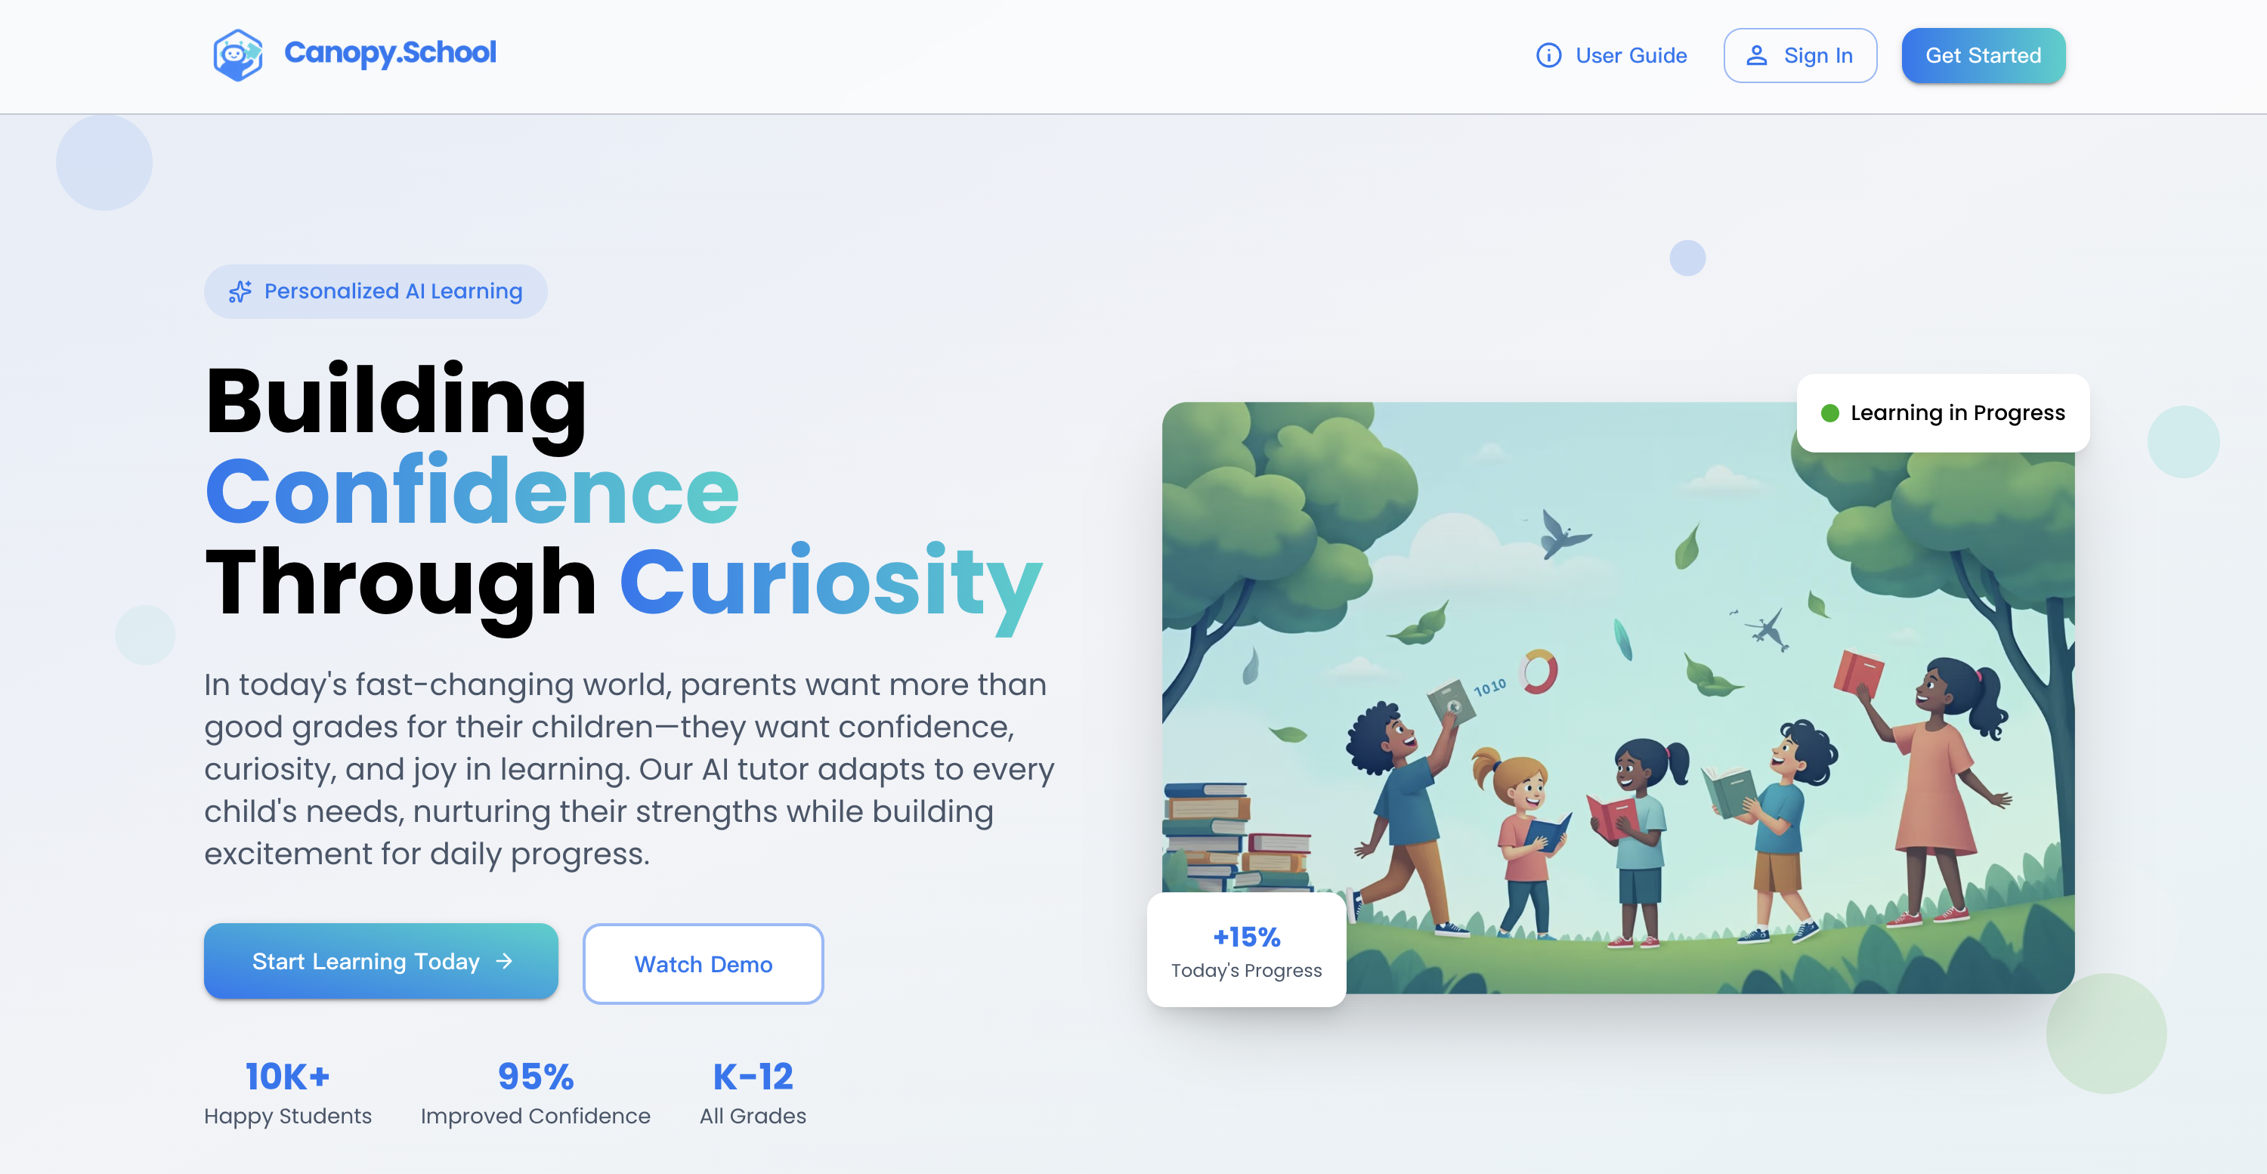
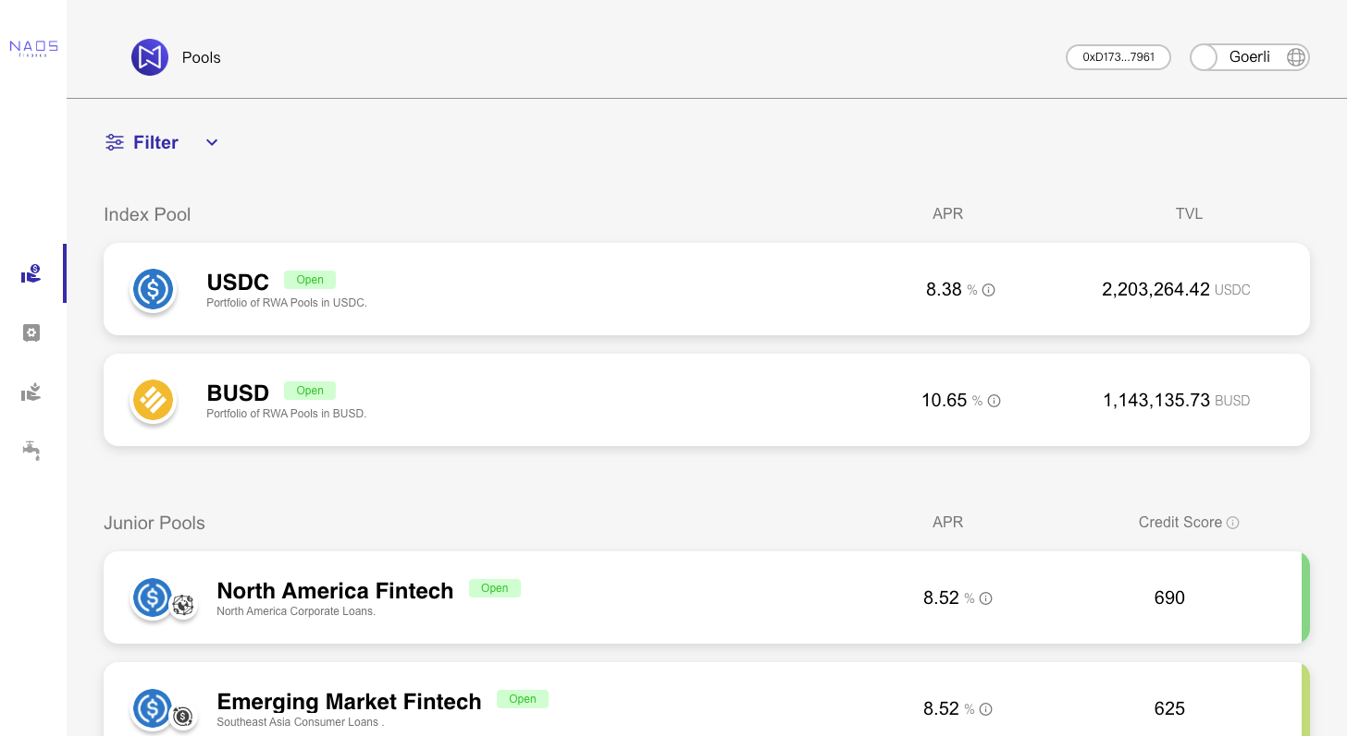
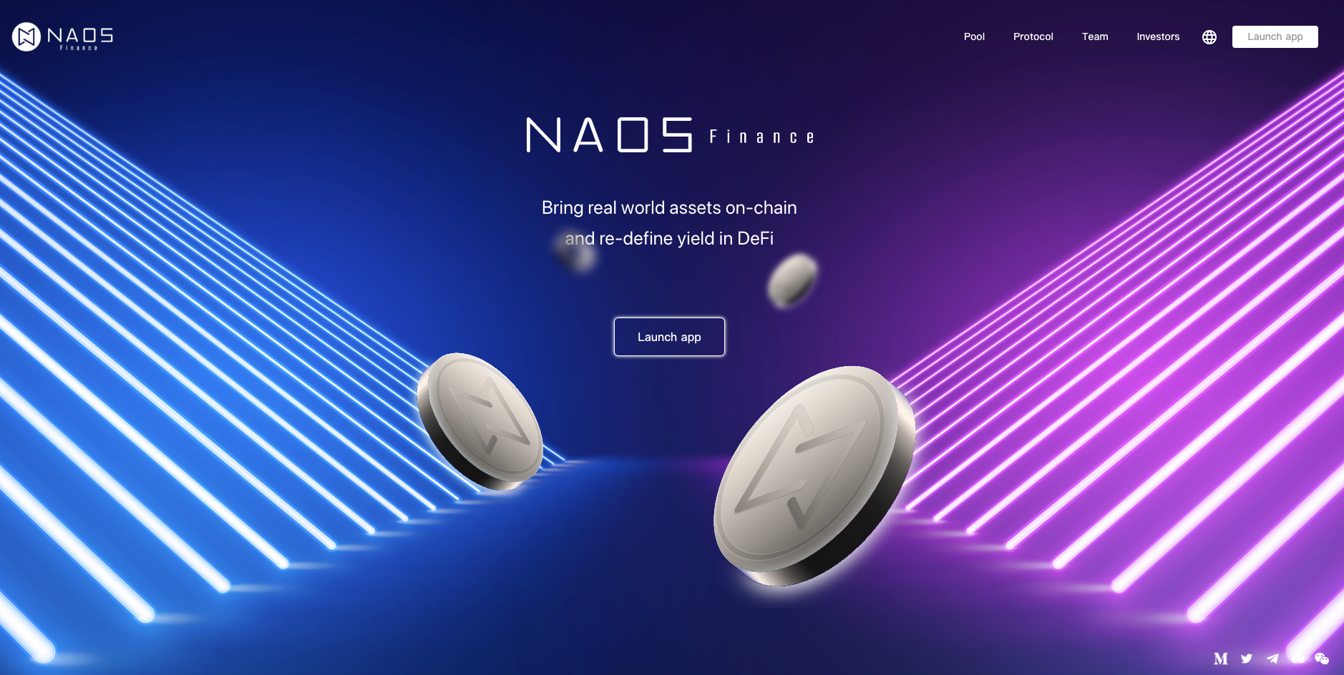
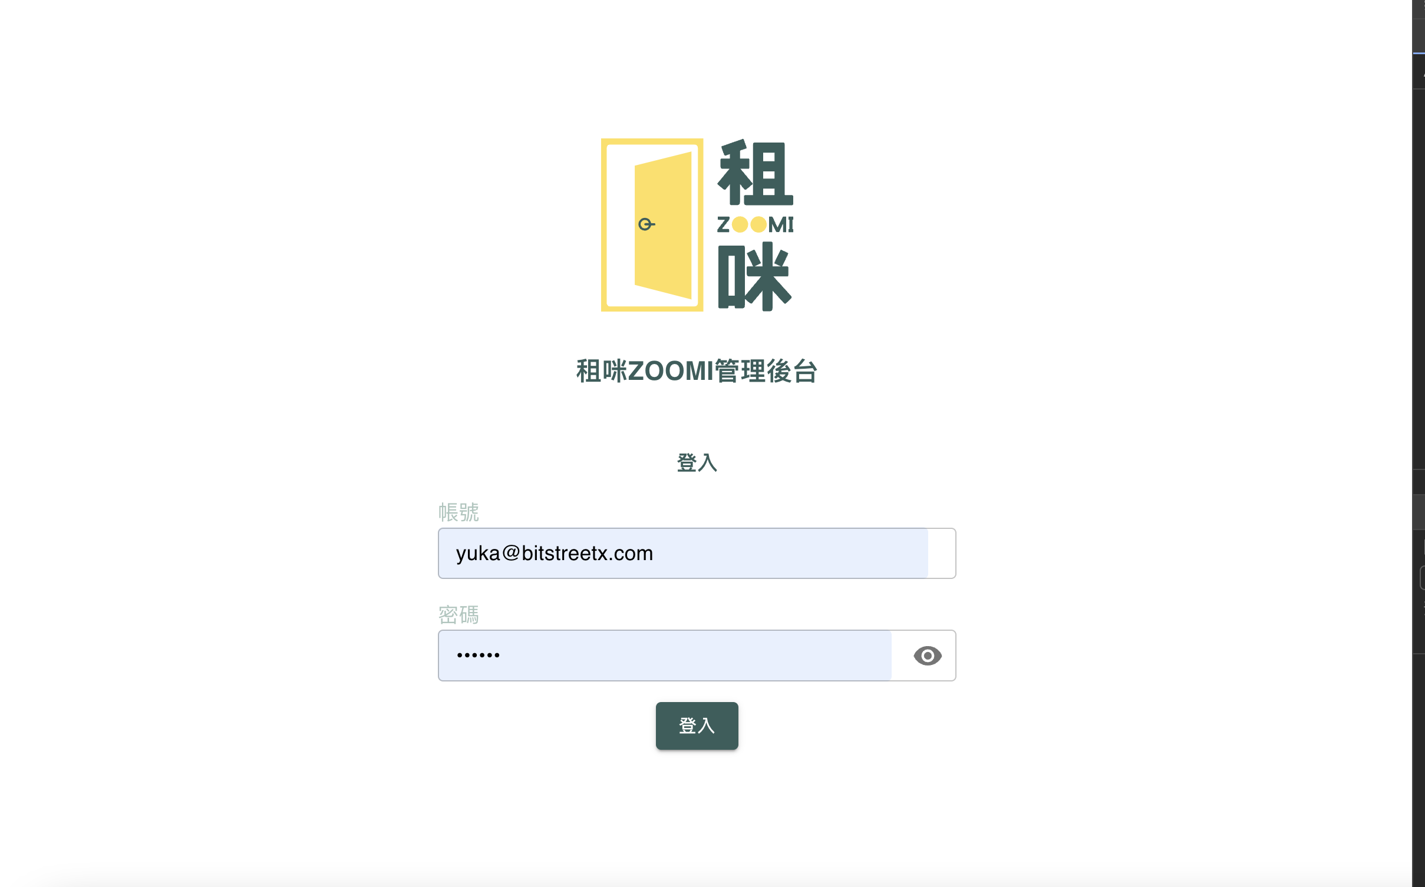
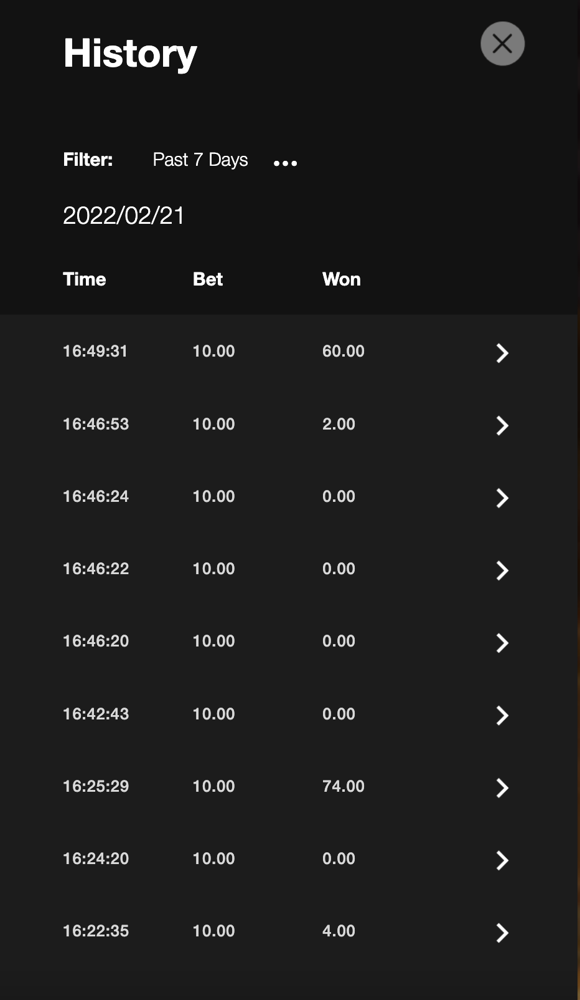
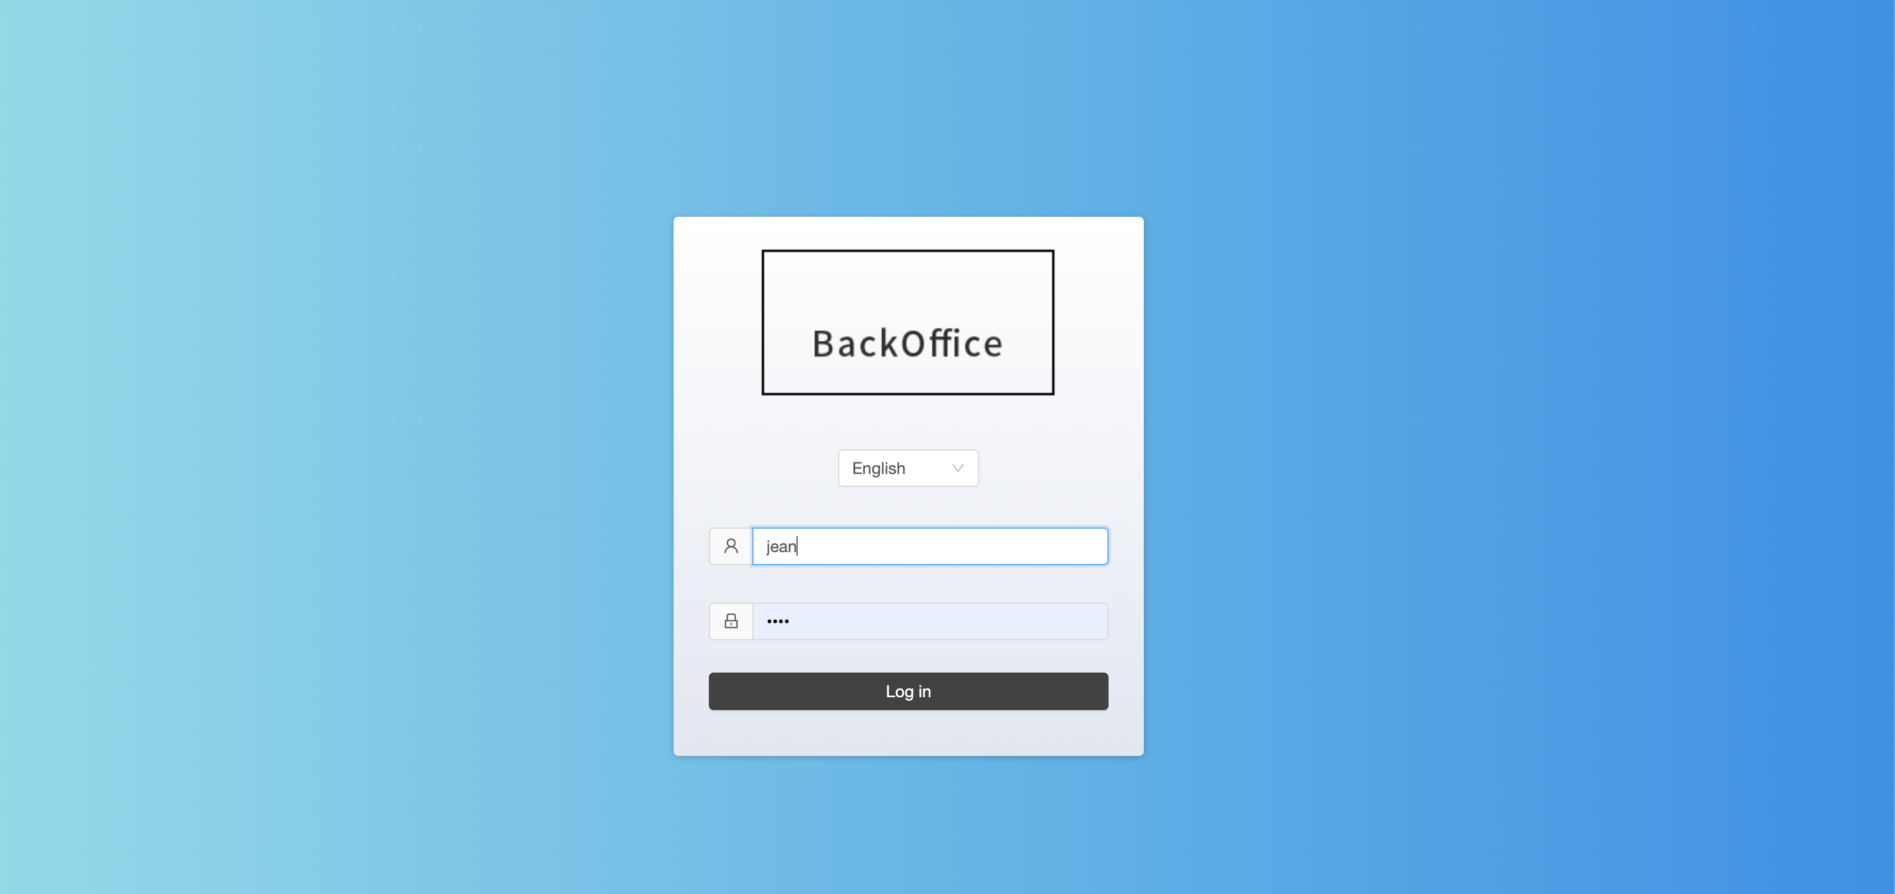
Overview
作品總覽
01
02
03
04
Saga Finance
Canopy School
NAOS Finance DApp
NAOS Finance 官網
Full-stack Web3 RWA Platform
Personalized AI Learning
DeFi Lending Platform
Brand & Product Website
05
06
07
Zoomi Admin
Web Element
Backstage Management
Management Backstage
Config-driven Web Framework
Platform Operations Console

Slide 3
01 / 07
Saga Finance
Full-stack Web3 RWA Platform
真實資產（RWA）代幣化平台。負責全端開發，涵蓋前端 DApp、後端 API 與智能合約串接；使用者可購買、領取股票與分紅。
Real-world asset (RWA) tokenization platform. Full-stack development covering the DApp frontend, backend API and smart-contract integration; users buy, claim and receive dividends on tokenized stock.
STACK
Next.js
TypeScript
Web3
ethers.js
Jean Chung · Projects 2026
RWA

Slide 4
02 / 07
Canopy School
Personalized AI Learning
AI 個人化教學平台。提供老師「自動產題給學生測驗」與「白板教學模式（含語音）」兩大核心功能；整合 LLM、Text-to-Speech 與 Speech-to-Text。
Personalized AI learning platform with two flagship features: automatic question generation for student quizzes, and a voice-enabled whiteboard teaching mode. Built on top of LLM services with TTS / STT.
STACK
Next.js
LLM
Text-to-Speech
Jean Chung · Projects 2026
Speech-to-Text

Slide 5
03 / 07
NAOS Finance DApp
DeFi Lending Platform
結合區塊鏈、加密貨幣與真實資產的 DeFi 借貸平台。負責 DApp 前端開發，整合 ethers.js 與智能合約 ABI；實作錢包連線、抵押借貸、流動性挖礦等核心功能。
A DeFi lending platform bridging crypto and real-world assets. Built the DApp frontend with React + ethers.js, integrated smart-contract ABIs, and shipped wallet connect, collateralized lending and liquidity-mining flows.
STACK
React
TypeScript
ethers.js
Jean Chung · Projects 2026
styled-components

Slide 6
04 / 07
NAOS Finance 官網
Brand & Product Website
NAOS Finance 的官方品牌網站，呈現產品願景、團隊與生態系資訊。負責整體前端架構、頁面切版與互動效果。
NAOS Finance's official brand site showcasing product vision, team and ecosystem. Owned the full frontend — architecture, layout, and interactions.
STACK
React
Styled-components
Jean Chung · Projects 2026

Slide 7
05 / 07
Zoomi Admin
Management Backstage
Zoomi 後台管理介面，提供使用者管理、權限控管、資料查詢與報表匯出等功能。
Zoomi's admin backstage — user management, permission controls, data querying, and reporting exports.
STACK
React
Styled-components
Jean Chung · Projects 2026

Slide 8
06 / 07
Web Element
Config-driven Web Framework
團隊內部開發的客製化 Web 框架，以 config 檔案驅動 layout 渲染。重點工作：設計可重用的框架架構、維持程式碼品質、規劃後續維運。
An in-house React framework that renders layouts from config files. Co-designed the reusable architecture, kept code quality high, and planned long-term maintenance.
STACK
React
JavaScript
Jean Chung · Projects 2026

Slide 9
07 / 07
Backstage Management
Platform Operations Console
平台後台管理介面，提供管理員操作合作夥伴、玩家、用戶、交易歷史與財務報表匯出。跨國團隊協作、維護程式碼品質、升級 webpack 模組。
Platform-wide operations console for managing partners, players, users, transaction history, and financial reports. Cross-border team collaboration, code-quality maintenance, and webpack upgrades.
STACK
React
Ant Design
webpack
Jean Chung · Projects 2026

Slide 10
Thank You.
謝謝聆聽
Let's build something together.
jean619215@gmail.com · LinkedIn / Jean Chung · Taipei, Taiwan

